Slide 1
Most popular profession of Germany
Prepared:
Olha Drahancuk
Iryna Kotelyikh
Bohdan Saenko
Vitali Basyuk

Slide 2
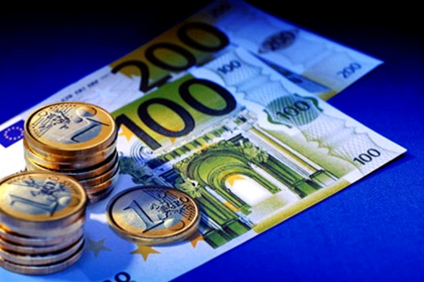



Economist
Most in demand profession in Germany, it is the economist. One of the directions of the profession - business economics
economist.

Slide 3



Lawyer
Lawyer- an individual who has professional legal knowledge in the field of jurisprudence, legislation and practice. In Germany, this profession is necessary and highly paid.

Slide 4


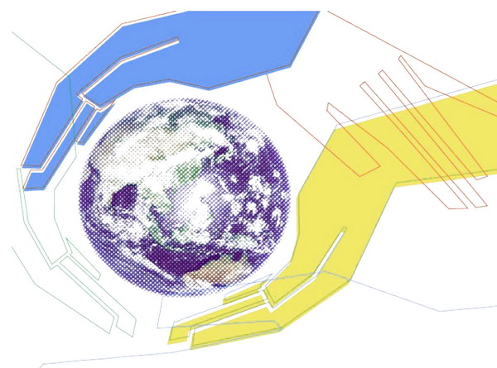
Social Worker
Social workers are less in demand in the labor market, but we must not forget that the unemployment rate in Germany is low, and therefore the lack of everything.

Slide 5

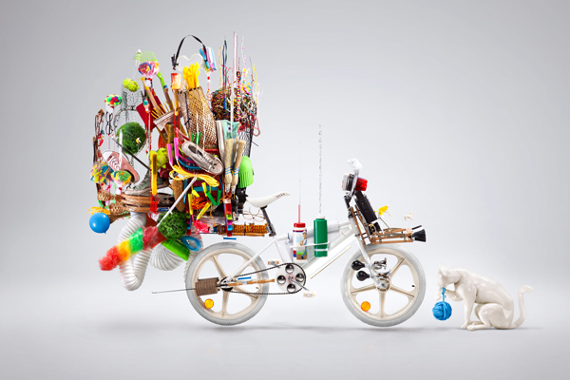

Designer
Highest paid profession in Germany is the designer. Germany's most famous designers: Karl Lagerfeld (creative director of the fashion house Chanel), Marcel Krinhs, Sebastian Myulhoyzer.

Slide 6



Teacher
School teacher has always demanded a trade, with an income of 3160 euros per month.

Slide 7


Nurse and doctor
Nurse and doctor, on account of which comes at the end of the month 2580 euro
Doctors and nurse always needed in any country, and non-exclusion in Germany. Nurse receive about 2,580 euros a month, and doctors from 3,000 a month.

