Slide 1
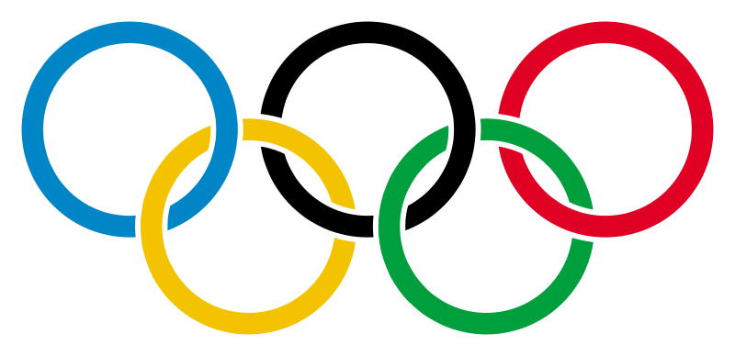
Olympic Games

Slide 2
THE OLYMPIC FLAME

Slide 3
THE OLYMPIC FLAG

Slide 4
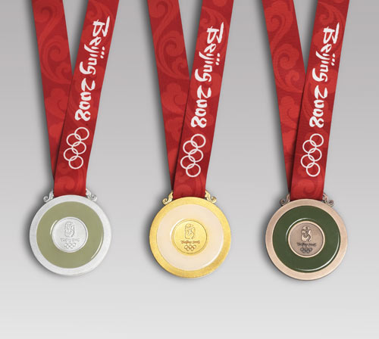
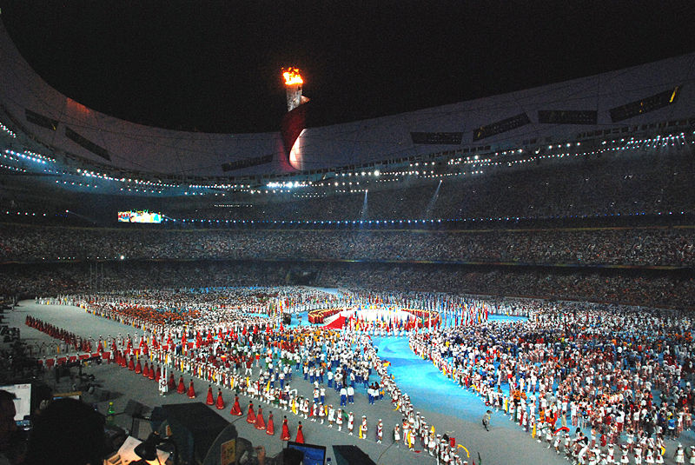

Slide 5
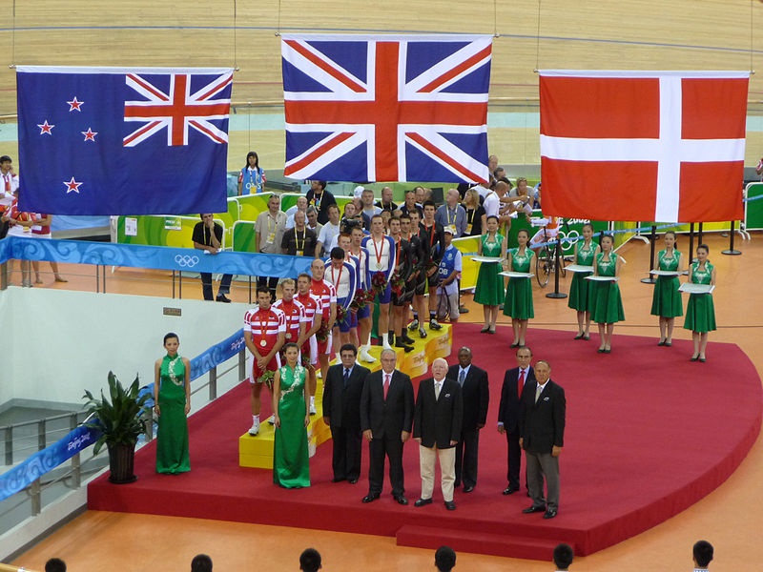
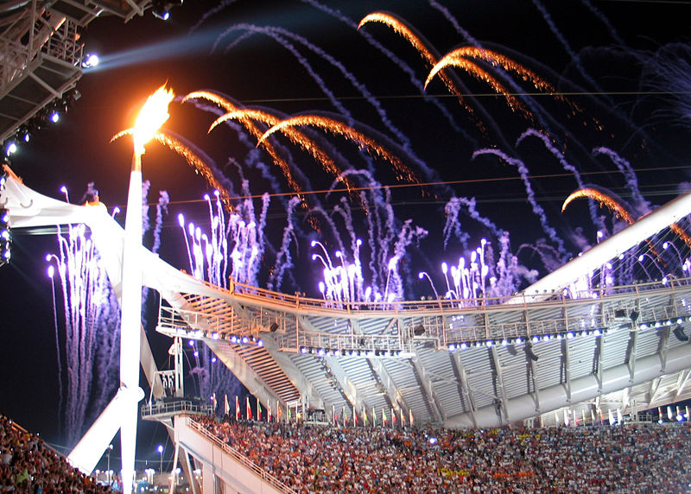

Slide 6
The Ancient Games were first held in
1) Italy 3) Greece
2) Germany 4) Spain
The first of the Modern Olympic Games were held in
1) London 3) Rome
2) Barcelona 4) Athens

Slide 7
The first of the Modern Olympic Games were held in
1) 1876 3) 1906
2) 1896 4) 1916
The Olympic Games are held every
1) 2 years 3) 6 years
2) 4 years 4) 8 years

Slide 8
The Olympic symbol is
1) 4 interlaced squares
2) 5 interlaced rings
3) 3 blue stars
The 1980 Summer Olympics were held in
1) Los Angeles 3) Moscow
2) Montreal 4) Atlanta

Slide 9
The 2008 Summer Olympic Games were held in
1) London 3) Salt Lake City
2) Sydney 4) Beijing
The 2010 Winter Olympic Games will be held in
1) Canada 3) Russia
2) The UK 4) the USA

Slide 10
The Olympic Games have a very long history. They began in ancient Greece.

Slide 11
The International Olympic Committee was founded in 1894 on the initiative of a French nobleman, Baron Pierre de Coubertin.

Slide 12
The modern Olympics feature the traditional Summer and the Winter Games
Currently, the Olympic Games program consists of
33 sports,
52 disciplines
and nearly 400 events.
The Summer Olympics program includes
26 sports with 36 disciplines,
while the Winter Olympics program is comprised of
7 sports with 15 disciplines.

Slide 13
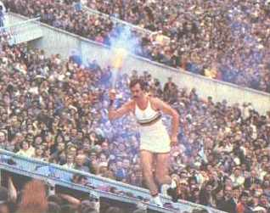
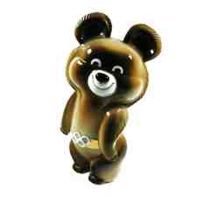
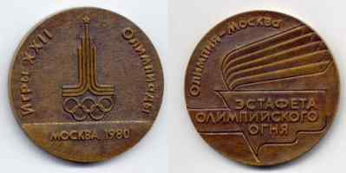
Russia joined the Olympic movement in 1952. In 1980 Moscow hosted the 22nd Olympic Games.

Slide 14
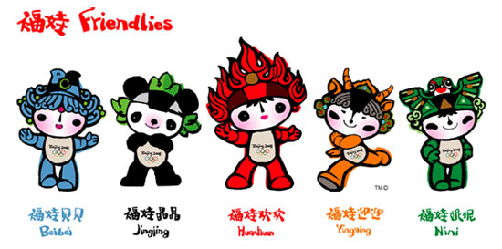
The 2008 Summer Olympic Games was a major international multi-sport event that took place in Beijing, China in August 2008.

Slide 15
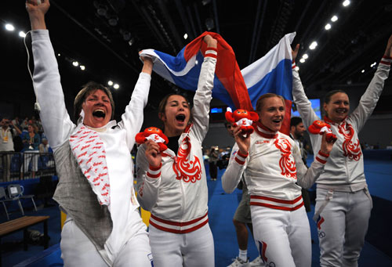
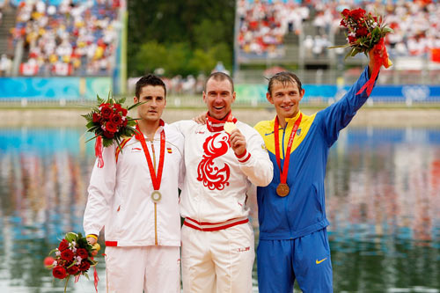
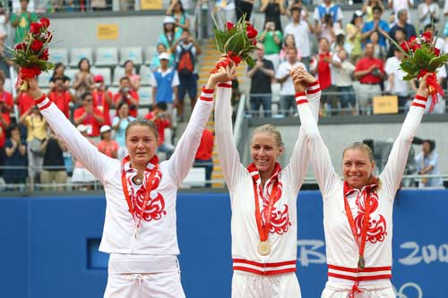
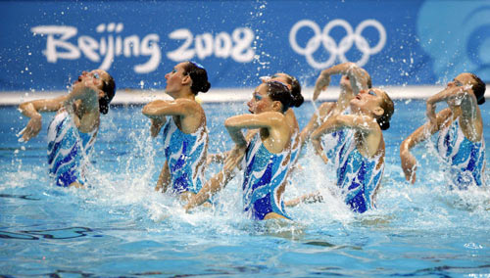
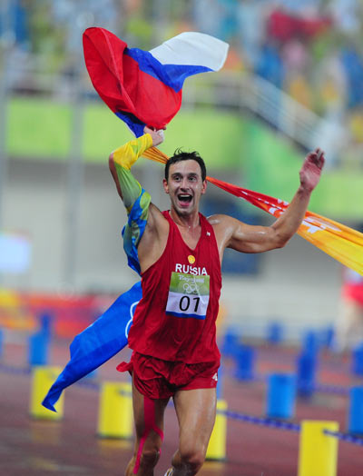
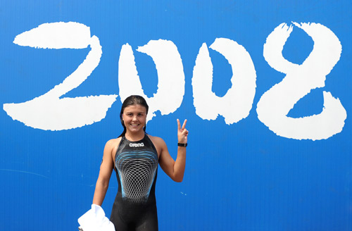
A total of 10,500 athletes competed in 302 events in 28 sports. Russian sportsmen won 72 medals: 23 gold, 21 silver, 28 bronze and took the 3rd rank after China and the USA.

Slide 16
The 2010 Winter Olympics, officially known as the 21st Winter Olympics, were held in February 12-28, 2010, in Vancouver, British Columbia, Canada.

Slide 17
The 2014 Winter Olympics, officially known as the XXII Olympic Winter Games, is an international winter multiple sports event that will be celebrated in February 2014. This will be the first time that the Russian Federation will host the Winter Olympics

Slide 18
Answer the questions:
When did the Olympic Games begin?
Who renewed the Olympic Games?
When did Russia joined the Olympic movement?
Where were the latest Summer Olympics held?
Where will be next Olympic Games held?

Slide 19
1. There are … ways to keep fit. (vary)
2. You can visit a … club. (fit)
3. Some kinds of sport are really … . (danger)
4. Physical … can be good for your body. (active)
5. You should be … active to stay … .
( physical, health)

