Slide 1
Youth organizations in Great Britain
Made by:
Filonovych Vika
Form 11B

Slide 2
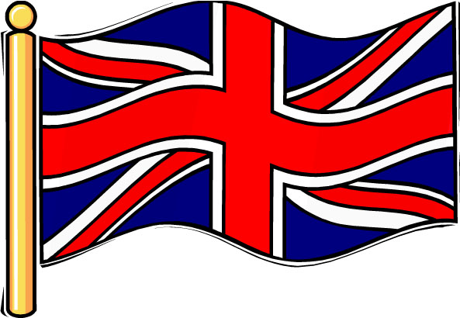
60 youth organizations
There are about 60 youth organizations in Great Britain. All youth organizations can be divided into three large groups: 1. non-political organizations; 2. youth organizations associated with political parties; 3. youth organizations controlled by religious bodies.

Slide 3

The Scout Association
The two largest non-political youth organizations are the associations of the Boy Scouts and the Girl Guides. There are about 1300000 boys and girls in them. The membership is voluntary.

Slide 4
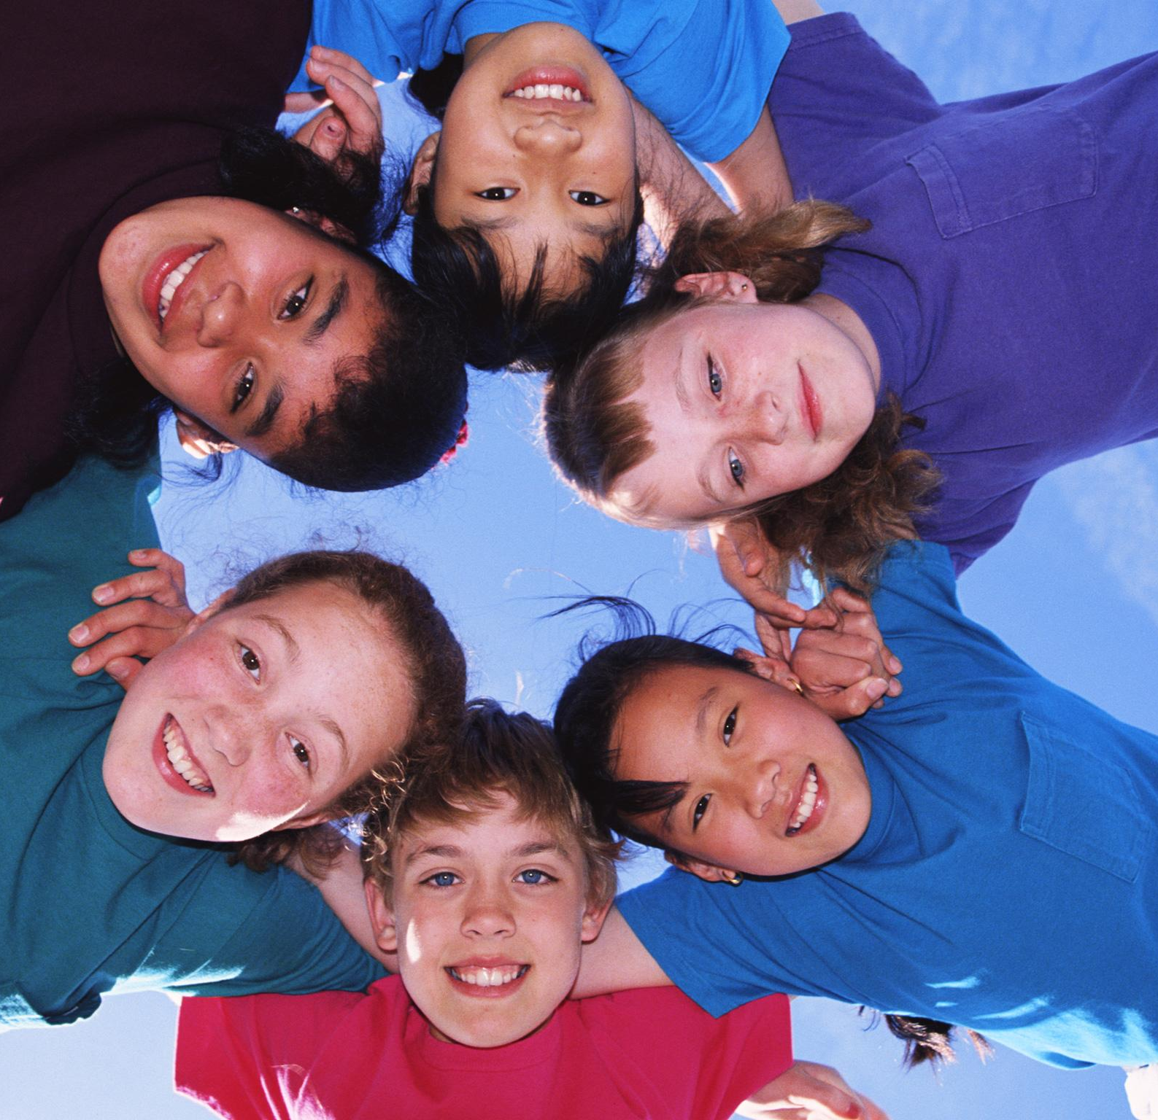
The Scout Association
The Scout Association was formed in 1908 by General Baden Powell. His idea was to train boys in mapping, signaling, knotting, first aid and all the skills that would arise from camping and outdoor activities. Most important of all for a Scout was to make a promise that he would do his best to do his duty to.

Slide 5
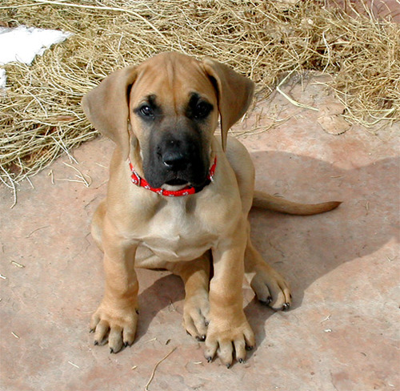
The Girl Guides Association
The Girl Guides Association was founded by Baden Pawell in 1910. It’s divided into three sections: Brownies (from 7.5 to 11), Guides (from 11 to 16), Rangers (from 16 to 21). The programme of training is planned to develop intelligence and practical skills including cookery, needlework, childcare. Like a Scout a Girl Guide must be a friend to animals.

Slide 6
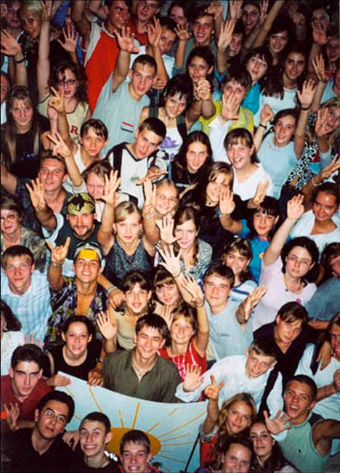
non-political organizations
There are some other non-political organizations: the Combined Cadet Force, Sea Cadet Corps, the Woodcraft Folk, the Youth Hostels Association, the National Federation of Young Farmers Clubs, Greenpeace.

Slide 7
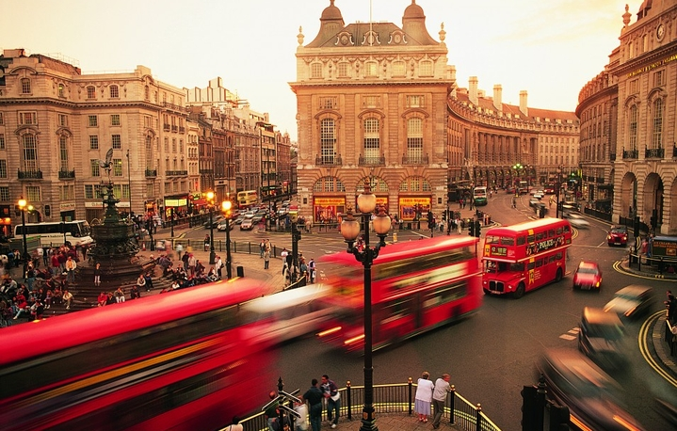
Religious young organizations
Religious young organizations and groups aim at helping to elderly people or working in hospitals. There are even groups where young people help released prisoners to start then life a-new. Religious organizations pay attention not only to the study of religious views but involve youth into such activities as music festivals and amateur theatre.

Slide 8
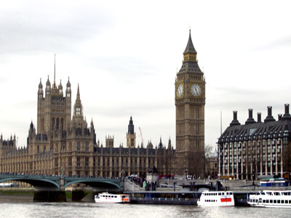
all there organizations
As you see, all there organizations aim at preserving and strengthening the social and political system existing in the country. Many of them have done and still are doing useful work in providing leisure facilities for young English people.

