Slide 1
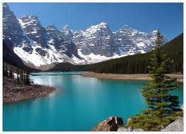
Some interesting facts about Canada

Slide 2

1.Canada is also home to the longest street in the world. Yonge Street in Ontario starts at Lake Ontario, and runs north through Ontario to the Minnesota border, a distance of almost 2000 kilometres.
2. The Blackberry Smartphone was developed in Ontario, at Research In Motion’s Waterloo offices.

Slide 3

3. A bear cub named Winnipeg was exported from Canada to the London Zoo in 1915. A little boy named Christopher Robin Milne loved to visit Winnipeg (or Winnie for short) and his love for the bear cub inspired the stories written by his father, A.A. Milne, about Winnie-the-Pooh.
4. Sandy Gardiner, a journalist with the Ottawa Journal in the 60’s coined the term ‘Beatlemania’ while he was writing a story about the Beatles.

Slide 4
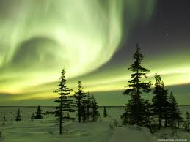
5. Canada is home to about 55 000 different species of insects.

Slide 5
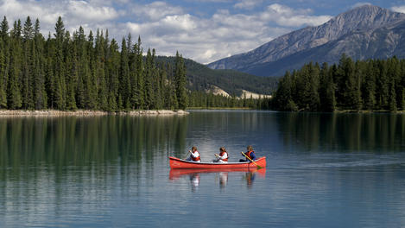
6. Canada basically has got its name by mistake. When Jaques Cartier, a French explorer, came to the new world, he met with local Natives who invited them to their ‘kanata’ (the word for ‘village’.

Slide 6
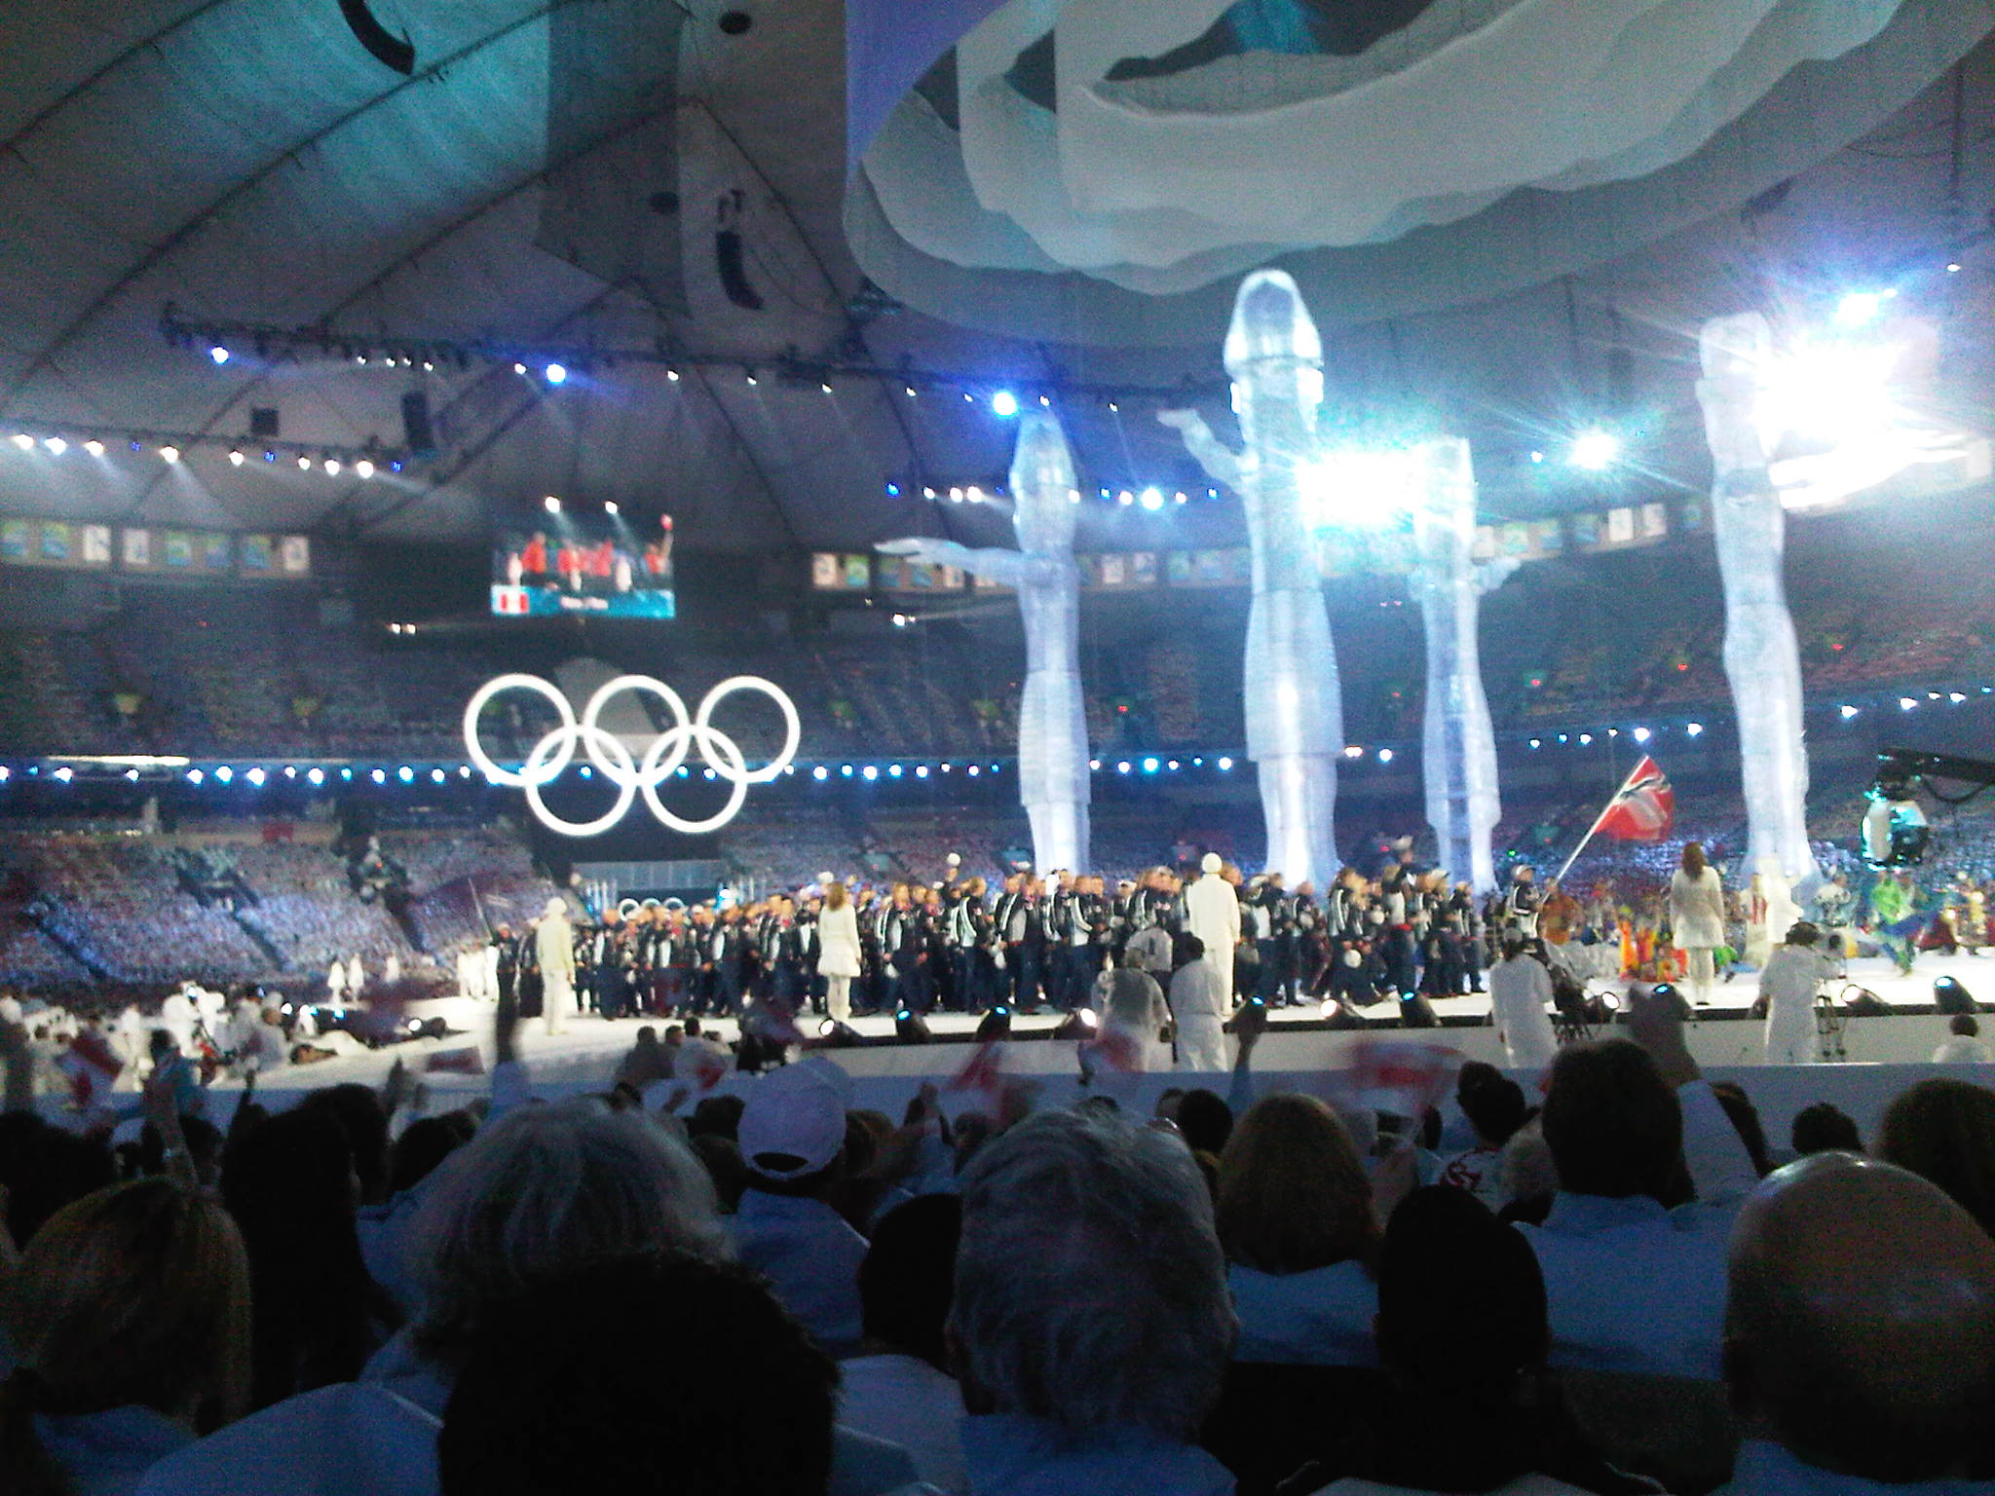
7. Canada holds the record for the most gold medals ever won at the Winter Olympics, since taking 14 Golds at the 2010 Vancouver Winter Olympics.

Slide 7
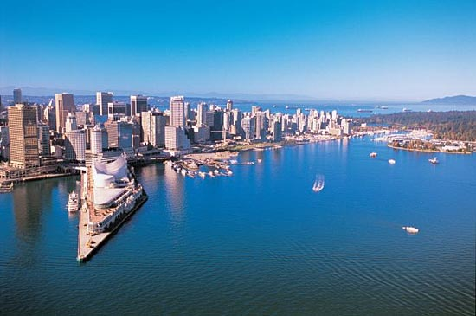
8. Canadians consume more macaroni and cheese than any other country in the world.
9. Hockey and lacrosse are the national sports.

Slide 8
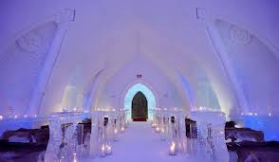
10. The Hotel de Glace in Quebec is built every year using 400 tons of ice and 12 000 tons of snow. Every summer it melts away and every winter it is rebuilt.

Slide 9

Thank you for your attention!

