Slide 1
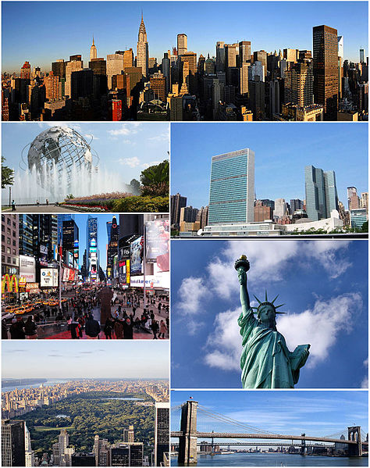
New York City
Form 11 – B

Slide 2
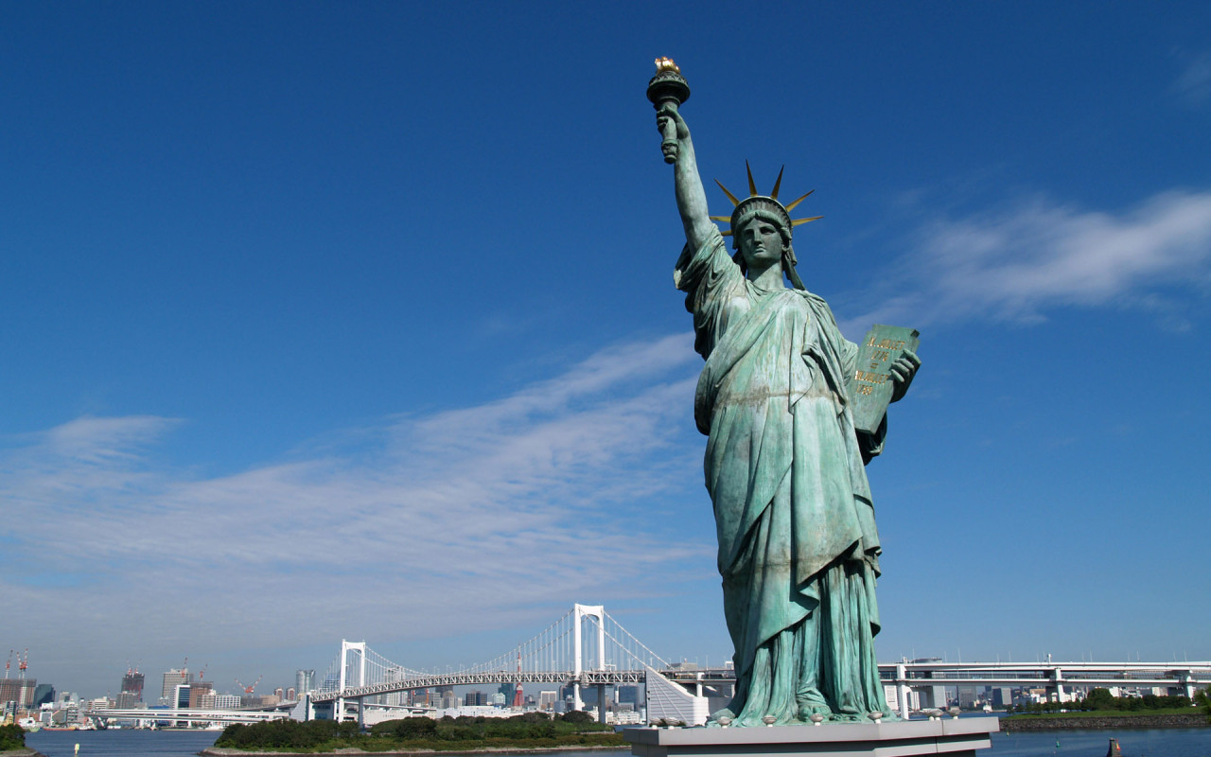
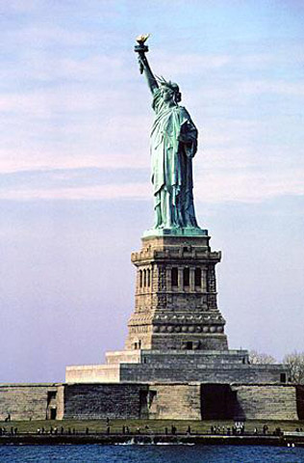
Statue of Liberty
The Statue of Liberty is a colossal neoclassical sculpture on Liberty Island in the middle of New York Harbor, in Manhattan. The statue, designed by Frédéric Auguste Bartholdi and dedicated on October 28, 1886, was a gift to the United States from the people of France.

Slide 3
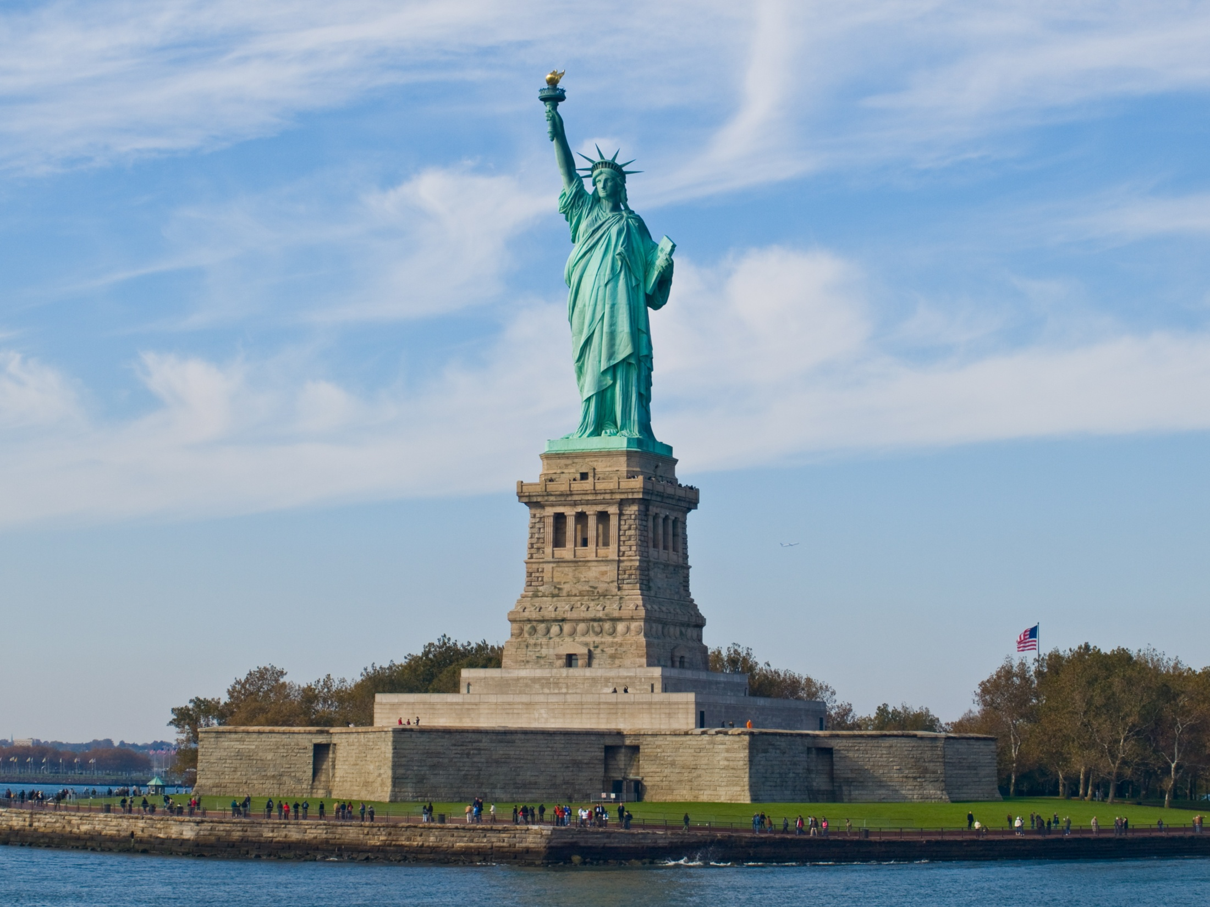

Slide 4
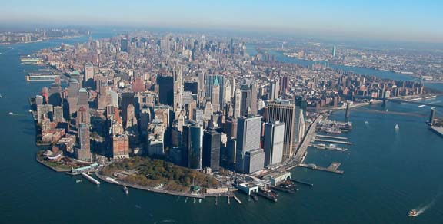
Manhattan
Is one of the five boroughs of New York City, geographically the smallest but also the most densely populated in the city. Located primarily on the island of Manhattan at the mouth of the Hudson River, the borough is conterminous with New York County, anoriginal county of the U.S. state of New York.

Slide 5
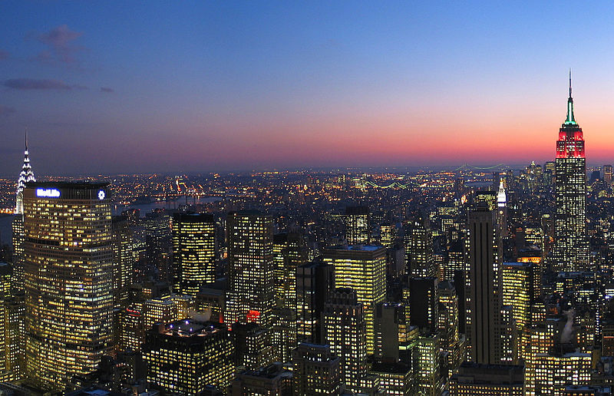

Slide 6
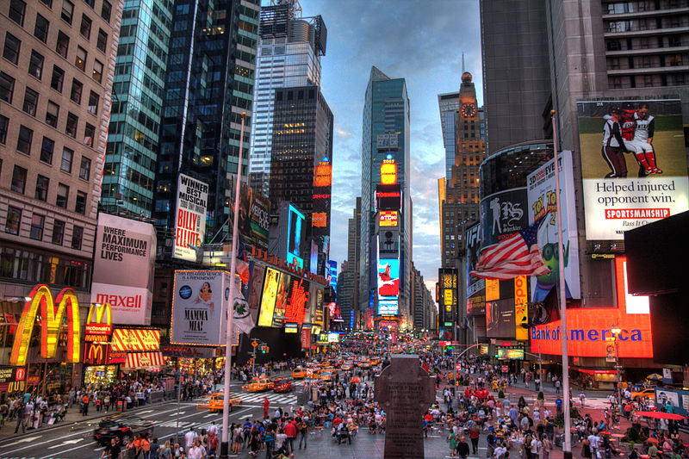
Times Square
Times Square is a major commercial intersection and a neighborhood in Midtown Manhattan , New York City , at the junction of Broadway. Times Square – iconified as "The Crossroads of the World“, " The Center of the Universe and the " The Great White Way "– is the brightly illuminated hub of the Broadway Theater District , one of the world's busiest pedestrian intersections, and a major center of the world's entertainment industry .

Slide 7
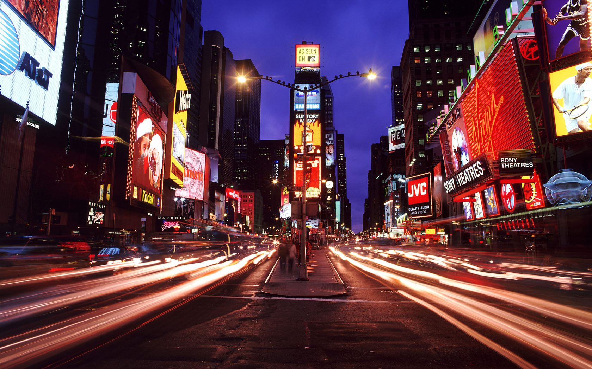

Slide 8
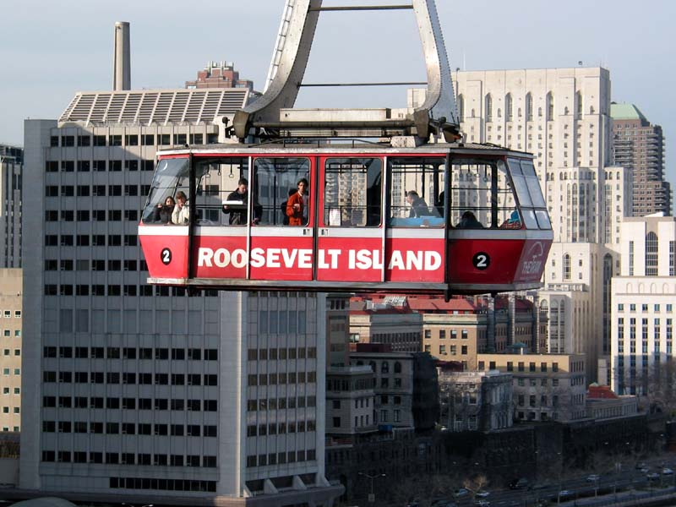
Roosevelt Island Tramway
The Roosevelt Island Tramway is an aerial tramway in New York City that spans the East River and connects Roosevelt Island toManhattan. Prior to the completion of the Mississippi Aerial River Transit in May 1984 and the Portland Aerial Tram in December 2006, it was the only commuter aerial tramway in North America.

Slide 9
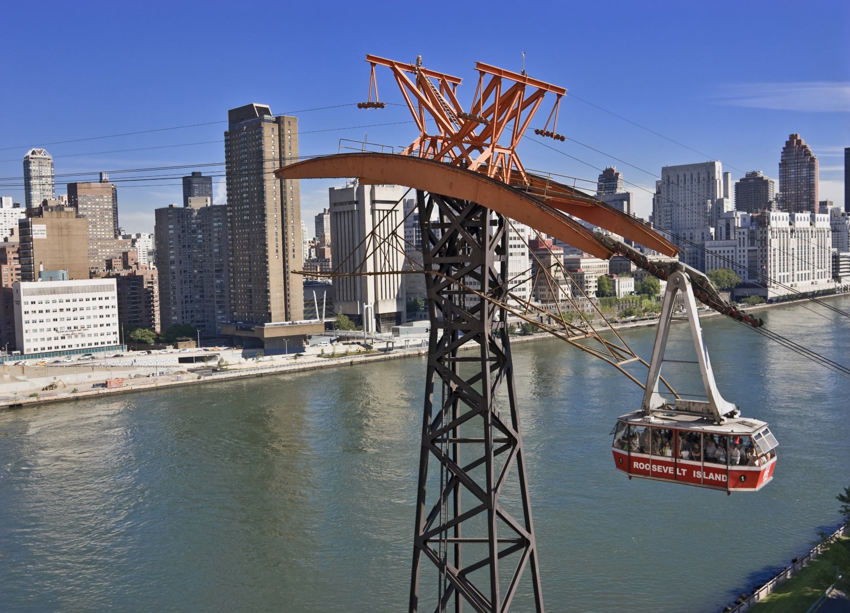

Slide 10
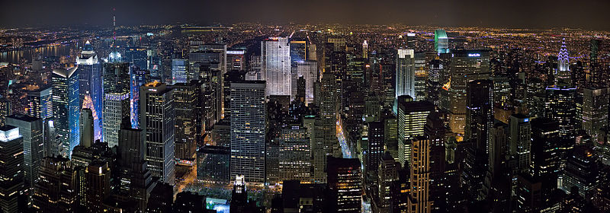
View of central Manhattan from The Empire State Building.

Slide 11
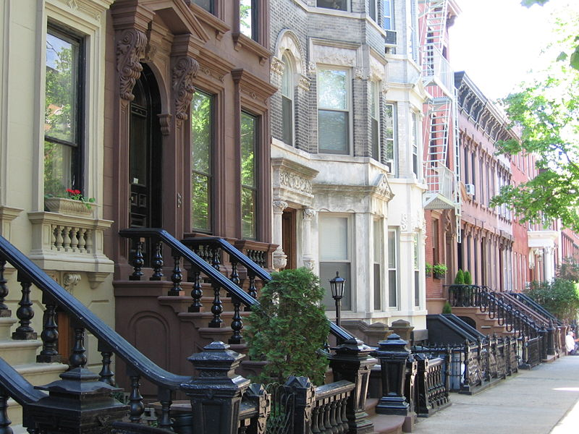
Landmark 19th-century rowhouses on tree-lined Kent Street in Greenpoint Historic District, Brooklyn

Slide 12
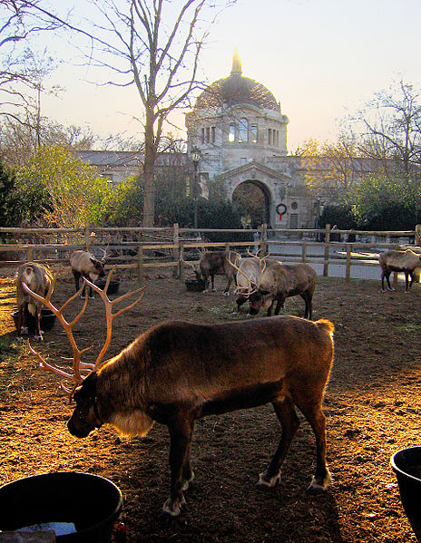
Reindeer at the Bronx Zoo, the world's largest metropolitan zoo.

Slide 13
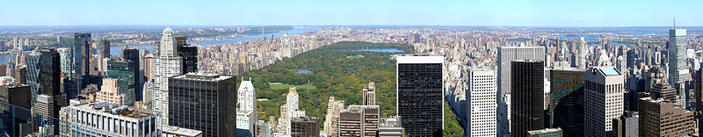
Central Park is the most visited city park in the United States.

Slide 14
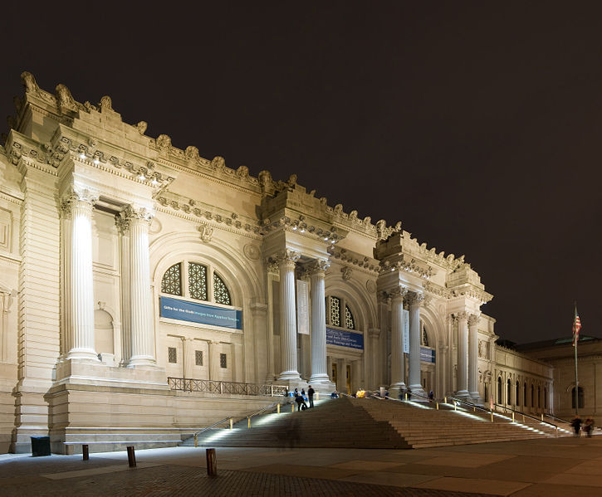
The Metropolitan Museum of Art, part ofMuseum Mile in the Carnegie Hillneighborhood of Manhattan's Upper East Side, is one of the largest museums in the world.

Slide 15
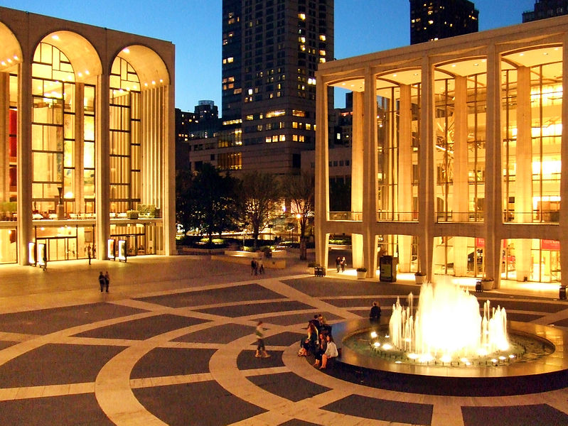
The Lincoln Center for the Performing Arts is home of the New York Philharmonicand other performing arts.

Slide 16
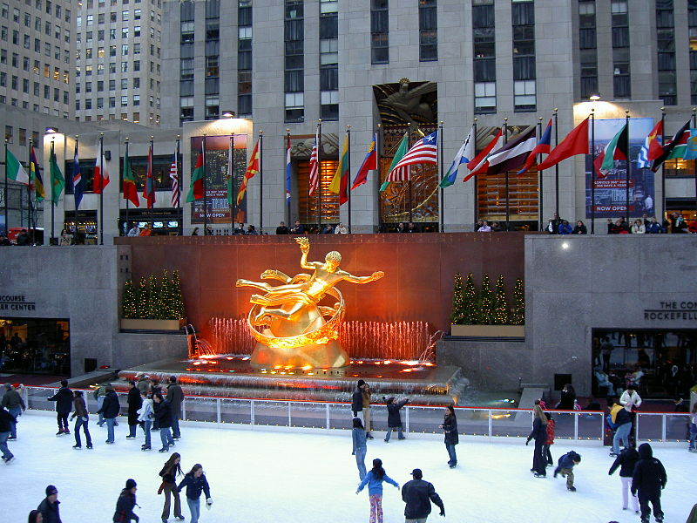
Rockefeller Center is home to NBC Studios

Slide 17
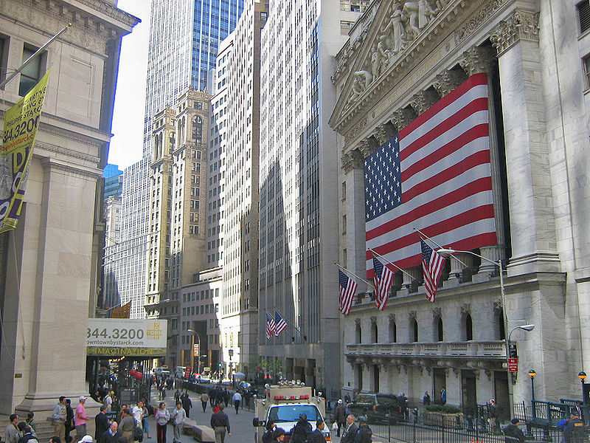
The New York Stock Exchange on Wall Street, the world's largest stock exchange per total market capitalization of its listed companies.

Slide 18
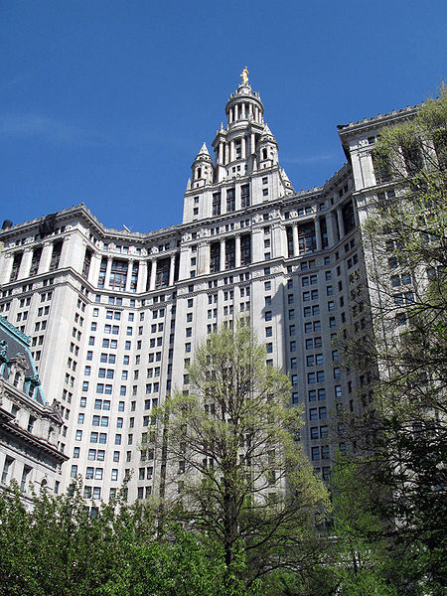
The Manhattan Municipal Building is home to many city agencies.

Slide 19
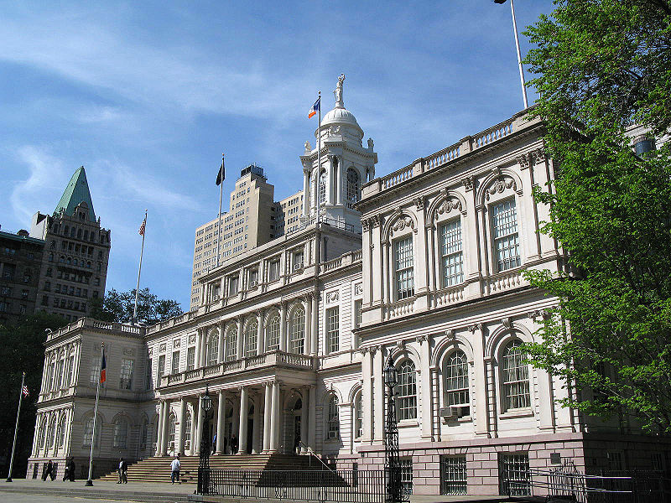
New York City Hall is the oldest City Hall in the United States that still houses its original governmental functions.

Slide 20
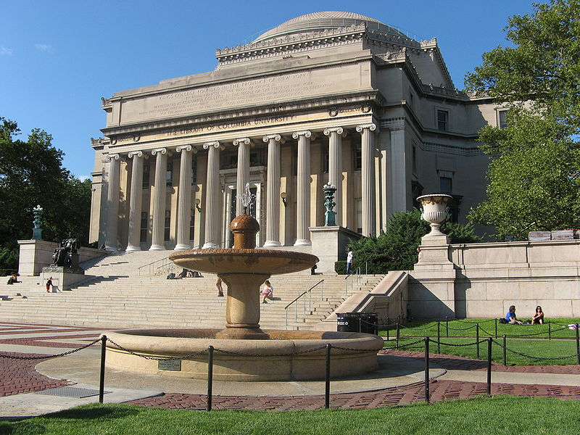
Columbia University's Low Memorial Library

Slide 21
