Slide 1
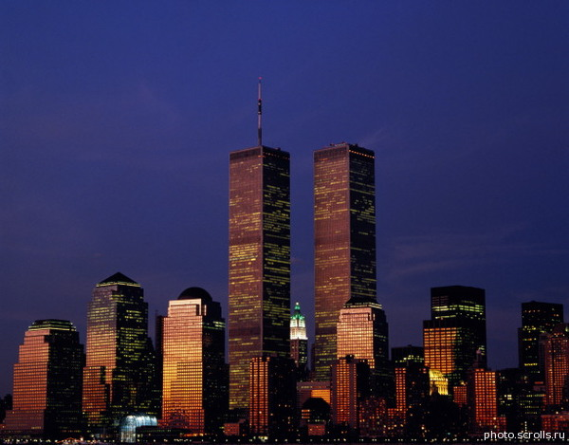
TWIN TOWERS

Slide 2
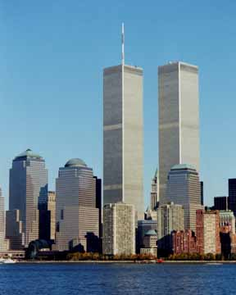
The World Trade Center in New York was built according to the project of Japanese architect to the minor Of Yamasaki, it was built to 1970, it is officially opened on April 4, 1973 and it was destroyed as a result terrorist act on September 11, 2001. Complex consisted of 7 buildings, each on 110 floors (northern with the height of 417 m and southern with the height of 415 m). For a while after the end of the building of tower they were the highest skyscrapers in the world

Slide 3
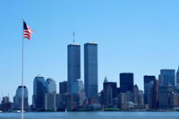
As the American Twin Towers of the World Trade Center were built
In the 60's the prestige of American democracy shook. In order to wake up in the consciousness of people pride for its country and to return the people of the USA optimism and the faith in the future was necessary project - something immense, that will act on minds and feelings of millions of people.
The projects, capable of striking the imagination of American people, was advanced several.

Slide 4
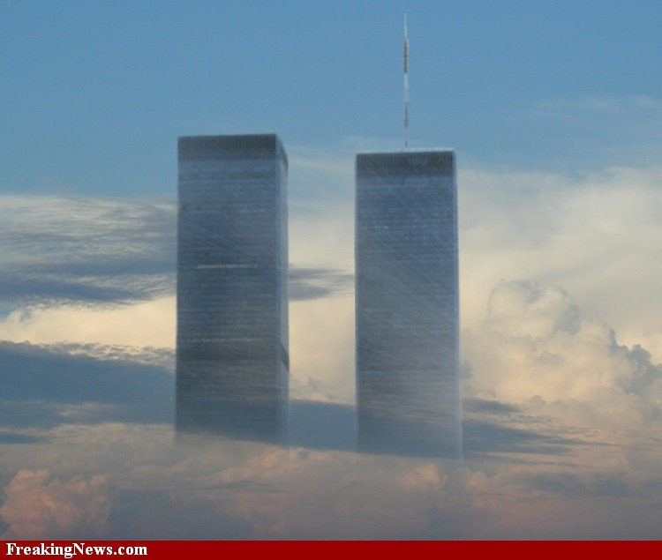
The structure of buildings was simple and reasonable. Facades are made in the form bodies from steel and mounted on them modular aluminum sections by the sizes of 3,5km 10 m, prepared with the plant method of stamping. This construction was capable of resisting wind pressure, very strong at the enormous height. The building of the World Trade Center they could even maintain collision with the aircraft or another projectile. But unhappy Gemini did not keep balance with the strongest explosion and the fire of 5 thousand liters of the aviation gasoline from the tanks of aggressive aircraft.

Slide 5
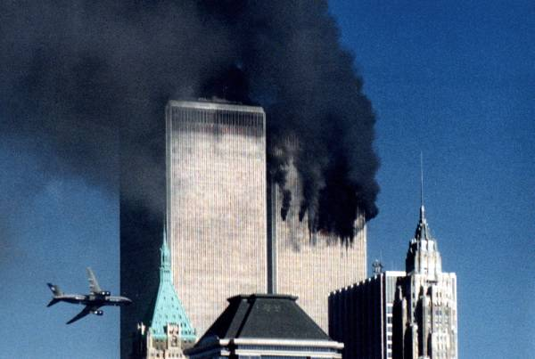
Chronicle item of the events of act of terror on September 11 in America
All began from the seizure of four aircraft of the commercial air lines, which were sent from the East coast of the USA for California. On board the aircraft there was significant fuel stock; the volume of fuel tanks is approximately equal to 91 thousand liters (about 65,5 thousand kg). Thus, jet aircraft with the passengers were aboard used as the guided missiles.

Slide 6
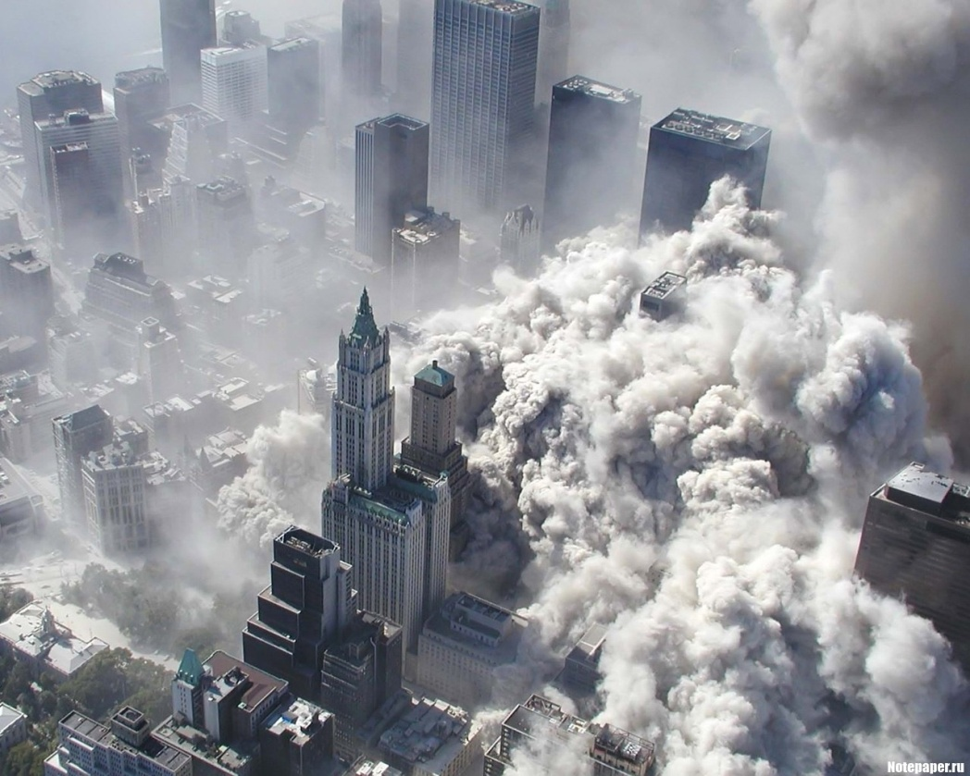
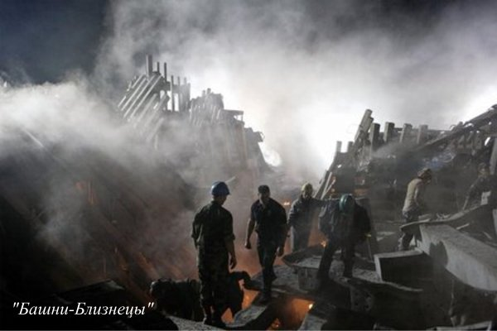
As a result attacks both skyscrapers, the adjacent to them buildings, and also one wing of the Pentagon were destroyed; perished about three thousand people.

Slide 7
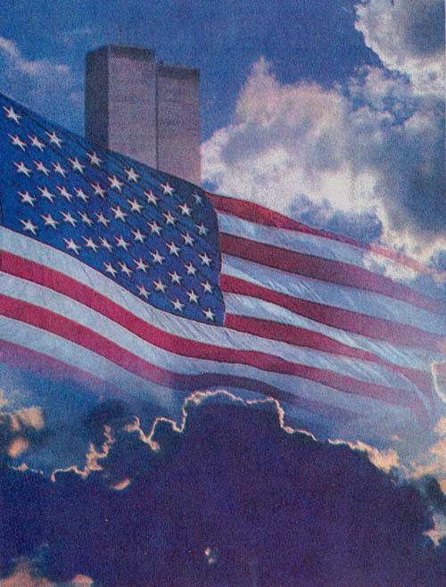
Consequences of tragedy on September 11, 2001
* It was the beginning of the new epoch, when full-scale wars can go not only between the states, but also between the states and the international groups, which do not have state structure and state responsibility.
* New York exchange on two days ended its work.
* adjacent region, including known Wall Street, proved to be the filled up ashes.
* government offices were evacuated.
* the President of the USA declared about the martial law.
* this event was the occasion of the war of the USA with Afghanistan and it is later with Iraq.

Slide 9
Выполнила: Клеткина Евгения ученица 9 «А» класса.

