Slide 1
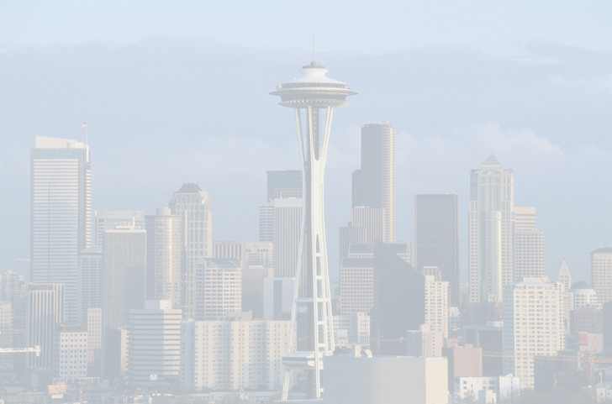
Seattle

Slide 2
Seattle
is a major coastal seaport and the seat of King County, in the U.S. state of Washington.

Slide 3
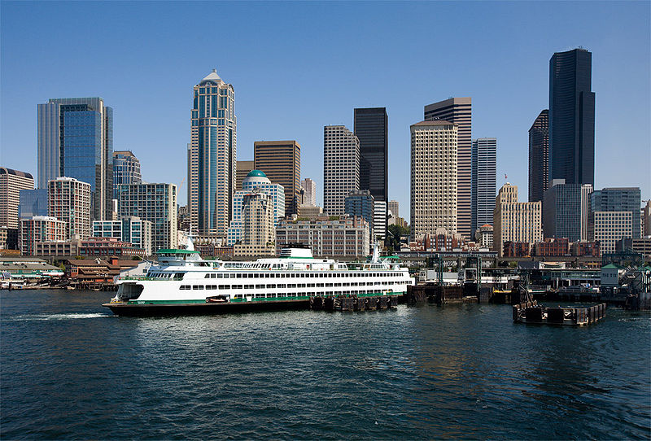
Downtown Seattle and a ferry at the Central Waterfront.

Slide 4
Seattle - a city built on top of another city. After the great fire in 1889, the townspeople lifted the level of the streets and began new construction. You can see the old city in a special museum Underground tour.

Slide 5
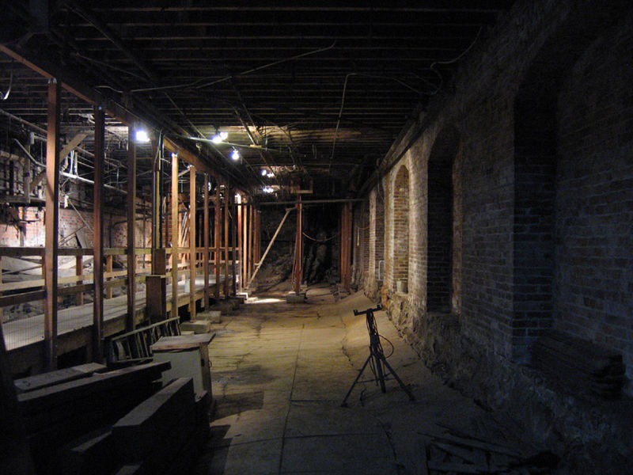
Seattle - a city built on top of another city. After the great fire in 1889, the townspeople lifted the level of the streets and began new construction. You can see the old city in a special museum Underground tour.

Slide 6
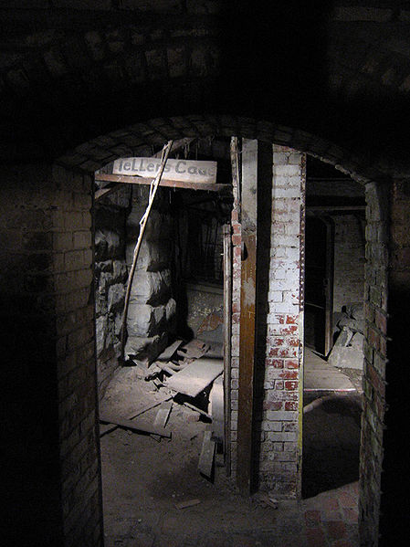
Seattle - a city built on top of another city. After the great fire in 1889, the townspeople lifted the level of the streets and began new construction. You can see the old city in a special museum Underground tour.

Slide 7
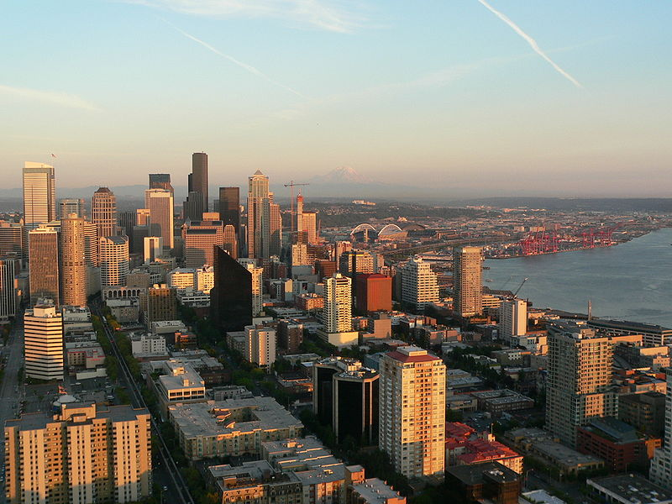
Downtown Seattle averages 71 clear (sunny) days a year, with most of those days occurring between May and September

Slide 8
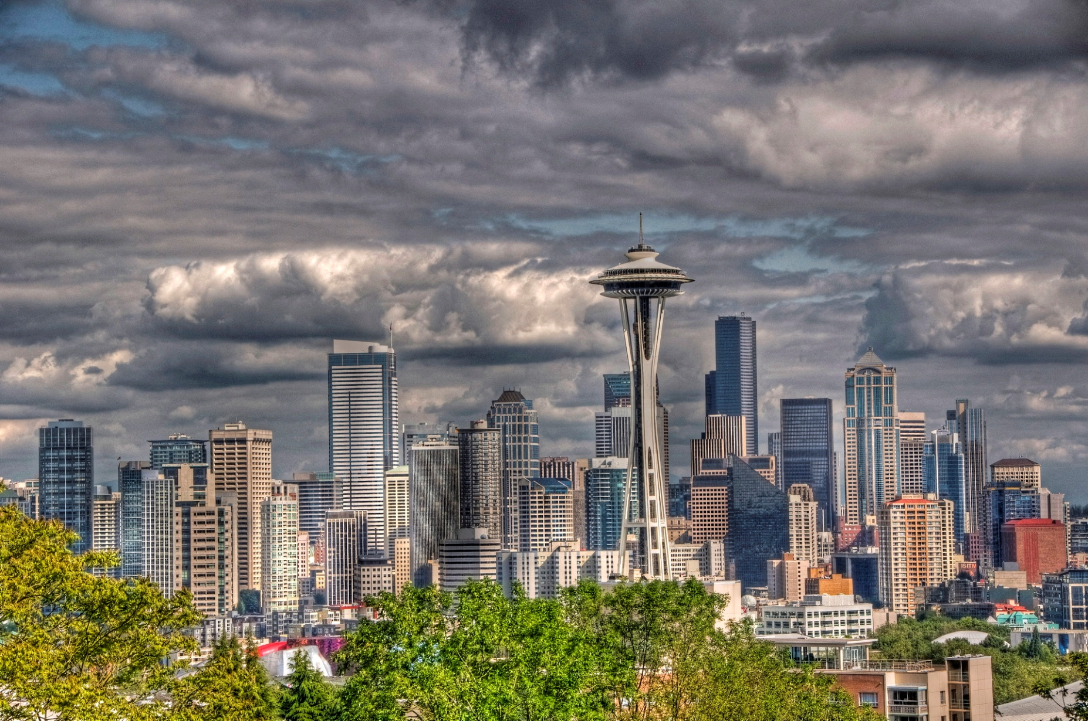
Between October and May, Seattle is mostly or partly cloudy six out of every seven day

Slide 9
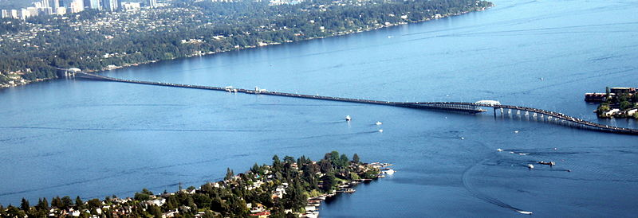
The Evergreen Point Floating Bridge is the longest floating bridge on Earth at 2,310 metres and carries State Route 520 across Lake Washington from Seattle to Medina.

Slide 10
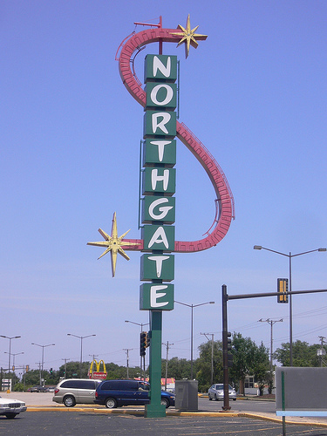
Northgate shopping mall, built in 1950, was the first shopping center in the world

Slide 11
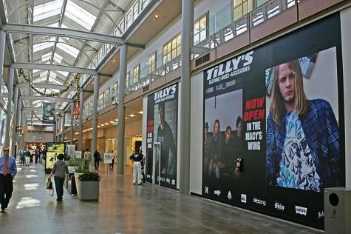
Northgate shopping mall, built in 1950, was the first shopping center in the world

Slide 12
Such famous names as Boeing, Microsoft and Starbucks belong to Seattle.

Slide 13
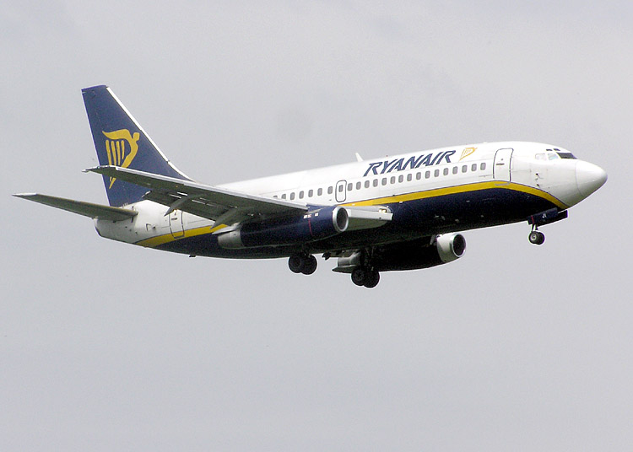
Such famous names as Boeing, Microsoft and Starbucks belong to Seattle.

Slide 14

Such famous names as Boeing, Microsoft and Starbucks belong to Seattle.

Slide 15
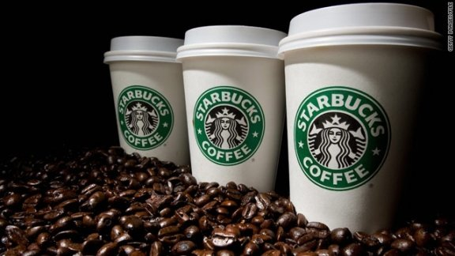
Such famous names as Boeing, Microsoft and Starbucks belong to Seattle.

Slide 16
Seattle is the most literary city in America.

Slide 17
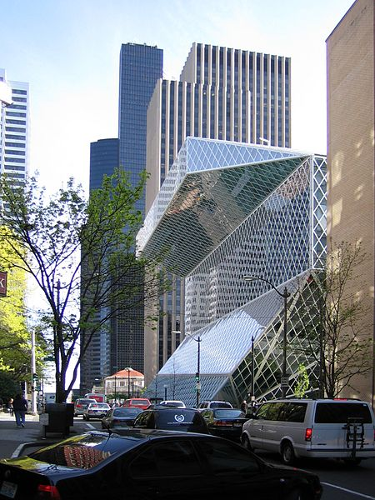
Seattle is the most literary city in America.
Seattle Central Library with the Columbia Center in the background

Slide 18
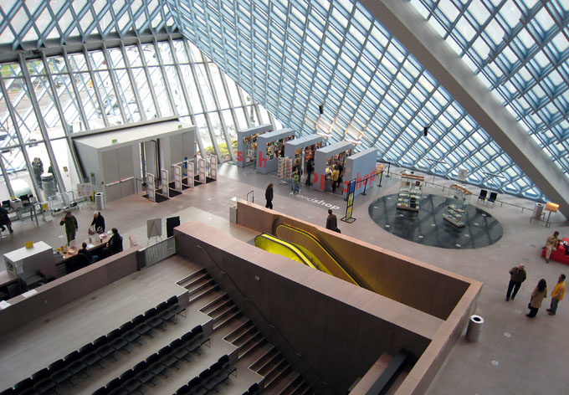
Seattle is the most literary city in America.
Seattle Central Library with the Columbia Center in the background

Slide 19
Seattle is the most educated city in the United States - is the highest percentage of people with higher education.

Slide 20
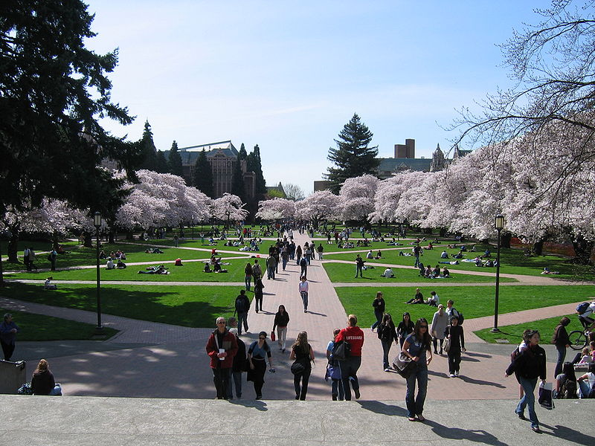
Seattle is the most educated city in the United States - is the highest percentage of people with higher education.
University of Washington Quad in Spring

Slide 21
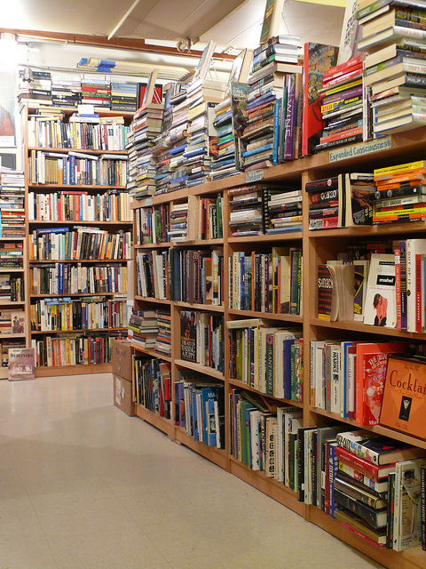
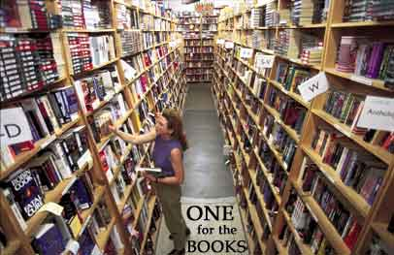
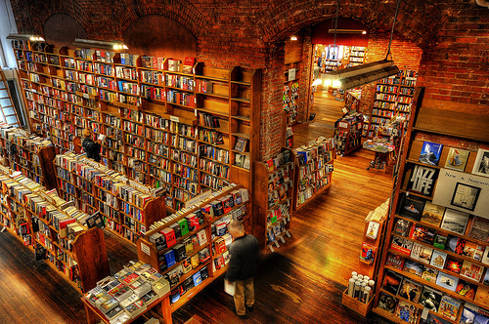
Seattle has more bookstores than any other town in America.

Slide 22
Top attractions in Seattle

Slide 23
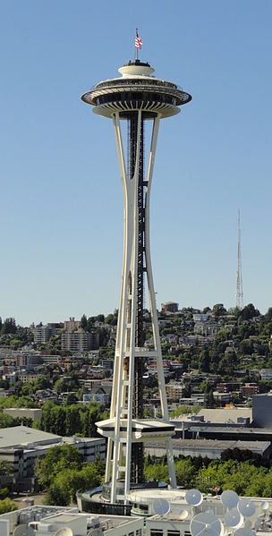
The Space Needle is a tower in Seattle, Washington and a major landmark of the Pacific Northwest region of the United States and a symbol of Seattle.

Slide 24
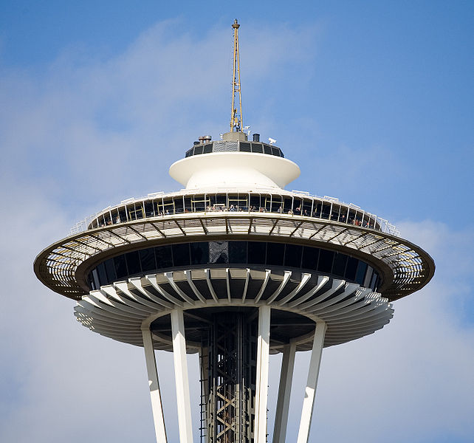
The Space Needle is a tower in Seattle, Washington and a major landmark of the Pacific Northwest region of the United States and a symbol of Seattle.

Slide 25
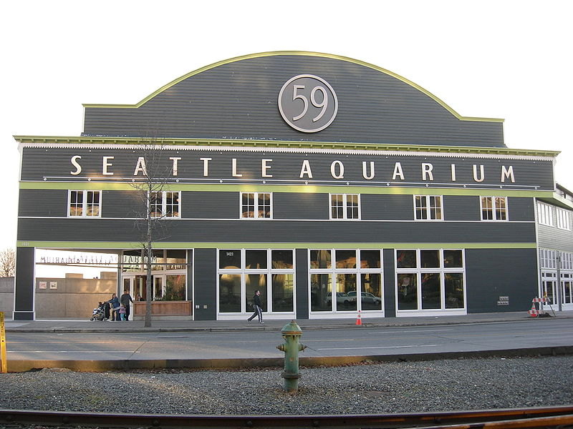
Seattle Aquarium

Slide 26
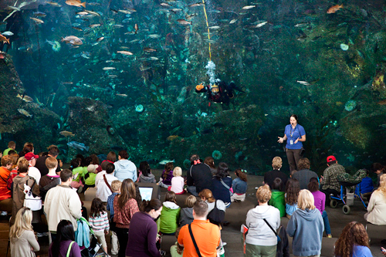
Seattle Aquarium

Slide 27
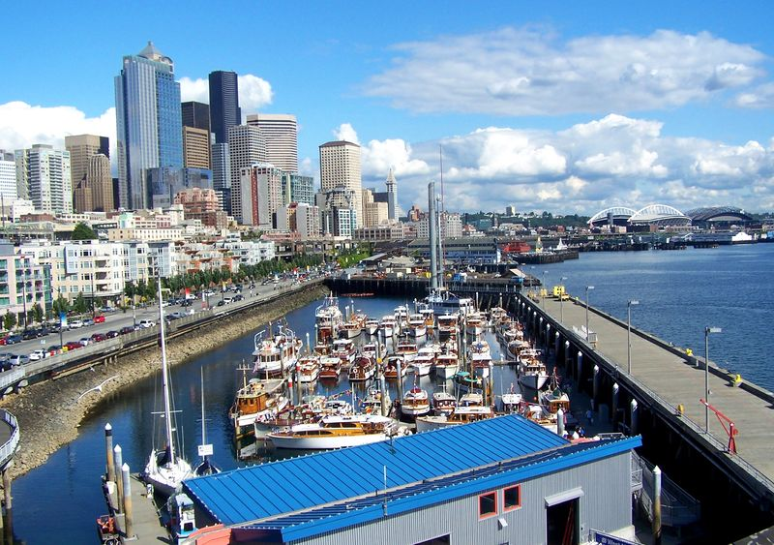
Central Waterfront

Slide 28
Central Waterfront

Slide 29
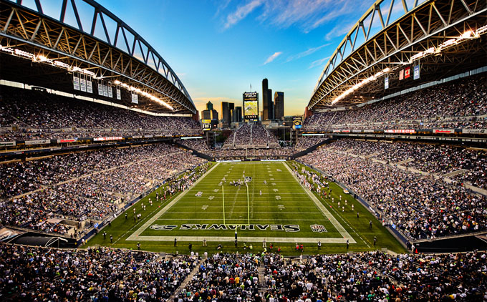
CenturyLink Field

Slide 30
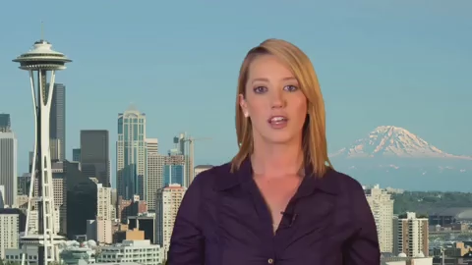

Slide 31
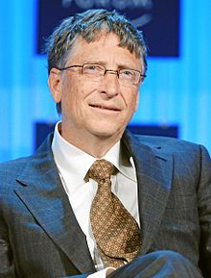
List of people from Seattle
Bill Gates
Co-founder of Microsoft

Slide 32
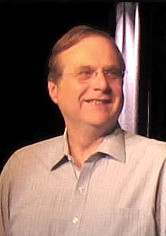
List of people from Seattle
Paul Allen
Co-founder of Microsoft

Slide 33
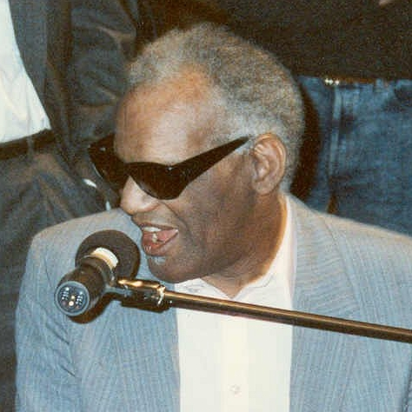
List of people from Seattle
Ray Charles
musician

Slide 34
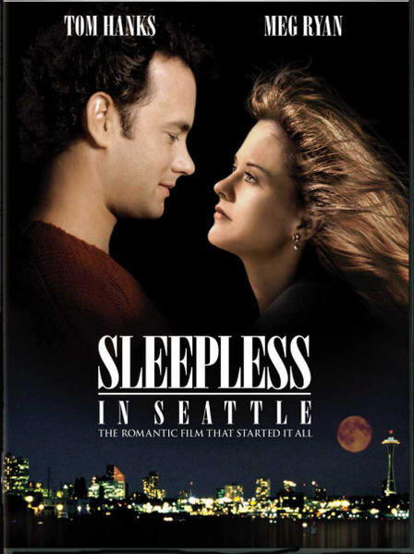
Films about Seattle

Slide 35
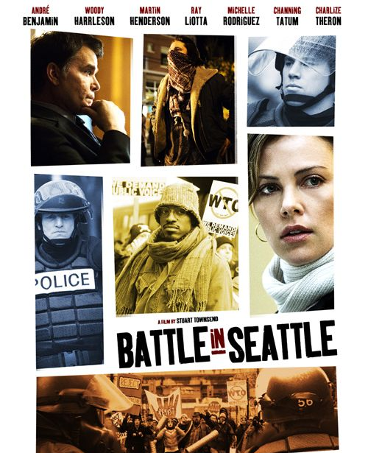
Films about Seattle

Slide 36

Films about Seattle

Slide 37
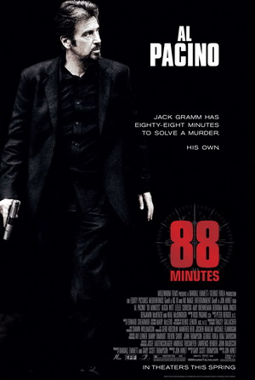
Films about Seattle

Slide 38
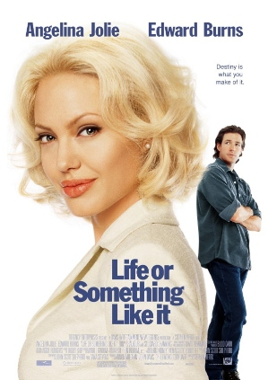
Films about Seattle

Slide 39
Films about Seattle

