Slide 1
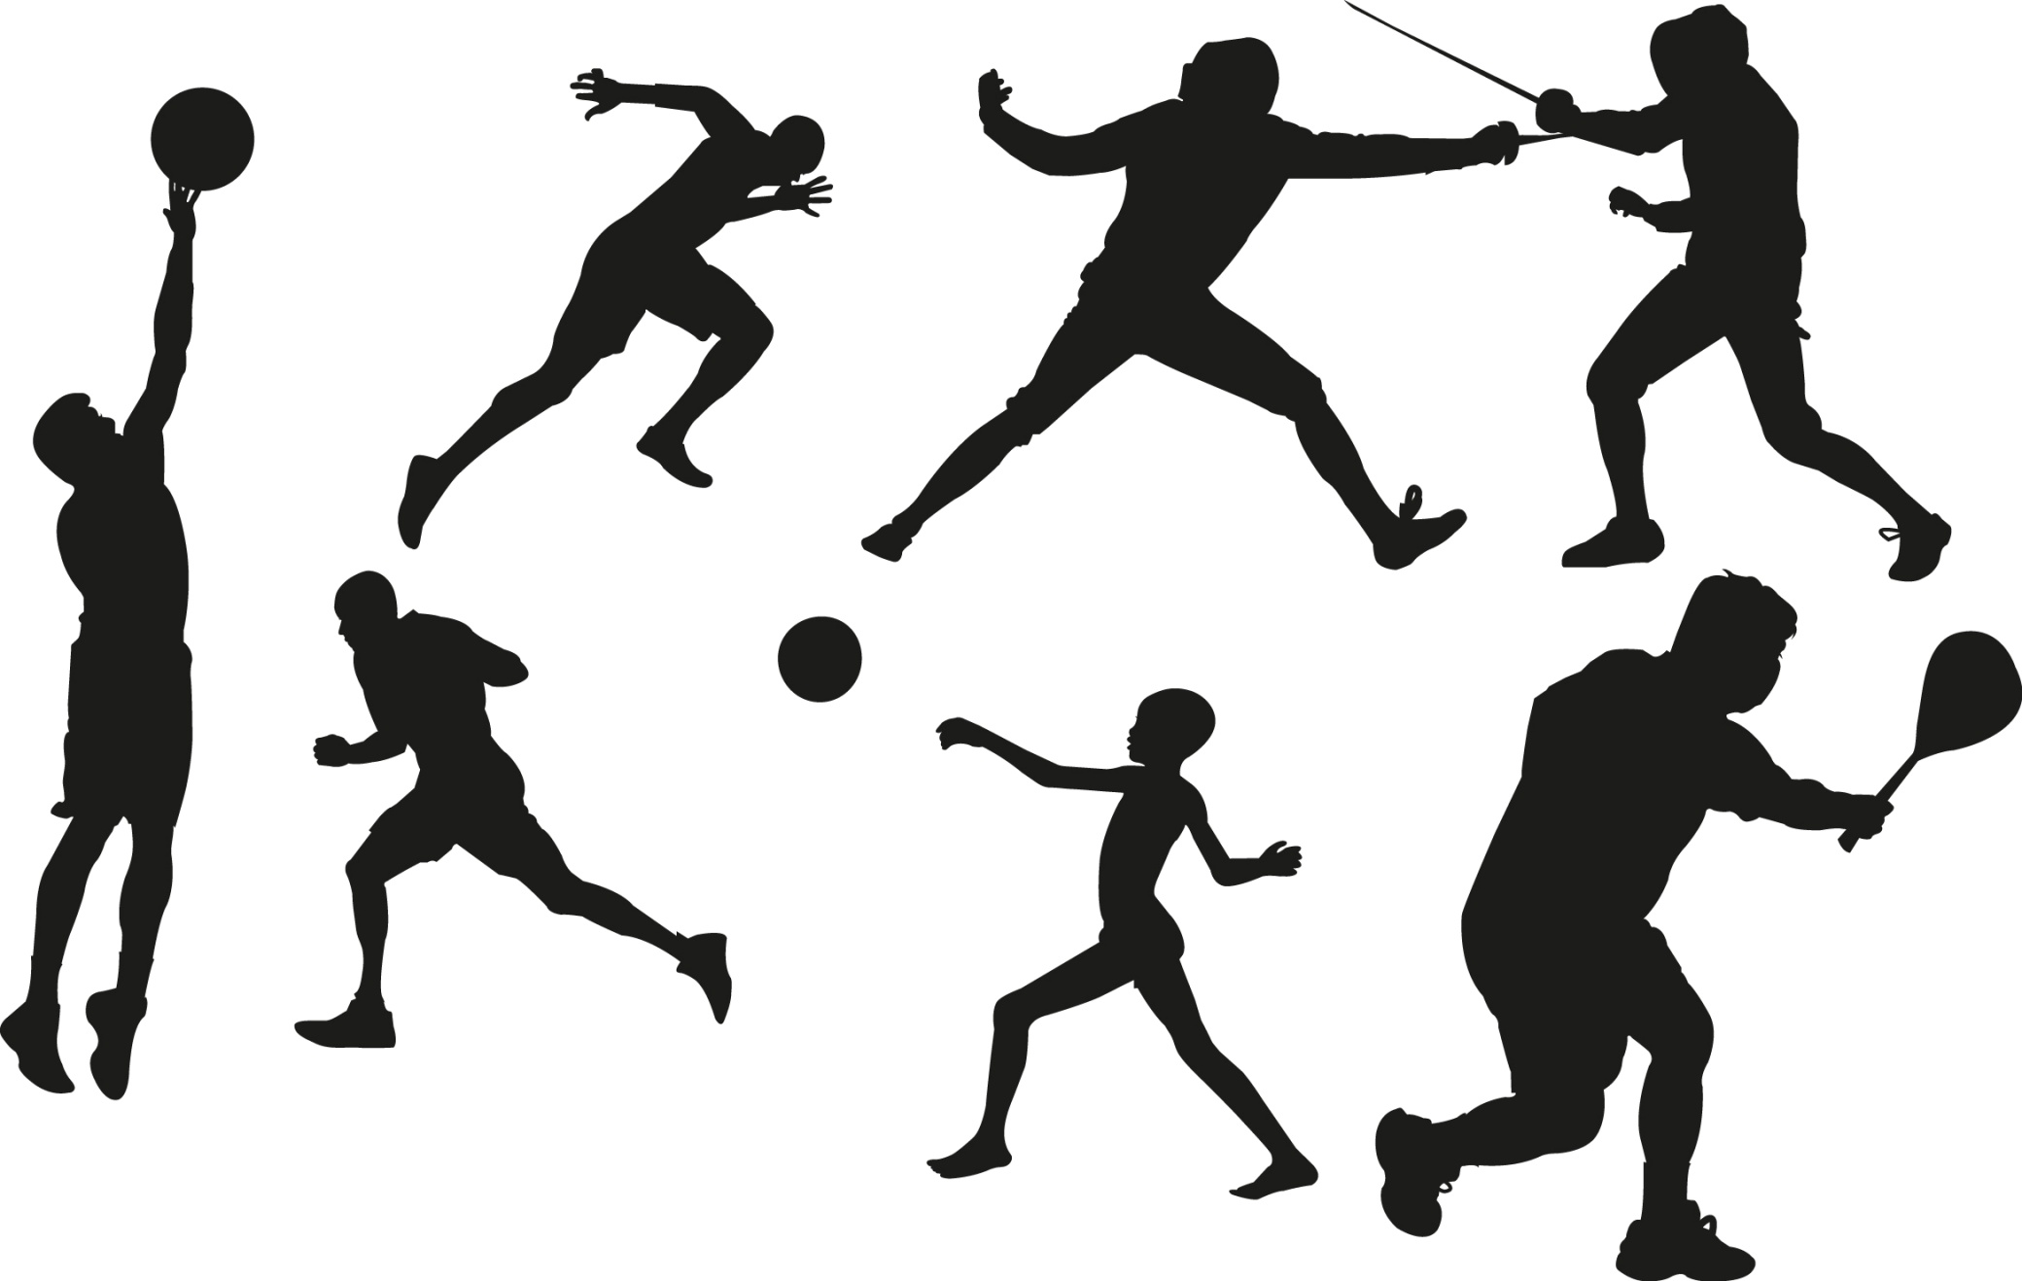
Sports

Slide 2
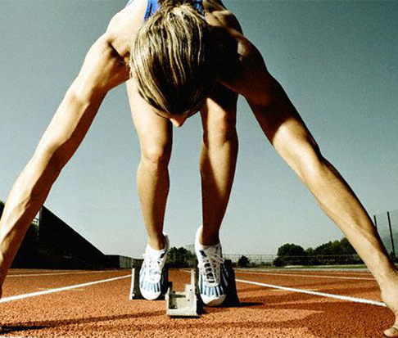
Sport is as old as the humanity itself. To my mind we can hardly overestimate the meaning of sport in our life and day-to-day activities.

Slide 3
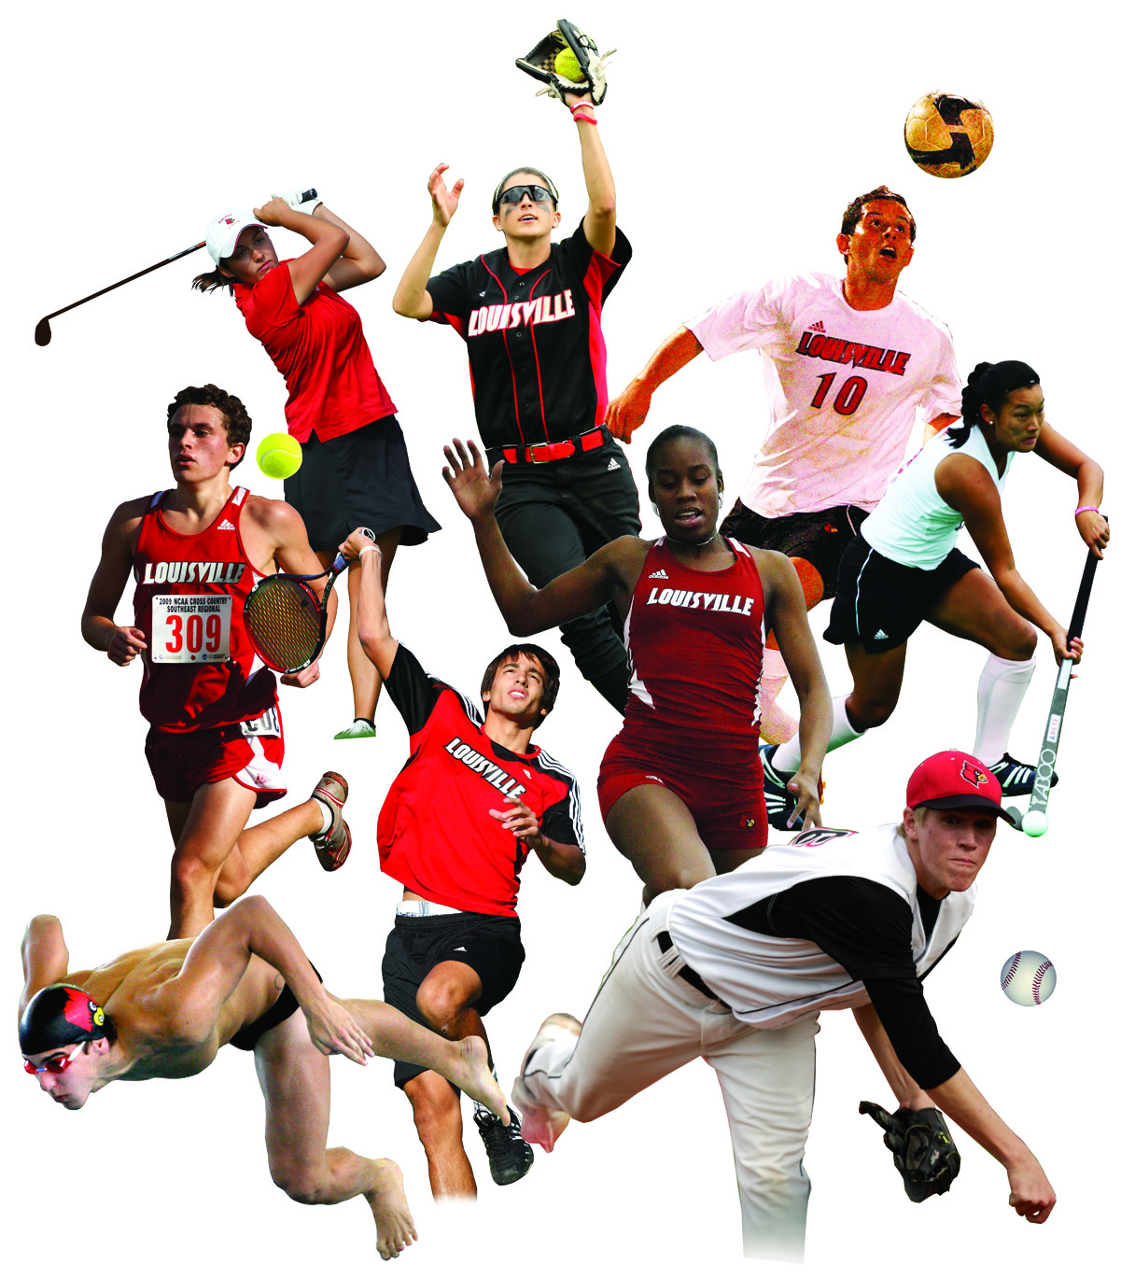
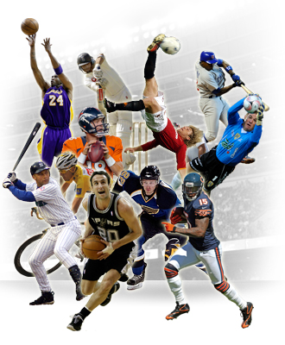
Its main purpose is to bring up the harmoniously developed generation - the generation of strong and healthy people.

Slide 4
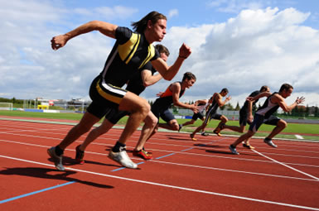
Sport makes our bodies strong, quickens our reaction and shapes the wits.

Slide 5
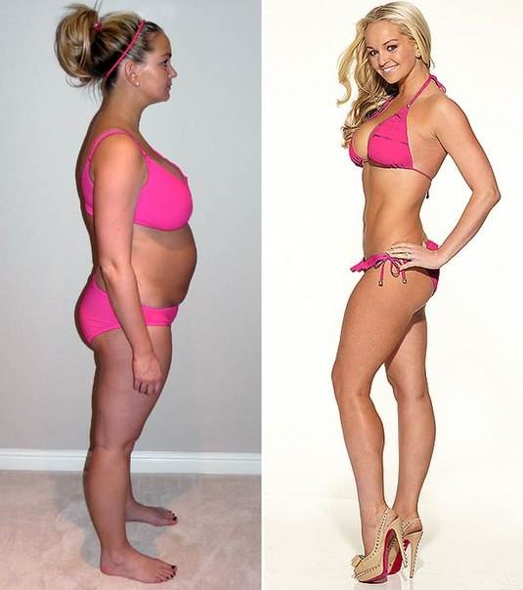
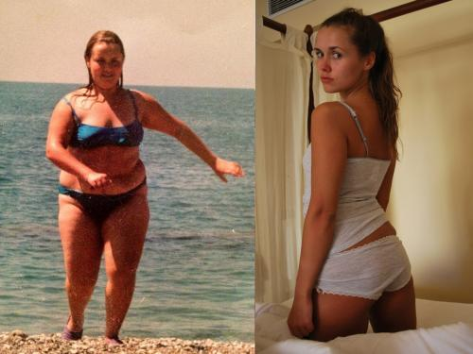
It also prevents us from getting to fat.

Slide 6
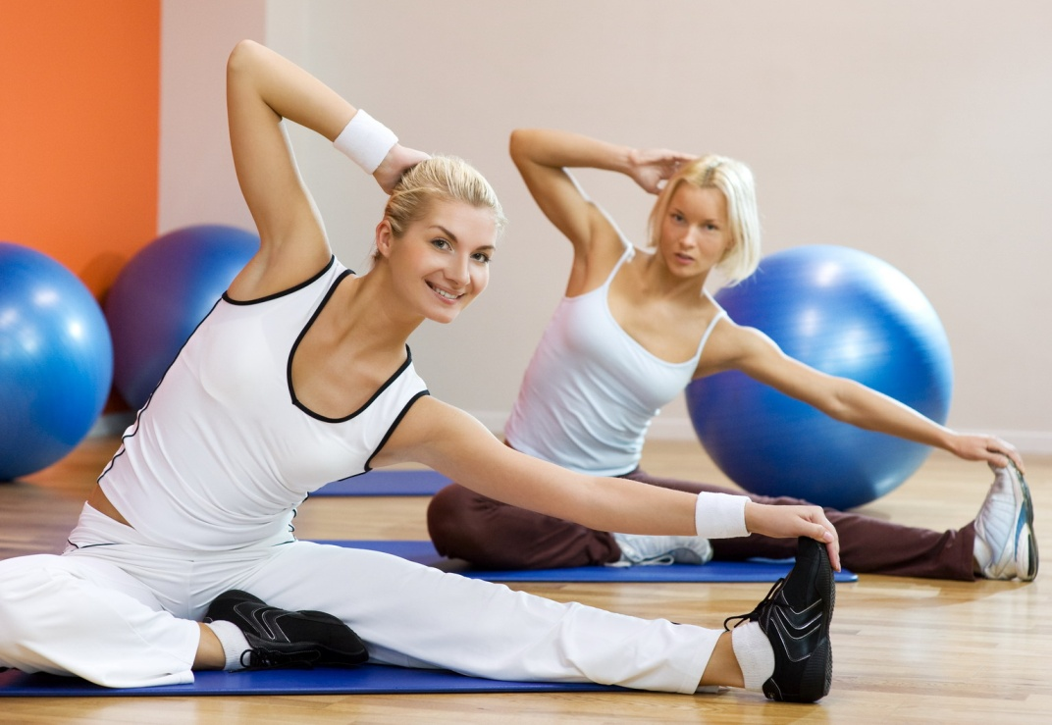
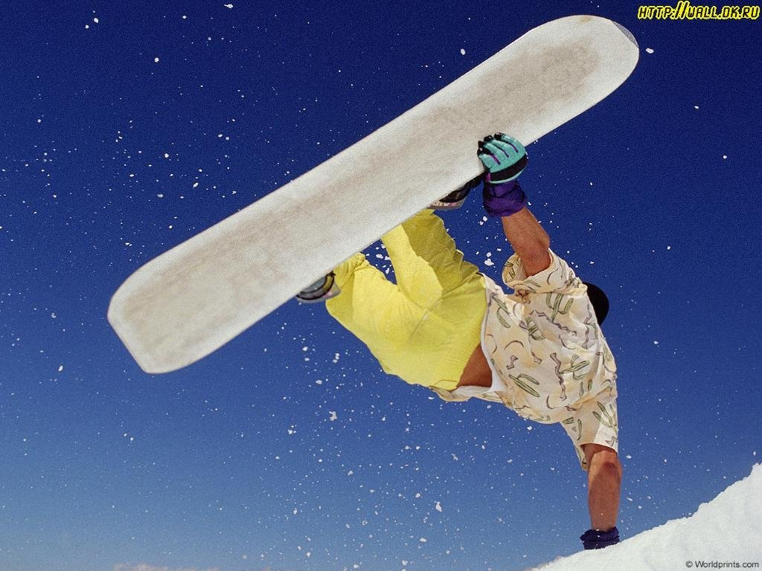
Sport makes us more organized and better disciplined.

Slide 7
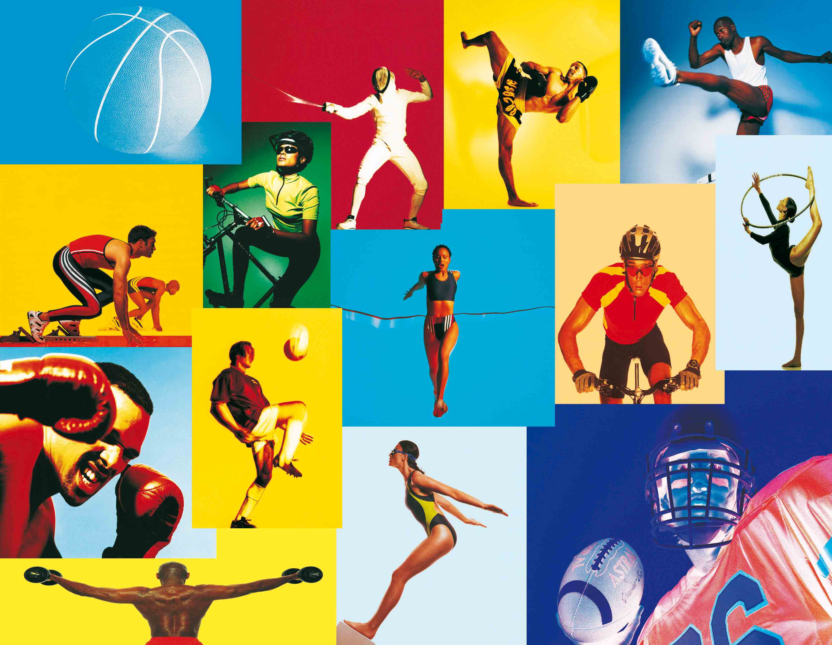
I`m absolutely sure that doing sports is the best way to keep fit. There is always a kind of sport which will suit you. There are many different kind to choose from.

Slide 8
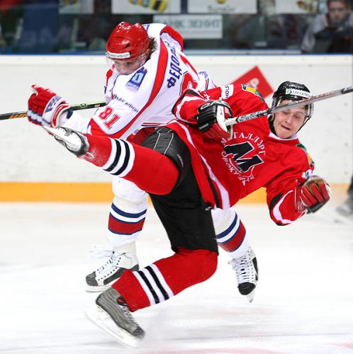
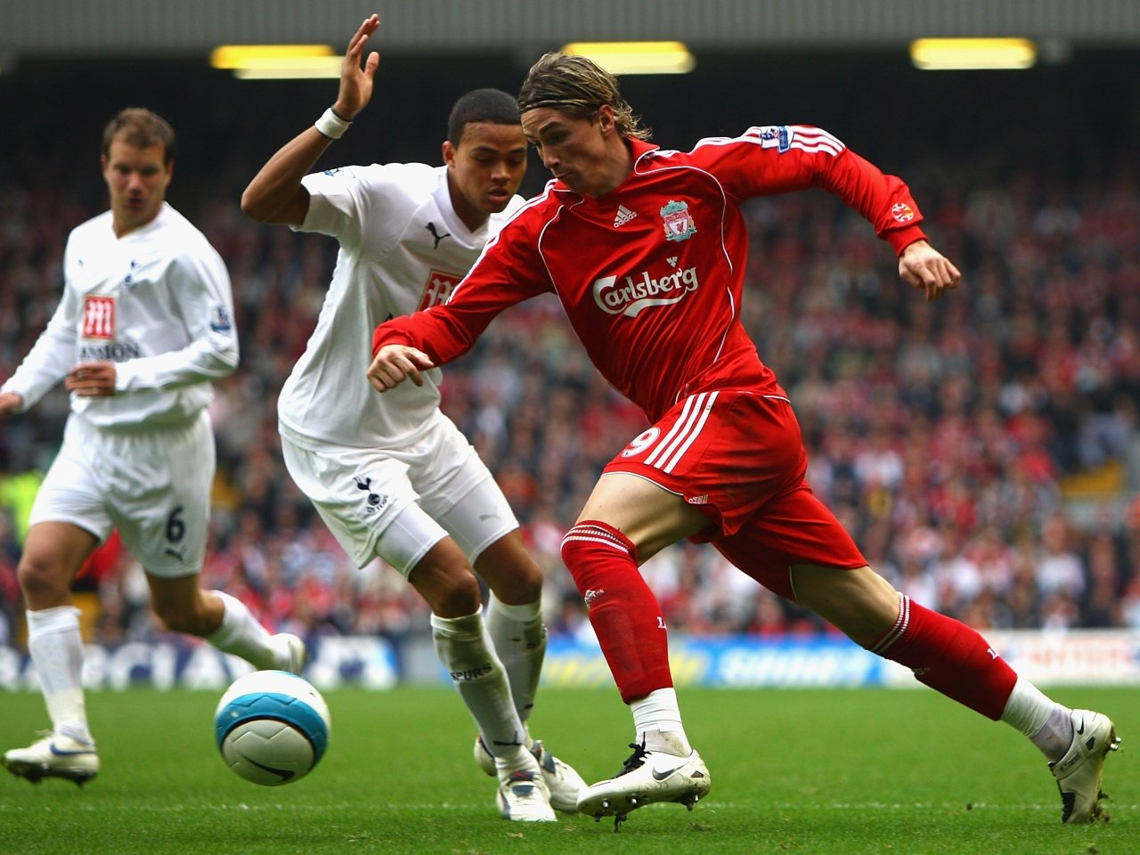
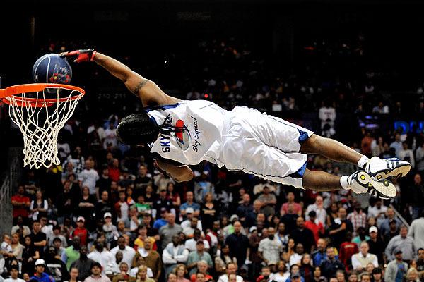
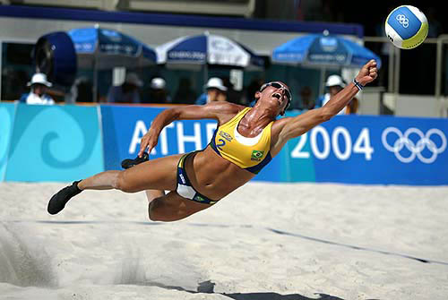
If you like team games ,try hockey, football,volleyball or basketball.

Slide 9
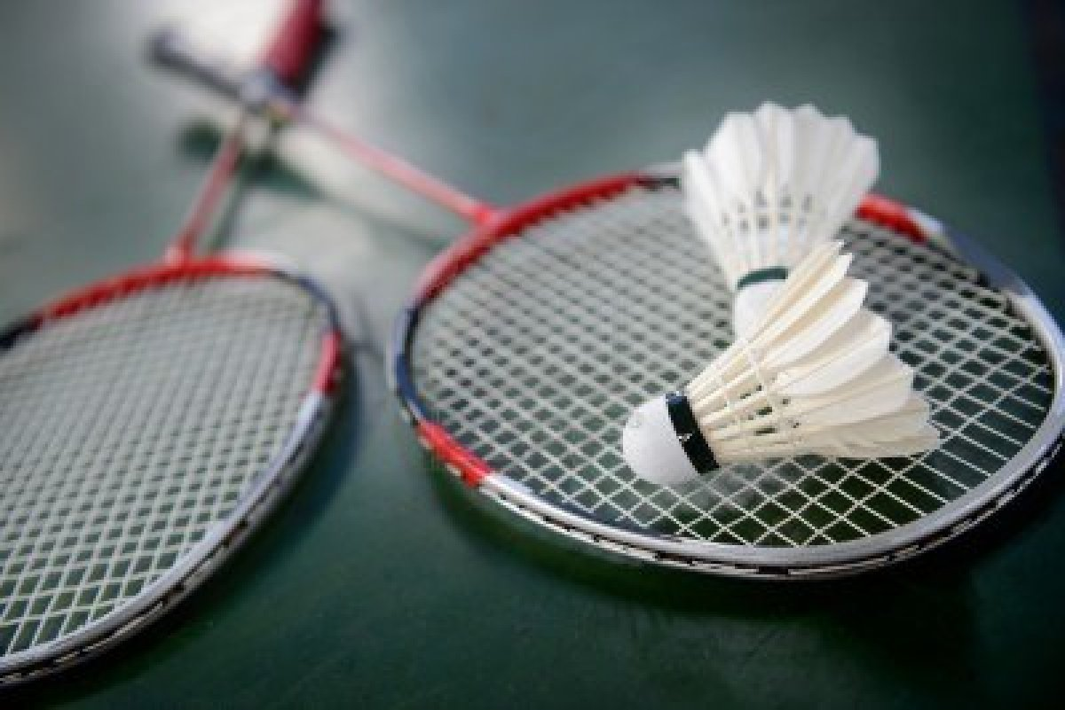
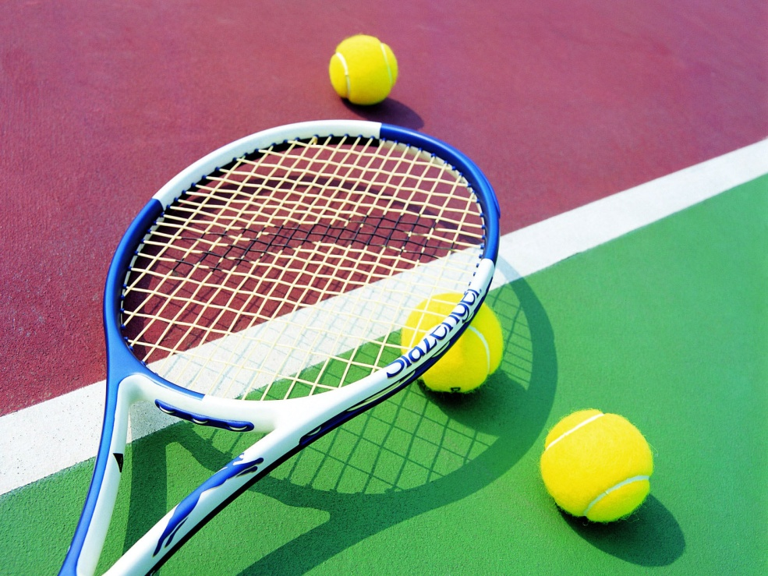
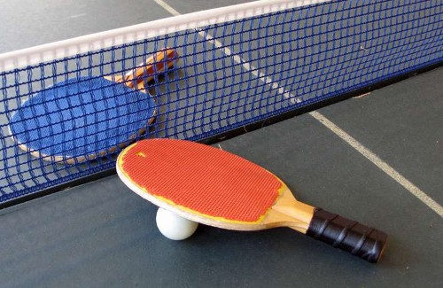
Games for you to play with a friend include badminton, tennis and table tennis.

Slide 10
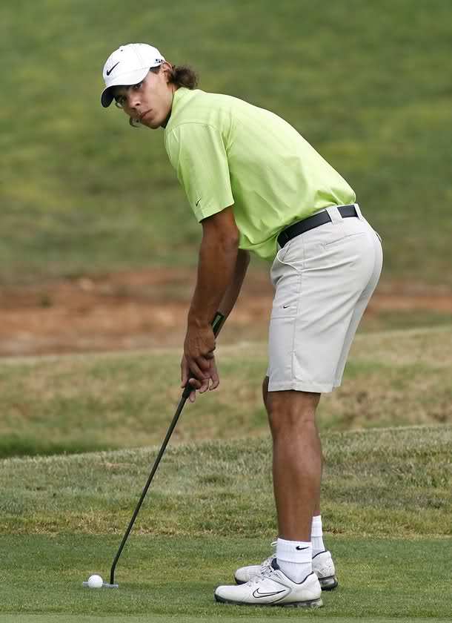
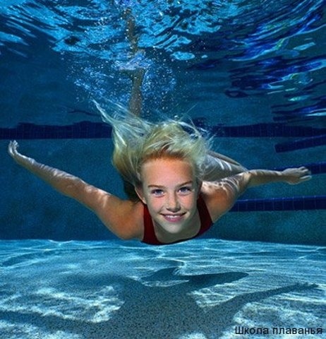
If you enjoy doing things on your own, you may take up swimming, riding, golf or athletics.

Slide 11
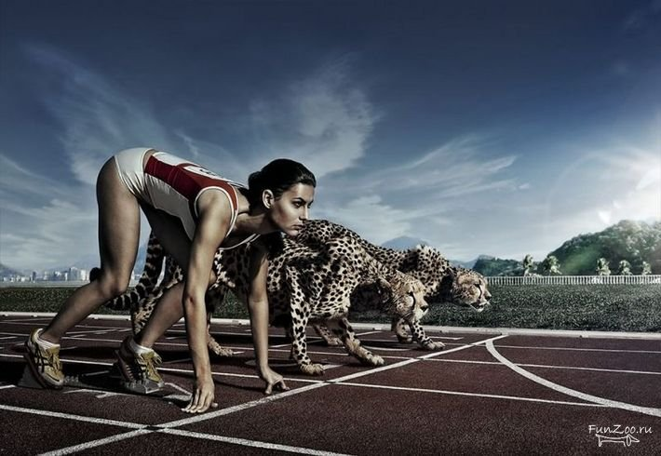
I`m sure you kow an axiom: "Sport makes people healthy".

Slide 12
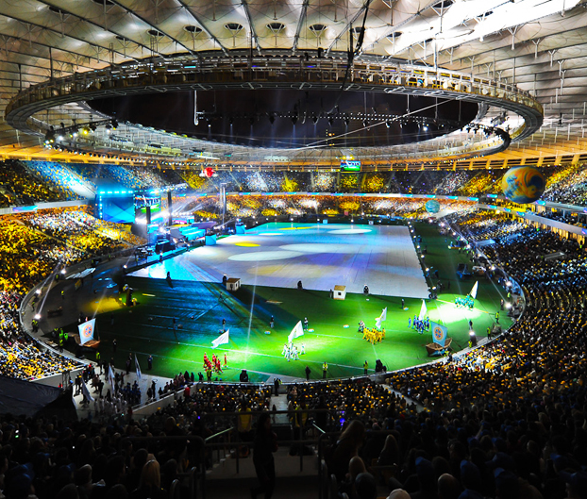
Sport is very popular in our country. There are many stadiums, sport grounds and swimming pools in every town.

Slide 13
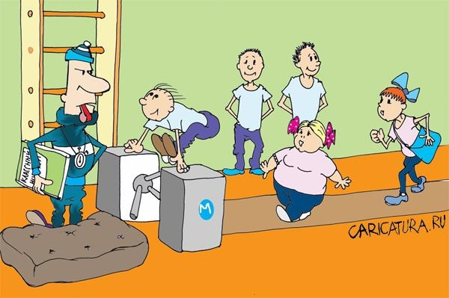
We have out P.T. lessons twice a week.

Slide 14
We jump, run and play team games.

Slide 15
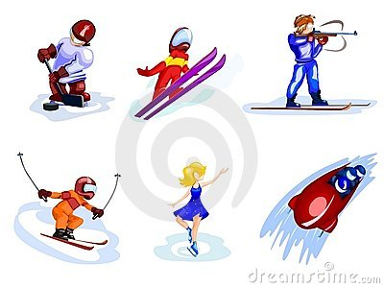
In winter we like skiing, skating, sledging and play hockey.

Slide 16
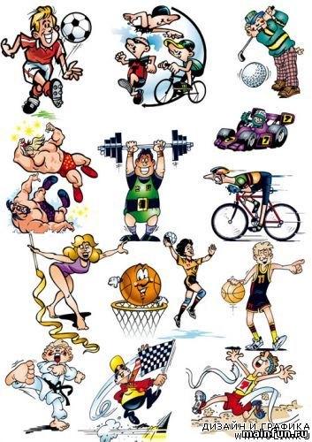
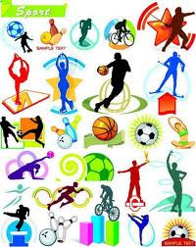
In summer we like swimming, boating, camping and cycling.

Slide 17
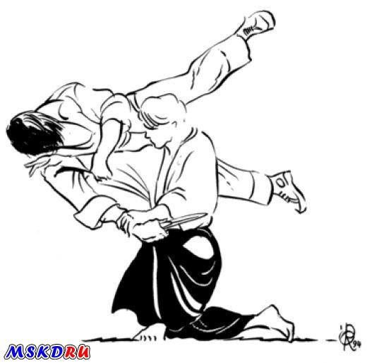
Boys are fond of wrestling and boxing.

Slide 18
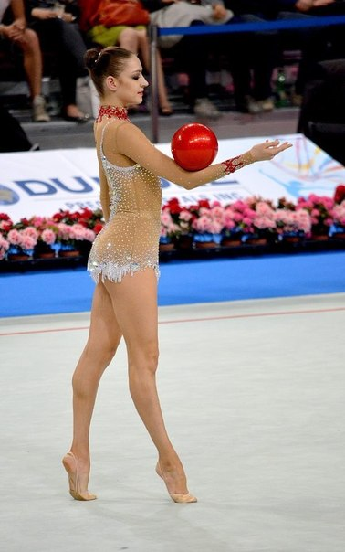
Girls are fond of gymnastics and aerobics.

Slide 19
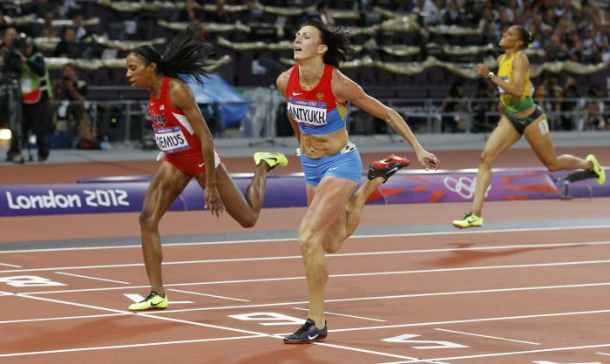
We like to take part in different sport competitions.

