Slide 1
Medicinal plants of Ukraine

Slide 2
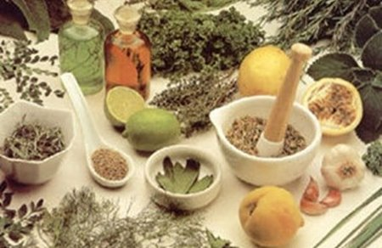
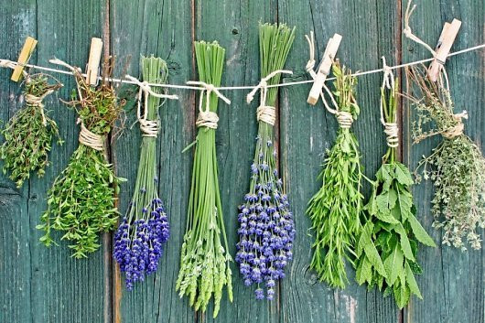
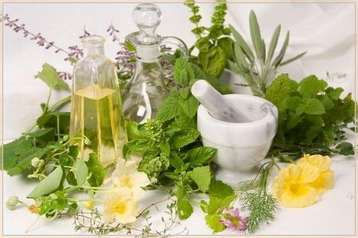
Phytotherapy
Using plants for scientific medicine or folk medicine is known as phytotherapy.
The roots, tubers, bulbs, leaves, flowers, seeds, and bark of medicinal plants are selectively used in making teas, infusions, tonics, juices, tinctures, powders, and poultices.

Slide 3
Medicinal plants
In Ukraine there are approximately 1,200 species of medicinal plants, including 68 wild and 52 cultivated officially recognized species.
Medicinal plants
Chemical components
Effect on the human organism
Symptom of a specific illness

Slide 4
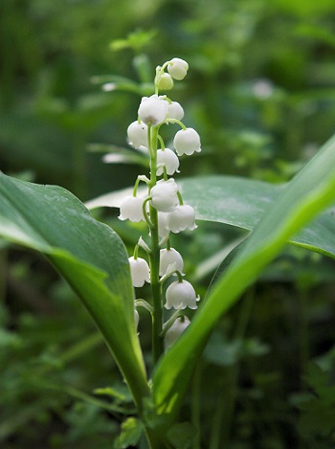
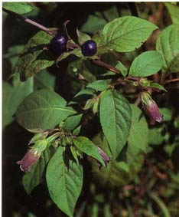
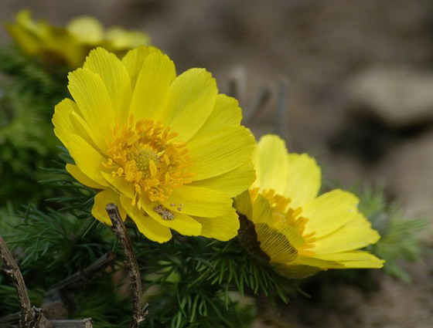
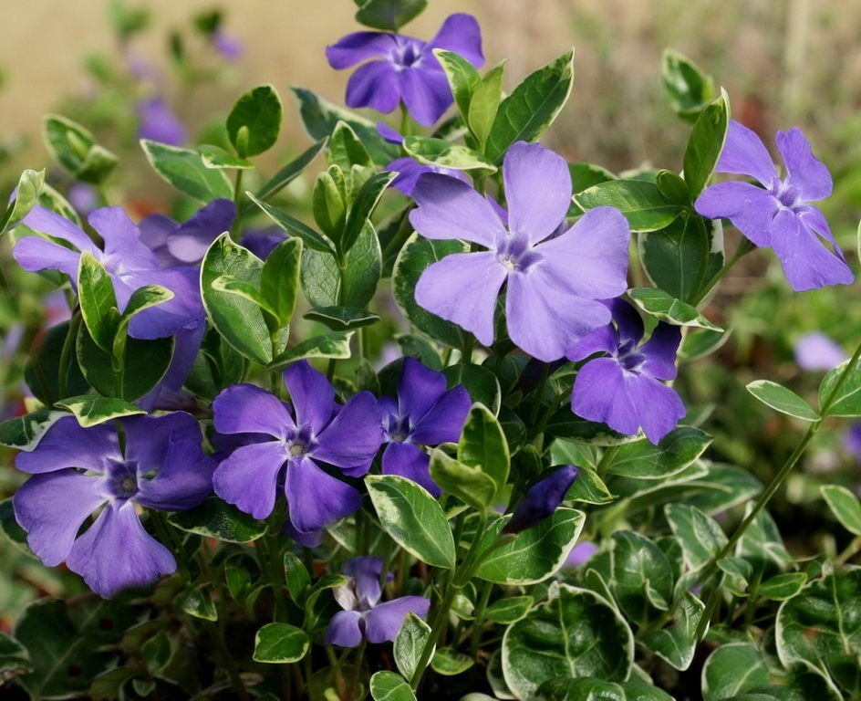
Cardiovascular disorders
Belladonna
(Ukrainian: beladonna likarska)
Campion
(Ukrainian: horytsvit vesnianyi)
Lily of the valley
(Ukrainian: konvaliia travneva)
Periwinkle
(Ukrainian: barvinok)

Slide 5
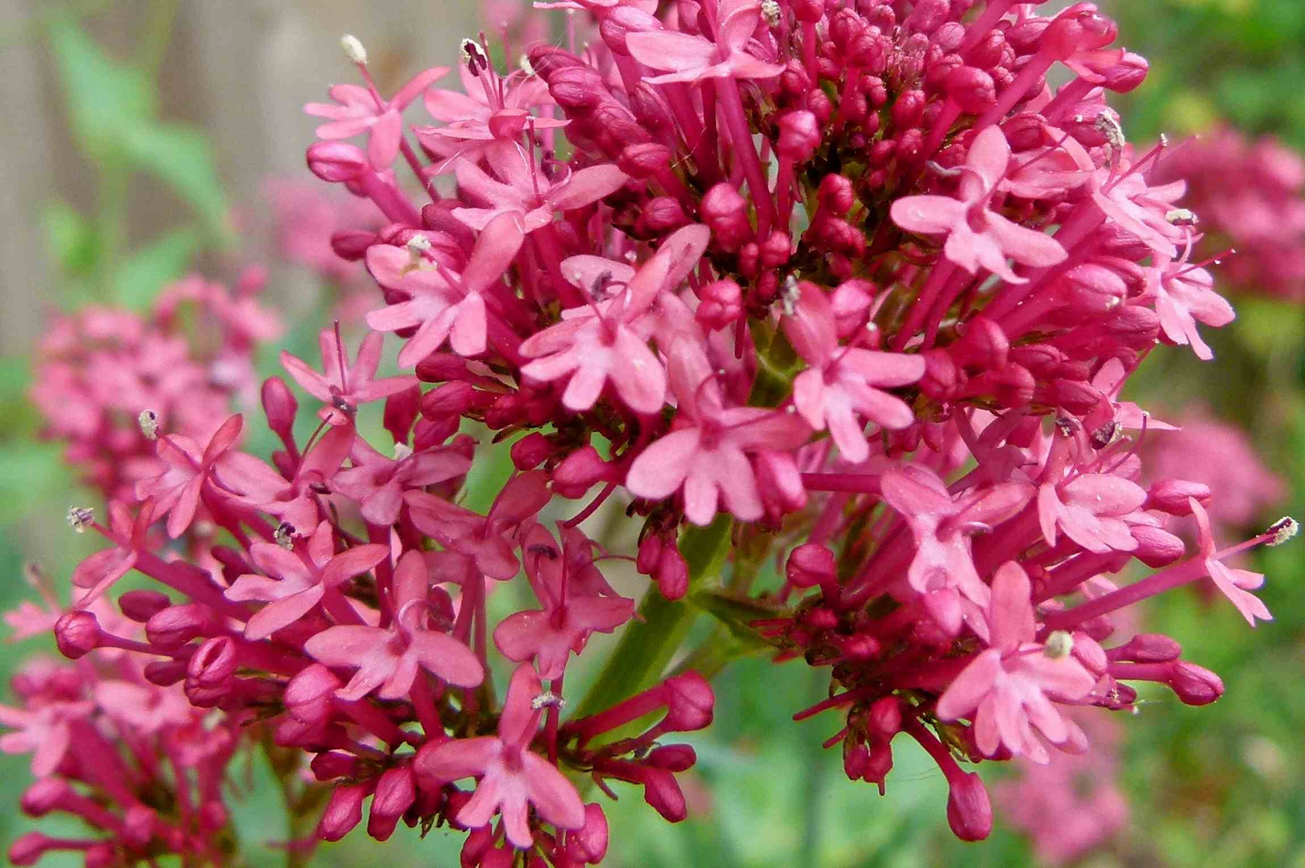
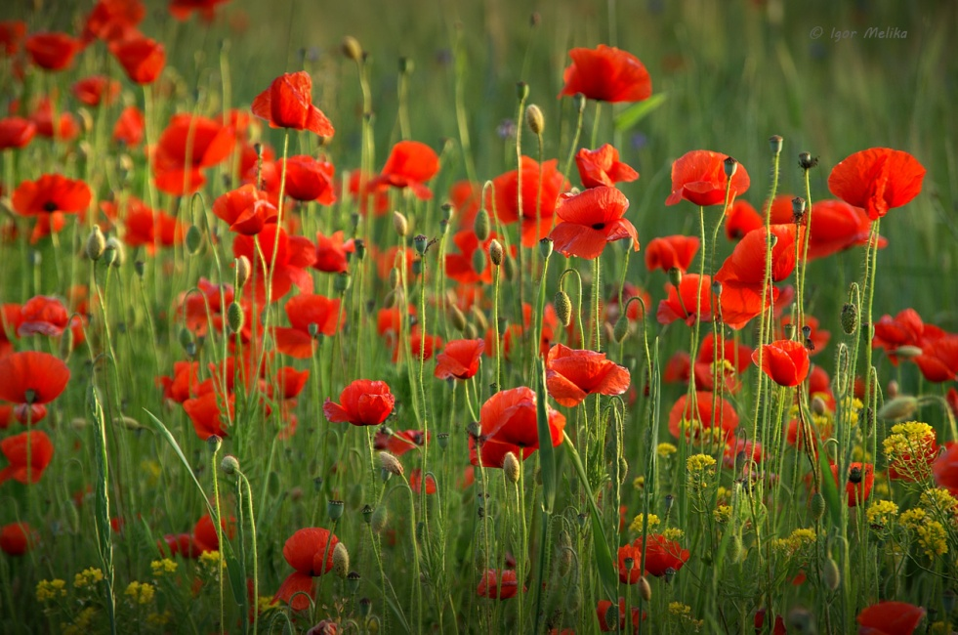
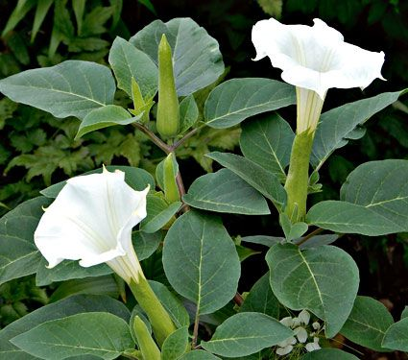
Painkillers and sedatives
Valerian
(Ukrainian: Valerian)
Wild poppy
(Ukrainian: mak dykyi),
Jimson weed
(Ukrainian: durman)

Slide 6
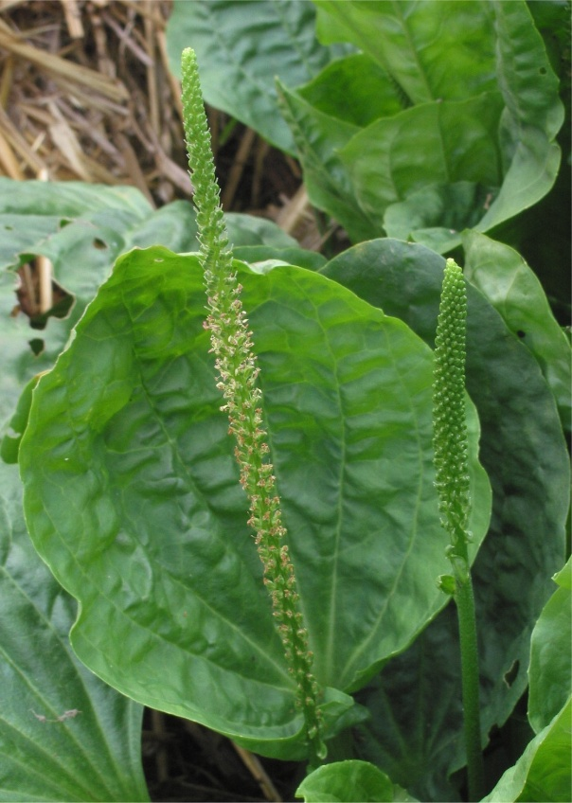
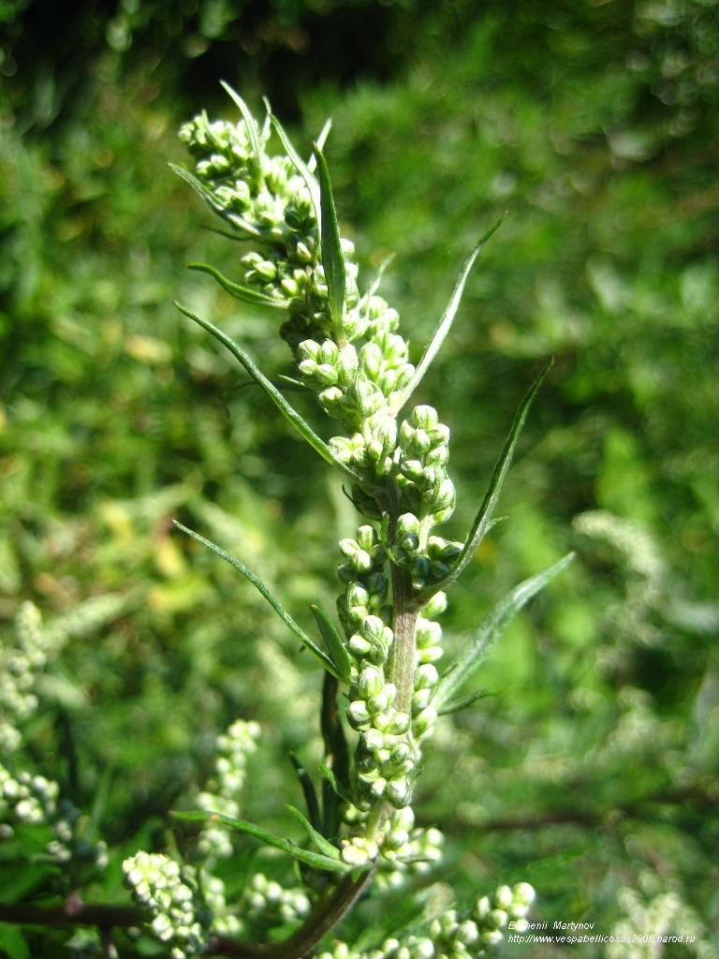
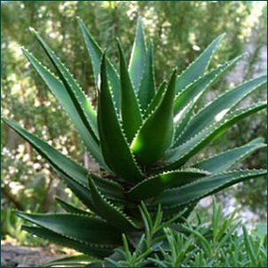
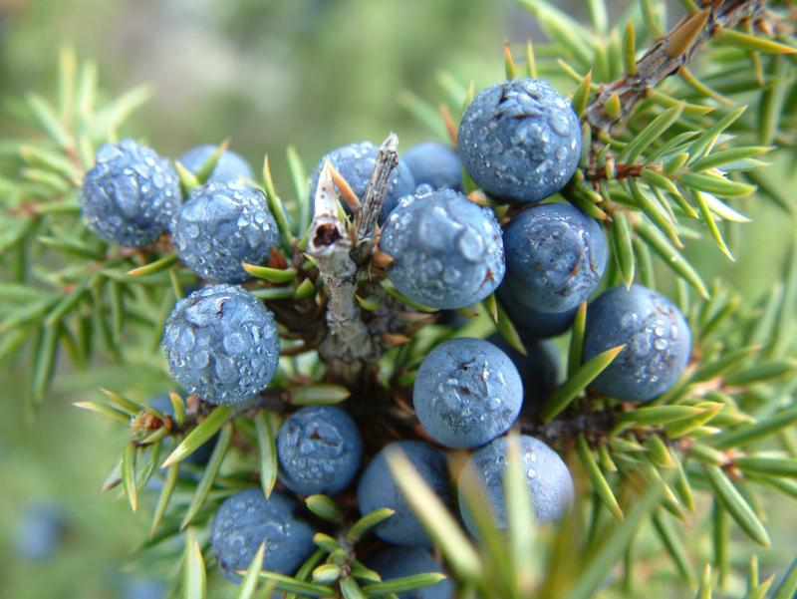
Skin disorders
Shrub aloe
(Ukrainian: aloe, stolitnyk)
Plantain
(Ukrainian: podorozhnyk)
Wormwood
(Ukrainian: polyn)
Juniper
(Ukrainian: yalivets)

Slide 7
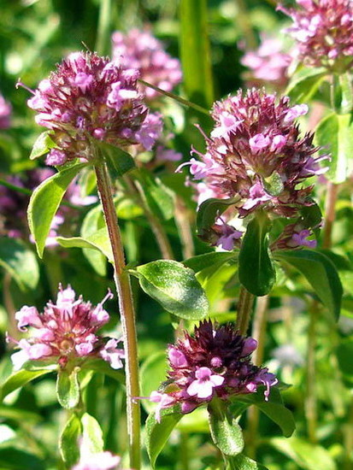
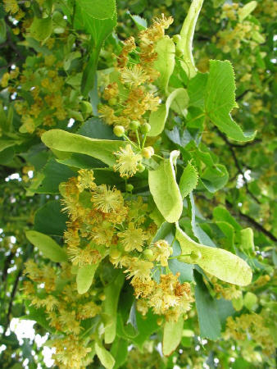
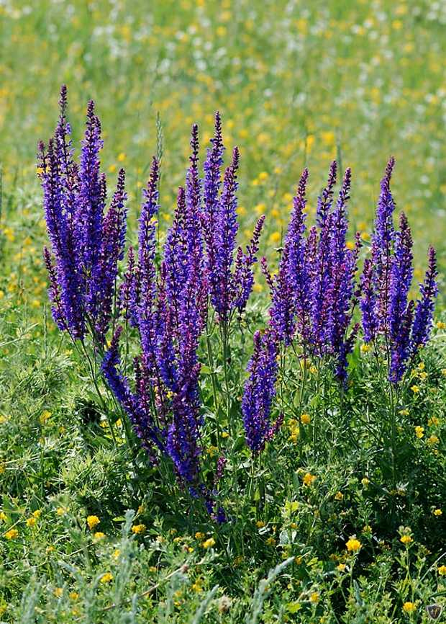
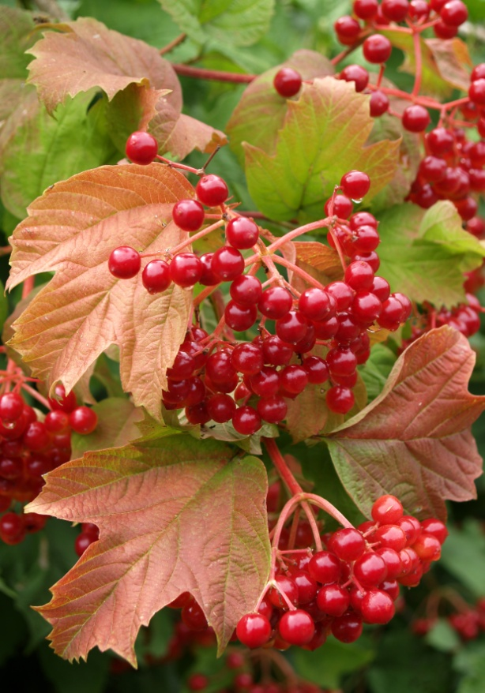
Bronchial and lung diseases
Thyme
(Ukrainian: chebrets)
Linden
(Ukrainian: lypa sertseva)
Sage
(Ukrainian: shavliia)
Viburnum
(Ukrainian: kalyna)

Slide 8
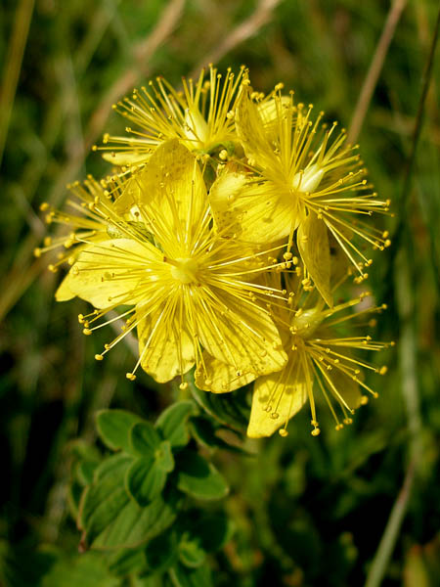
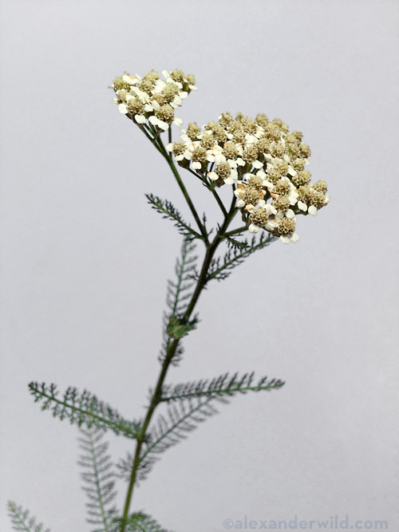
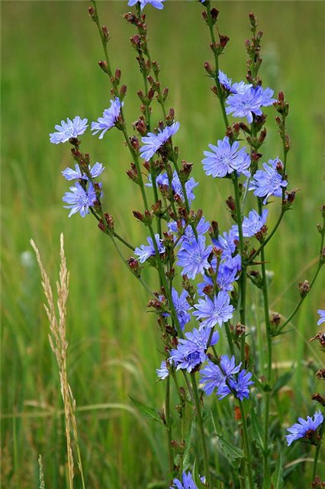
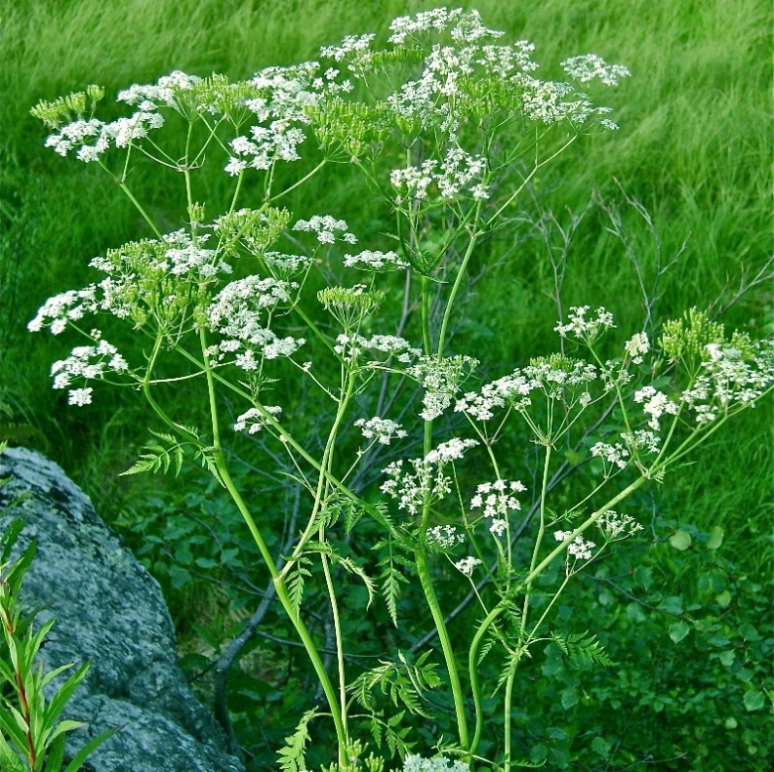
Hepatic and bilious disorders
Saint-John's-wort
(Ukrainian: zvirobii),
Yarrow
(Ukrainian: derevii)
Chicory
(Ukrainian: tsykorii)
Caraway
(Ukrainian: kmyn)

Slide 9
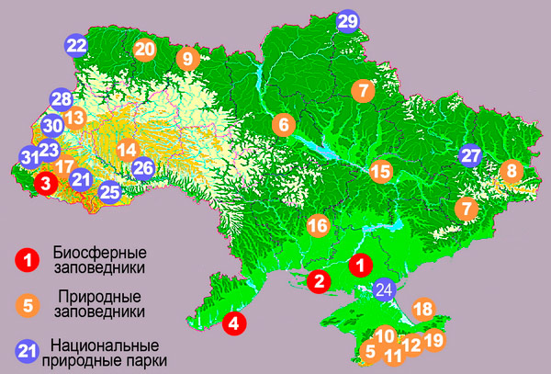
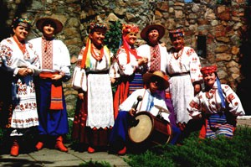
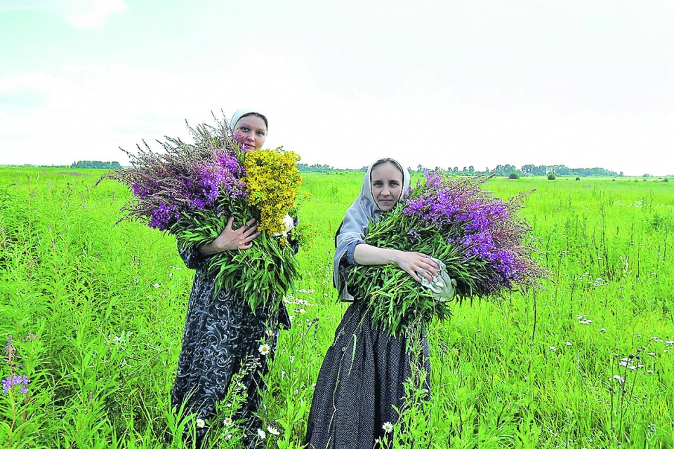
Medicinal plants are mentioned in Ukrainian folk songs and folktales. Folklore conferred special status and power on the men and women who knew how to use such plants.
Many wild-growing medicinal plants have been placed on the endangered species list. Efforts are being made by specific agrarian institutions and farm collectives to protect, cultivate, and preserve these valuable plants for posterity.

