Slide 1
Major cities
of Great Britain

Slide 2
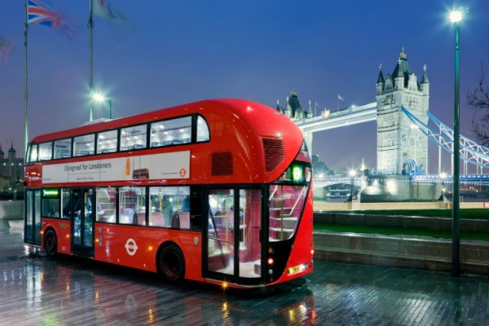
London

Slide 3
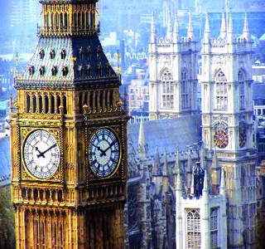
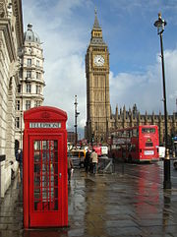
London - the capital of the United Kingdom of Great Britain and Northern Ireland and the largest city in the British Isles. Located on the River Thames, 64 km from its mouth. London - one of the largest ports in Britain and the main industrial center of the country. Area of ​​the city is 1560 square meters. Km. The population of almost 7 million people.

Slide 4
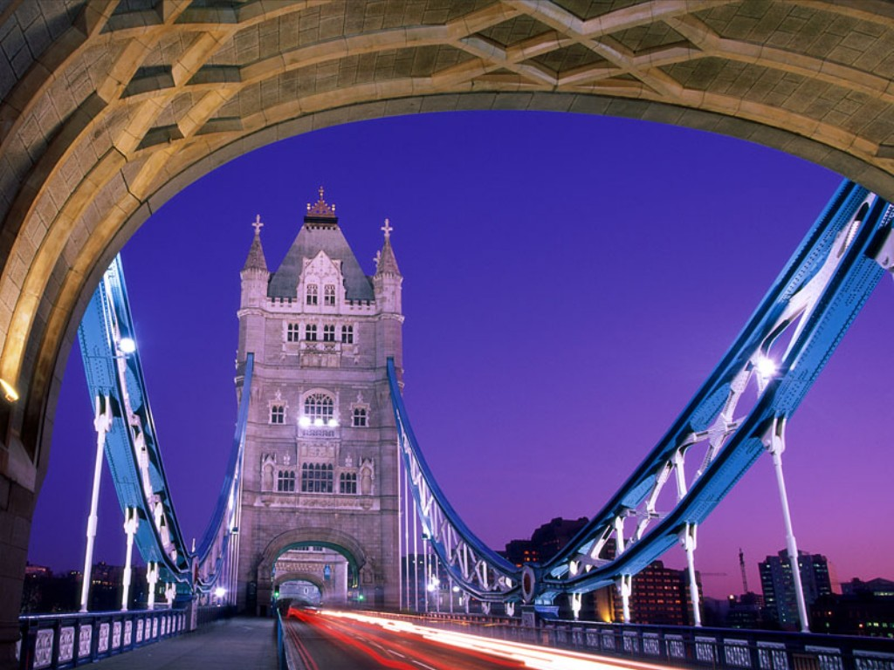
London has played a leading role in the political and cultural life of the UK. There are parliament, government and higher authorities of justice. As the cultural center of London gained popularity thanks to its museums and art galleries, theaters and musical life. The city is known as numerous ancient churches, which kept the national sanctuary.

Slide 5
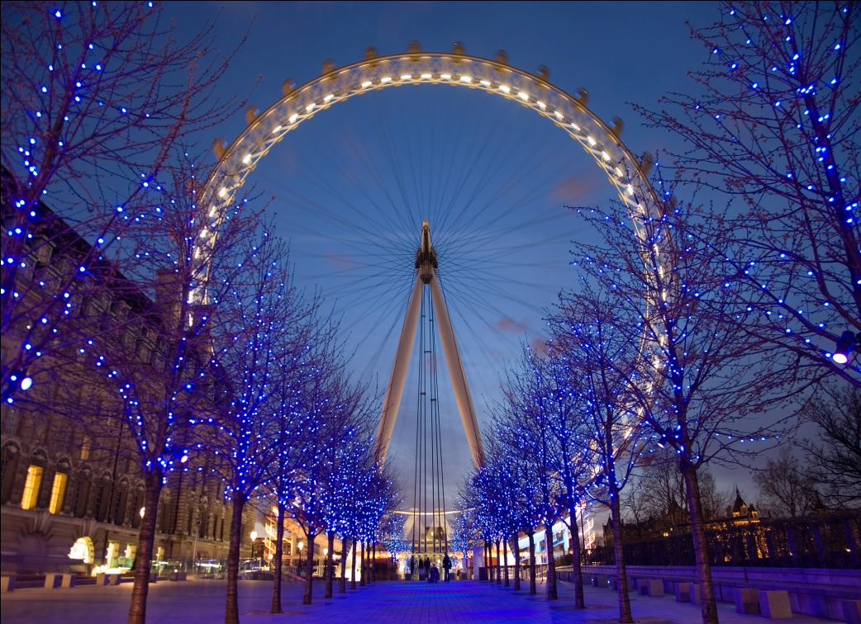
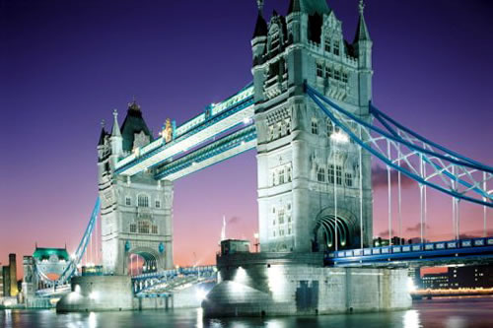
As the cultural center of London gained popularity thanks to its museums and art galleries, theaters and musical life. The city is known as numerous ancient churches, which kept the national sanctuary. London has always differed active participation in international affairs. Once the capital of the British empire, it still plays an important role as a center of the Commonwealth.

Slide 6
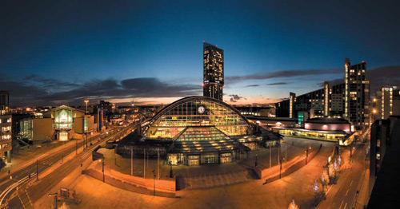
Manchester

Slide 7
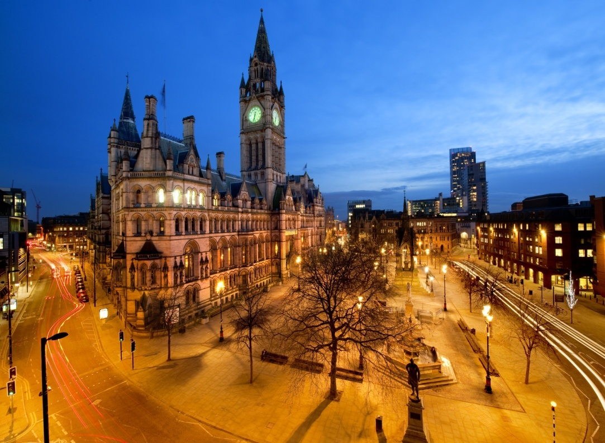
Manchester (Manchester) - a city in north-west England, 257 km from London. The first mention of it belongs to the X century, but only in the second half of the XVIII century, began the history of Manchester as a major industrial center. In 1880, Queen's University is founded.

Slide 8
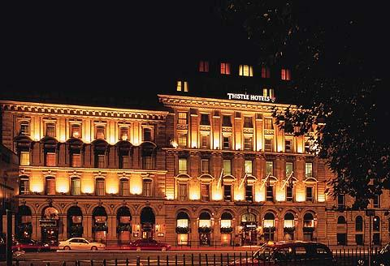
Manchester's museums and theaters are also noteworthy. For the first time there were "British repertory theater." It is interesting to visit the Palace Theatre and Opera House (Opera House). Art Gallery (Manchester Art Gallery) is a rich collection of English art of XVII-XIX centuries, and the Manchester Museum (Manchester Museum), the largest after London British Egyptology collection.

Slide 9
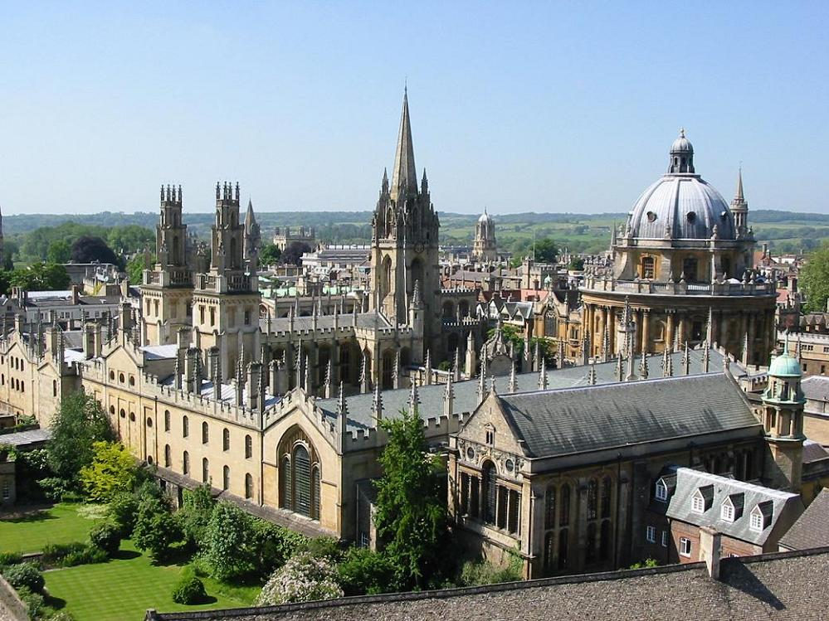
Oxford

Slide 10
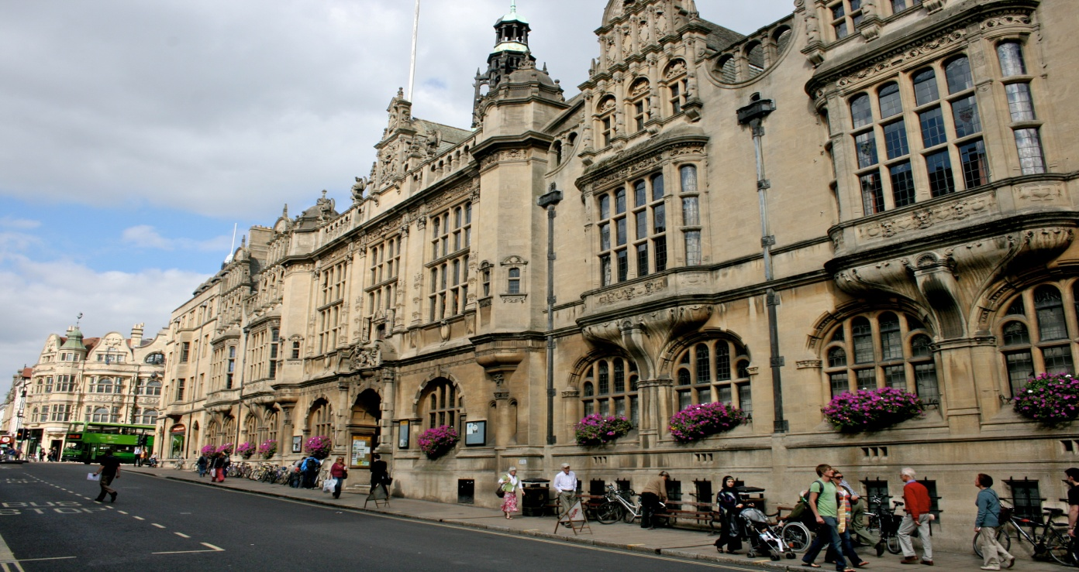
Oxford (Oxford) - the best place to discover the English tradition. This city is located in the county of Oxfordshire, 80 miles from London, is on the river Thames and Chervel and is known primarily as an educational center. Oxford - the oldest university town in England, the stronghold of English education and just a very beautiful place with a typical "British" architecture.

Slide 11
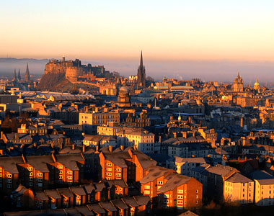
Edinburgh

Slide 12
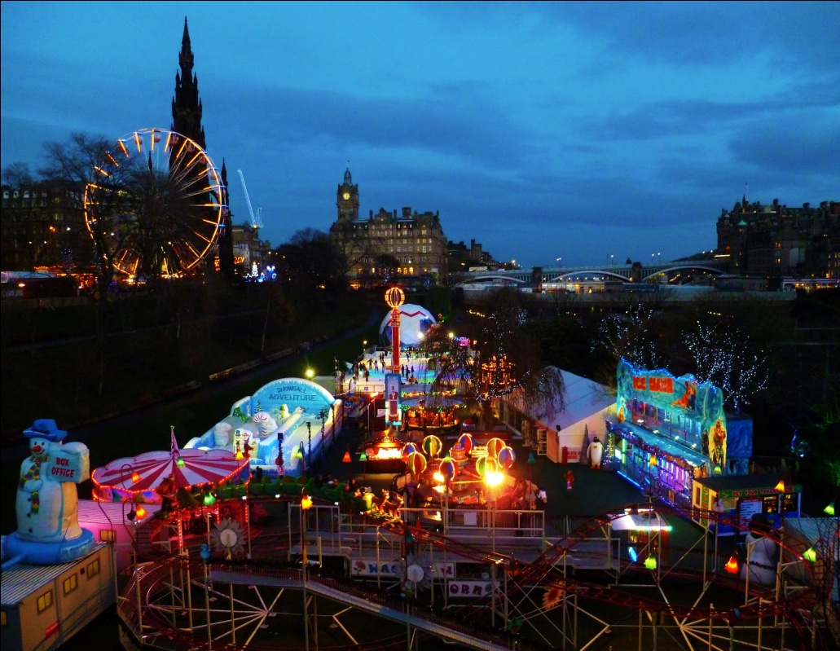
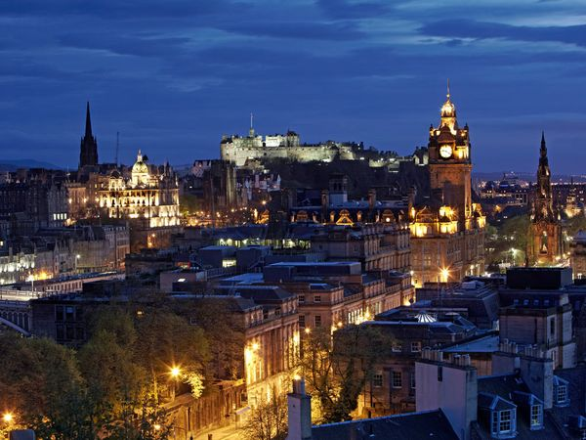
Edinburgh is in the heart of Scotland and is situated in a beautiful location in the Firth of Forth. This area was chosen for the construction of the castle for three thousand years ago. Today, close to the castle, whose height is 137 meters, located abbey and palace of Scottish kings. There is also a parade area: Every year in late summer, the Edinburgh Festival takes, which is attended by orchestras around the world and open the festivities performances of Scottish musicians.

Slide 13
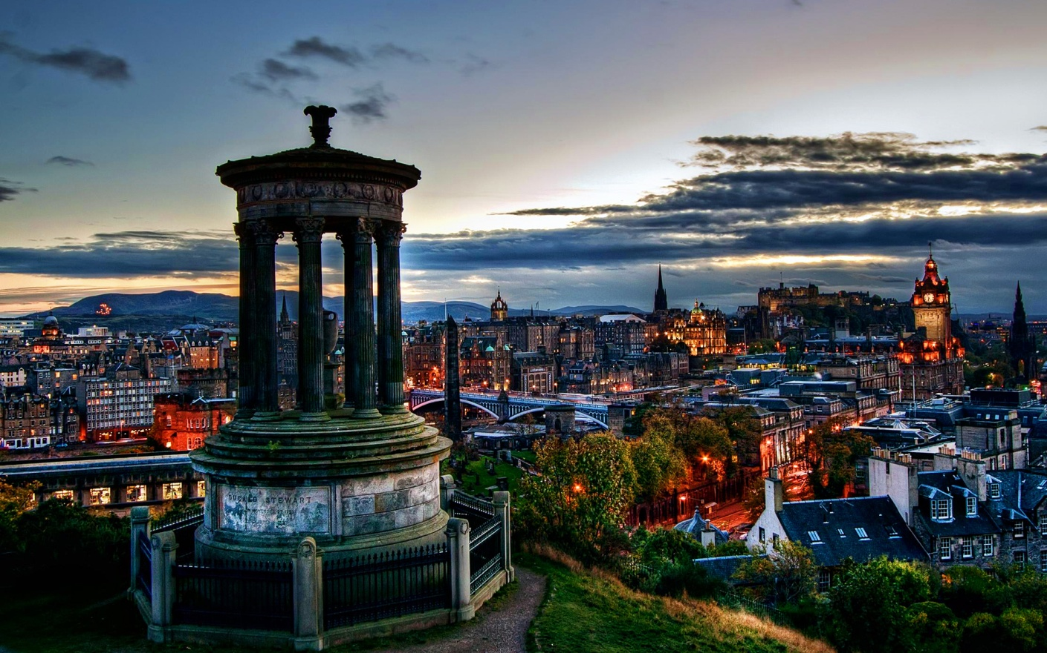
Edinburgh is famous legends, it is very interesting in terms of walking - it is no accident the locals always say that Edinburgh has three dimensions of streets - the length, width and depth. The city is filled with many stone staircases, and, at most, a very multi-stage. This is - an integral part of the architectural face of the mystery of Edinburgh.

Slide 14
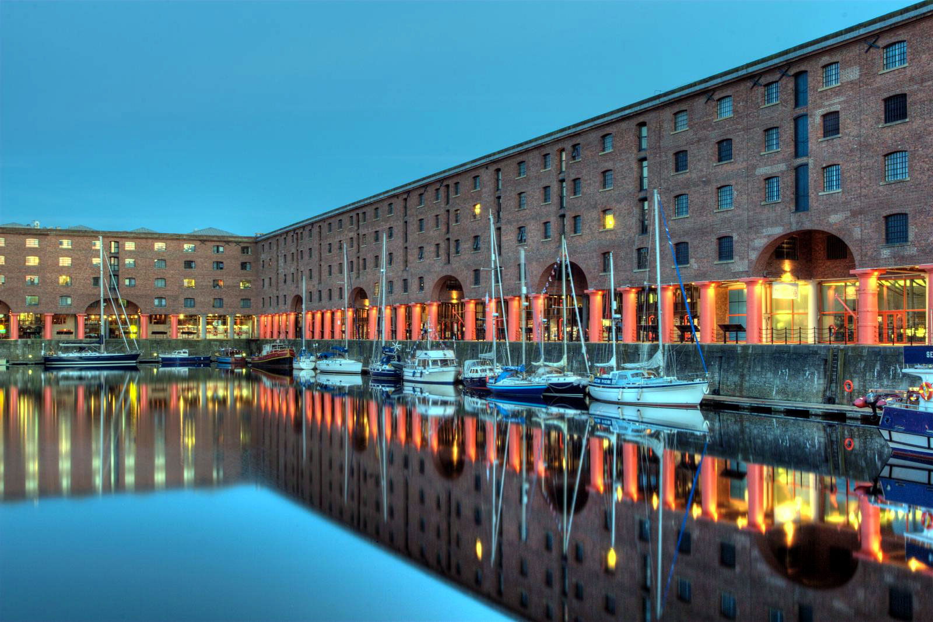
Liverpool

Slide 15
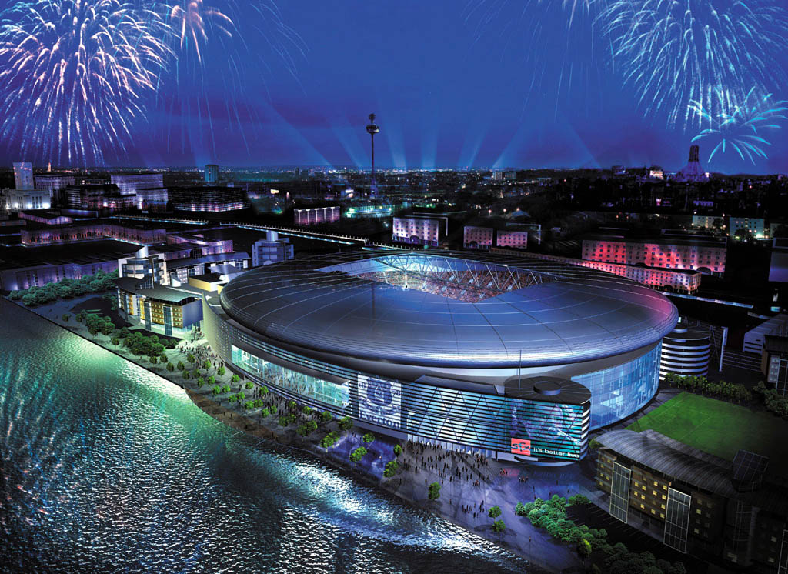
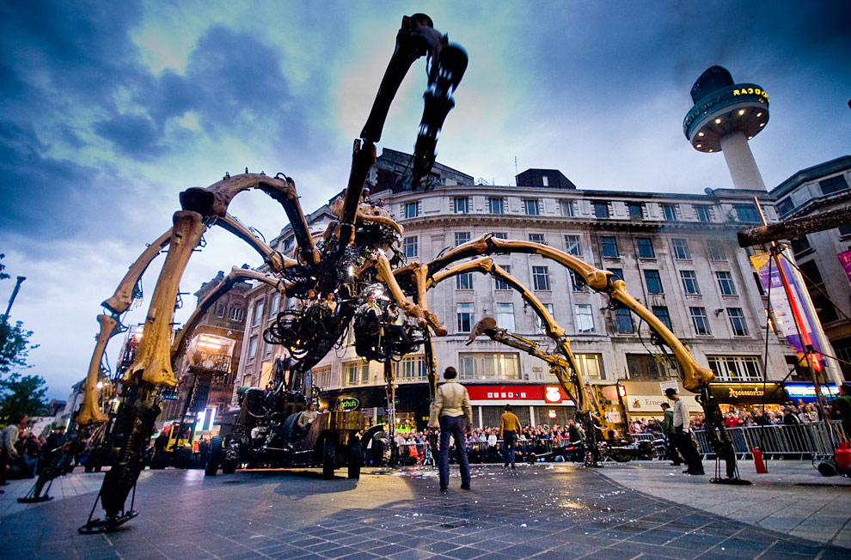
British port of Liverpool (Liverpool), which has a population in the mid XVI century, there were only 500 people in 2007, celebrated its 800th anniversary, and in 2008 was declared the cultural capital of Europe.

Slide 16
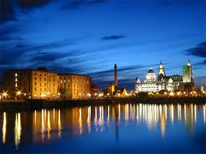
In Liverpool, there are more than 2500 historic buildings. Biggest attraction - Albert Dock, one of the world's first enclosed dock. Today, in this vast complex is full of restaurants and shops, the Merseyside Maritime Museum, International Museum of slavery, the history museum of "The Beatles" and the London branch of the Tate Modern.

Slide 17
Prepared
Pupil 9-B class
Sarny School second-degree Economics and Law Lyceum "Leader“
Zhuchenya Kateryna

