Slide 1

Ecological problems.
Let’s save our planet!

Slide 2

For centuries man lived in harmony with nature until industrialization brought human society into conflict with the natural environment. Today, the contradictions between man and nature have acquired a dramatic character.

Slide 3
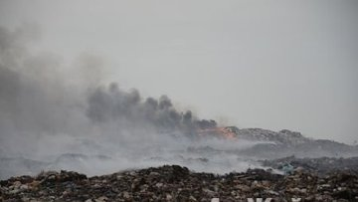
Ukraine is suffering a lot of environmental problems. There are many consequences of damaging environment.

Slide 4
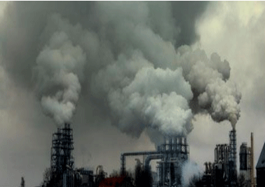
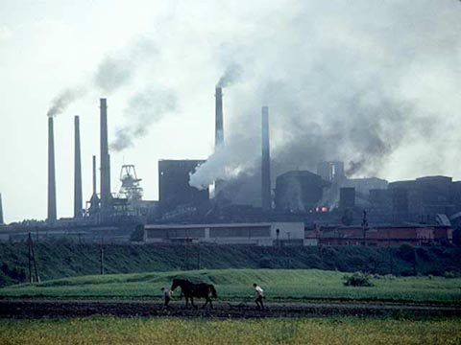
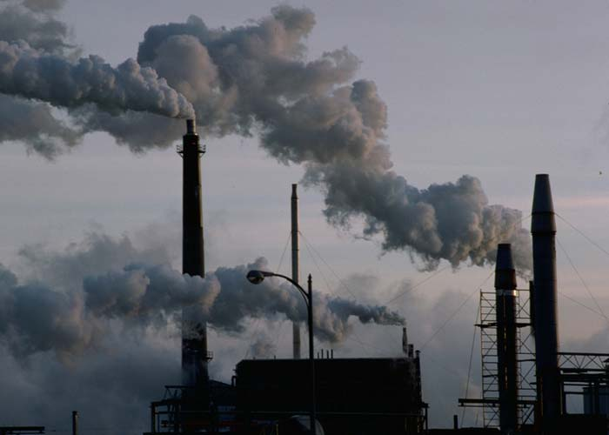
Large cities with thousands of smoky industrial enterprises appear all over the world today.
In Ukraine these cities are Kharkiv, Dnepropetrovsk, Donetsk, Lugansk

Slide 5
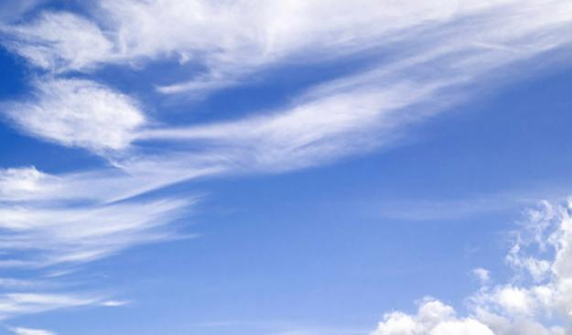
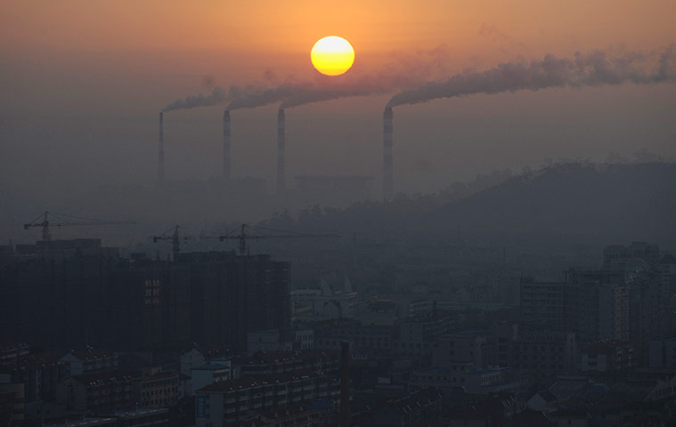
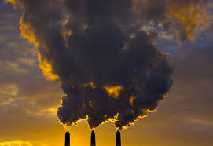
It is the air pollution. For example, pumping waste gases from a power station or metallurgical plants do not get rid of them. The waste gases cause acid rains.

Slide 6
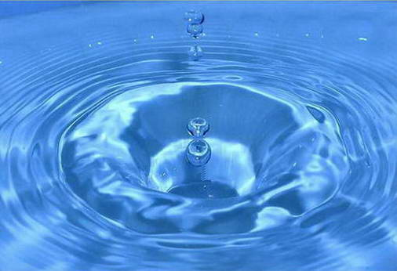
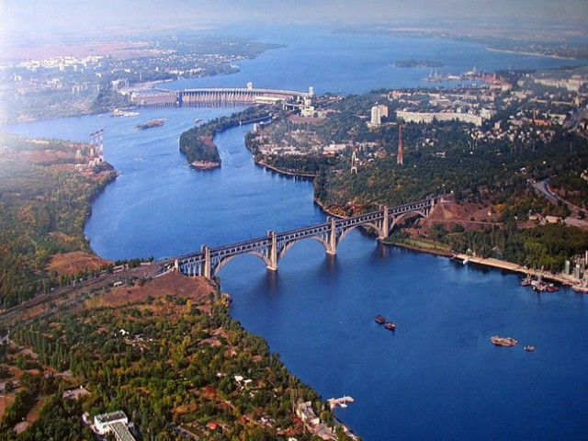
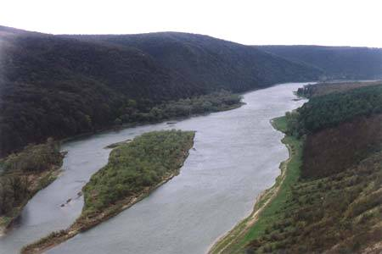
The Dnipro and others rivers are in danger. They are filled with poison: industrial waste, all kinds of chemical elements and pesticides. Ukraine releases polluted water, heavy metal, organic compounds, and oil-related pollutants into the Black Sea.

Slide 7

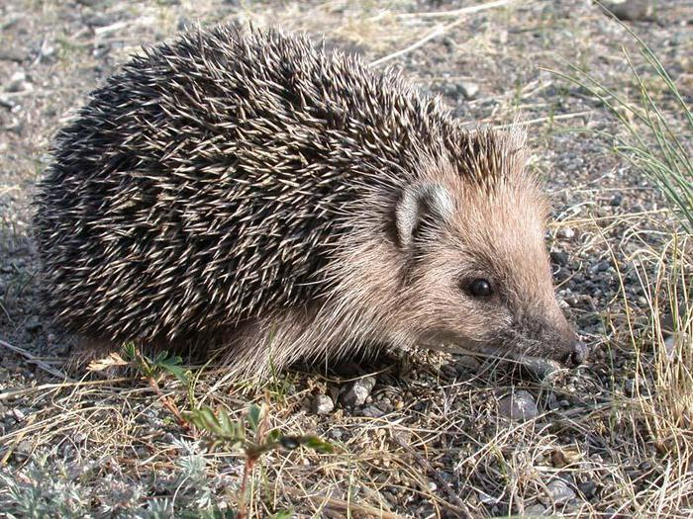
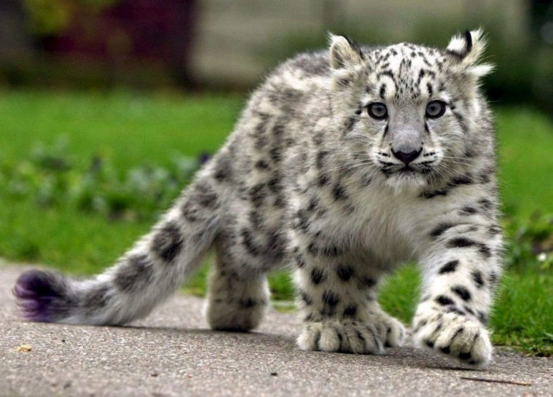

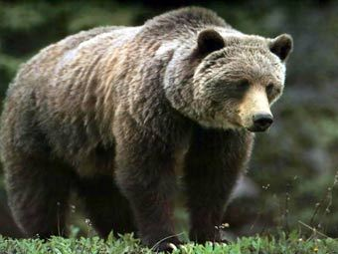
We kill animals for our needs and destroying our fauna! More and more animals are becoming extinct.

Slide 8

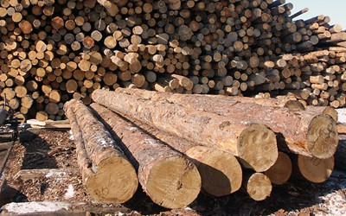
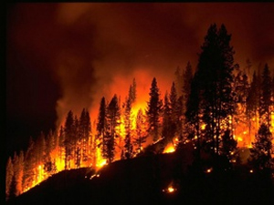
Forests are cut and burn in fire. Their disappearance upsets the oxygen balance. As a result some rare species of animals, birds, fish and plants disappear forever, a number of rivers and lakes dry up.

Slide 9

LET’S SAVE OUR PLANET!

Slide 10
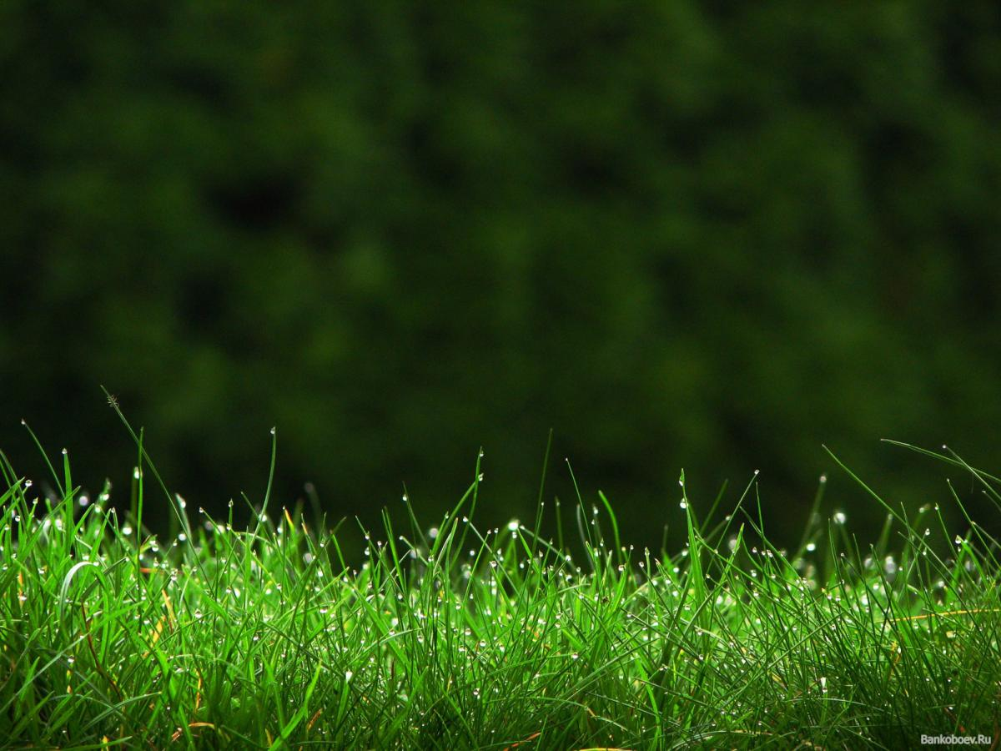
The world has a lot of environmental groups such as Green Peace. Together with them, we'll save the planet and our future!

Slide 11
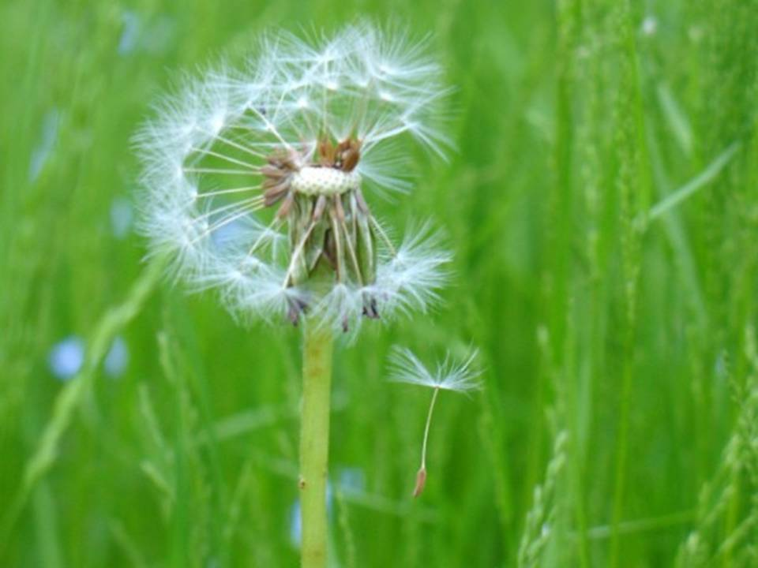

Thank you for attention!

