Slide 1
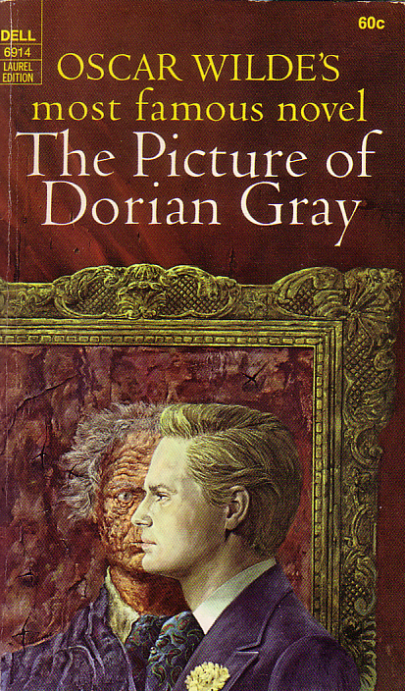
Oscar Wilde
“The Picture of Dorian Gray”
Julia Kolchag
Form 11-B

Slide 2
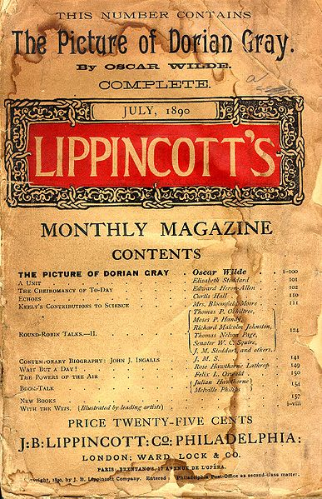
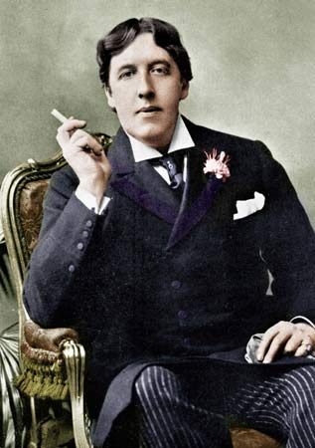
The Picture of Dorian Gray is the only published novel by Oscar Wilde, appearing as the lead story in Lippincott's Monthly Magazine on 20 June 1890, printed as the July 1890 issue of this magazine.

Slide 3
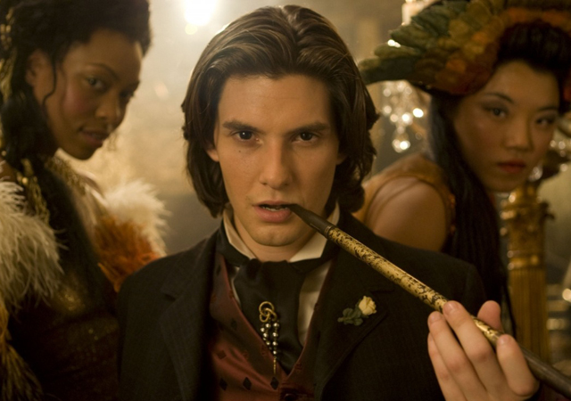
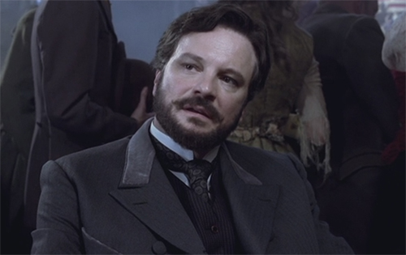
The novel tells of a young man named Dorian Gray, the subject of a painting by artist Basil Hallward.
Dorian Gray
Basil Hallward

Slide 4
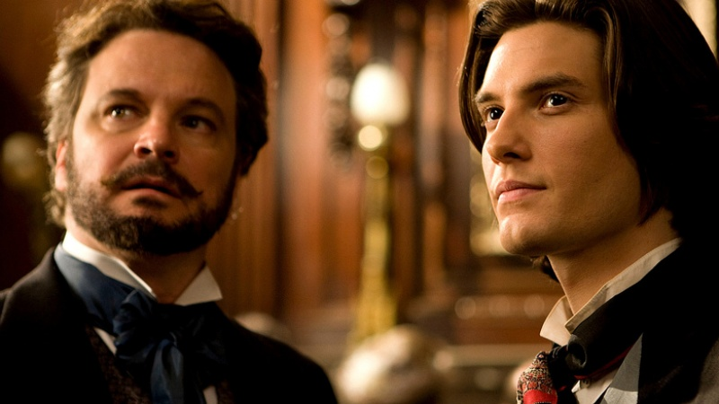
Basil is impressed by Dorian's beauty and becomes infatuated with him, believing his beauty is responsible for a new mode in his art.

Slide 5
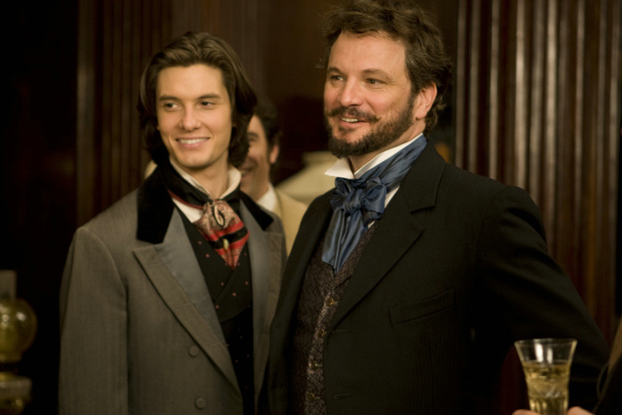
Dorian meets Lord Henry Wotton, a friend of Basil's, and becomes enthralled by Lord Henry's world view.

Slide 6
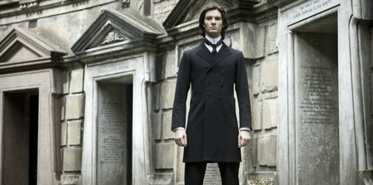
In a letter, Wilde said the main characters are reflections of himself: «Basil Hallward is what I think I am: Lord Henry what the world thinks me: Dorian what I would like to be–in other ages, perhaps».

Slide 7
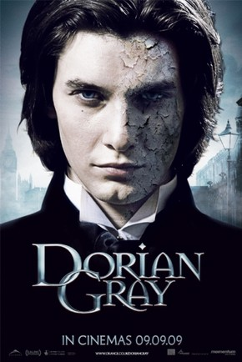

Things are changing.

Slide 8
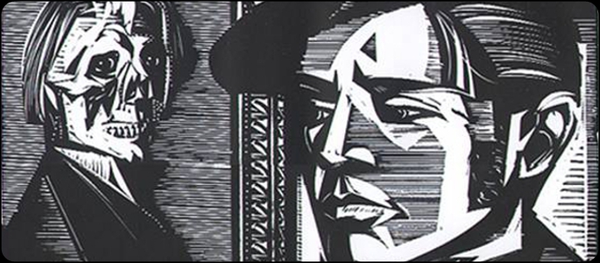
Contemporary portrait of Dorian Gray

Slide 9
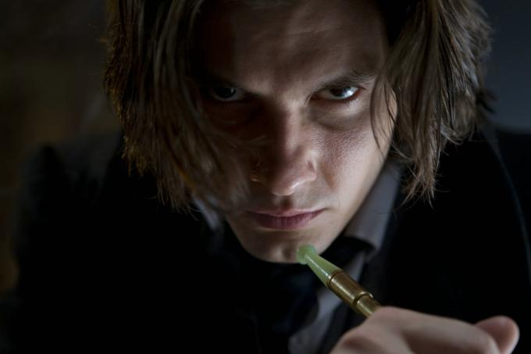

Slide 10


Slide 11
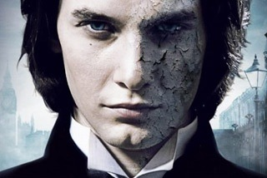

Slide 12
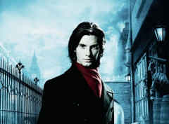
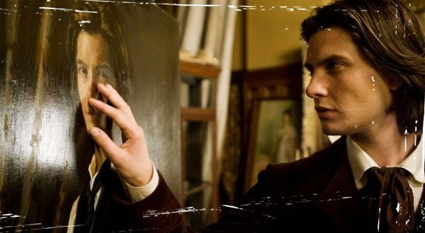

Slide 13
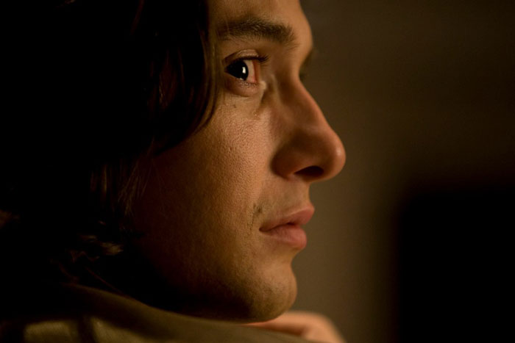

Slide 14
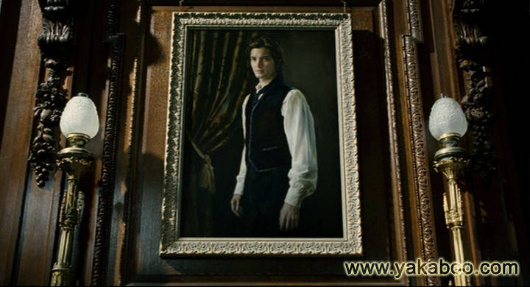
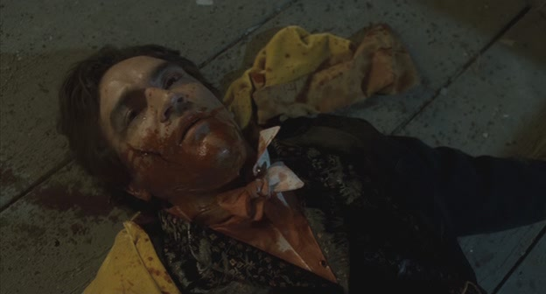
Dorian had shoot. Portrait became the same, but his hero became the older man of seventy years.

Slide 15


