Slide 1
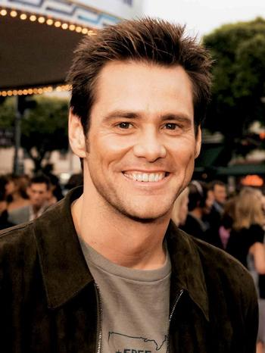
Jim Carrey
“Favorite Star”

Slide 2
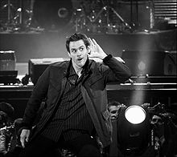
James "Jim" Carrey (born January 17, 1962) is a Canadian-American actor, comedian, singer and writer. He has received two Golden Globe Awards and has also been nominated on four occasions.

Slide 3
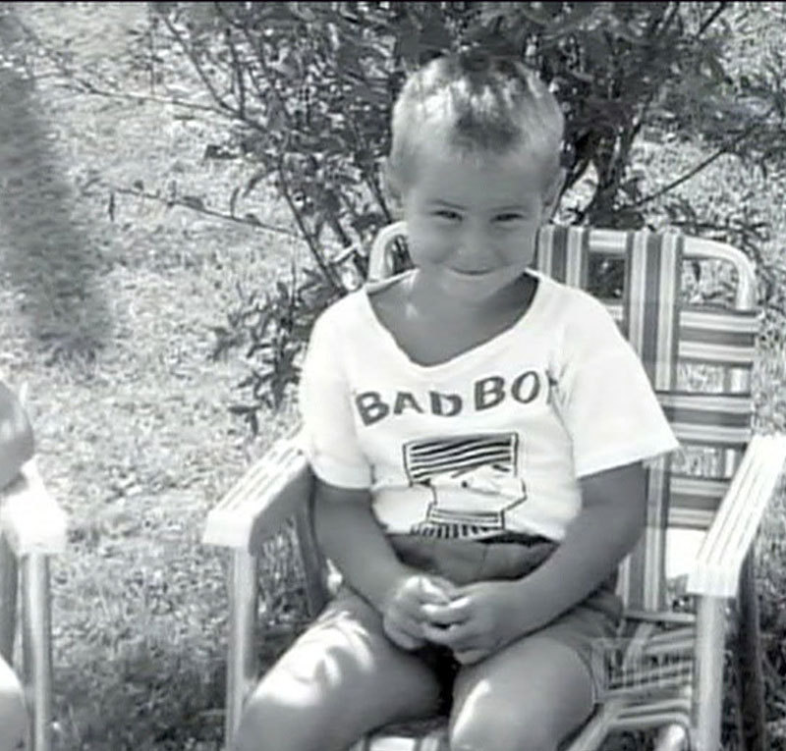
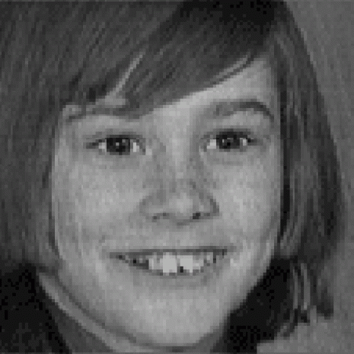
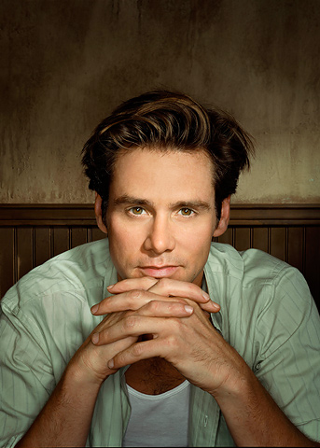
Early life
Carrey was born in Newmarket, Ontario, the son of Kathleen (née Oram), a homemaker, and Percy Carrey, a musician and accountant. He has three older siblings, John, Patricia, and Rita. He was raised Roman Catholic.
His mother was of French, Irish, and Scottish descent and his father was of French Canadian ancestry (the family's original surname was Carré).
After his family moved to Scarborough, Ontario, when Carrey was 14 years old, he attended Blessed Trinity Catholic School, in North York, for two years, enrolled at Agincourt Collegiate Institute for another year, then briefly attended Northview Heights Secondary School for the remainder of his high school career (all together, he spent three years in Grade 10).
Carrey lived in Burlington, Ontario, for eight years and attended Aldershot High School, where he once opened for 1980s new wave band Spoons.

Slide 4

Family and Relationships
Carrey has been married twice, first to former actress and Comedy Store waitress Melissa Womer on March 28, 1987; the two were divorced in late 1995. Their only child, a daughter named Jane Erin Carrey, was born on September 6, 1987, in Los Angeles County.

Slide 5
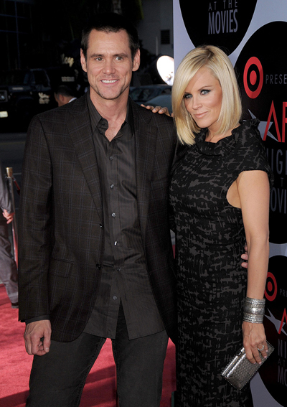
In December 2005, Carrey began dating actress and model Jenny McCarthy. They made their relationship public in June 2006. She announced on April 2, 2008, that the two were then living together, but had no plans to marry; as they do not need a "piece of paper." In April 2010, Carrey and McCarthy ended their near five-year relationship.

Slide 6
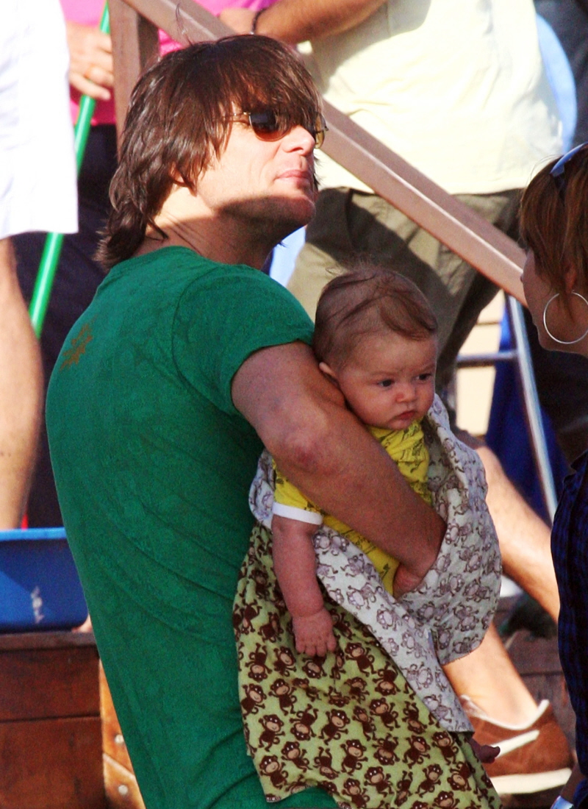
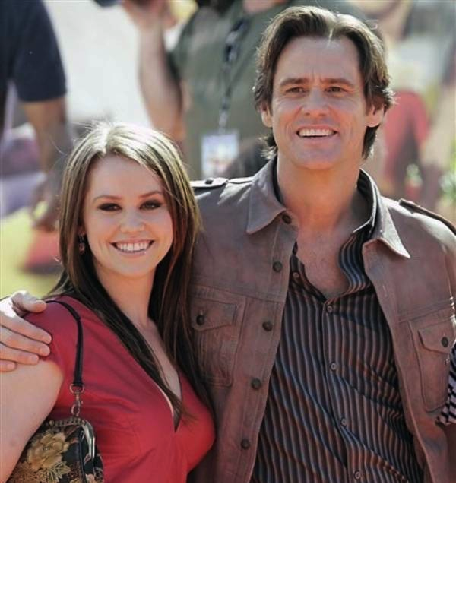
In Los Angeles on February 27, 2010, Carrey announced in his Twitter account that he had become a grandfather when his daughter Jane gave birth to her first child with musician husband Alex Santana. He announced that his grandson's name was Jackson Riley Santana.

Slide 7
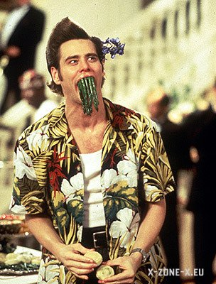
Having had little success in television movies and several low-budget films, Carrey was cast as the title character in Ace Ventura: Pet Detective which premiered in February, 1994, making more than $72 million domestically.

Slide 8
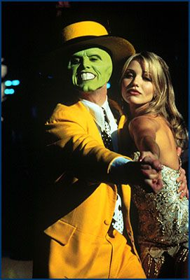
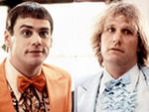
High profile roles followed when he was cast as Stanley Ipkiss in The Mask (1994) for which he gained a Golden Globe Awardnomination for Best Actor in a Musical or Comedy, and as Lloyd Christmas in the comedy film Dumb and Dumber (1994).

Slide 9

Liar Liar (1997), in which he was nominated for another Golden Globe Award

Slide 10

How the Grinch Stole Christmas (2000) where he played the title character

Slide 11

Bruce Almighty (2003) where he portrayed the role of unlucky TV reporter Bruce Nolan

Slide 12

Fun with Dick and Jane (2005)

Slide 13

Yes Man (2008)

Slide 14
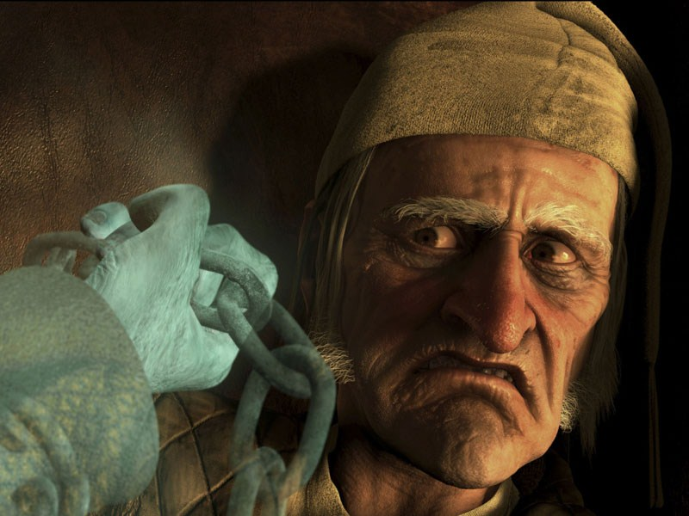
A Christmas Carol (2009)

Slide 15

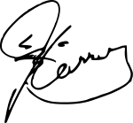
As of December 2010, Carrey's films grossed over $2.3 billion in total

Slide 16

The End!

