Slide 1
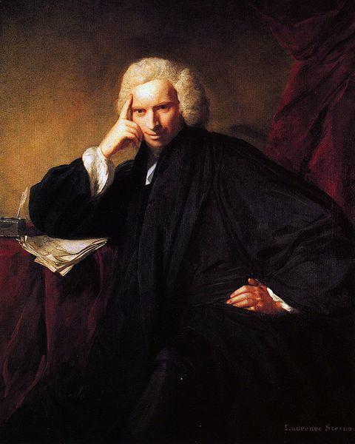
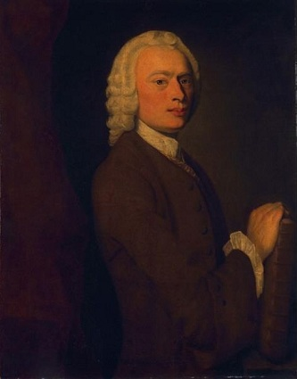
English Sentimentalism
Laurence Sterne (1713-1768)
The crown and completion of the English sentimentalism
Novel A Sentimental Journey Through France and Italy

Slide 2
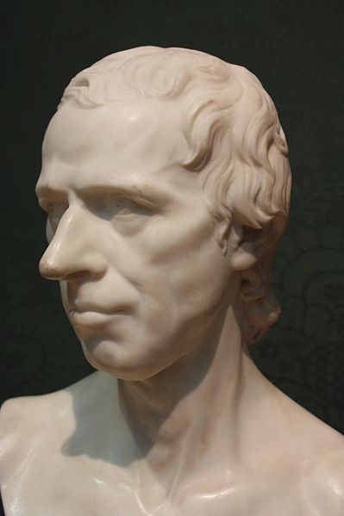
Biography
Sterne was born in Clonmel, Ireland, on November 24, 1713, the son of an English army officer. After spending his early years moving about with his father's regiment, he attended school in Yorkshir. Sterne received a bachelor of arts degree from Jesus College, Cambridge. His marriage to Elizabeth Lumley proved unhappy.
In 1743 Sterne published his first verses, The Unknown World, Verses Occasioned by Hearing a Pass-Bell. But his verses and the second work The History of a Good Warm Watch had prepared the English reading audience for the first two volumes of Tristram Shandy.

Slide 3
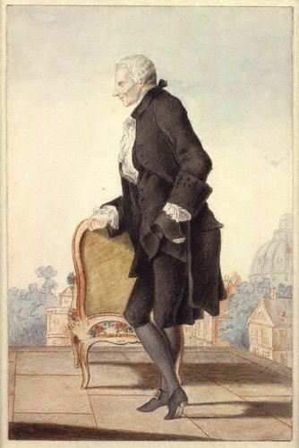
Biography
The enormous popularity of Sterne's unusual novel quickly made him a celebrity. Sterne continues writing the book until the end of his life. During the last winter before his death, Sterne readied his A Sentimental Journey for the press.
Sterne's irascibility and bawdy humor were well known to his congregations and to the English public. His local reputation around York was based on his eccentric dress and habits, his mordant wit, and his fund of indecorous anecdotes. He died in London on March 18, 1768.

Slide 4
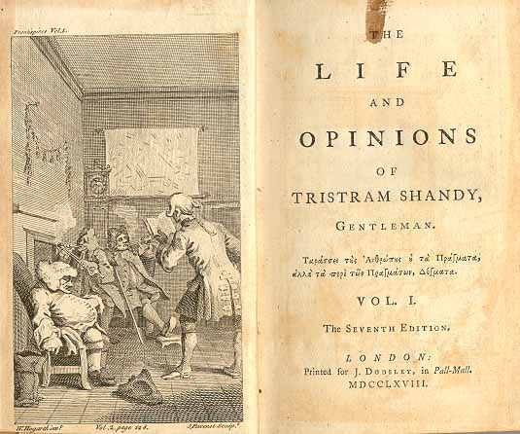
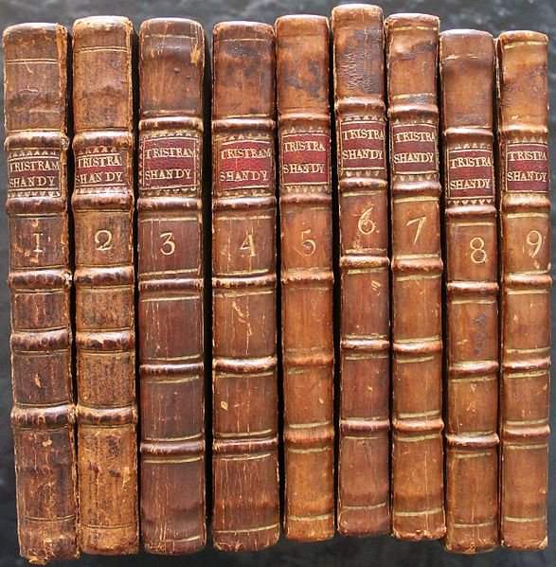
Laurence Sterne’s works
A Political Romance (1759)
The Life and Opinions of Tristram Shandy, Gentleman (1767)
A Sentimental Journey Through France and Italy (1768)
Journal to Eliza (1767)

Slide 5
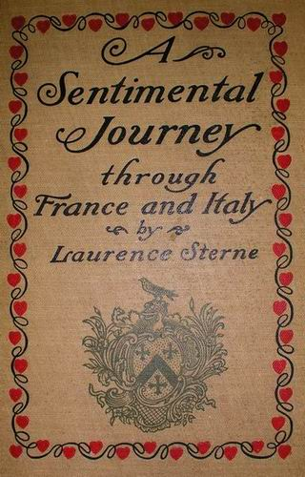
A sentimental journey though france and italy
A Sentimental Journey, published in 1768, consists in a description of his travel through France, expecially in Paris, and Italy, where he visited Milan, Rome, Florence and Naples. He shows the impossibility to describe the enormous chaotic things that form people's life. One of the topics of this novel is the isolation of the man, the difficulty to communicate with other people. The narrator is the Reverend Mr. Yorick, who is slyly represented to guileless readers as Sterne's barely disguised alter ego. The book recounts his various adventures, usually of the amorous type, in a series of self-contained episodes. The book is less eccentric and more elegant in style than Tristram Shandy and was better received by contemporary critics.

Slide 6
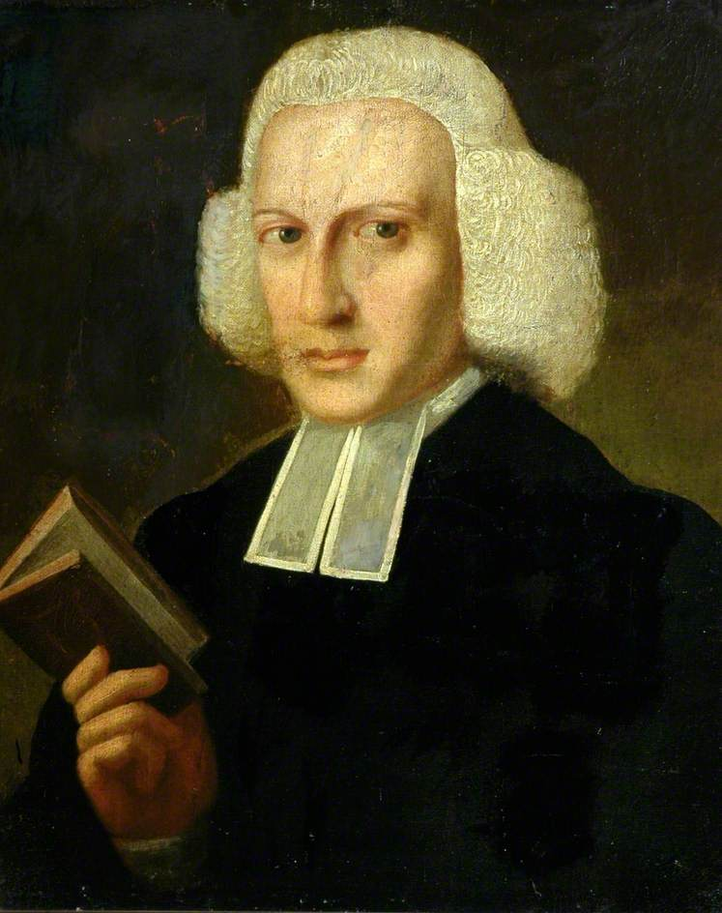
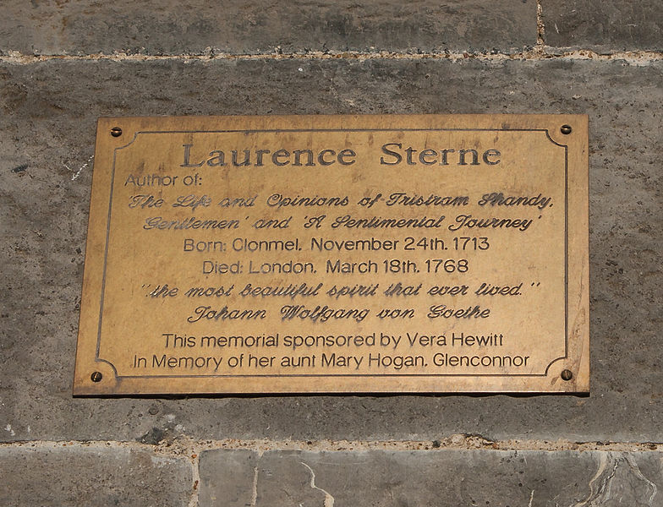
I am persuaded that every time a man smiles - but much more so when he laughs - it adds something to this fragment of life.
Laurence Sterne

