Slide 1
Architecture of the United Kingdom
Buildings of the Middle Ages

Slide 2
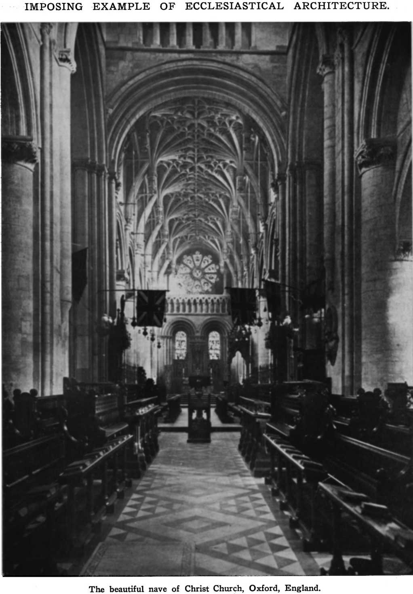
The architecture of Great Britain has a long history, and over that history architecture has ranged from the simplest hovel to the most elaborate palace.

Slide 3
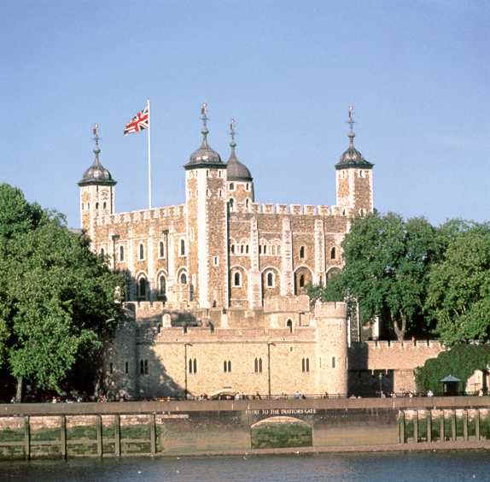
White Tower, at the heart of the Tower of London, was begun by Bishop Gundulf in 1078 on the orders of William the Conqueror. The structure was completed in 1097, providing a colonial stronghold and a powerful symbol of Norman domination.

Slide 4
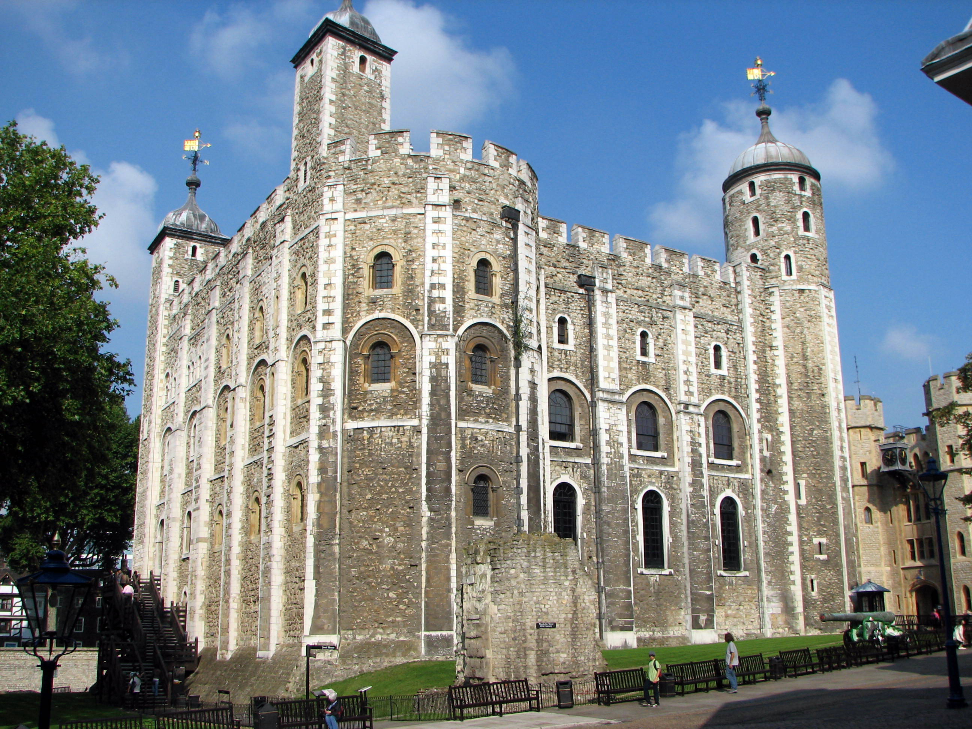

Slide 5
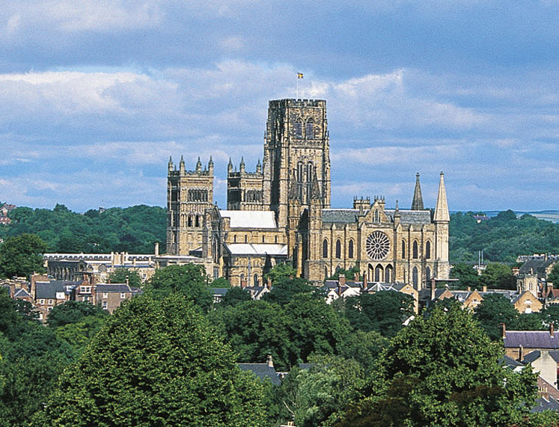
Durham Cathedral was begun by Bishop William de St Carilef in 1093 and completed about 1175. The choir was extended in the Gothic style between 1242 and 1280. Muscular pillars and round-headed arches make Durham one of the most imposing Norman buildings in England.

Slide 6
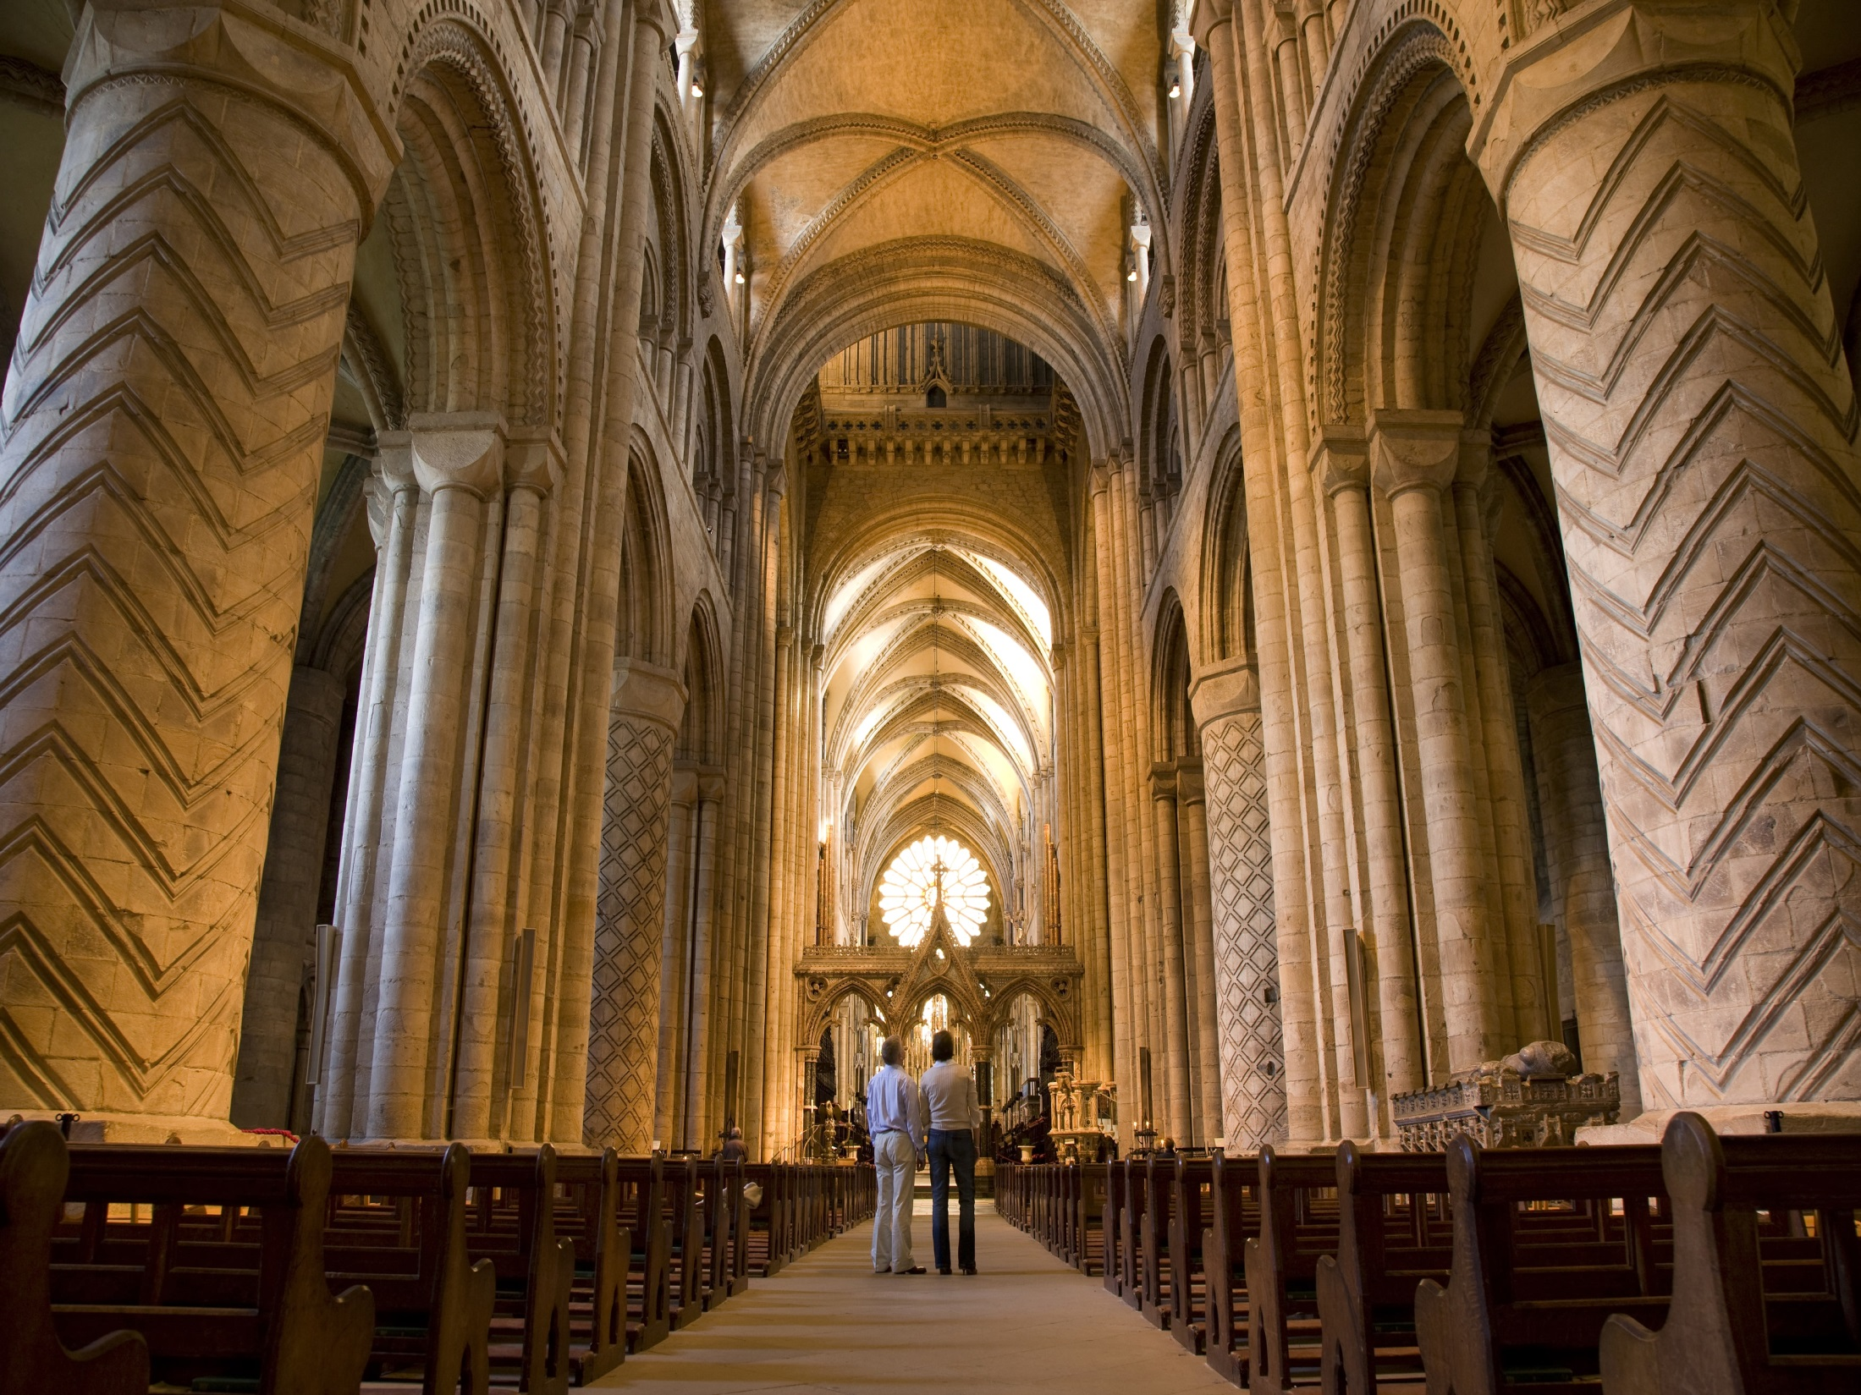

Slide 7
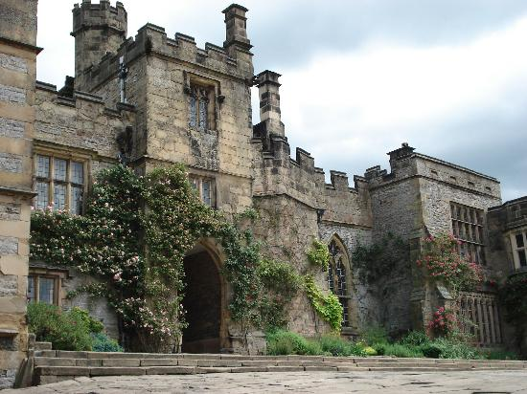
Haddon Hall, Derbyshire, was probably begun in the 12th century, but was remodelled and adapted at various times right through to the 16th century. It was then carefully restored in the early 20th century. Haddon shows the quality which characterises the great medieval house, in which function dictates form.

Slide 8
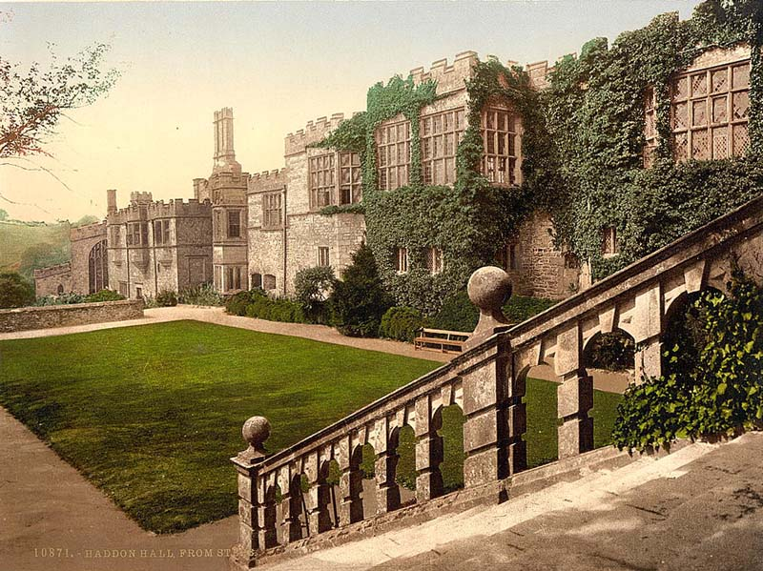

Slide 9
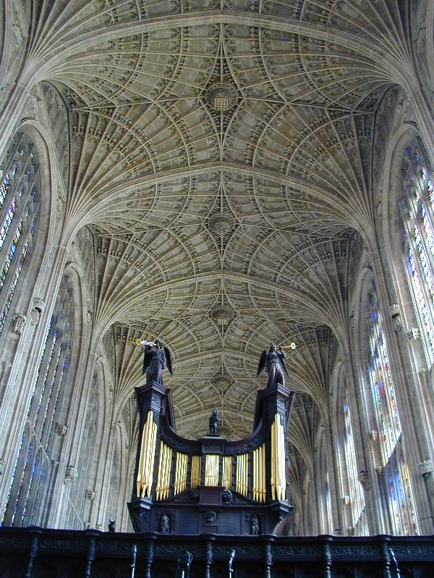
King's College Chapel, Cambridge, spans the period of transition between the Middle Ages and the Tudors. Its foundation stone was laid in 1446 by Henry VI and the structure, with its lacy perpendicular fan-vaulting, was completed by 1515 during the reign of Henry VIII. The windows were installed in 1546-7.

Slide 10
