Slide 1
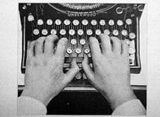
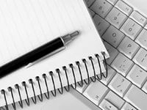
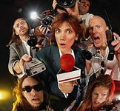
Profession : journalist
Raisa Barabash

Slide 2
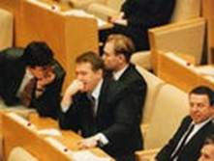
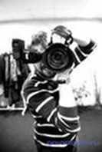
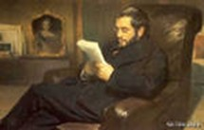
"On the bright future care policians, of a bright past - historians, this bright - journalists" Hot Petan

Slide 3
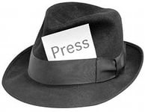
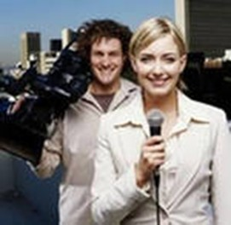
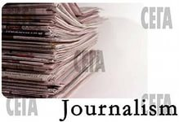
Journalist – is person who contributing content to the media by collecting, interpreting and presenting to the audience information about important facts, events, people.

Slide 4
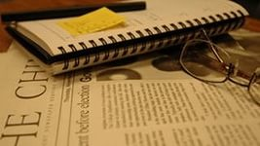
Journalist - ancient creative profession.
The journalist is a source of information about news and events happening in the world.
The journalists working in newspapers, magazines, television, radio, press centres, education.
The main task of the journalist is to inform people new reliable evidence. A journalist is finding and writing articles, news, advertising texts, reports, reviews, essays.

Slide 5
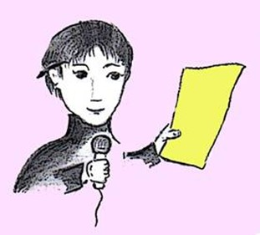
10 commandments of journalism
Work enthusiastically
Announce important
Work systematically
Talk about specific
Prepare and listen
Not to interfere with the course of events
Preserve the culture of the language
Create new versions
Be neutral to the effects
Keep pace with the times

Slide 6
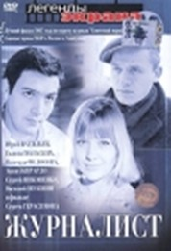
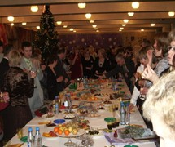
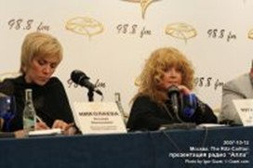
A journalist's work - a solid detective investigations, interviews with the stars and a press conference with a buffet table.

Slide 7

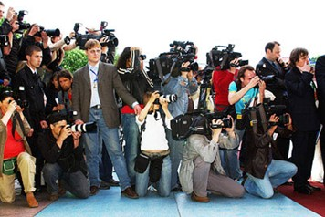
Life journalists - interesting!
But this is not just a myth! Journalism is really very interesting profession. For those who loved her and she owns.

Slide 8
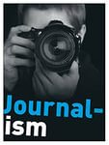
Requirements for the profession
It should:
quickly handle a large flow of information;
to be sociable;
to be curious;
to be knowledgeable;
to have a creative and artistic abilities;
have a creative and artistic skills;
a good memory;
to have creative thinking;
to be tactful;
to be mobile;
have a stress tolerance, ability to work in a team;

Slide 9
Pluses
Active lifestyle;
Meet and chat with many famous, talented and just good people;
The ability to travel to different cities and countries, to be there, where you do not let the majority;
The status of "free artist" not to work "from start to finish."

Slide 10
Cons
Long working hours;
Almost always have to work in an emergency mode;
The inability to disconnect from work, because everything around is perceived as a pretext for another article or report;
Journalists included in the list of dangerous occupations.

Slide 11
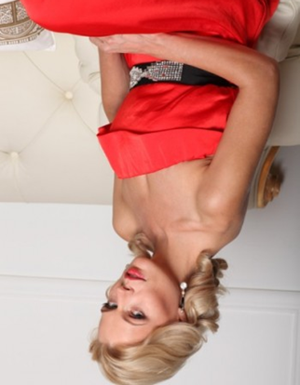
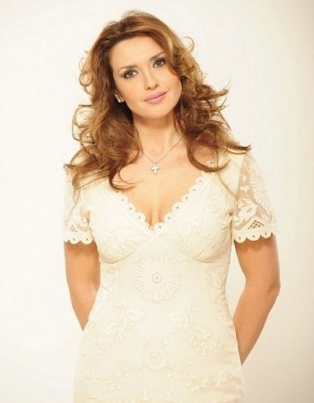
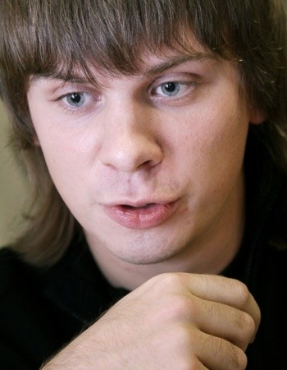
Well-known journalists
Among the most prominent journalists have made great strides people such as:
Olga Freimuth;
Oksana Marchenko;
Dmitry Komarov;

Slide 12
Thank you for the attention

