Slide 1
Rihanna.

Slide 2
Robyn Rihanna Fenty (born February 20, 1988), known by her stage name Rihanna is a Barbadian recording artist, actress, and fashion designer. She was born in Saint Michael, Barbados, and her career began when she met record producer Evan Rogers through mutual friends in late 2003 and recorded demo tapes under Rogers's guidance. Her demo tape was sent to several record labels, and she subsequently signed a contract with Def Jam Recordings after auditioning for its president, rapper Jay-Z. Rihanna's debut and second studio albums, Music of the Sun (2005) and A Girl Like Me (2006), peaked in the top ten on the Billboard 200 chart. Both albums spawned the Billboard Hot 100 top two hit single "Pon de Replay" and her first Hot 100 number-one "SOS".

Slide 3
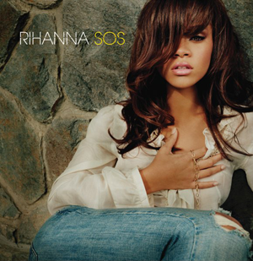
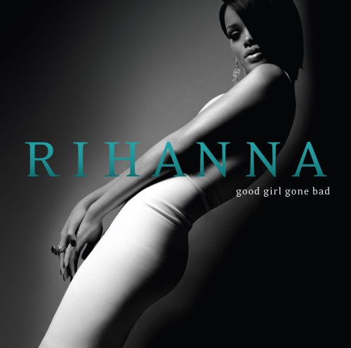
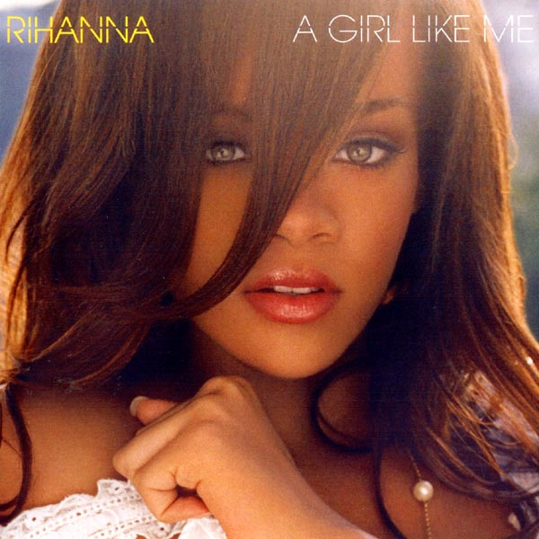
First album.
Third studio album
Debut and second studio albums.

Slide 4
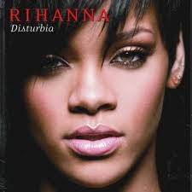
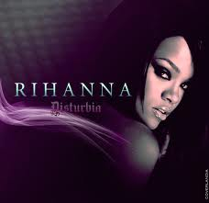
Her third studio album, Good Girl Gone Bad (2007), and its chart-topping lead single "Umbrella" were major breakthroughs in her career that brought her to widespread prominence. The album and its Reloaded version (2008) produced the worldwide hit singles "Don't Stop the Music", "Take a Bow", and "Disturbia". The record was nominated for nineGrammy Awards, winning Best Rap/Sung Collaboration for "Umbrella", and is Rihanna's best-selling album in the US to date. After an altercation with then-boyfriend Chris Brown, Rihanna released her fourth studio album, Rated R, in November 2009. It was followed by three more albums: Loud (2010), Talk That Talk (2011), and her first Billboard 200 number one album Unapologetic (2012).

Slide 5
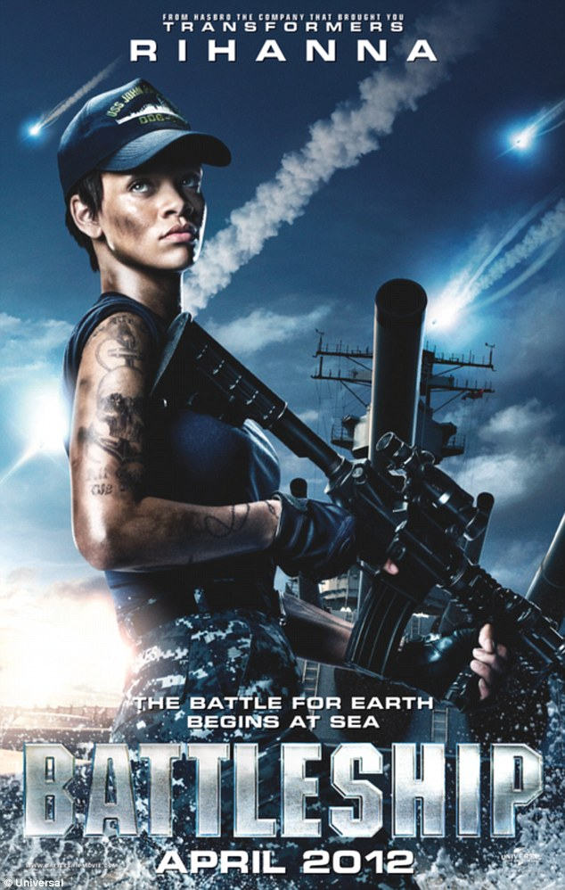
That same year she appeared in her first theatrical feature film: Battleship. These albums feature the global hit singles "Rude Boy", "What's My Name?", "S&M", "Where Have You Been" and "Stay", as well as some of the best-selling singles of all time, such as "Umbrella", "Disturbia", "Only Girl (In the World)", "We Found Love", and "Diamonds". In addition to her solo work, Rihanna has collaborated with numerous other artists, including being featured on the worldwide hits "Live Your Life" (withT.I.) and "Love the Way You Lie" (with Eminem).

Slide 6
Rihanna's work has earned her numerous awards and accolades, including six Grammy Awards, five American Music Awards, 22 Billboard Music Awards, and two BRIT Awards. She has sold over 30 million albums and 120 million singles worldwide, which makes her one of the best-selling artists of all time.

Slide 7
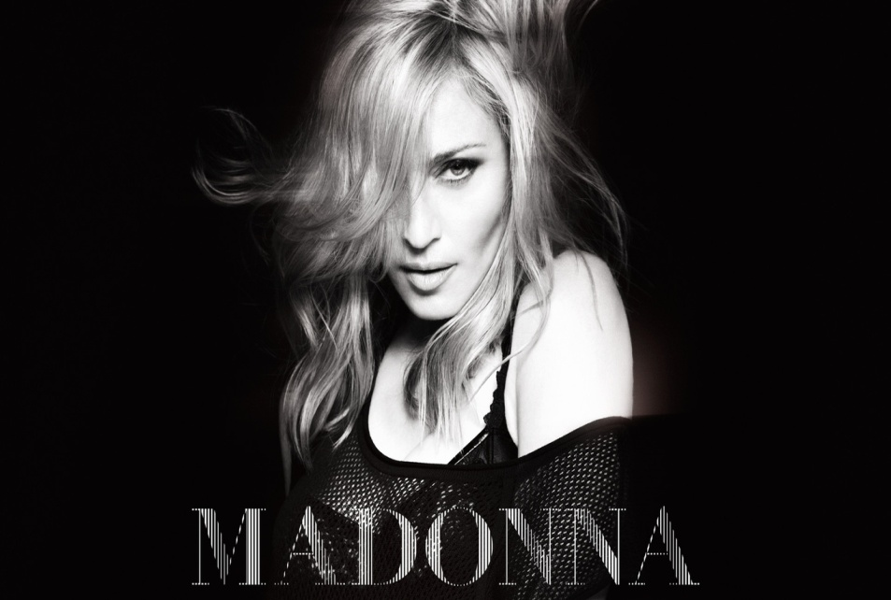
Influences
Rihanna has named Madonna as her idol and biggest influence. She said she wants to be the "black Madonna". "I think that Madonna was a great inspiration for me, especially on my earlier work. If I had to examine her evolution through time, I think she reinvented her clothing style and music with success every single time. And at the same time remained a real force in entertainment in the whole world.
Britney Spears

Slide 8
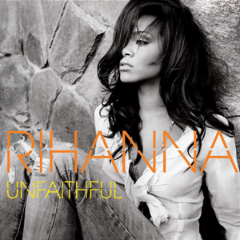
Videos and stage
Rihanna has worked with music video director Anthony Mandler on more than a dozen music videos, the first being "Unfaithful" (2006). "We've done 16 videos together; they're not all tough, [...] Yeah, I mean, I'm known for the 'Disturbia's and the 'Russian Roulette's and things like that, but 'Only Girl (In the World)' is certainly an ethereal kind of empowering, beauty-filled video," Mandler said.

Slide 9
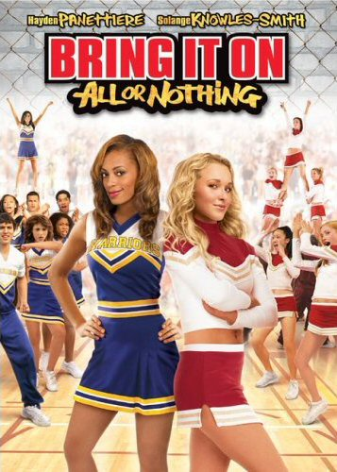
Other ventures
Rihanna has ventured into other businesses and industries. In October 2005, Rihanna struck an endorsement deal (her first of many) with Secret Body Spray. In 2006, she created her Believe Foundation to help terminally ill children. Rihanna made her acting debut in a cameo role in the straight-to-DVD film Bring It On: All or Nothing, released in August 2006.

