Slide 1
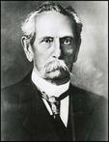
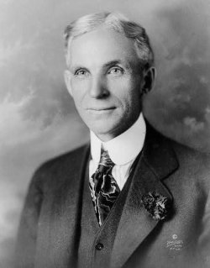
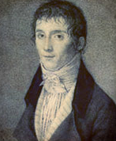
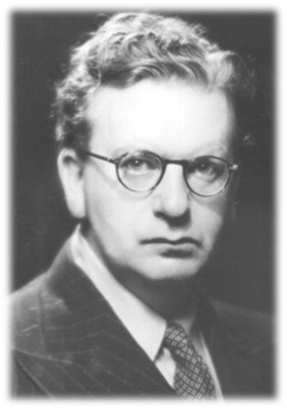

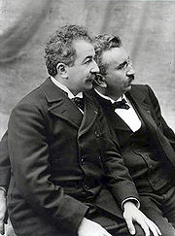
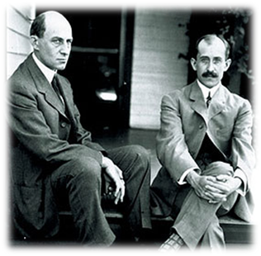
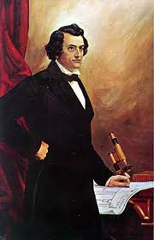
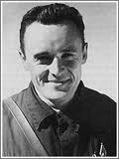
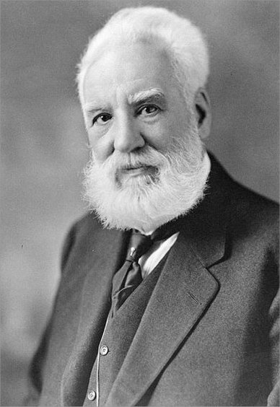
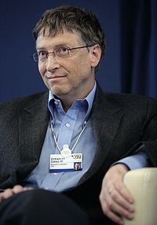
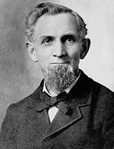
INVENTIONS AND INVENTORS

Slide 2
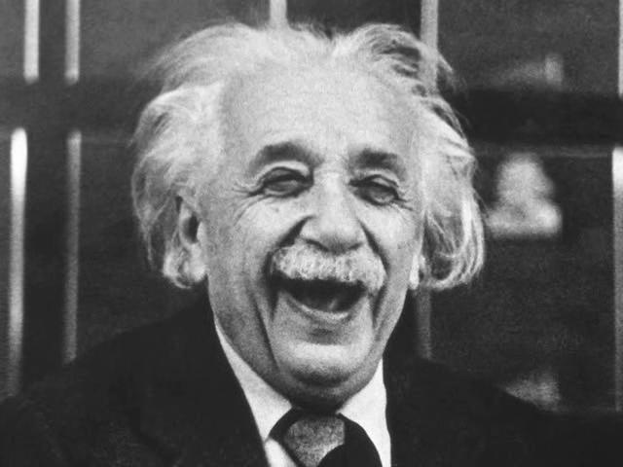
"To raise new questions, new possibilities, to regard old questions from a new angle, requires creative imagination and marks real advance".
"Imagination is more important than knowledge".
Albert Einstein

Slide 3
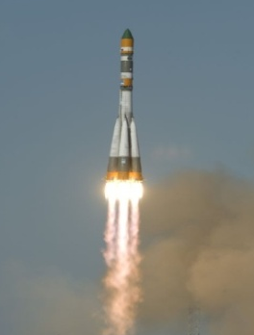

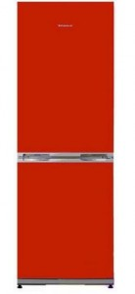
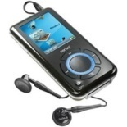
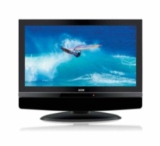
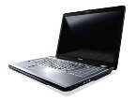
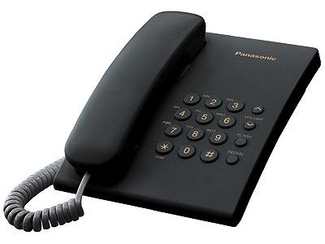
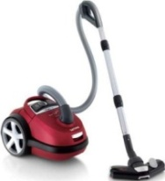
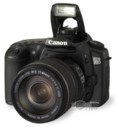
To invent is to see anew.
An invention is a new composition, device, or process. Some inventions are based on pre-existing models or ideas and others are radical breakthroughs. Inventions can extend the boundaries of human knowledge or experience.

Slide 4
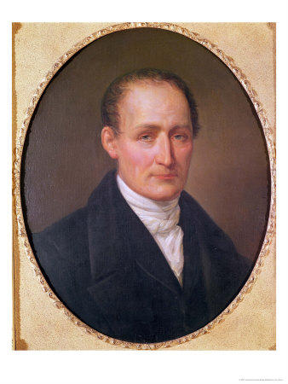


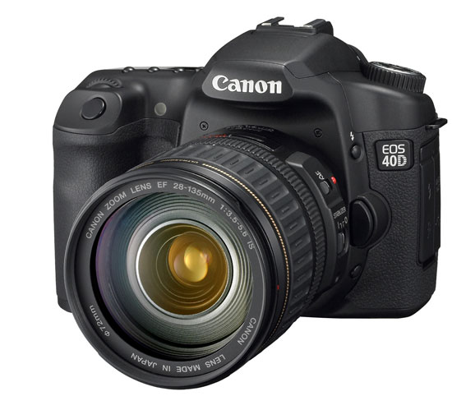
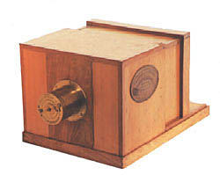
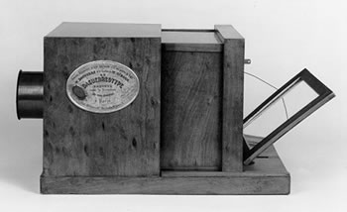
Joseph Nicéphore Niépce
(1765 – 1833)
Joseph Nicéphore Niépce was a French inventor, most noted as one of the inventors of photography and a pioneer in the field. He is well-known for taking some of the earliest photographs, dating to the 1820s. As revolutionary as his invention was, Niépce is little known even today.

Slide 5

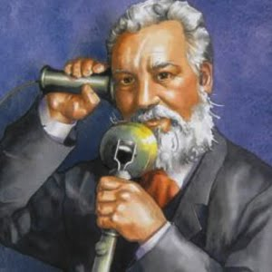
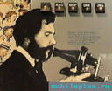
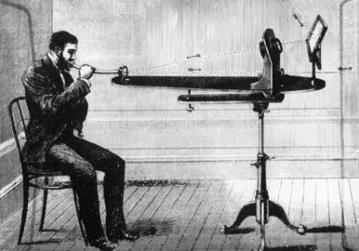
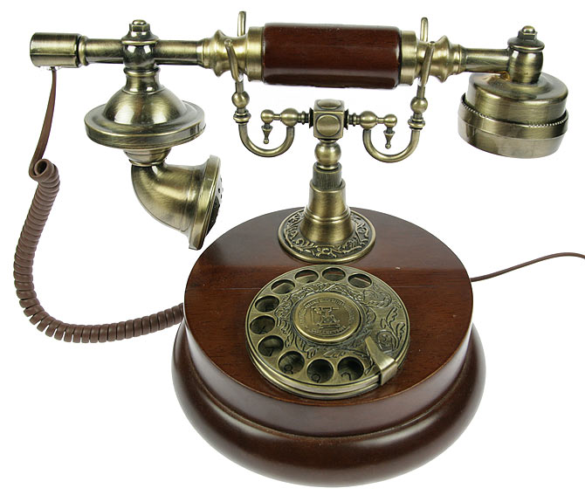
Alexander Graham Bell
(1847 – 1922)
Alexander Graham Bell was an eminent scientist, inventor, engineer and innovator who is credited with inventing the first practical telephone. His research on hearing and speech led him to experiment with hearing devices which eventually culminated in Bell being awarded the first U.S. patent for the telephone in 1876.

Slide 6
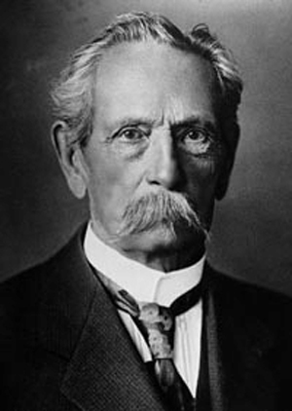

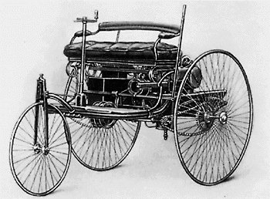
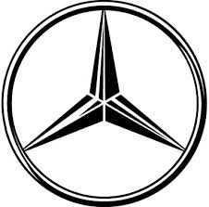
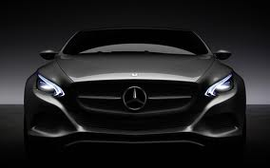
Karl Friedrich Benz
(1844 – 1929)
Karl Friedrich Benz was a German engine designer and automobile engineer, generally regarded as the inventor of the petrol-powered automobile and pioneering founder of the automobile manufacturer, Mercedes-Benz.

Slide 7
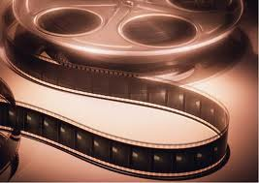
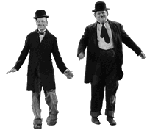
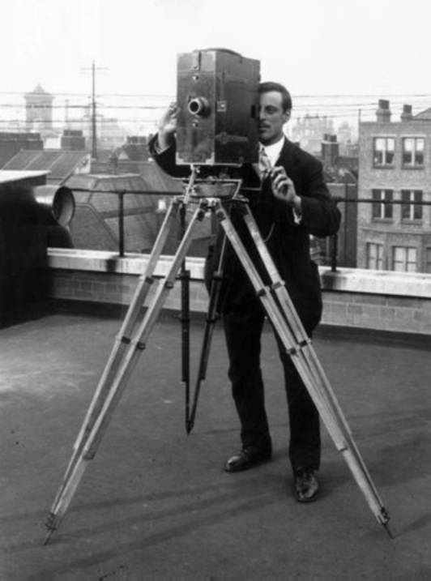
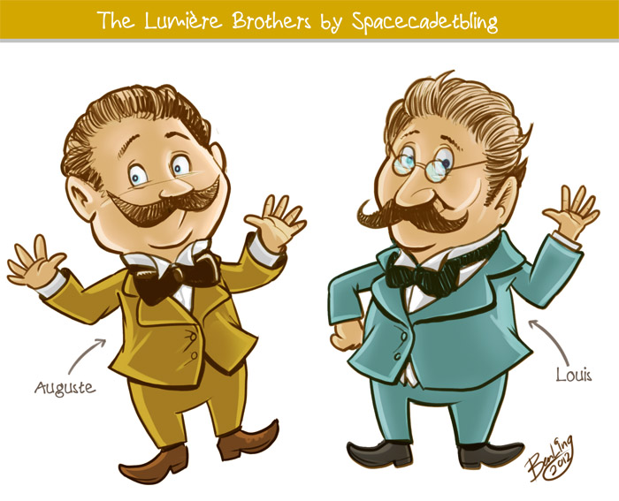
The Lumière brothers:
Auguste Marie Louis Nicolas (1862 – 1954)
Louis Jean (1864– 1948)
The Lumière brothers were among the earliest filmmakers. Louis had made some improvements to the still-photograph process, the most notable being the dry-plate process, which was a major step towards moving images. The cinematograph itself was patented on 13 February 1895 and the first footage ever to be recorded using it was recorded on 19 March 1895.

Slide 8
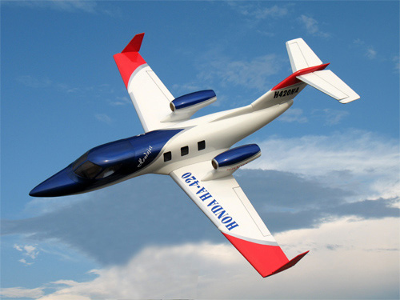

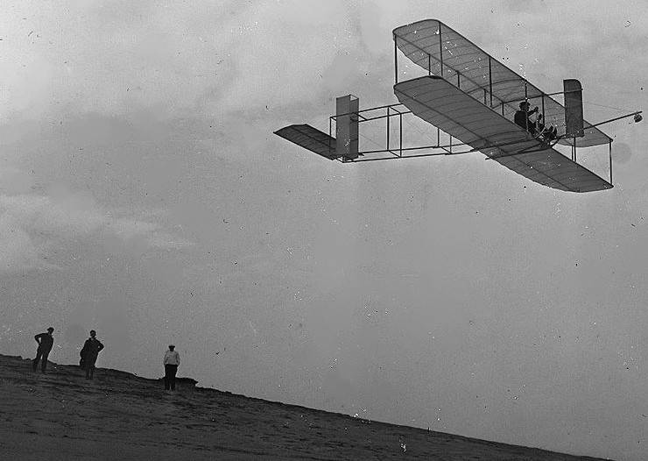
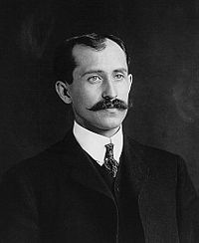
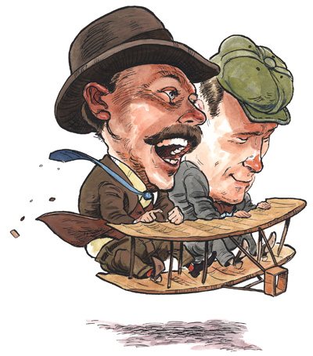
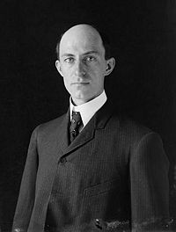
The Wright brothers:
Orville (1871 – 1948)
Wilbur (1867 – 1912)
The Wright brothers were two Americans who are generally credited with inventing and building the world's first successful airplane and making the first controlled, powered and sustained heavier-than-air human flight, on December 17, 1903. In two years afterward, the brothers developed their flying machine into the first practical fixed-wing aircraft. The Wright brothers were the first to invent aircraft controls that made fixed-wing flight possible.
Orville
Wilbur

Slide 9
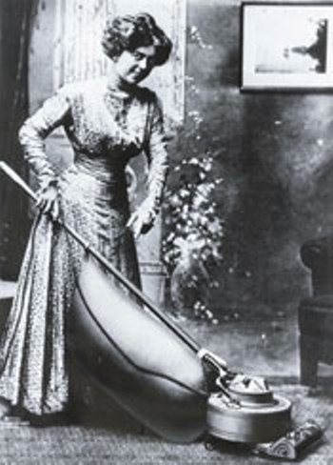
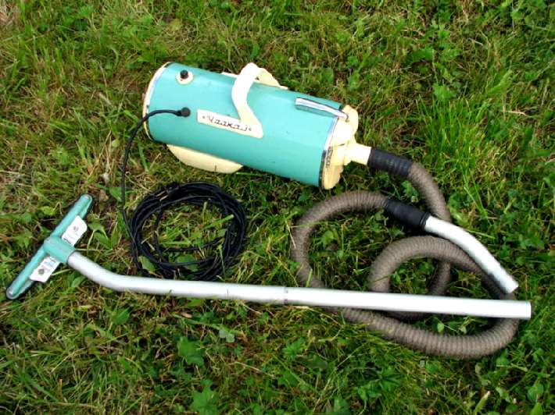

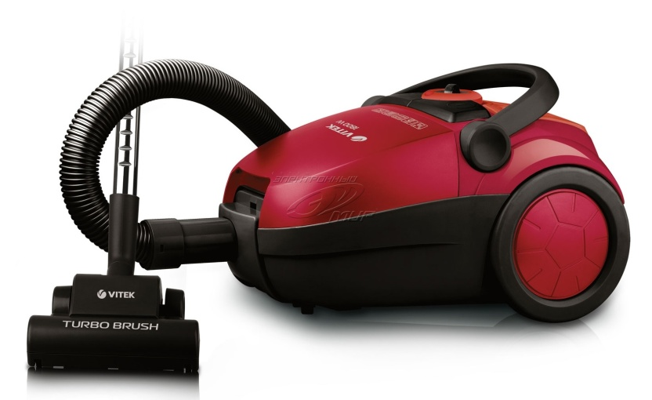
James Murray Spangler
(1848 - 1915)
In 1907, James Murray Spangler, a janitor in Canton, Ohio invented an electric vacuum cleaner from a fan, a box, and a pillowcase.

Slide 10

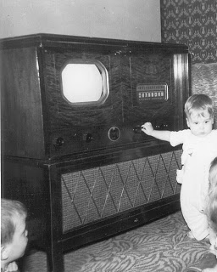
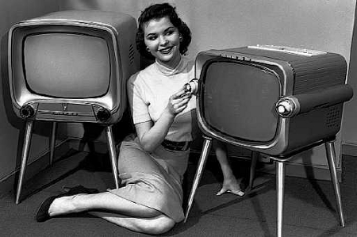
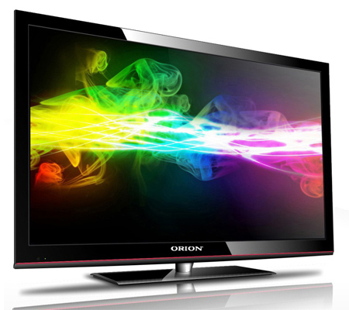
John Logie Baird
(1888 – 1946)
John Logie Baird was a British engineer and inventor of the world's first working television system, also the world's first fully electronic colour television broadcast. Although Baird's electromechanical system was eventually displaced by purely electronic systems his early successes demonstrating working television broadcasts and his colour and cinema television work earn him a prominent place in television's invention.

Slide 11
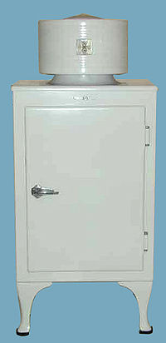
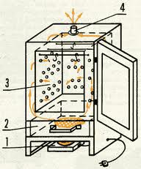
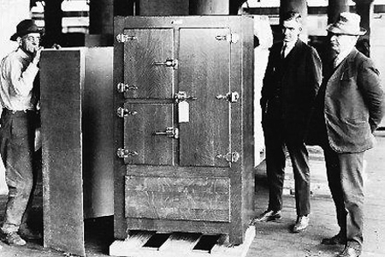


John Gorrie
(1803 – 1855)
John Gorrie was a physician, scientist, inventor, and humanitarian, is considered the father of refrigeration and air conditioning.

Slide 12




Henry Ford
(1863 – 1947)
Henry Ford was the American founder of the Ford Motor Company and father of modern assembly lines used in mass production. His introduction of the Model T automobile revolutionized transportation and American industry. He was a prolific inventor and was awarded 161 U.S. patents.

Slide 13





Sergey Pavlovich Korolyov
(1907 – 1966)
Sergey Pavlovich Korolyov was the head Soviet rocket engineer and designer during the Space Race between the United States and the Soviet Union in the 1950s and 1960s. He is considered by many as the father of practical astronautics.

Slide 14






Akio Morita
(1921 — 1999)
Akio Morita was a Japanese entrepreneur, cofounder of Sony Corp. In 1949, the company developed magnetic recording tape and in 1950, sold the first tape recorder in Japan. In 1957, it produced a pocket-sized radio.

Slide 15






William Henry "Bill" Gates III
(born October 28, 1955)
William Henry "Bill" Gates III is an American business magnate, philanthropist, and chairman of Microsoft, the software company. During his career at Microsoft, Gates held the positions of CEO and chief software architect, and remains the largest individual shareholder. Gates is one of the best-known entrepreneurs of the personal computer revolution.

Slide 16
Thank you for your attention
Oxana Bondar
Form 7(11) B
Gimnasium 1

