Slide 1
Hydrography Canada

Slide 2
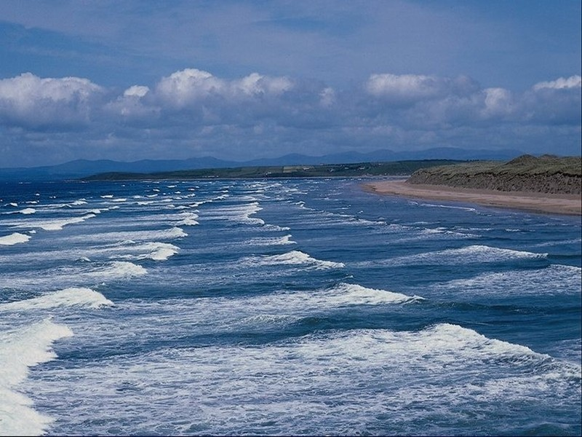
Canada's motto "from sea to sea" untrue. Canada is surrounded by three oceans. Atlantic Ocean - in the east, the Pacific Ocean - in the west, and the Arctic Ocean - the north.

Slide 3
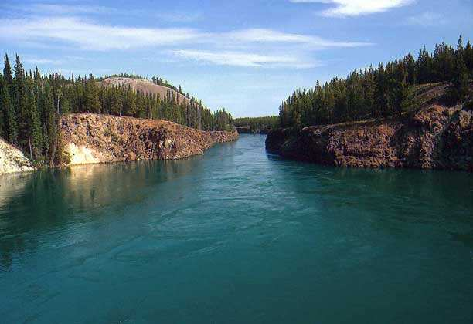
Canadian river
Fraser river;
Columbia river;
Mackenzie river;
Nelson river;
St. Lawrence river;
Churchill river;
St. John river;

Slide 4
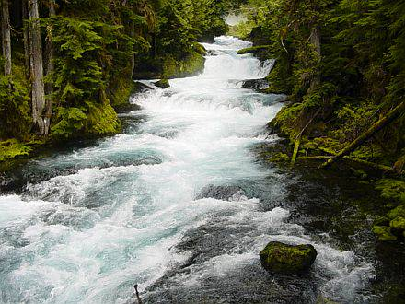
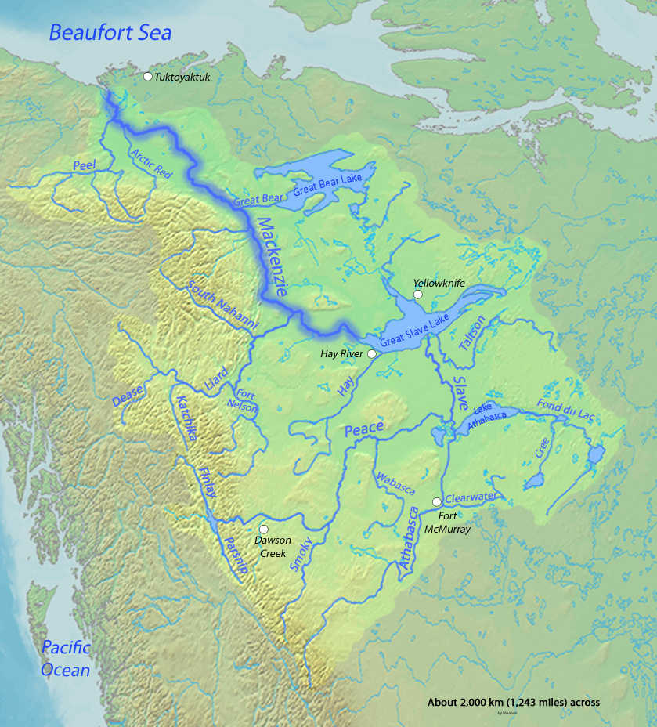
Mackenzie river
Mackenzie - the largest Canadian river length 4241 km. Its flow rate is 10 to 300 m ³ / s, which is approximately equal to the water flow of the river St. Lawrence.

Slide 5
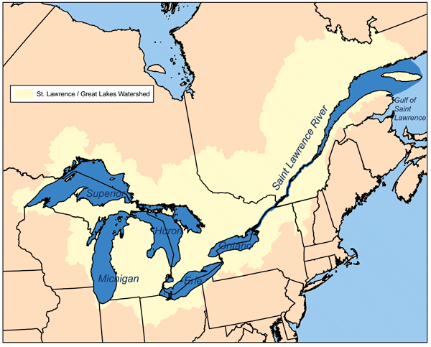
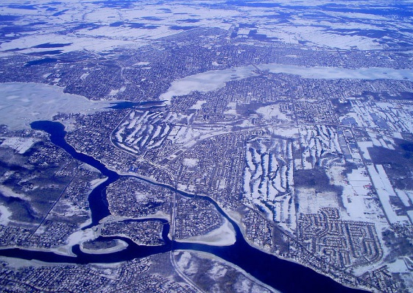
St. Lawrence river
Major waterway in North America, which flows through the U.S. and Canada and connects the Great Lakes with the Atlantic Ocean. Length of the river - 1197 km. River basin - one of the most densely populated and cultivated in Canada, developed here as agriculture: meat and dairy cattle, grain (wheat), and industry. In the river basin is home to about 20 million people

Slide 6
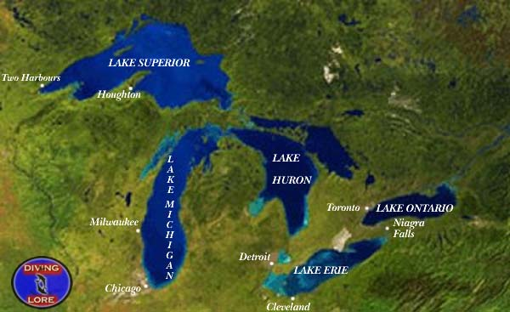
Lakes of Canada
Canadian lakes or the Great Lakes of North America - the largest concentration of fresh water on the globe. They constitute one river area. Great Lakes consist of six lakes: Lake Superior, Lake Huron, Michigan, St. Clair, Erie and Ontario

Slide 7
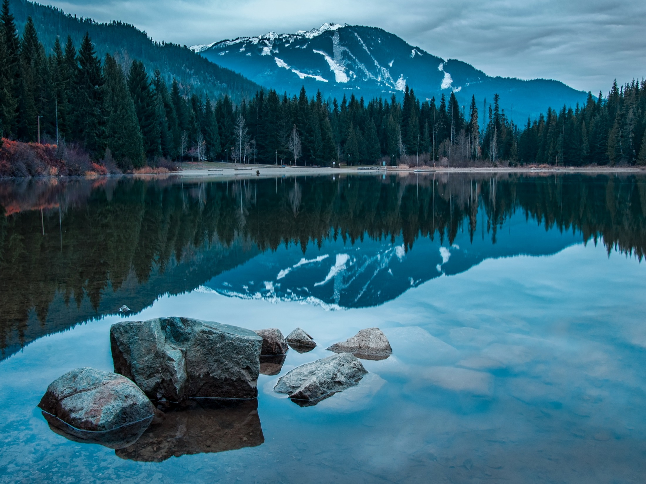

Slide 8
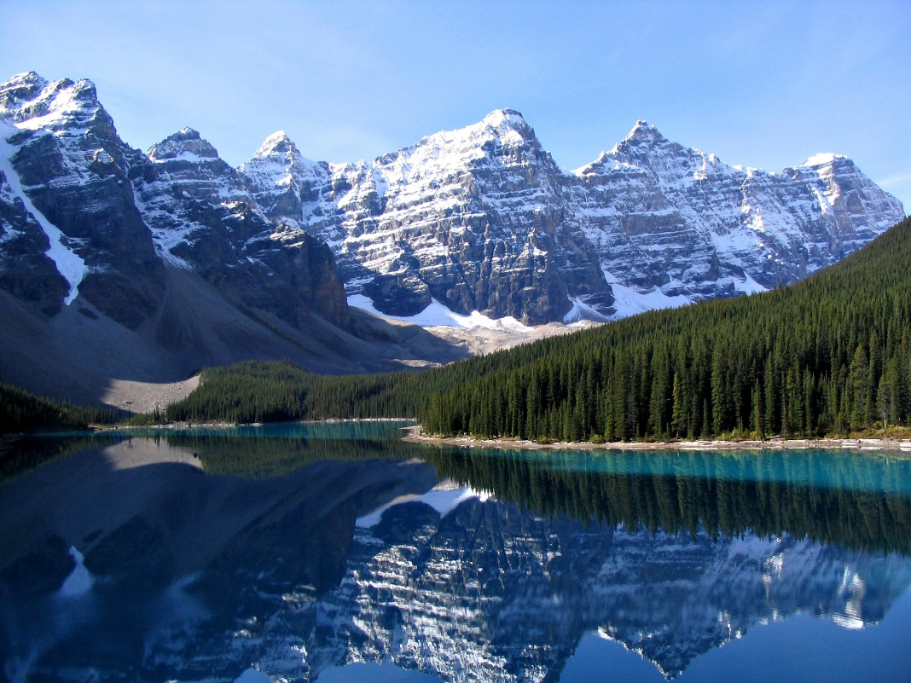

Slide 9
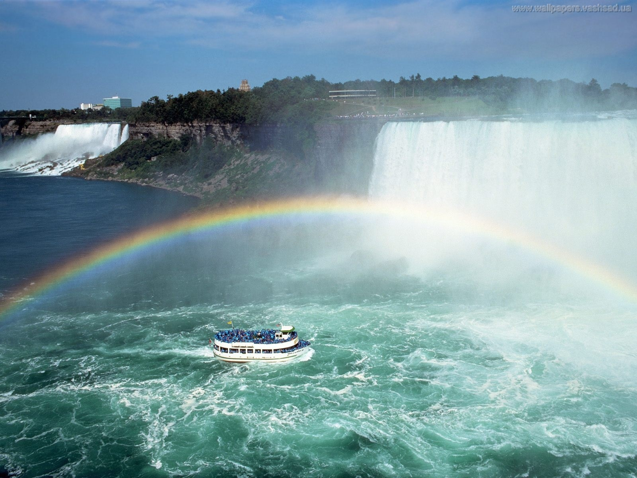
Of course, the hallmark of Canada is Niagara Falls. It is located on the Niagara River.

Slide 10
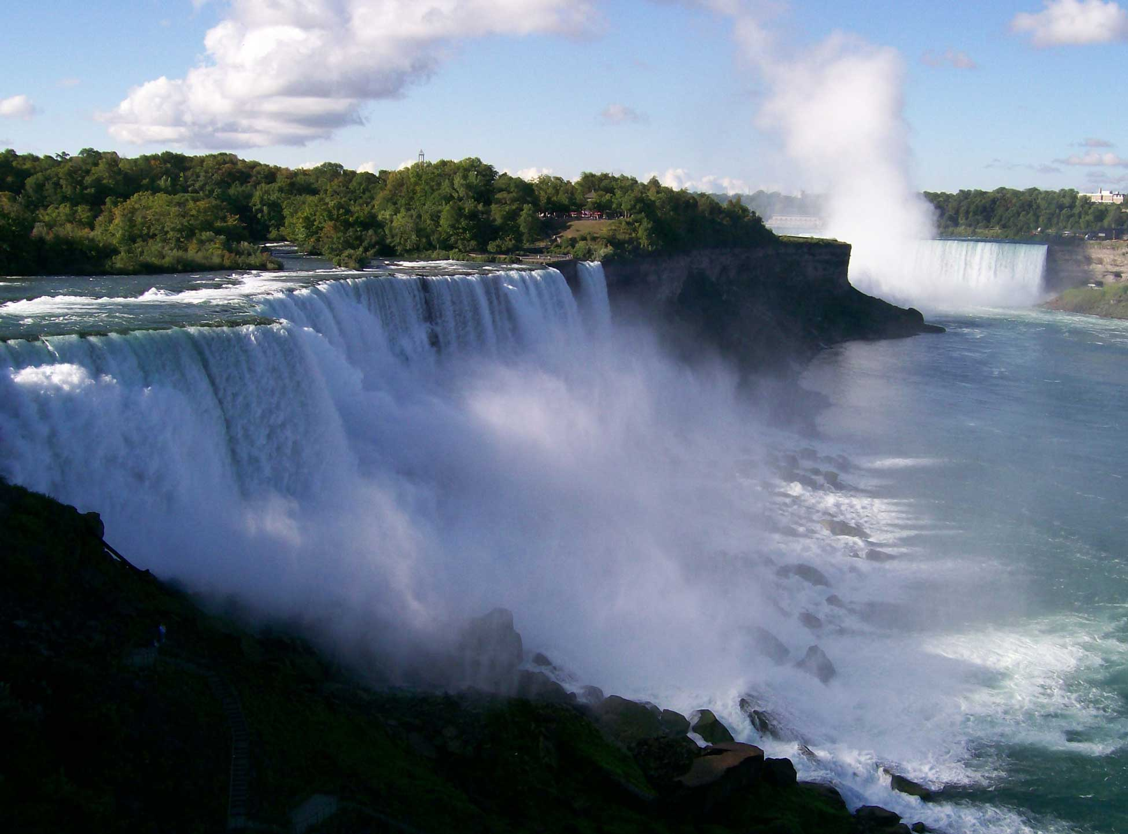
Niagara Falls - a set of waterfalls on the Niagara River, which separates the U.S. state of New York from the Canadian province of Ontario. elevation change and is not very large, very broad waterfalls, and the volume of water passing through it Niagara Falls - the most powerful in North America.

Slide 11
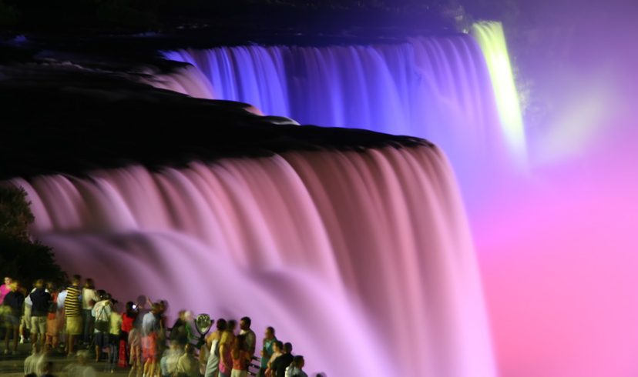
Niagara Falls - it falls "Horseshoe", and American Falls "Veil"

Slide 12
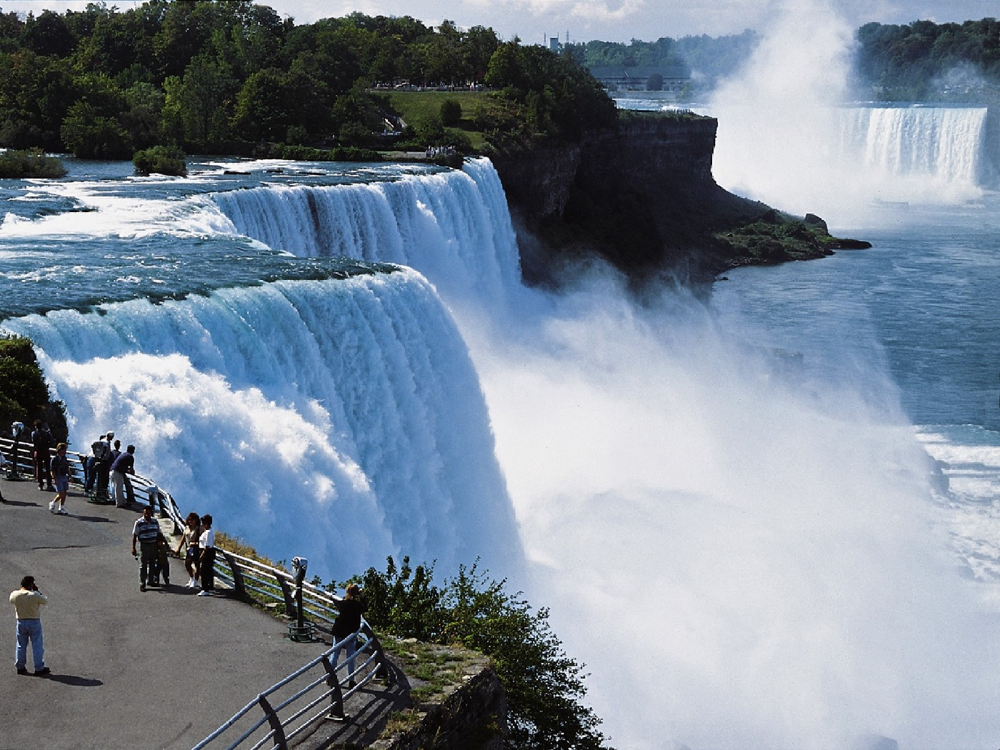
Height waterfalls is 53 meters. Foot of American Falls obscures a heap of stones, which is why its apparent height - only 21 meters. Width American Falls - 323 meters, the waterfall "Horseshoe" - 792 meters.

