Slide 1

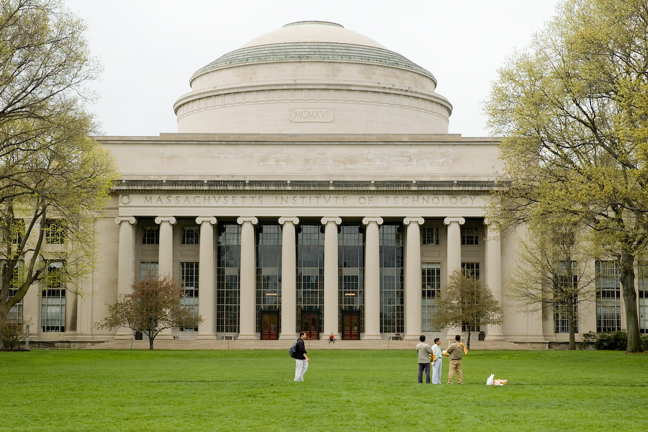
Massachusetts Institute of Technology

Slide 2
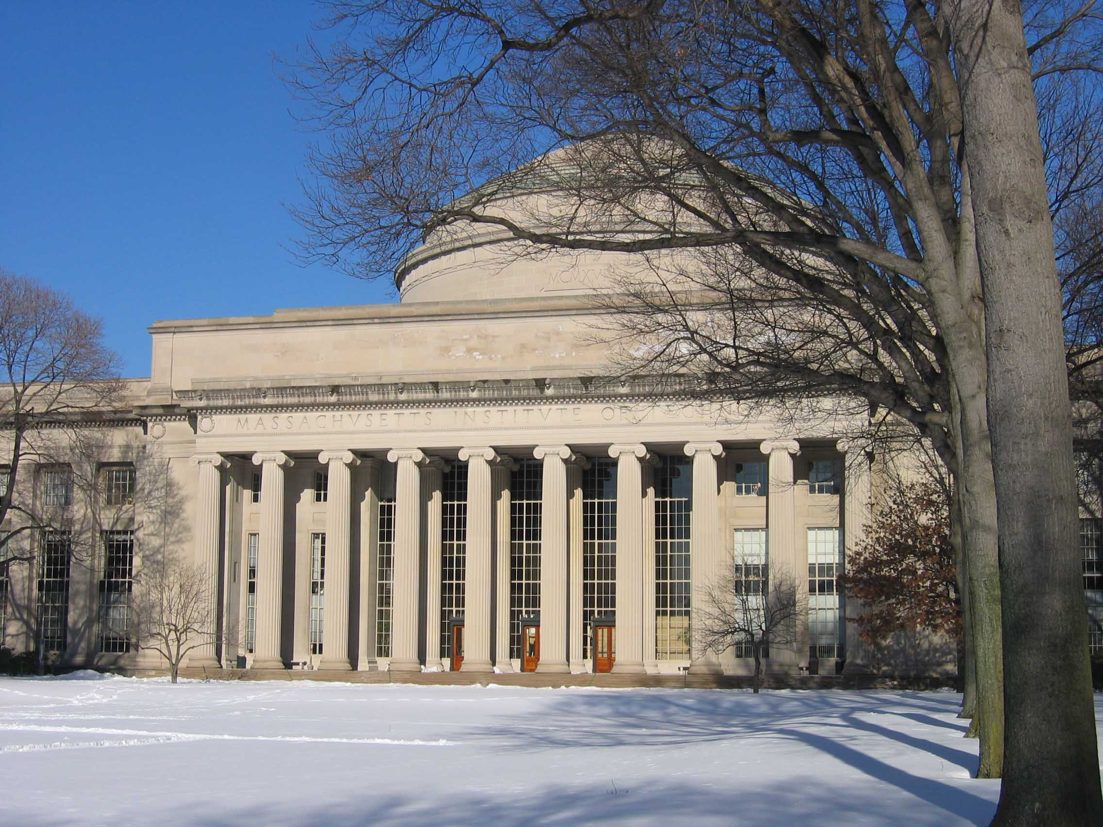
The Massachusetts Institute of Technology (MIT) is a private research university in Cambridge, Massachusetts traditionally known for research and education in the physical sciences and engineering, but in recent decades increasingly associated with fields such as biology, economics, linguistics, and management as well.

Slide 3
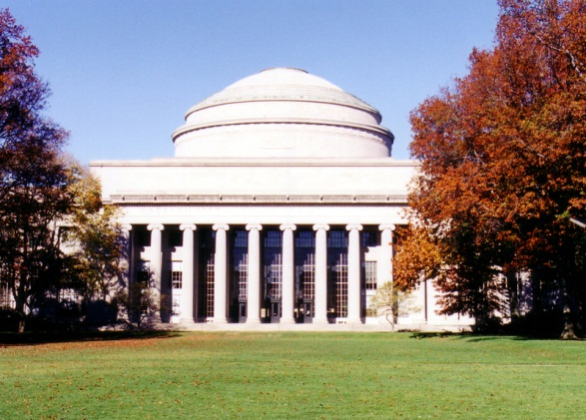
Founded in 1861 in response to the increasing industrialization of the United States, the institute used a polytechnic university model and stressed laboratory instruction. Today, the University comprises various academic departments with a strong emphasis on scientific, engineering, and technological education and research.

Slide 4
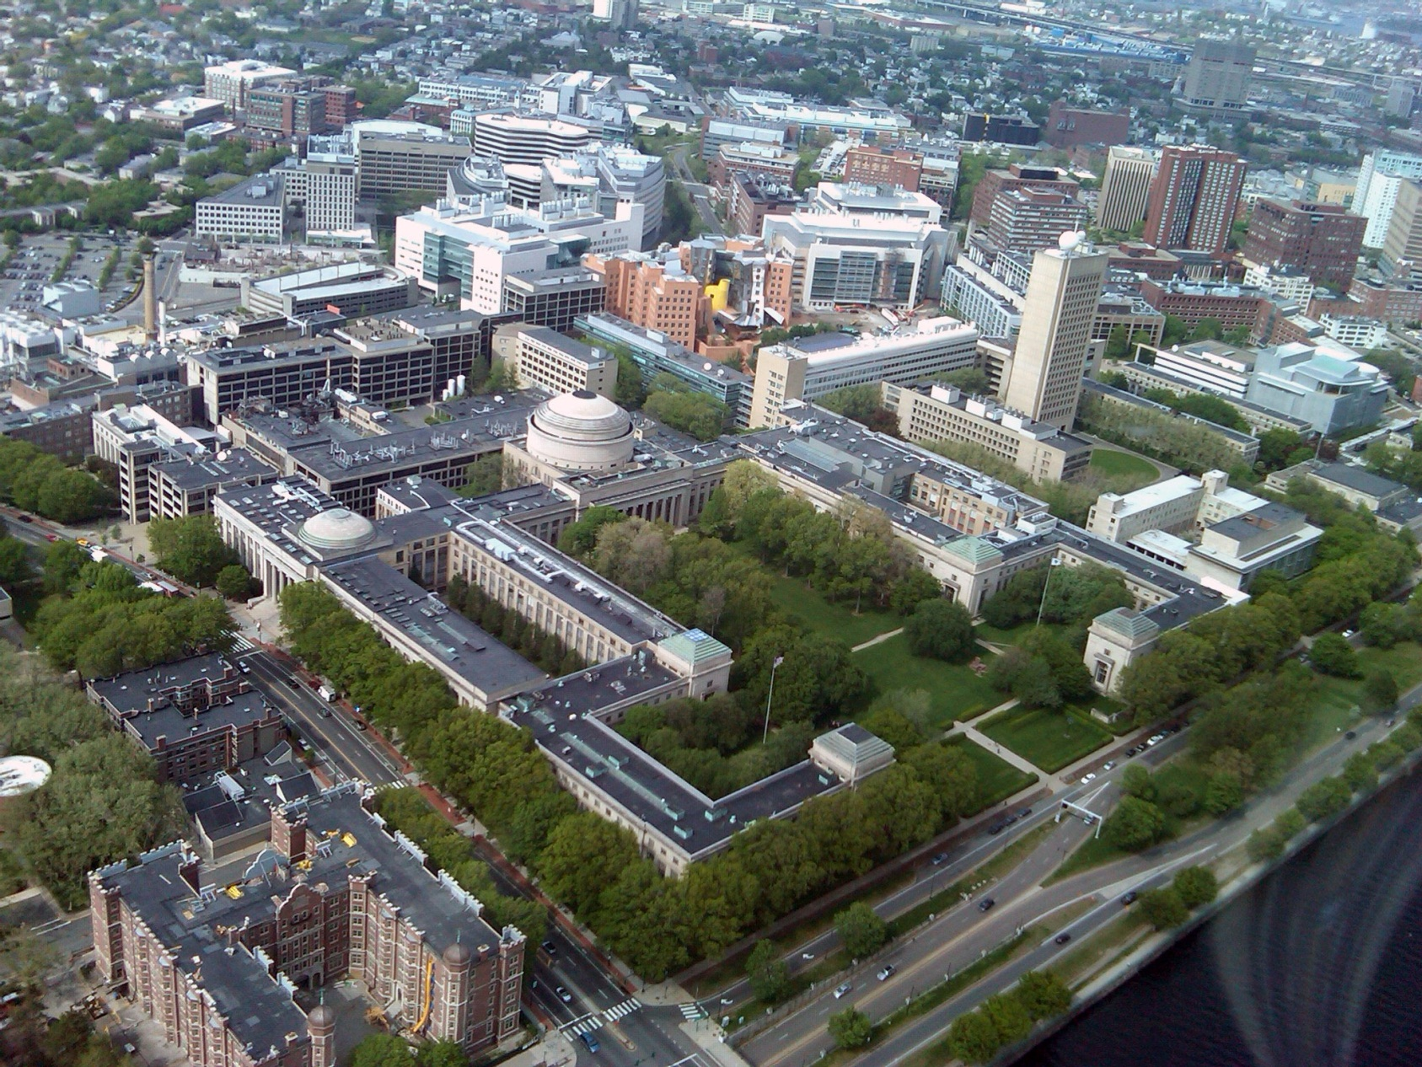
History

Slide 5
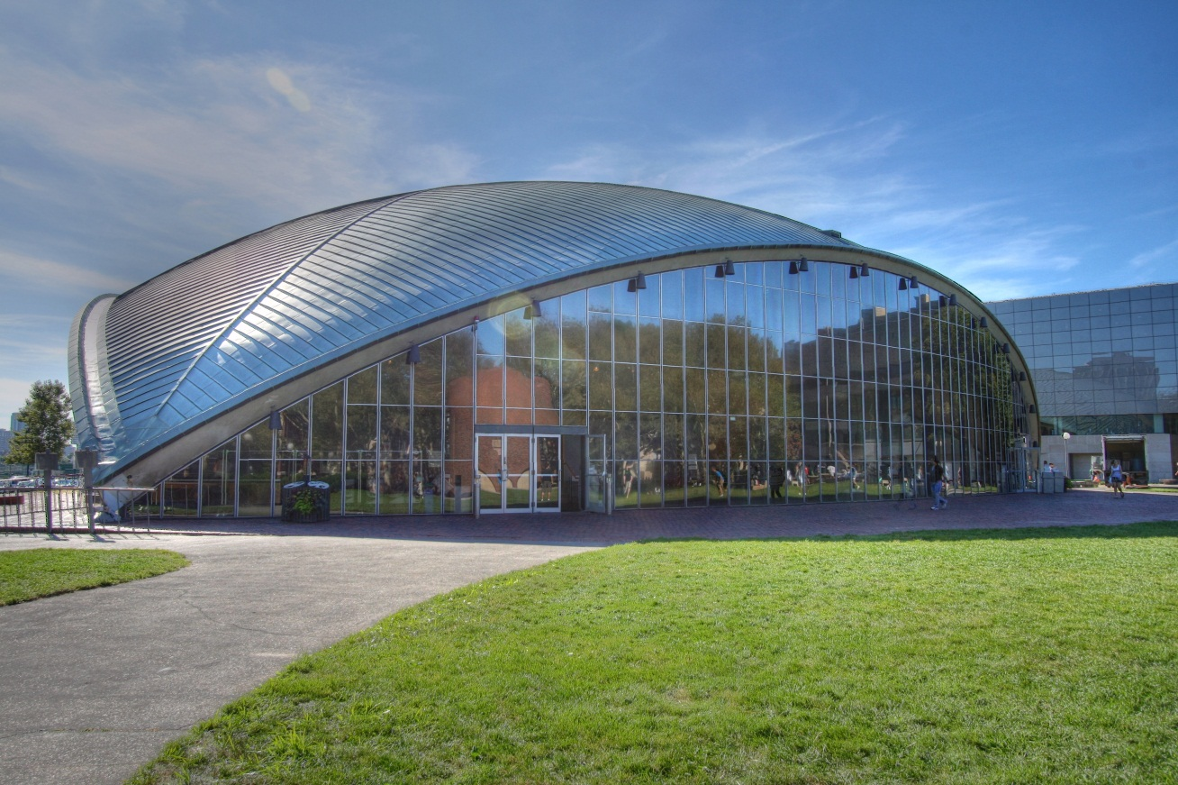
In 1859, a proposal was submitted to the Massachusetts General Court to use newly filled lands in Back Bay, Boston for a "Conservatory of Art and Science", but the proposal failed. A proposal by William Barton Rogers led to a charter for the incorporation of the Massachusetts Institute of Technology, signed by the governor of Massachusetts on April 10, 1861.

Slide 6
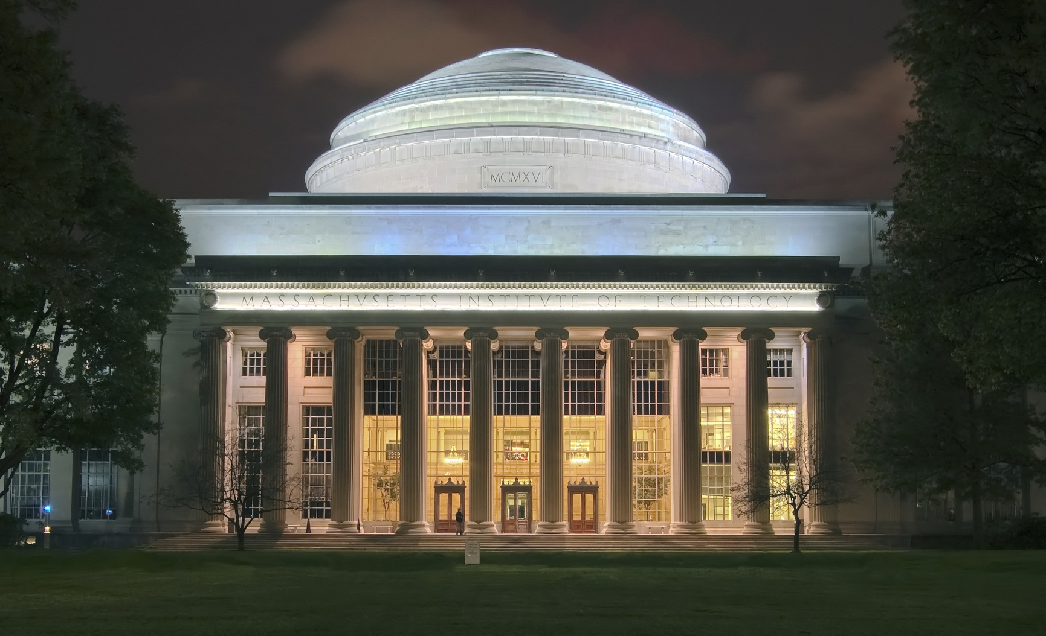
Rogers wanted to establish an institution to address rapid scientific and technological advances. He did not wish to found a professional school. The Rogers Plan reflected the German research university model, emphasizing an independent faculty engaged in research as well as instruction oriented around seminars and laboratories.

Slide 7
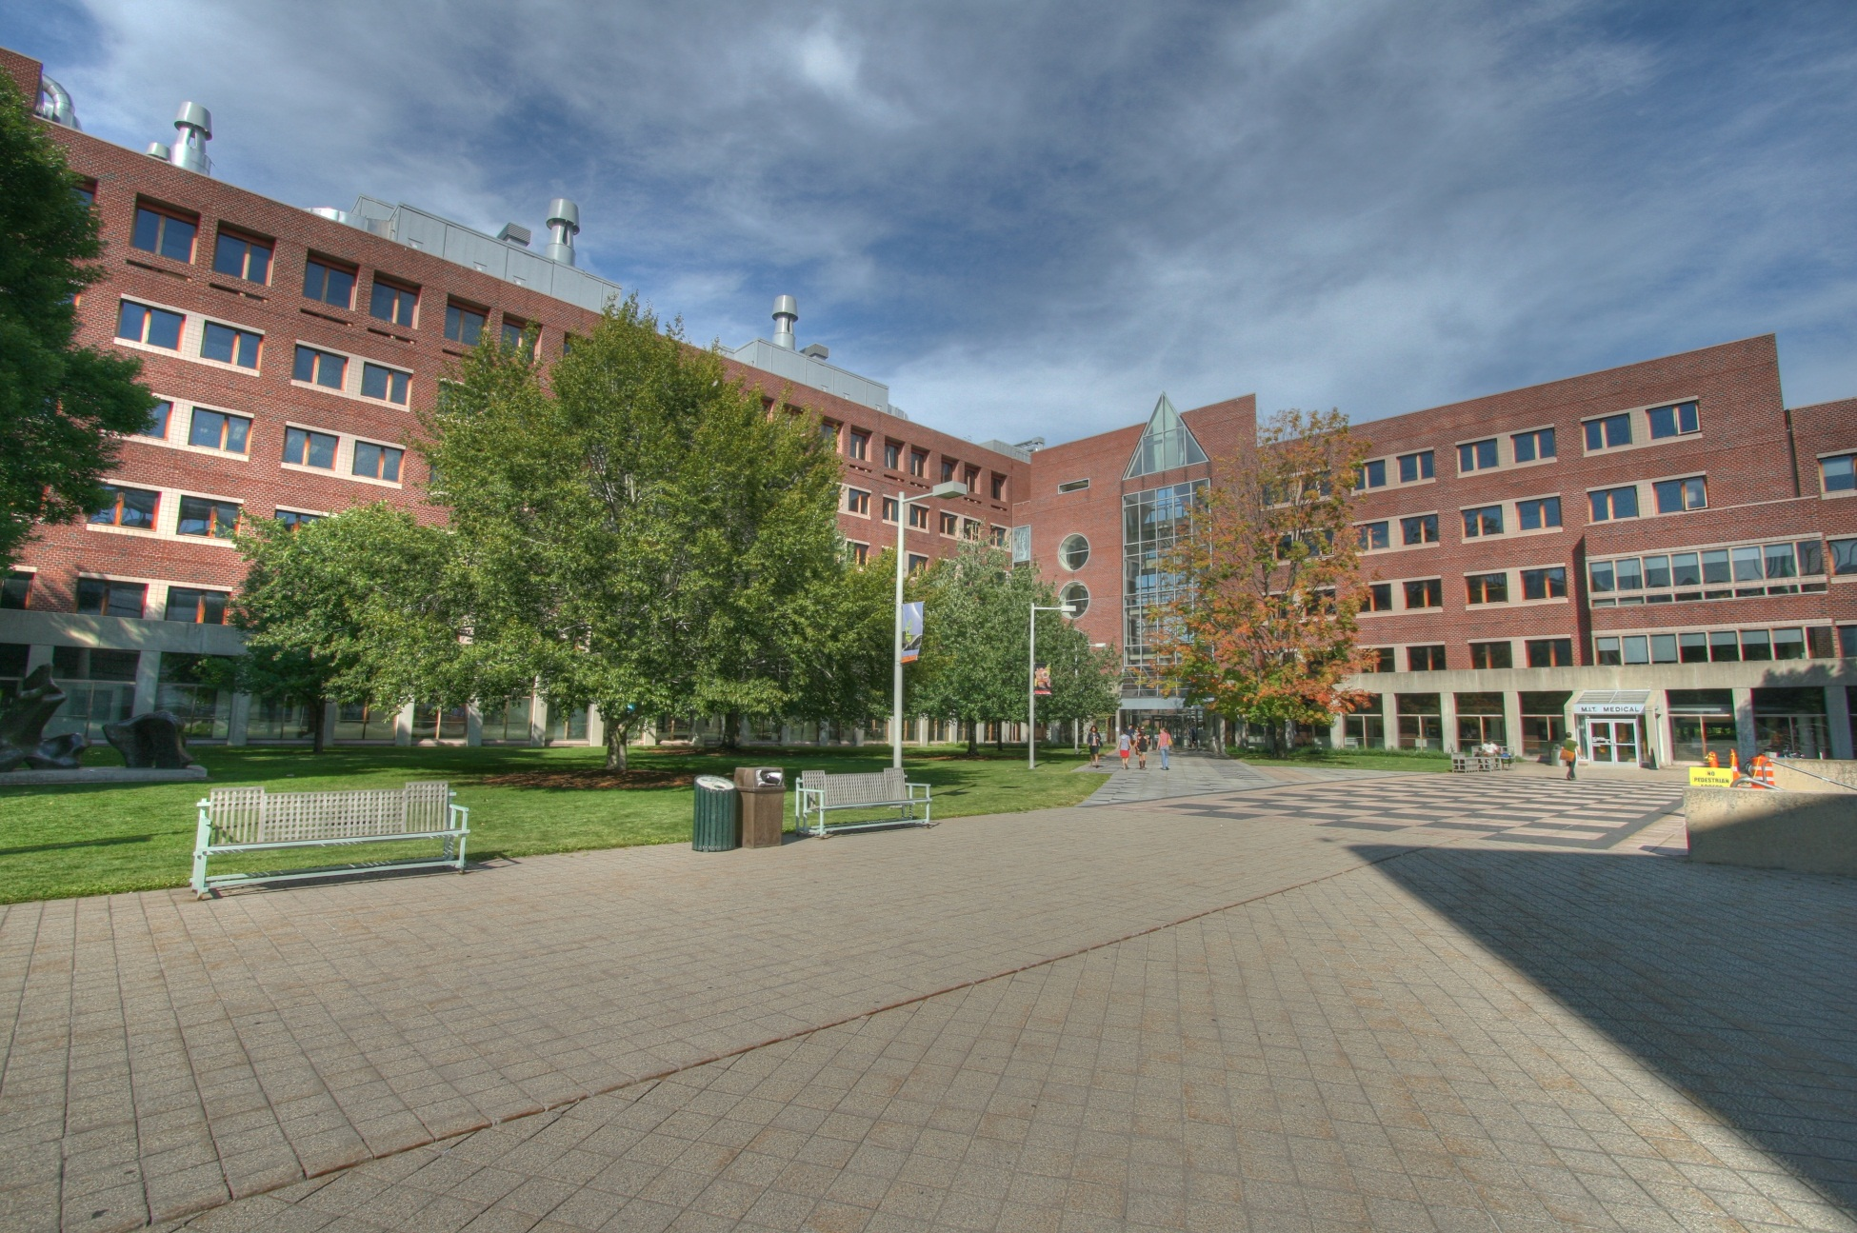
Campus

Slide 8
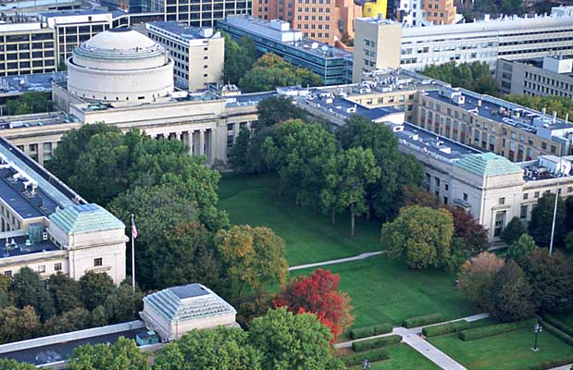
MIT's 168-acre (68.0 ha) campus spans approximately a mile of the north side of the Charles River basin in the city of Cambridge. The campus is divided roughly in half by Massachusetts Avenue, with most dormitories and student life facilities to the west and most academic buildings to the east. The bridge closest to MIT is the Harvard Bridge, which is known for being marked off in a non-standard unit of length – the smoot.

Slide 9
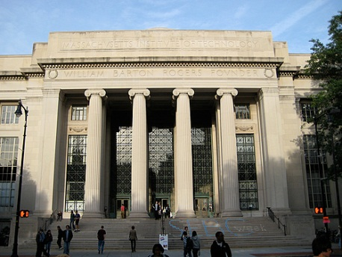
Academics

Slide 10
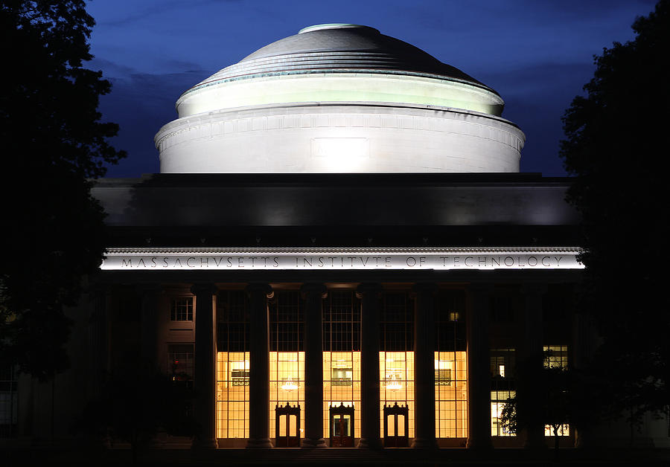
MIT is a large, highly residential, research university with a majority of enrollments in graduate and professional programs. MIT operates on a 4–1–4 academic calendar with the fall semester beginning after Labor Day and ending in mid-December, a 4-week "Independent Activities Period" in the month of January, and the spring semester beginning in early February and ending in late May.

Slide 11
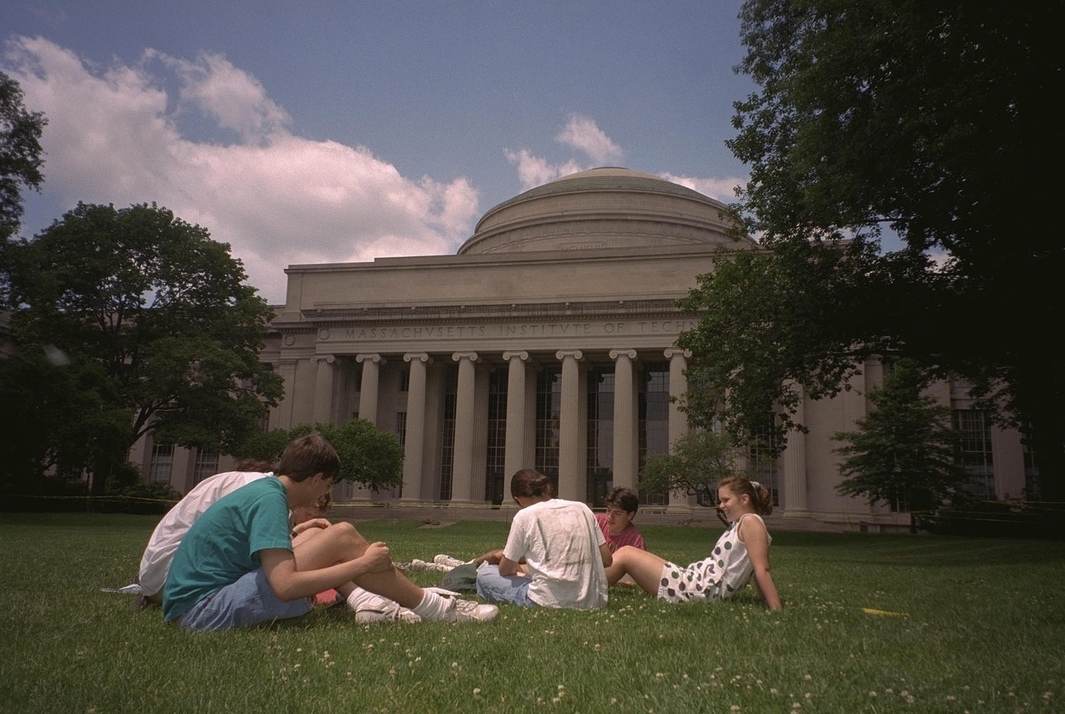
Traditions and student activities

Slide 12
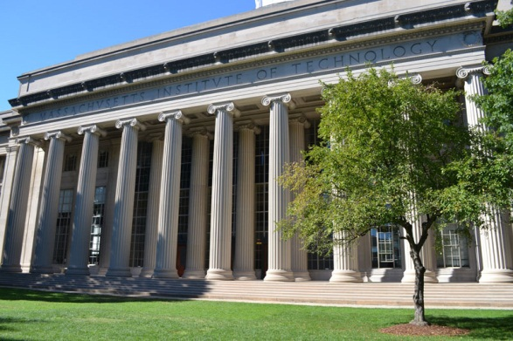
The faculty and student body highly value meritocracy and technical proficiency. MIT has never awarded an honorary degree, nor does it award athletic scholarships, ad eundem degrees, or Latin honors upon graduation. However, MIT has twice awarded honorary professorships: to Winston Churchill in 1949 and Salman Rushdie in 1993.

Slide 13
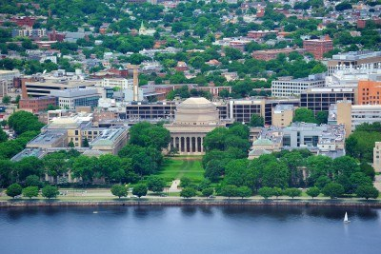
Many upperclass students and alumni wear a large, heavy, distinctive class ring known as the "Brass Rat". Originally created in 1929, the ring's official name is the "Standard Technology Ring."

Slide 14
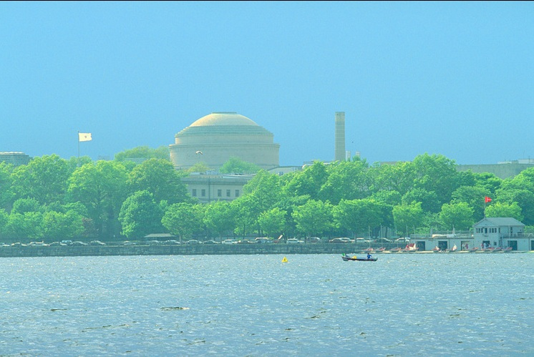
The undergraduate ring design (a separate graduate student version exists as well) varies slightly from year to year to reflect the unique character of the MIT experience for that class, but always features a three-piece design, with the MIT seal and the class year each appearing on a separate face, flanking a large rectangular bezel bearing an image of a beaver.

Slide 15
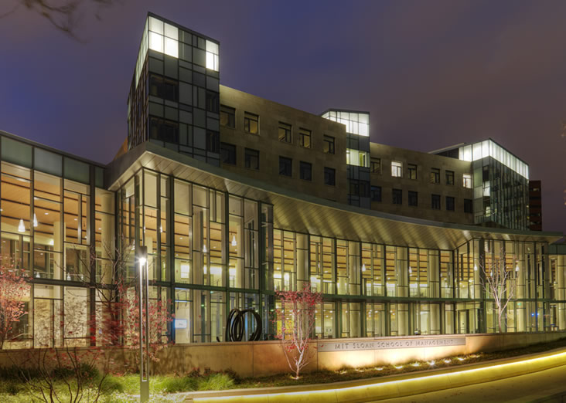
The initialism IHTFP, representing the informal school motto "I Hate This Place" and jocularly euphemized as "I Have Truly Found Paradise," "Institute Has The Finest Professors," "It's Hard to Fondle Penguins," and other variations, has occasionally been featured on the ring given its historical prominence in student culture.

Slide 16
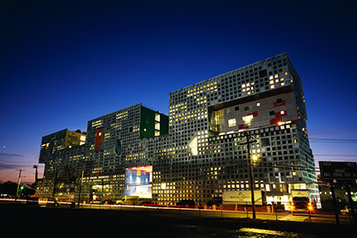
Thanks for your attention!

