Slide 1
UK Universities

Slide 2
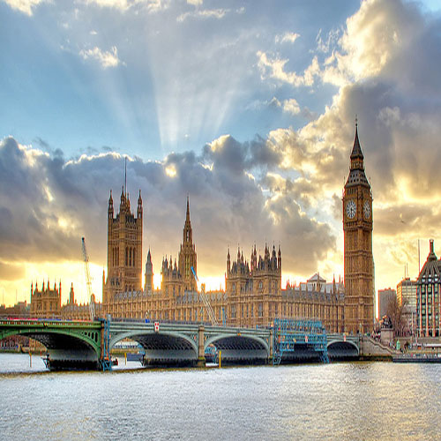
Britain called the country of conservative and classical education. Education in England is one of the best in the world for many years. This country has a slim fundamental system, allowing us to obtain a good education and training at all levels. And this is understandable: English in England taught to foreigners on a model created by the British and it is they opened the first school of English as a Foreign Language. Education in England, highly professional and well-known image of teachers in higher education.

Slide 3
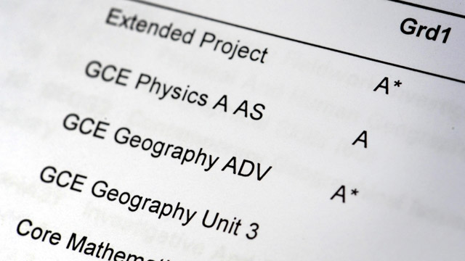
In 16 years, British students must successfully pass the exam GCSE (General Certificate of Secondary Education). In order to continue to go to university they need to learn the UK for two years and then take exams GSE A-level. Preparation for these exams for university you can do both at school and in college (Sixth Form College). To be admitted to the University of the United Kingdom need to pass the exam 4.3 A-level.
In 16 years, British students must successfully pass the exam GCSE (General Certificate of Secondary Education). In order to continue to go to university they need to learn the UK for two years and then take exams GSE A-level. Preparation for these exams for university you can do both at school and in college (Sixth Form College). To be admitted to the University of the United Kingdom to take 3 - 4 exams A-level.

Slide 4
The education system is one of the UK's most successful the world, for many years already in the top ten universities in the world UK is a leader sharing this top-10 with U.S. universities. Even before the advent of various ratings, education in the UK stands for quality, tradition and prestige. Often, only the name of one British university opens its doors to the best companies in the world. In recent years become very popular educational tours to the UK for children from the age of seven, because it is better to start learning English early, and the UK has long been known for its language school for children. Britain is the undisputed leader in terms of quality of higher education in such areas as educational tourism and language schools in the country remains a leader for many years. This is the best place to learn English, the best place to get a higher or secondary education.

Slide 5
So we want to tell you about two of the most famous and oldest universities in Britain. The first of these is University of Cambridge

Slide 6
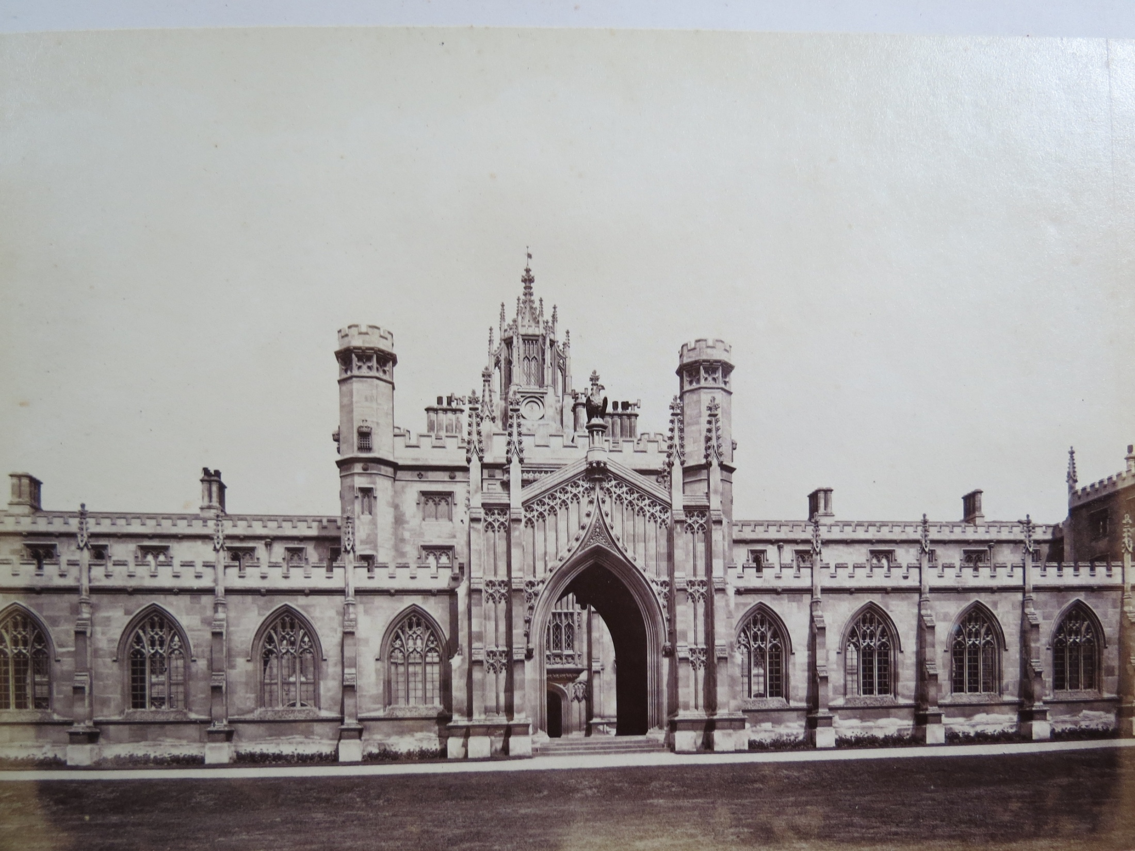
The University of Cambridge (informally known as Cambridge University or simply as Cambridge) is a public research university located in Cambridge, United Kingdom. It is the second-oldest university in the English-speaking world (after the University of Oxford), and the third-oldest surviving university in the world. In post-nominals the university's name is abbreviated as Cantab, a shortened form of Cantabrigiensis (an adjective derived from Cantabrigia, the Latinised form of Cambridge). The university grew out of an association of scholars that was formed in 1209, early records suggest, by scholars leaving Oxford after a dispute with townsfolk. The two "ancient universities" have many common features and are often jointly referred to as Oxbridge. In addition to cultural and practical associations as a historic part of British society, they have a long history of rivalry with each other.

Slide 7
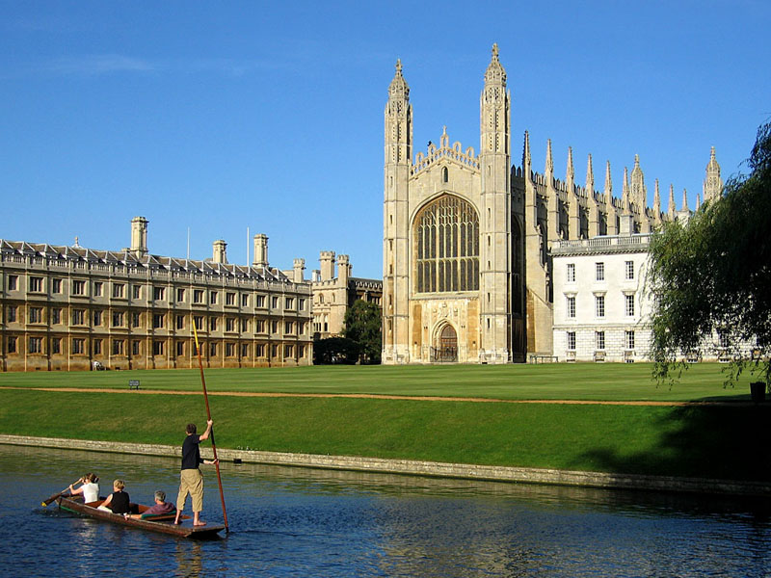
The University of Cambridge (informally known as Cambridge University or simply as Cambridge) is a public research university located in Cambridge, United Kingdom. It is the second-oldest university in the English-speaking world (after the University of Oxford), and the third-oldest surviving university in the world. In post-nominals the university's name is abbreviated as Cantab, a shortened form of Cantabrigiensis (an adjective derived from Cantabrigia, the Latinised form of Cambridge). The university grew out of an association of scholars that was formed in 1209, early records suggest, by scholars leaving Oxford after a dispute with townsfolk. The two "ancient universities" have many common features and are often jointly referred to as Oxbridge. In addition to cultural and practical associations as a historic part of British society, they have a long history of rivalry with each other.

Slide 8
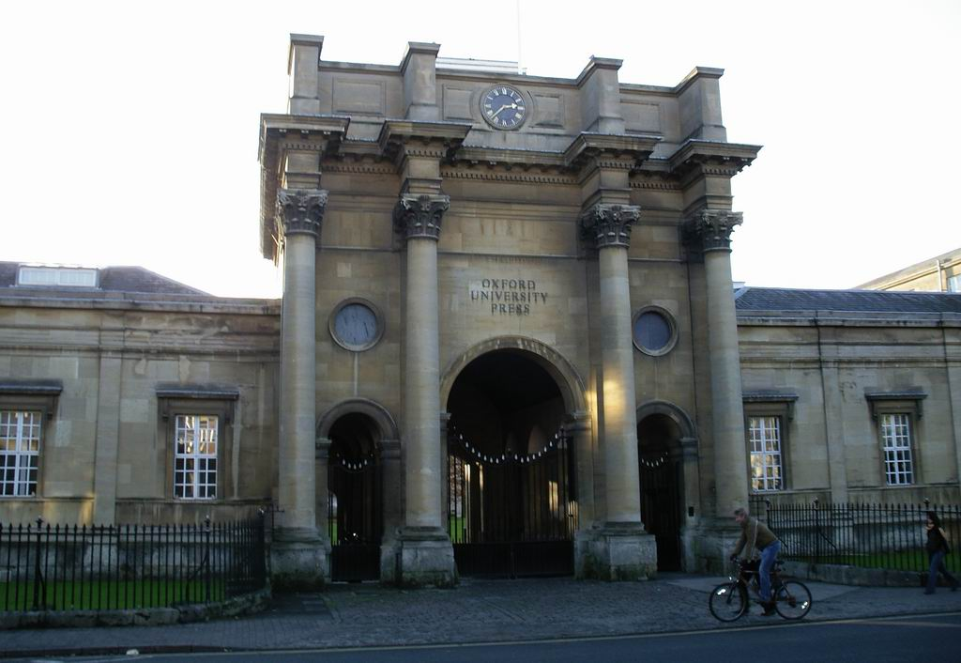
Second is University of Oxford.
The University of Oxford (informally Oxford University or Oxford, derived from the Latin, Universitas Oxoniensis) is a university located in Oxford, England. It is the oldest university in the English-speaking world, and the second-oldest surviving university in the world. Although its exact date of foundation is unclear, there is evidence of teaching as far back as 1096. The University grew rapidly from 1167 when Henry II banned English students from attending the University of Paris. In post-nominals the University of Oxford is commonly abbreviated as Oxon., from the Latin Universitas Oxoniensis, although Oxf is now used in official university publications.
After disputes between students and Oxford townsfolk in 1209, some academics fled north-east to Cambridge, where they established what became the University of Cambridge. The two ancient English universities have many common features and are often jointly referred to as Oxbridge. In addition to their cultural and practical associations, as an historic part of British society, they have a long history of rivalry with each other.

Slide 9
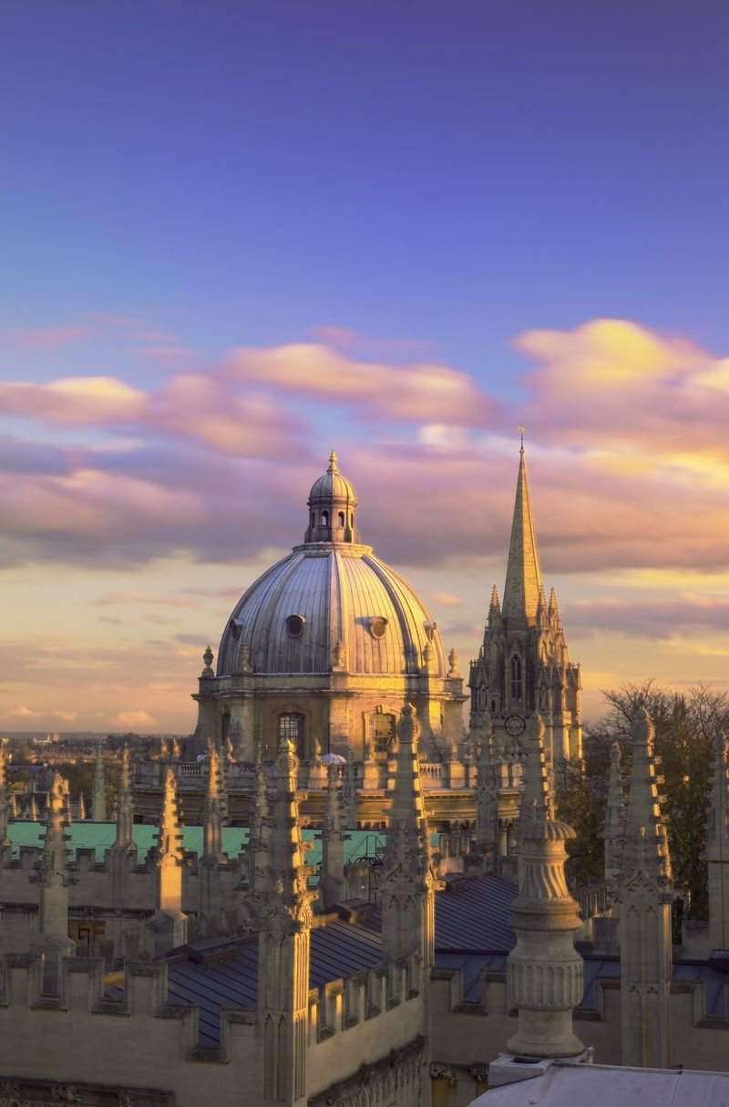
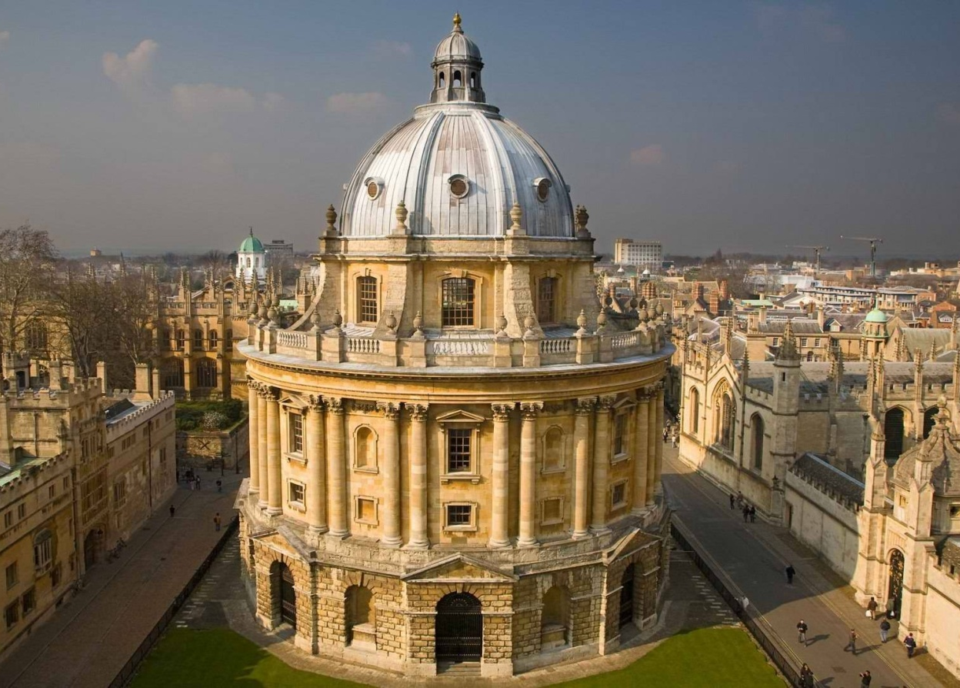
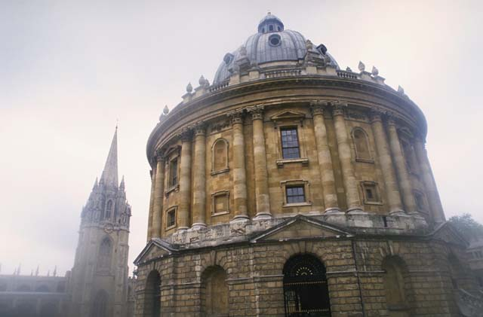
Most undergraduate teaching at Oxford is organised around weekly tutorials at self-governing colleges and halls, supported by classes, lectures and laboratory work organised by University faculties and departments. Oxford regularly contends with Cambridge for first place in the league tables, and consistently ranks among the top ten universities in the world, according to global rankings.For more than a century, it has served as the home of the Rhodes Scholarship, which brings students from a number of countries to study at Oxford as postgraduates or for a second bachelor's degree. Oxford is a member of the Russell Group of research-led British universities, the Coimbra Group, the G5, the League of European Research Universities, and the International Alliance of Research Universities. It is also a core member of the Europaeum and forms part of the "Golden Triangle" of British universities

