Slide 1
My favourite actress is….

Slide 2
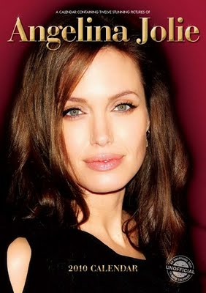

Slide 3
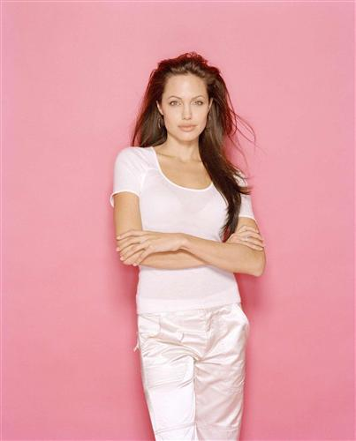
Born on June 4, in Los Angeles. As a child Jolie collected snakes and lizards . She regularly saw movies with her mother and later explained that this had inspired her interest in acting. When she was 11, Jolie decided she wanted to act.

Slide 4
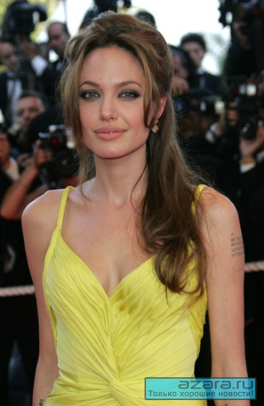
Jolie began working as a fashion model at 14. She was signed with Finesse Model Management and modeled in both the United States and Europe, working mainly in Los Angeles, New York and London. At the age of 16 Jolie returned to theatre, and played her first role as a German dominatrix.

Slide 5
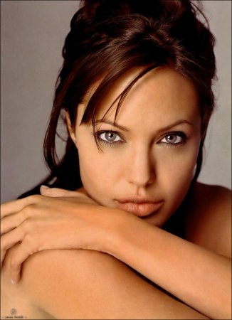
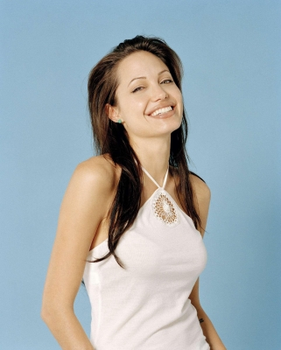
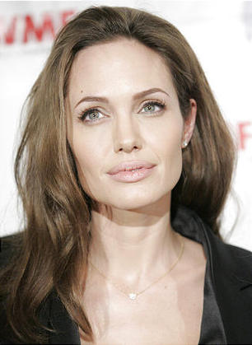
Her professional movie career began in 1993, when she played her first leading role in the low budget film Cybord 2.

Slide 6
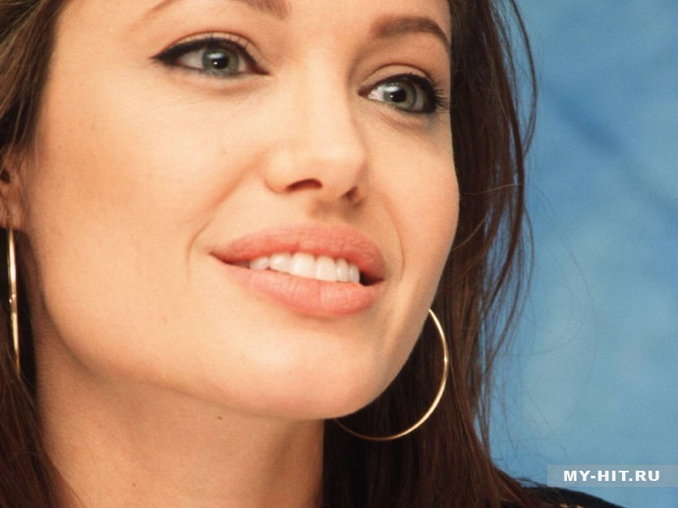
In 2000 Jolie appeared in her first summer blockbuster Gone in 60 seconds.
Lara Croft: Tomb Raider (2001) made her an international superstar.
Jolie’s only movie of 2005, the action – comedy Mr.& Mrs. Smith, is also her biggest commercial success to date.

Slide 7
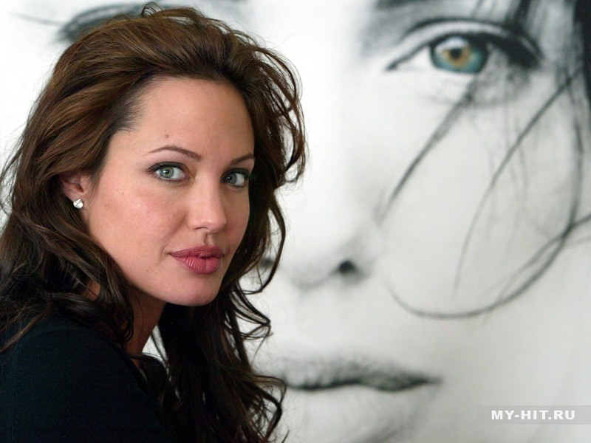
Divorced from actors Jonny Lee Miller and Billy Bob Thornton, Jolie currently lives with actor Brad Pitt, in a relationship that has attracted worldwide media attention.

Slide 8
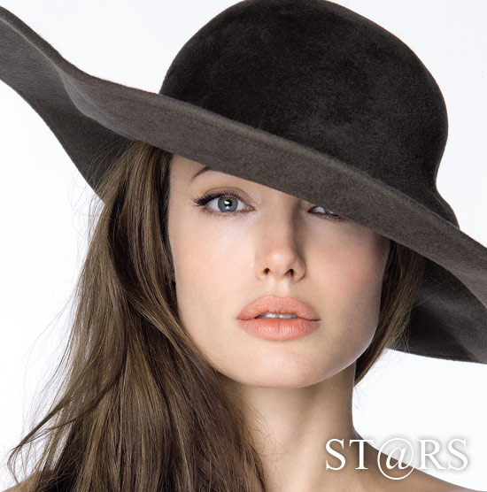
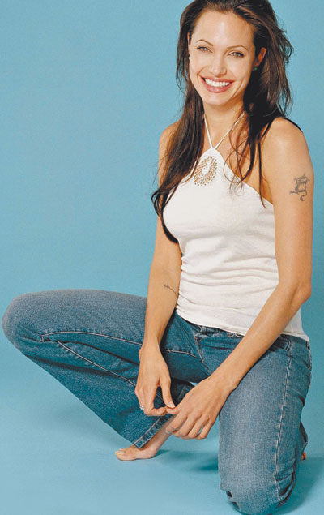
I like she as a woman, because she is very beautiful. And I want to look like Angelina Jolie

