Slide 1
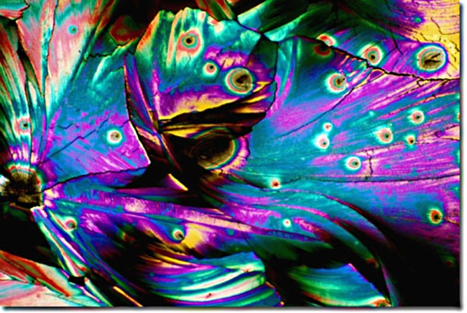
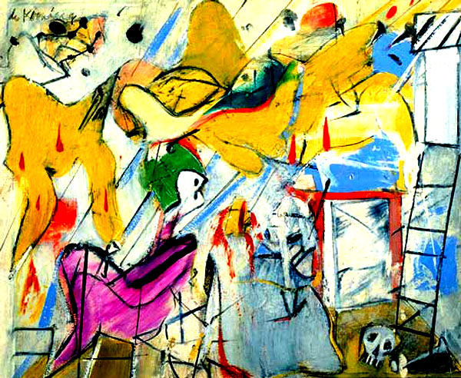
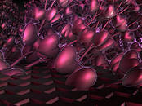
Painters

Slide 2
Kazimir Malevich
Russian and Soviet avant-garde artist of Polish origin, teacher, art theorist, philosopher.

Slide 3
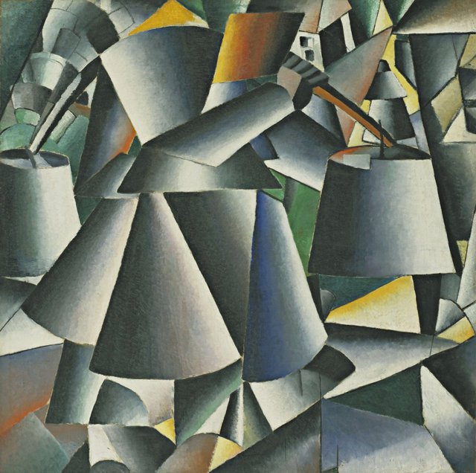

Slide 4
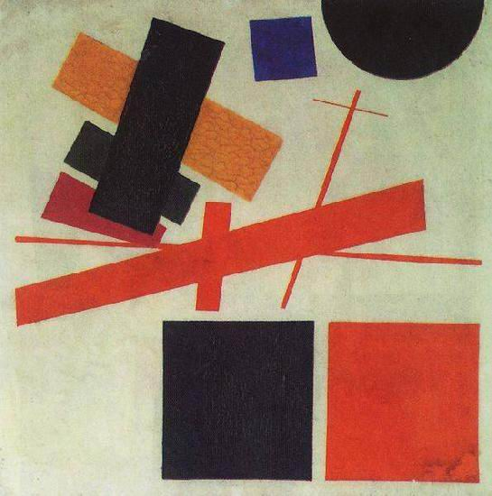

Slide 5
Otto Dix
The famous German painter and graphic artist, one of the representatives of "hard" realism and impressionism.

Slide 6
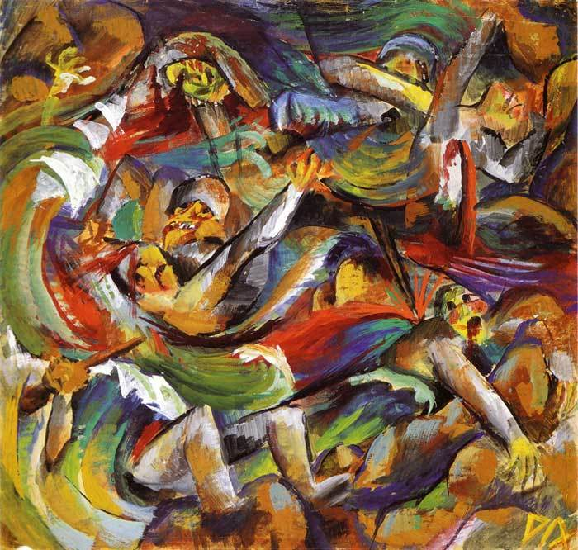
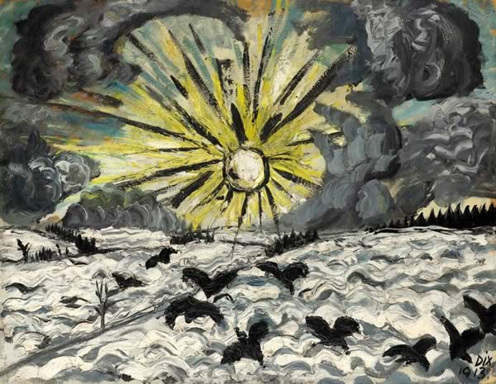

Slide 8
Pablo Picasso
Spanish painter, sculptor, graphic artist, scene-painter, ceramist and designer

Slide 9
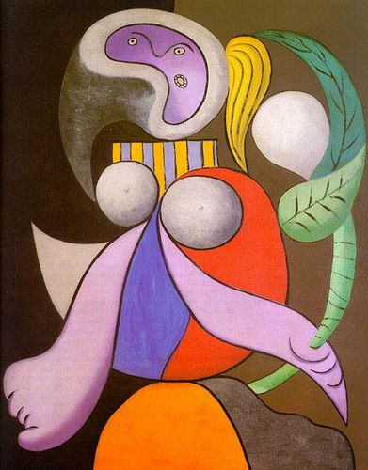

Slide 10
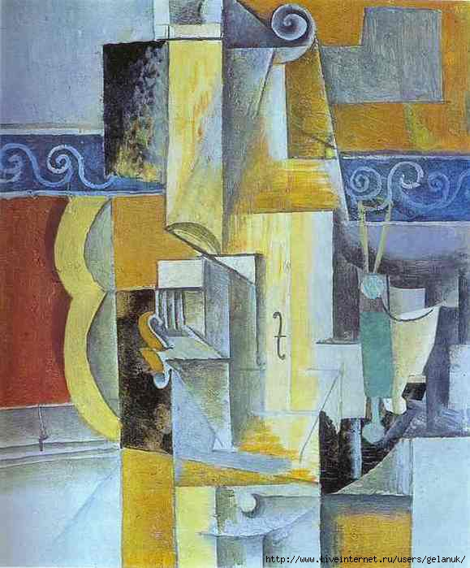

Slide 11
Thank you for your attention

Slide 12
Work has been fulfilled by the student 10 - b class Veronika Paskal

