Slide 1
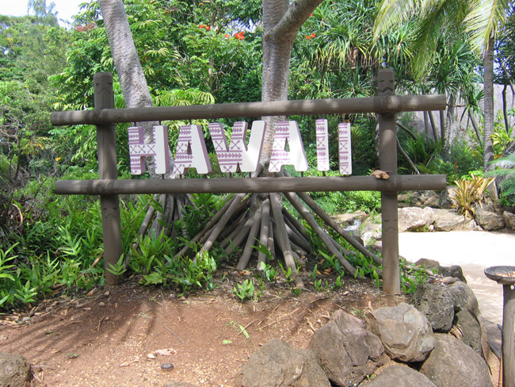

Slide 2
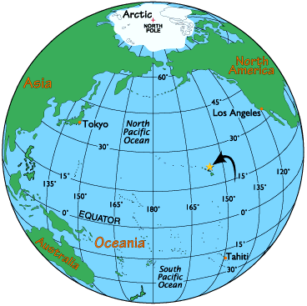
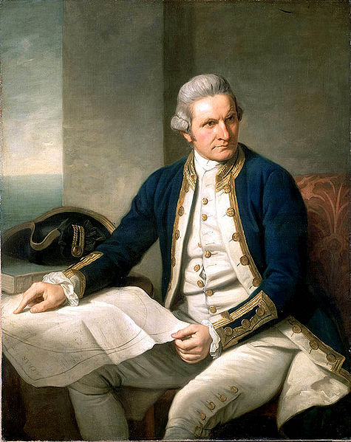
The Hawaiian Islands are an archipelago [ˌɑːkɪ'peləgəu] of eight major islands, several atolls ['ætɔl], numerous smaller islets ['aɪlət], and undersea seamounts in the North Pacific Ocean.
Hawaiian Islands were discovered by Captain James Cook in 1778.

Slide 3
The largest island of the archipelago [ˌɑːkɪ'peləgəu] is Hawaii. [hə'waɪiː ], [hɑː'waɪiː] The most popular islands with tourists are: Oahu [əu'ɑːhuː], Hawaii, Maui ['maʊɪ], Kauai [kɑː'wɑːiː], Lanai [lɑː'nɑːɪˌ lə'naɪ] and Molokai [ˌməʊləʊ'kɑːɪ].

Slide 4
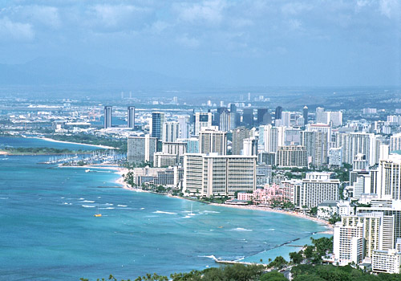
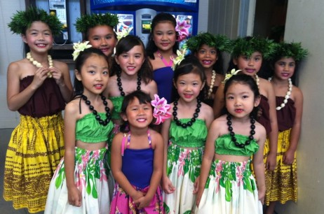
The population of the Hawaiian Islands is 1.3 million people.
The majority of the population belongs to the Catholic ['kæθ(ə)lɪk] and Protestant ['prɔtɪst(ə)nt] churches.
The national capital is Honolulu. [ˌhɔn(ə)'luːluː]

Slide 5
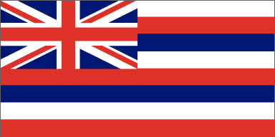
Political system of Hawaii
Government in Hawaii is similar to other U.S. states but has several differences. The state constitution was modeled from the constitution of the Kingdom of Hawaii, modified to not conflict with the U.S. Constitution.
English and Hawaiian are official languages, though in practice, it’s not required that all official documents be printed in each language, or that government officials be fluent Hawaiian speakers. Admission Day (День официального вхождения штата или территории в состав Соединенных Штатов Америки) is a state holiday in Hawaii, observed on the third Friday in August.

Slide 6
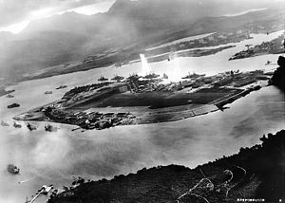
Pearl Harbor, named for the pearl oysters (устрица) once harvested (проводить массовые охоты) there, is the largest natural harbor (гавань) in Hawaii, on the island of Oahu. It is the only naval (военно-морской) base in the United States to be designated a National Historical Landmark. The devastating ['devəsteɪtɪŋ] (опустошительный) aerial attack on Pearl Harbor on the morning of December 7, 1941 by the Imperial Japanese Navy (военно-морские силы) resulted in more than 2,000 dead and hundreds wounded, and drove the United States into World War II.

Slide 7
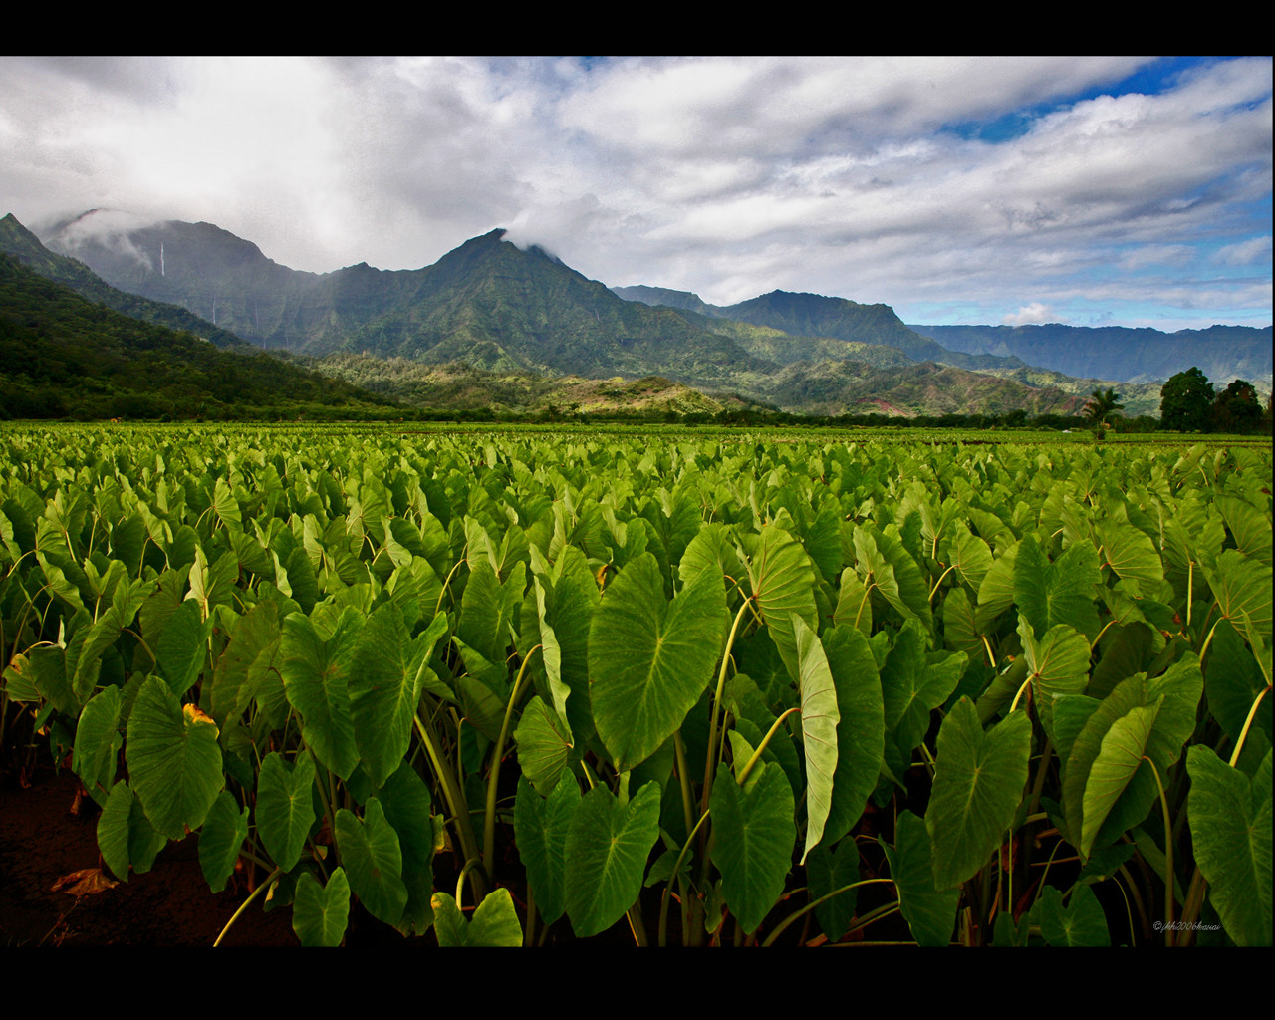
The Chief industries of the state are tourism, defense, sugar and pineapples.
Chief manufacturing goods of the state are processed sugar, canned pineapple, clothing, foods, printing & publishing.
Major crops (с/х культуры) of the state are sugar, pineapples, macadamia nuts, fruits, coffee, vegetables and floriculture.

Slide 8
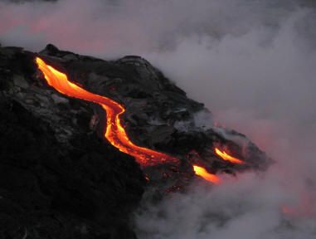
On the Hawaiian island there are two most active volcano on earth – Mauna Loa /ˌmaʊnə ˈloʊ.ə/
and Kilauea [ˌkiːlɑːuː'eɪə]. Mauna Loa is the highest active volcano in the world. Mauna Loa is in eruption (извержение) once every 4.5 years.

Slide 10
The most famous people from Hawaii are

Slide 11
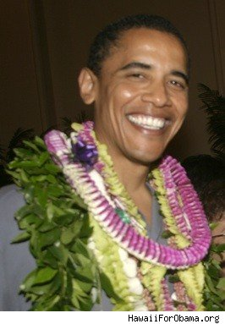

Slide 12
Haleakala [ˌhɑːliːˌɑːkɑː'lɑː] National Park
A scenic ['siːnɪk] (живописный) national park known as the “house of the sun” on the island of Maui and home to Maui's highest peak (пик).

Slide 14
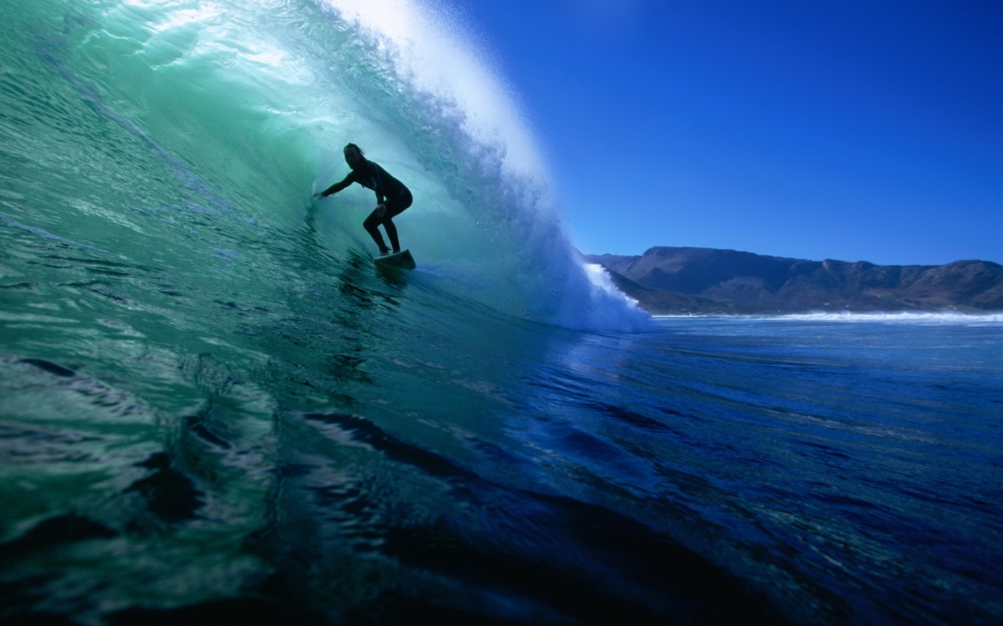
Surfing
Surfing is believed to have originated long ago in ancient Polynesia [ˌpɔlɪ'niːʒə], later thriving [θraɪv] (процветать) in Hawaii. It was once a sport only reserved for Hawaiian royalty, which is why surfing is often called the “sport of kings”. Hawaii is considered as the birthplace of modern surfing and big wave surfing and continues to be a surfing mecca for the world.

Slide 16
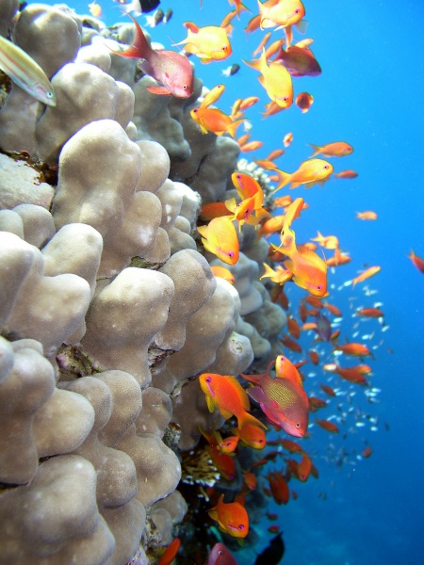
Hawaii has year round warm waters and has been a popular dive location for years offering some of the best dive sites in the world. The islands of Hawaii each have their own personalities and characteristics and due to Hawaii's geographical isolation they each offer unique and exciting dive sites, and an abundance of marine mə'riːn life

Slide 18
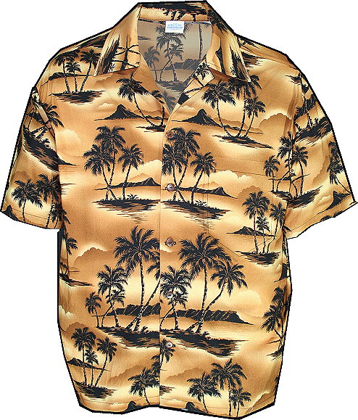
You might have denounced extravagance, the craving for vivid colors and unusual prints. But within two centuries a modest workman's shirt grew into the trademark wear of Hawaii.
In the late 1920's and early 1930's tourists, always looking for exotic souvenirs, fell for a fad (прихоть) of the young islander. Artists and tailors spotted a serious business. The name "aloha shirt", registered['reʤɪstəd] in 1936, soon labeled a flourishing ['flʌrɪʃɪŋ] industry.

Slide 20
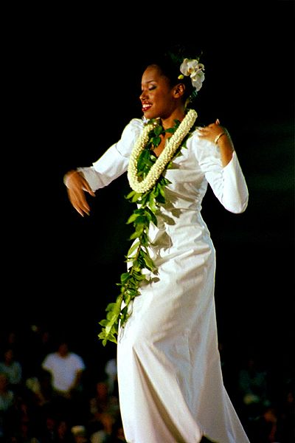
Lei is a Hawaiian word for a garland or wreath [riːθ] (венок). A lei is any series of objects strung together with the intent to be worn. The most popular concept of a lei in Hawaiian culture is a wreath of flowers draped around the neck presented upon arriving or leaving as a symbol of affection.

Slide 21
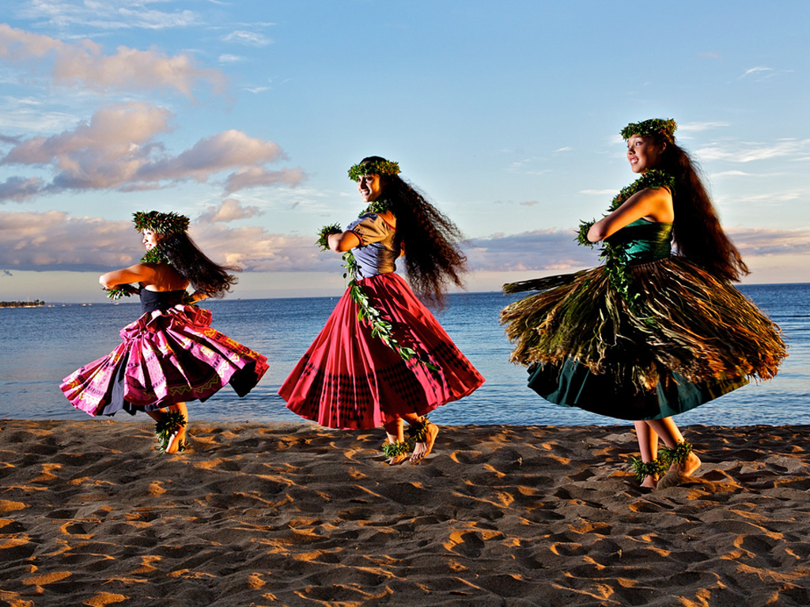
Hula dancing is the traditional art of movement, smooth bodily gestures and vocals. You may notice that Hula Dancing seems to have an incredibly smooth "flow" and the movements are extremely fluid. These movements are said to actually tell a story or represent movements of nature such as trees blowing in the wind or fish swimming smoothly in the ocean.

