Slide 1
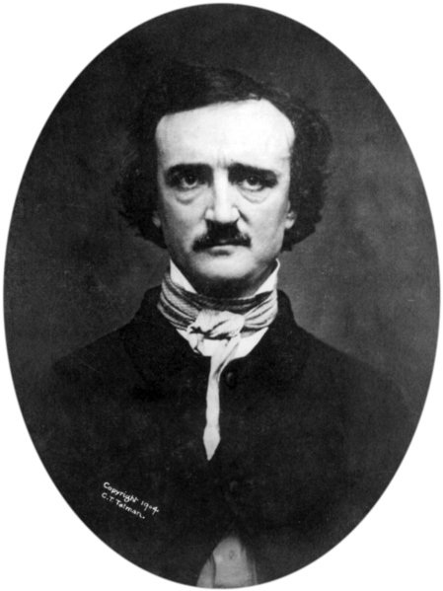
Edgar Allan Poe

Slide 2
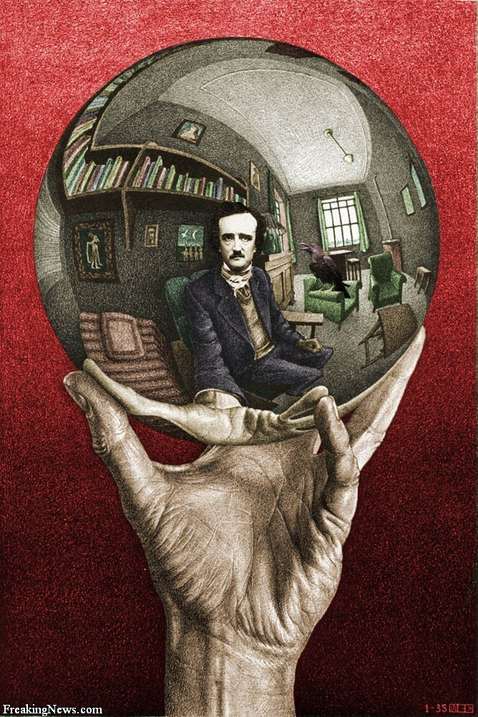
Edgar Allan Poe (born Edgar Poe; January 19, 1809 – October 7, 1849) was an American author, poet, editor, and literary critic.
Best known for his tales of mystery and the macabre, Poe was one of the earliest American practitioners of the short story and is generally considered the inventor of the detective fiction genre. He is further credited with contributing to the emerging genre of science fiction. He was the first well-known American writer to try to earn a living through writing alone, resulting in a financially difficult life and career.

Slide 3
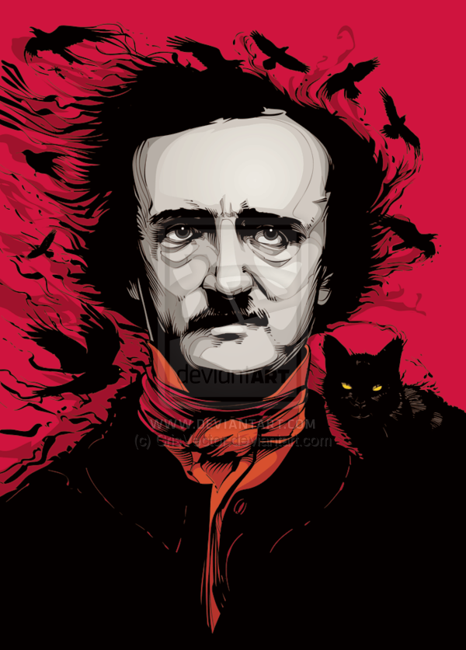
Poe and his works influenced literature in the United States and around the world, as well as in specialized fields, such as cosmology and cryptography. Poe and his work are popular in literature, music, films, and television. A number of his homes are dedicated museums today. The Mystery Writers of America present an annual award known as the Edgar Award for distinguished work in the mystery genre.

Slide 4
Born in Boston, he was the second child of two actors. His father abandoned the family in 1810, and his mother died the following year. the child was taken in by John and Frances Allan, of Richmond, Virginia. Poe attended the University of Virginia for one semester but left due to lack of money. His publishing career began in 1827.
In Baltimore in 1835, he married Virginia Clemm, his 13-year-old cousin. His wife died in 1847.
For years, he had been planning to produce his own journal but he died before it could be produced. On October 7, 1849, at age 40, Poe died in Baltimore; the cause of his death is unknown and has been variously attributed to alcohol, brain congestion, cholera, drugs, heart disease, rabies, suicide, tuberculosis, and other agents.

Slide 5
Literary style and themes
Genres
Poe's best known fiction works are Gothic,a genre he followed to appease the public taste.
His most recurring themes deal with questions of death, including its physical signs, the effects of decomposition, concerns of premature burial, the reanimation of the dead, and mourning.
Beyond horror, Poe also wrote satires, humor tales, and hoaxes. For comic effect, he used irony.
Poe wrote much of his work using themes aimed specifically at mass-market tastes.

Slide 6
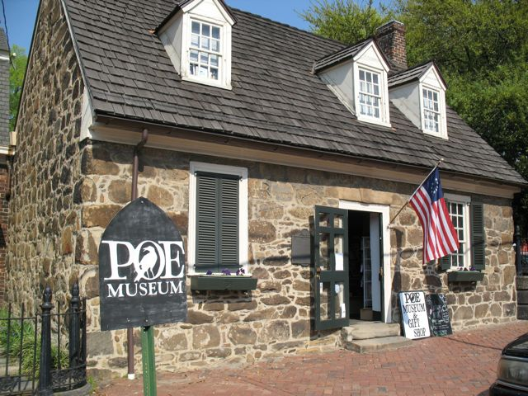
Preserved homes,
landmarks, and museums
The historical Edgar Allan Poe has appeared as the "mad genius“.
The earliest surviving home in which Poe lived is in Baltimore, preserved as the Edgar Allan Poe House and Museum. Poe is believed to have lived in the home at the age of 23

Slide 7
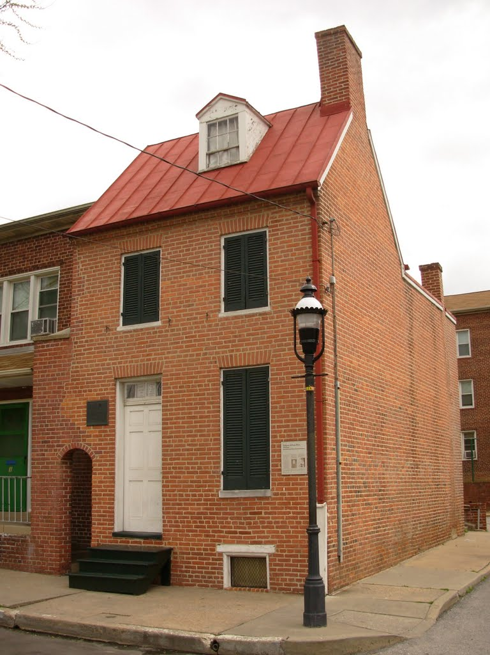
In Boston, a commemorative plaque on Boylston Street is several blocks away from the actual location of Poe's birth. As of 2013, fundraising is proceeding to construct a permanent memorial sculpture at this location.
Other Poe landmarks include a building in the Upper West Side, where Poe temporarily lived when he first moved to New York.

Slide 8
Selected list of works
Tales
"The Black Cat"
"The Cask of Amontillado"
"A Descent into the Maelström“
"The Fall of the House of Usher"
"The Gold-Bug"
"Hop-Frog"
"The Imp of the Perverse“
"Morella"
"The Murders in the Rue Morgue"
"The Oval Portrait"
"The Pit and the Pendulum"
"The Premature Burial"
"The Purloined Letter“
"The Tell-Tale Heart"
Poetry
"Al Aaraaf"
"Annabel Lee"
"The Bells"
"The City in the Sea"
"The Conqueror Worm"
"A Dream Within a Dream"
"Eldorado"
"Eulalie"
"The Haunted Palace"
"To Helen"
"Lenore"
"Tamerlane"
"The Raven"
"Ulalume"

Slide 9
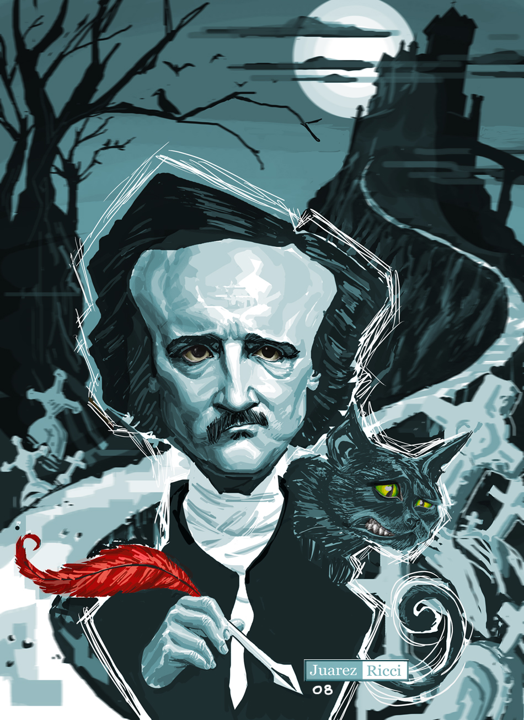
Other works
Politian (1835) – Poe's only play
The Narrative of Arthur Gordon Pym of Nantucket (1838) – Poe's only complete novel
"The Balloon-Hoax" (1844) – A journalistic hoax printed as a true story
"The Philosophy of Composition" (1846) – Essay
Eureka: A Prose Poem (1848) – Essay
"The Poetic Principle" (1848) – Essay
"The Light-House" (1849) – Poe's last incomplete work

Slide 10
Thank you for your attention!

