Slide 1
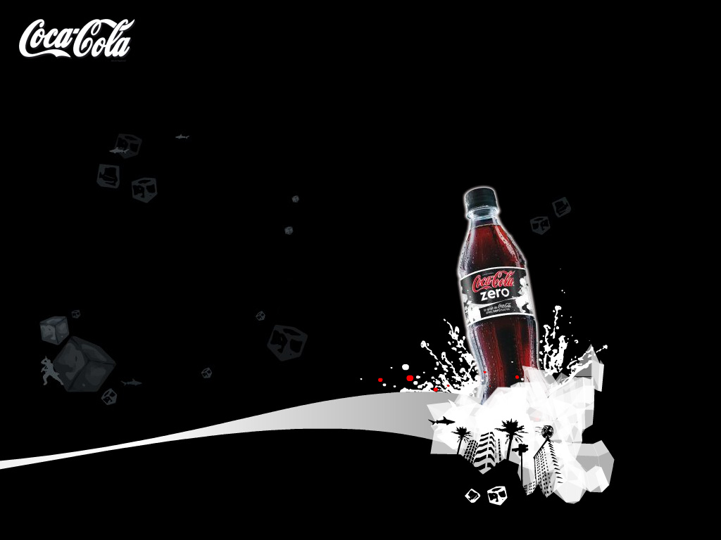

Coca-Cola
Life Begins Here

Slide 2
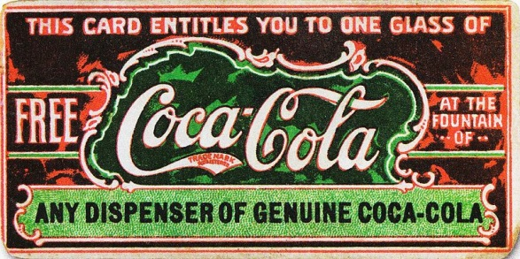

Coca-Cola is a carbonated soft drink.
It was invented in 1886 in Georgia, Atlanta by pharmacist John Pemberton.
Initially it was sold as a
patent medicine for five cents.
Pemberton claimed Coca-Cola cured many diseases,
including morphine
addiction,
dyspepsia, neurasthenia, headache, and impotence.

Slide 3

At first drink was unprofitable
Just about 9 people a day bought Coca-Cola.
So, at the first year receipts was only 50 dollars. And for production this drink was expended 70 dollars.
And in 1888 Pemberton sold right to production of the Coca-Cola. In 1892 businessman Asa Candler,
Who was the new
owner of
rights,
founded “The Coca-Cola Company” which we know now.

Slide 4


The richest drink of the USA
The turnover of the company in 1902 was 120 thousand
dollars. Since this moment
the popularity
of Coca-Cola
increased

Slide 5
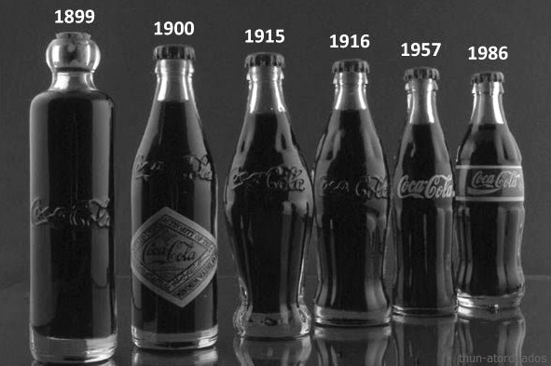
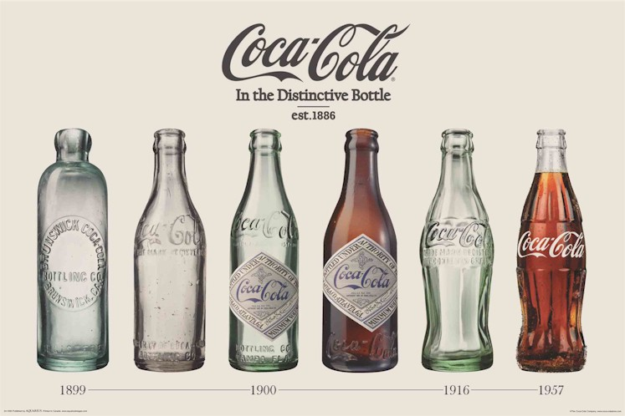
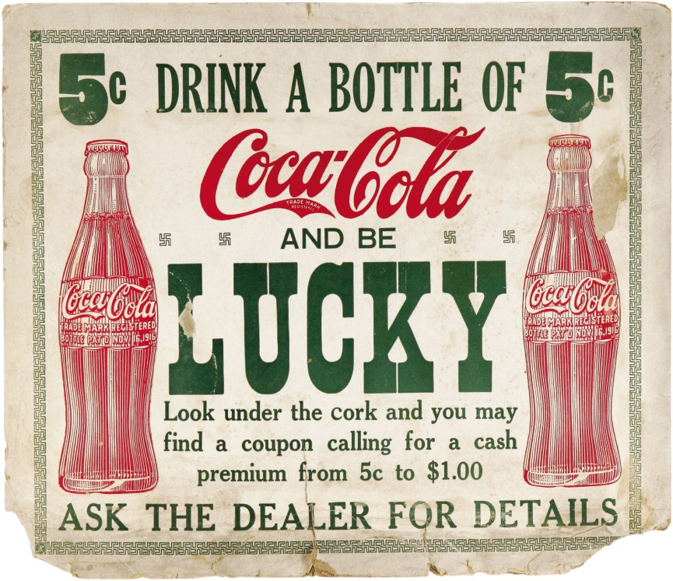
Bottles and cans
Since 1894 Coca-Cola was sold in bottles
And since 1955 – in cans

Slide 6


Slogans
Slogans of the company for the last 20 years:
1991 - Can't Beat the Real Thing.
1993 - Always Coca-Cola.
1999 - Enjoy.
2001 - Life tastes good.
2003 - Real.
2005 - Make It Real.
2006 - The Coke Side of Life
2007 - Live on the Coke Side of Life
2008 - love it light
2009 - Open Happiness
2010 - Twist the Cap to
Refreshment
2011 - Life Begins Here

Slide 7
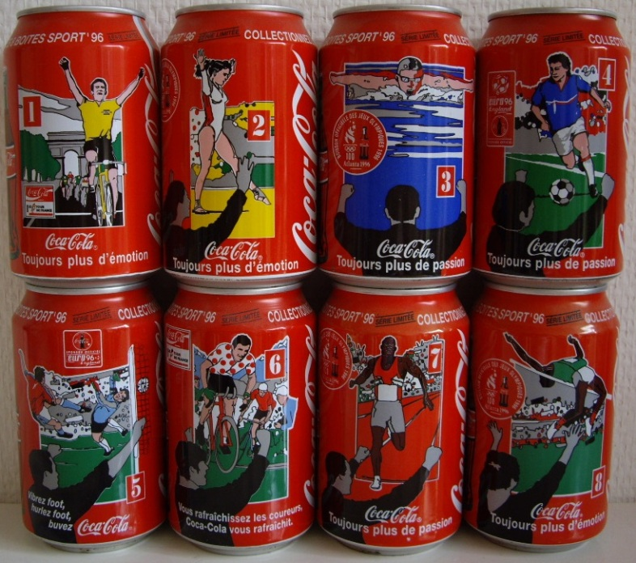
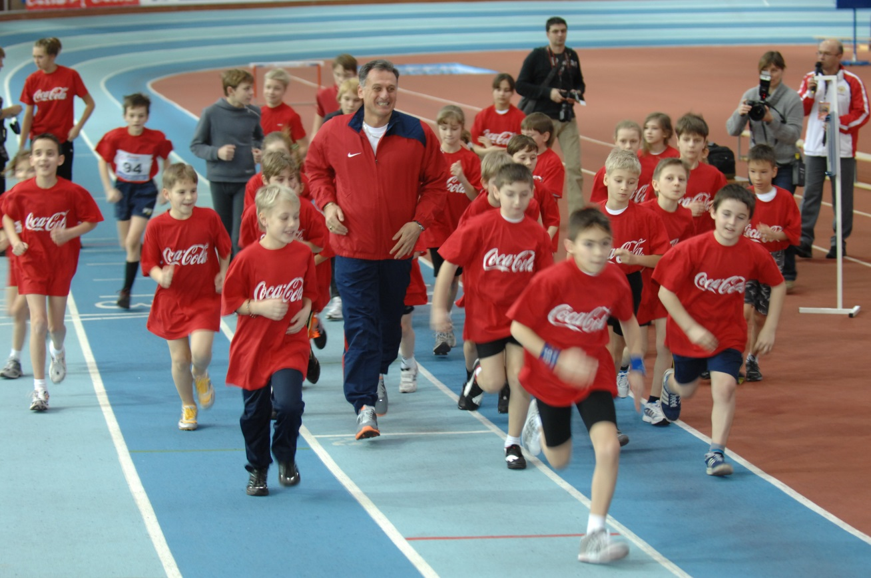
Market
In the Coca-Cola company it is always looked after changing of tastes of the customer. The company innovated the whole line of the special programs for the customers.
For the healthy style of life:
The growth of the assortment: low-calorie and fortified with the healthy components products.
The information about the composition.
Propagation of sport and physical culture

Slide 8
Environment
The company trying to minimize negative influence on the environment. Coca-Cola Beverages Ukraine (a member of Coca-Cola Hellenic Group) at first achieved ISO14001(certificate of accordance to the European standards) in 2002.
Water stewardship:
Company raises the effectiveness of water demand
Decreases quantity of the water necessary for the production
Propagation of rational use of water.
Protects local watershed
In 2009 Coca-Cola Beverages Ukraine signed a Memorandum in cooperation with the Water Information Center, where Kyiv habitants
visited the Water Museum.
At an international level, Coca-Cola Hellenic is
a founding signatory of the CEO Water Mandate of the
UN Global Compact. This initiative aims to address water.

Slide 9
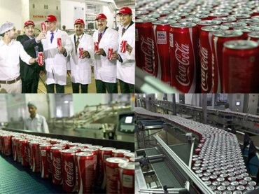
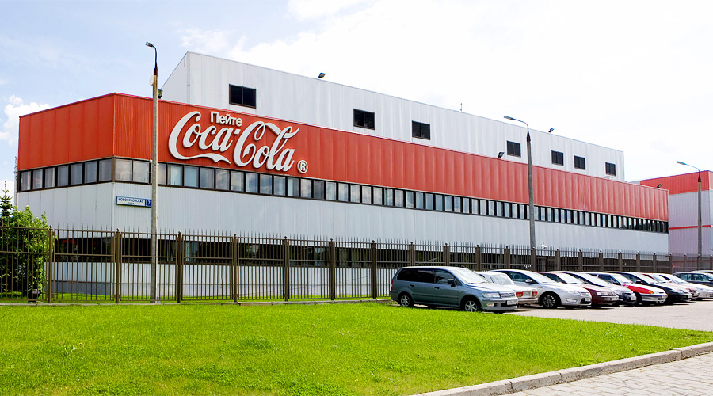
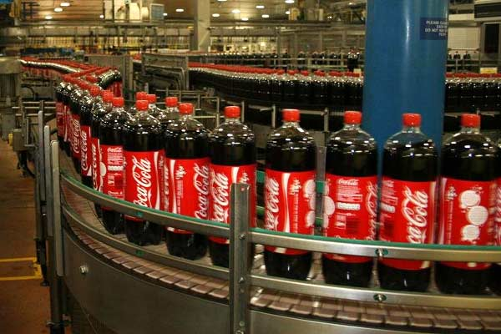
Energy and climate protection
Company expands on the bottling plants energy-savings programs.
Company explores low-power technologies
Changing drivers` behavior with Safe and Eco-Driving program.
New energy-efficient cold drink equipment reduces discharge of in the atmosphere.
At an international level, Coca-Cola Hellenic Group
is a founder signatory of the UN Global Compact’s
Caring for Climate, the largest global business
coalition on climate.

Slide 10
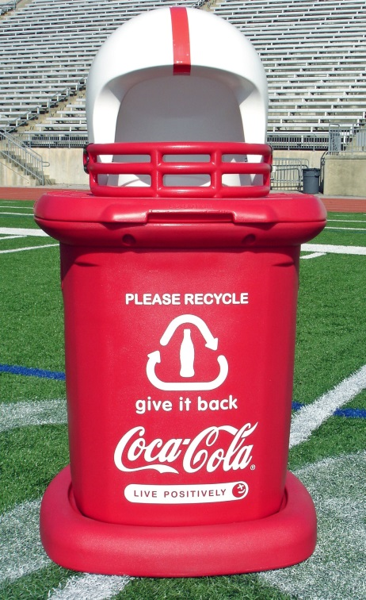
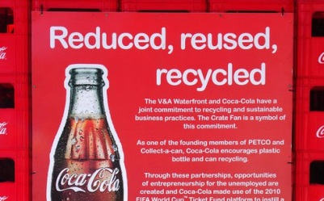
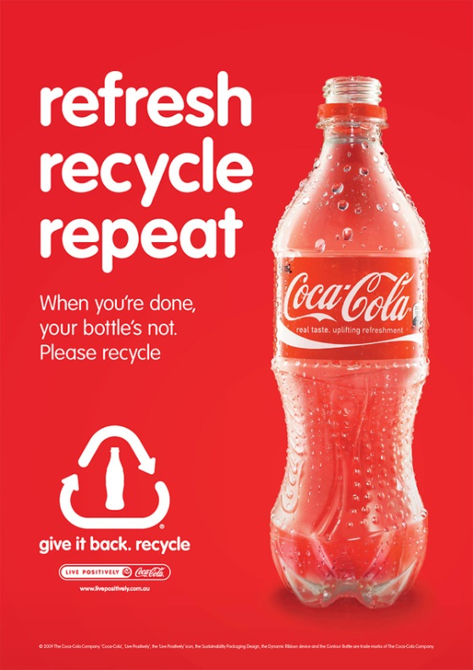
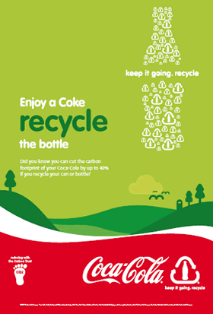

Packaging and recycling
Company reduces impact of the wrapper on the environment.
Reducing the amount of packaging
Increasing recycled content
Promoting recycling and recovery

Slide 11
Sustainability policies
At the heart of the company approach is Code of Business Conduct which defines the standards of business conduct.
There are few policies, which regulate all aspects of office relations.
Equality of opportunity policy
Environmental policy
Quality and food safety policy
Genetically modified organism (GMO) position statement
HIV/AIDS policy
Human rights policy
Occupational health and safety policy
Packaging waste and recycling policy
Supplier Guiding Principles policy
Climate change policy
Fleet safety policy
Health and wellness policy

Slide 12
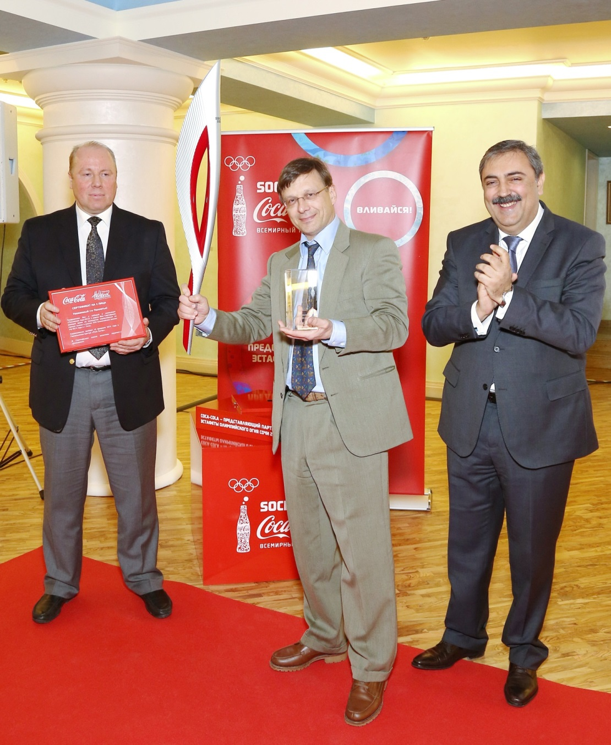
International leadership
At international level, the company support business leadership platforms that promote corporate responsibility and sustainable development, and they support and develop these at national level.
Coca-Cola Hellenic Group has been named as a global sustainability leader with its inclusion in the Dow Jones Sustainability Indexes in 2008 and at national level in Ukraine company work hard to ensure that Group maintains its position.

Slide 13
Engaging with stakeholders
These stakeholders are the people on whom the company have the greatest impact - or who have the greatest impact on the company. They include: suppliers, customers, non-government organisations (NGOs), government, consumers and local communities among others.
They learn from these groups in a variety of ways: from meetings to formal surveys of employees, customers, and others.
Most longstanding partnership is the Green Danube. This award-winning partnership with the International Commission for the Protection of the Danube River and The Coca-Cola Company works to protect
the iconic river and its ecosystems.
Associates:
The National Olympic Committee of Ukraine
to promote sports and fitness
The European Business Association
The American Chamber of Commerce
The Chamber of Commerce and Industry of Ukraine.

Slide 14





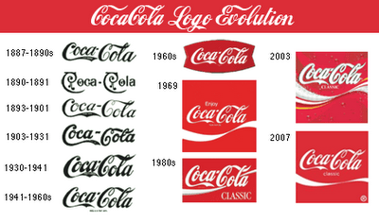
Thank you for attention

