Slide 1
Education in Ukraine

Slide 2
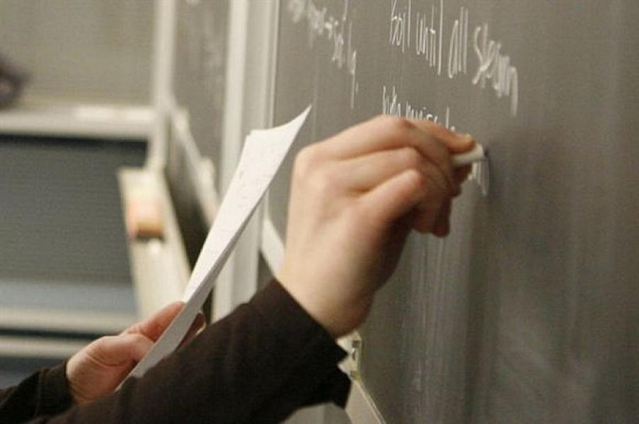
The system of secondary education in Ukraine includes primary forms and junior and senior secondary forms.

Slide 3
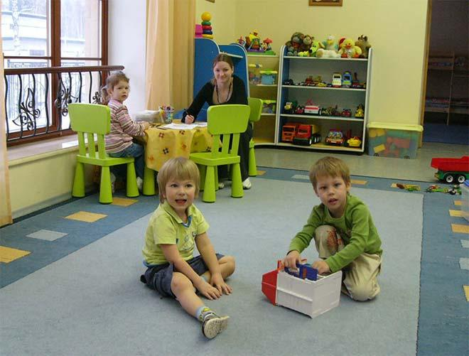
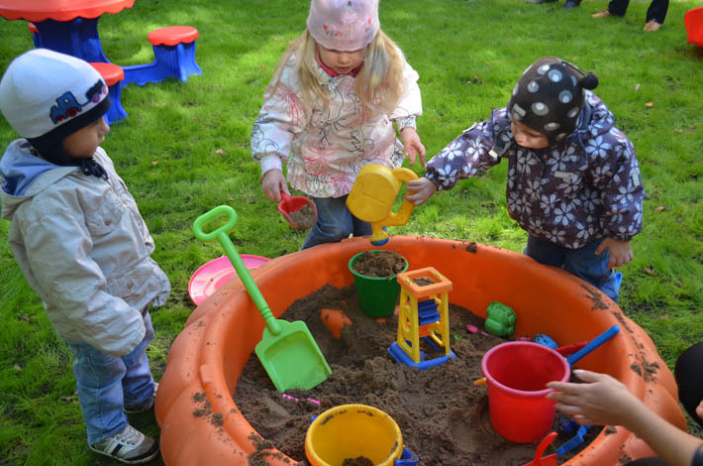
Children usually go to school at the age of 6 or 7. There are some pre-school institutions, like nursery schools or kindergartens, but they are not obligatory.

Slide 4
Primary forms comprise 1 to 4 forms. Junior secondary forms comprise 5 to 9 forms.

Slide 5
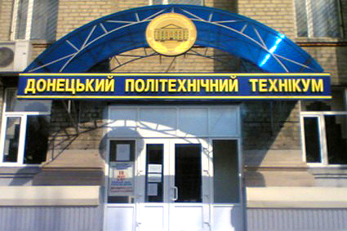
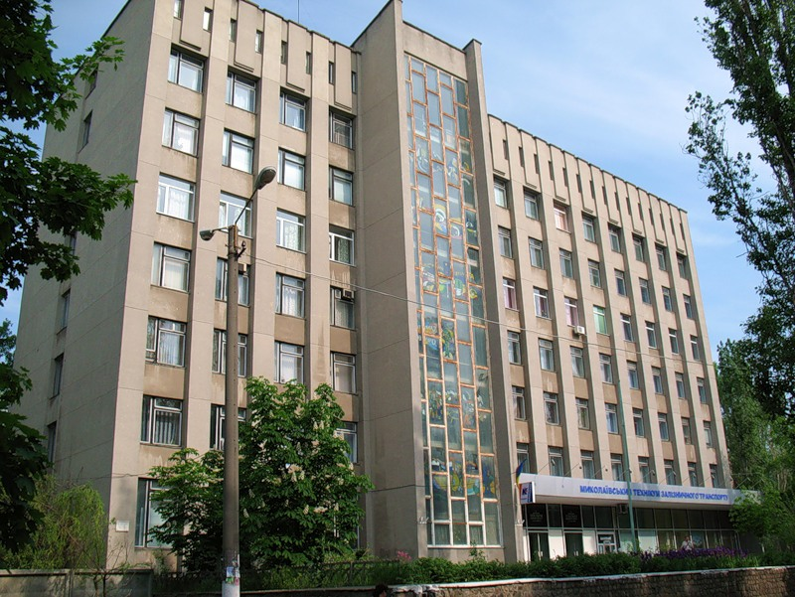
After the 9-th form children can enter technical schools of different types. Those who want to enter higher educational institutions should complete 10-11 forms.

Slide 6
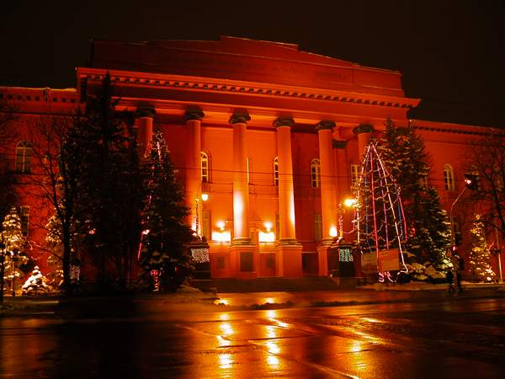
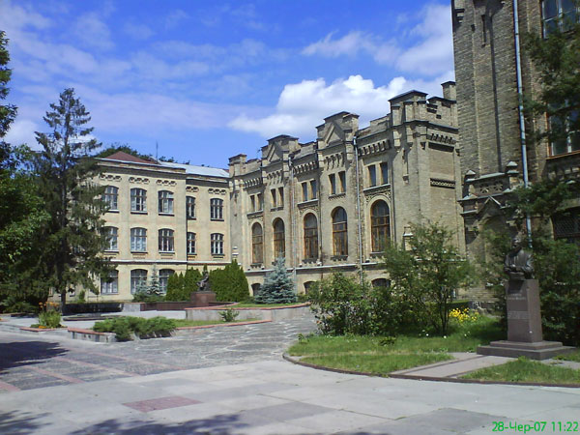
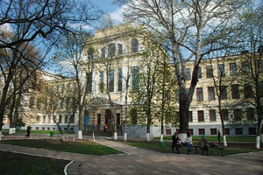
The system of higher education is presented by universities, polytechnic institutes or specialized institutes.

Slide 7
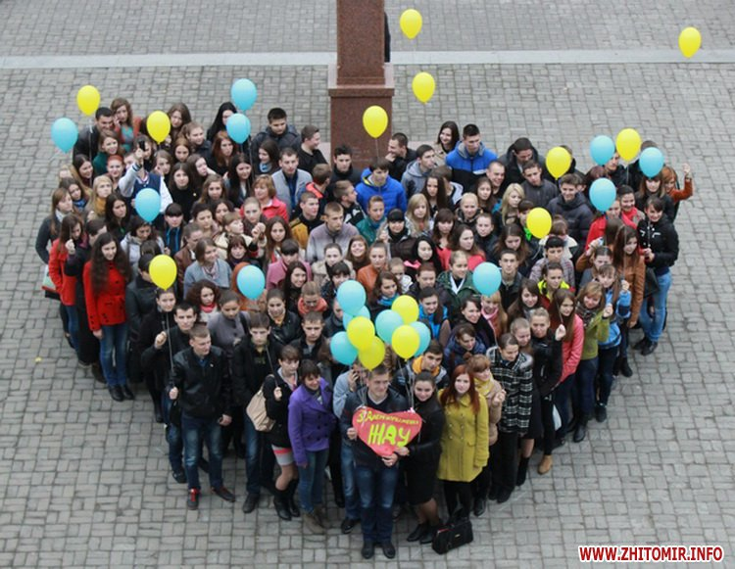
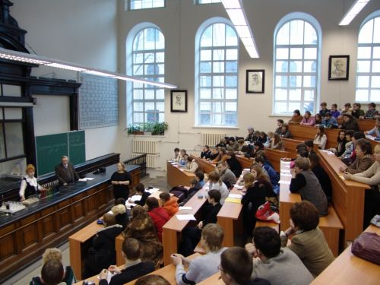
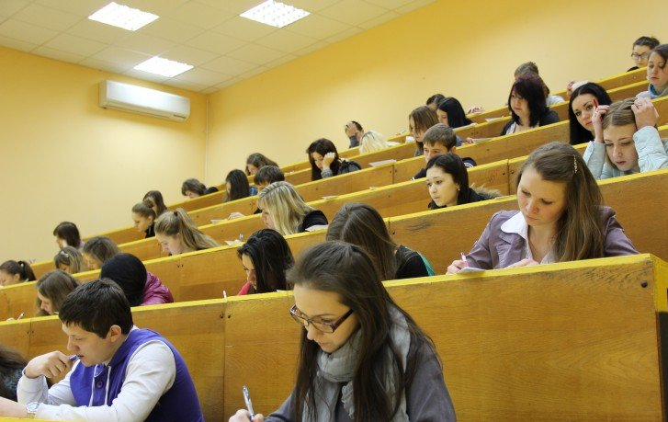
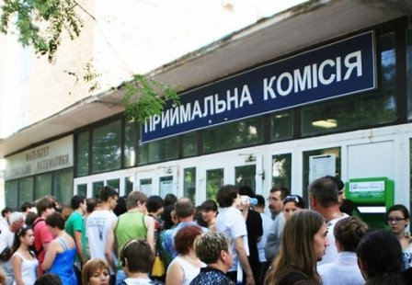
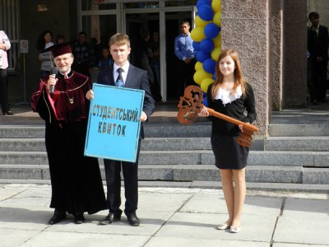
Universities offer a five-year course of study and usually have from six to twelve departments.

Slide 8
Students are also offered post-graduate education and scientific research work.
Some universities and institutes have refresher courses.
Some institutions have fee-paying groups or faculties. There the students may get education at the same high level as in the state institutions.

