Slide 1

LEGOLAND
Ventseslavsky Daniil

Slide 2
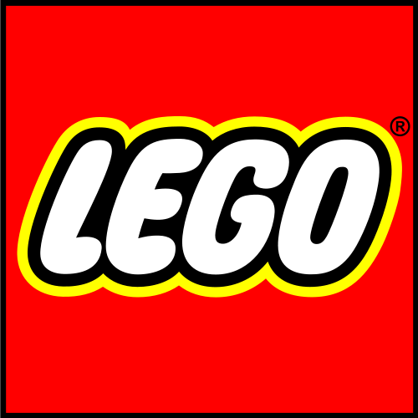
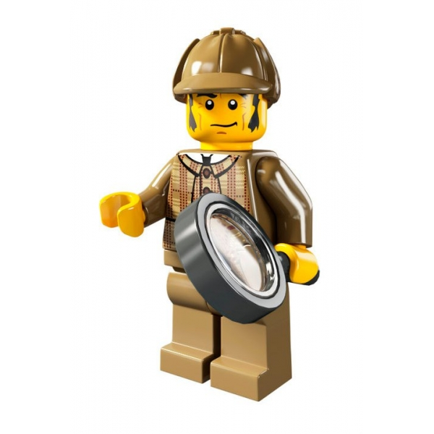

What's this?
Legoland Billund Resort (Billund, Denmark; opened in 1968)
Legoland Windsor Resort (Windsor, United Kingdom; opened in 1996)
Legoland California Resort (Carlsbad, San Diego County, California, USA; opened in 1999)
Legoland Deutschland Resort (Günzburg, Germany; opened in 2002)
Legoland Florida (Winter Haven, Florida, USA; opened in 2011)
Legoland Malaysia Resort (Nusajaya, Johor, Malaysia; opened in 2012)
Legoland is a chain of Lego-themed theme parks. They are not fully owned by Lego Group itself; rather they are owned and operated by the British theme park company Merlin Entertainments.

Slide 3
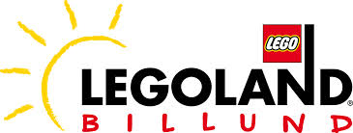
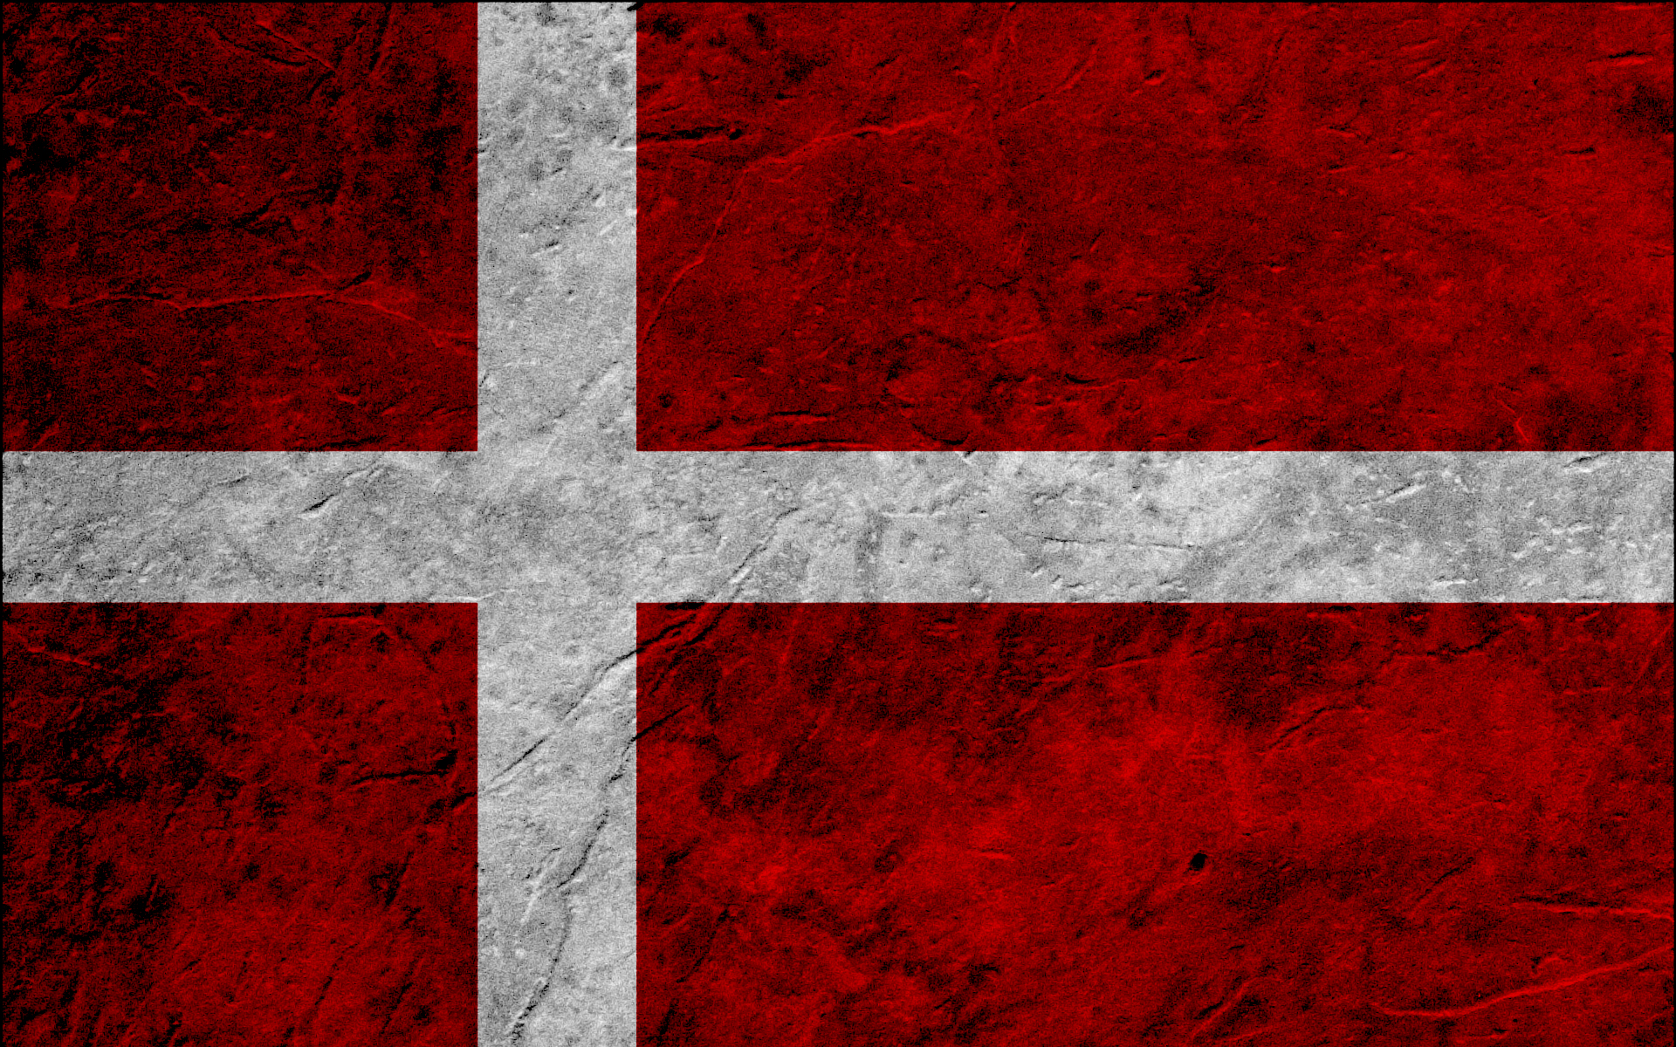
Billund, Denmark

Slide 4
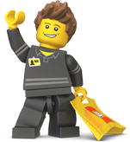
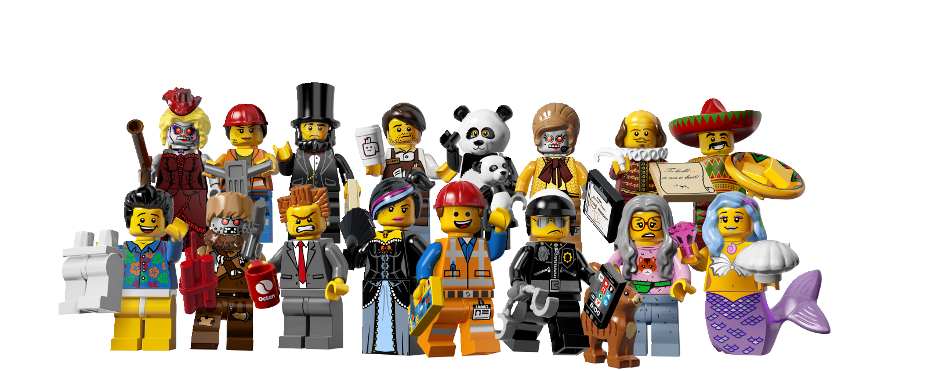
What's this?
Legoland Billund, the original Legoland park, opened on June 7, 1968 in Billund, Denmark. The park is located next to the original Lego factory and Denmark's second busiest airport Billund Airport. Over 1.9 million guests visited the park in 2011 and since the opening more than 50 million guests have visited the park. This makes Legoland the largest tourist attraction in Denmark outside of Copenhagen. The Legoland parks that have since been built are modelled upon Legoland Billund, most noticeably the Miniland area which is made up of millions of Lego bricks.

Slide 5
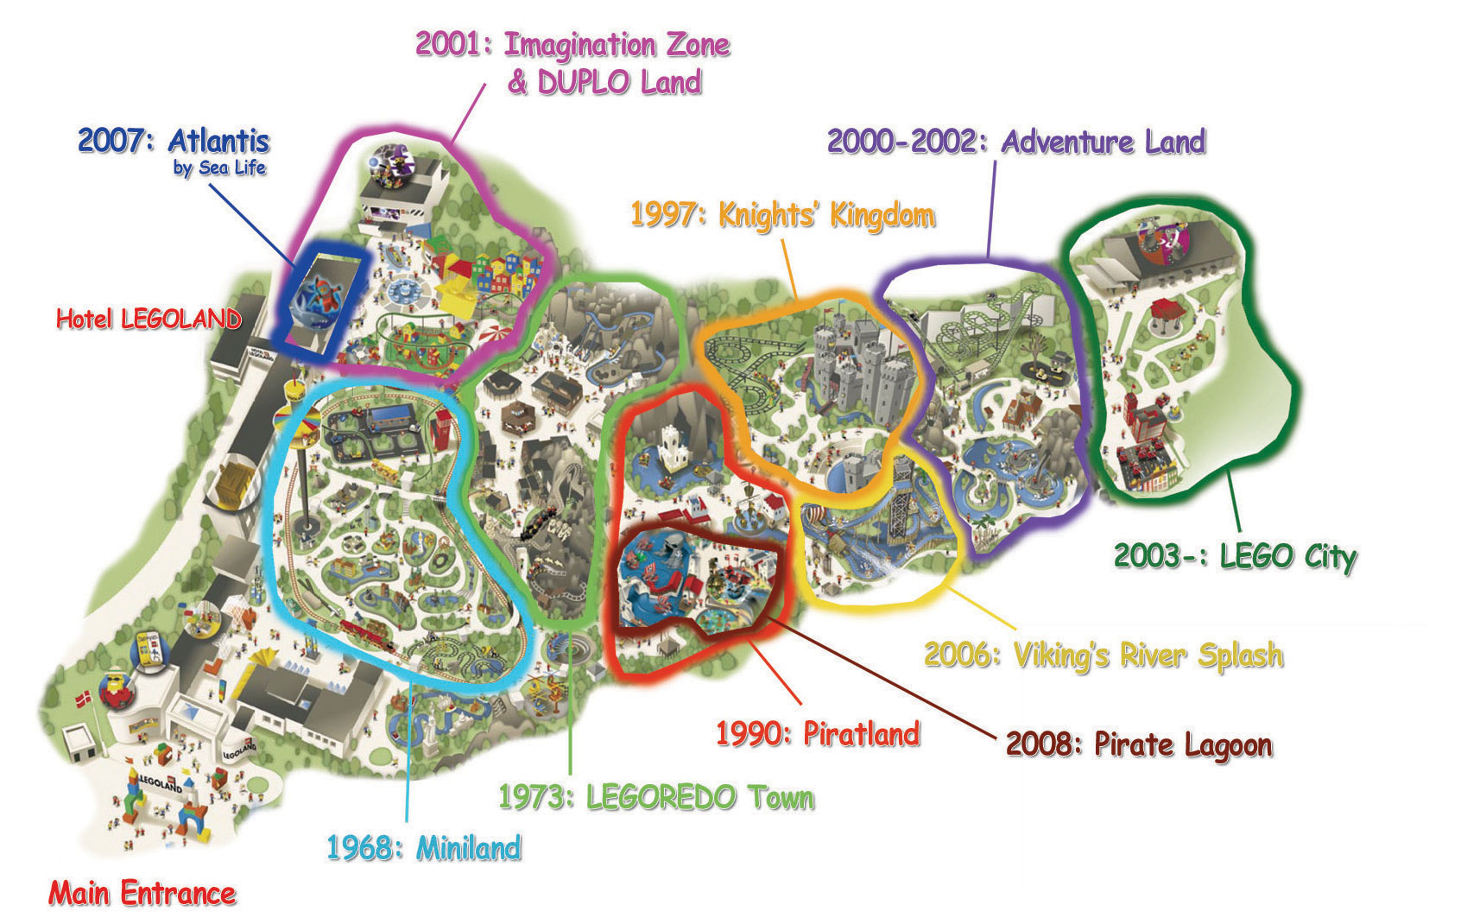
History
The first Legoland was built next door to the Lego factory that was founded by Ole Kirk Christiansen in 1949. His son, Godtfred, took over the family business in 1958 when his father passed away and just two years later he bought out his three brothers. In 1968 Godfredt decided to open a 14-acre Legoland Park to promote his toy business. The park became an instant success and has over the years added many original rides and been divided into specific themed worlds. The now 45-acre park is divided into 9 themed areas.
1. Duplo Land
2. Imagination Zone
3. LEGOREDO Town
4. Adventure Land
5. Lego City
6. Knight´s Kingdom
7. Mini Land
8. Pirate Land
9. Polar Land

Slide 6
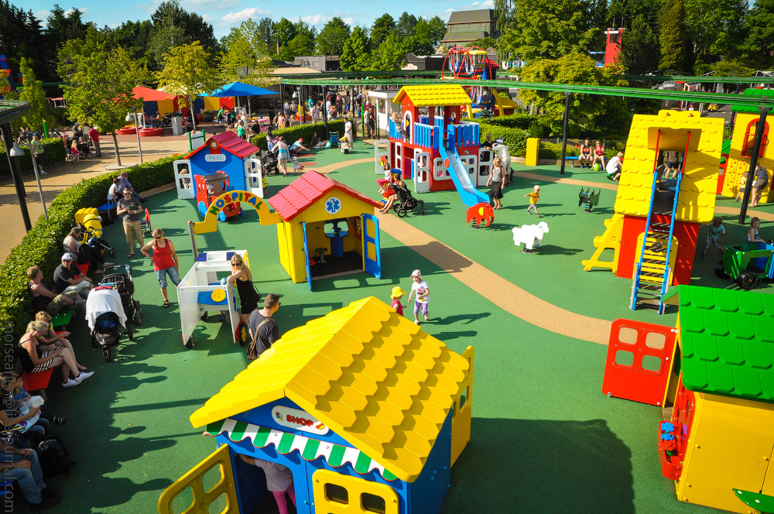
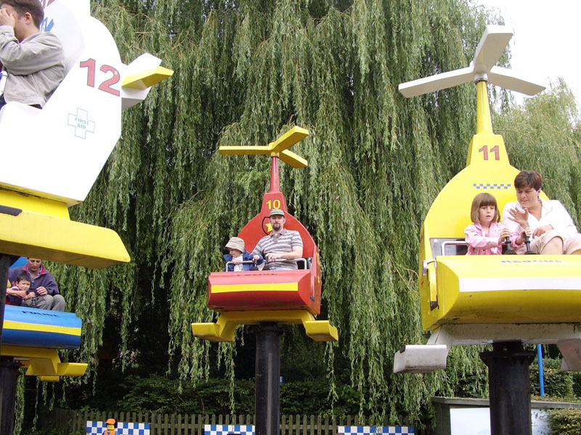
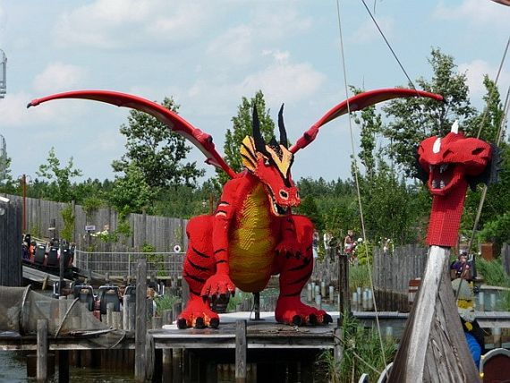
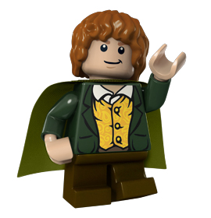
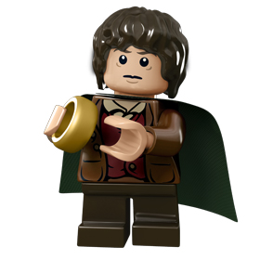
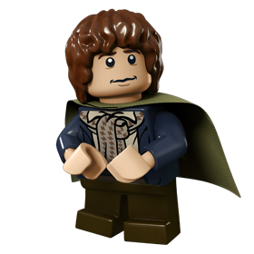
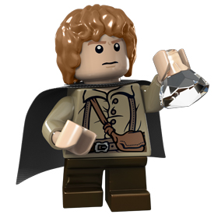
Duplo Land
Duplo Land contains rides and attractions for young children, with the Lego Duplo brand name. The Duplo Playhouse is a play area for children ages 2–6, which is themed like a city that children can play in. They can build using Lego, or play on fake planes and fake cars. There are also slides, stairs, interactive elements and a role-play area. The Duplo train, which is a kiddie train ride that looks like a train made of Duplo Bricks, takes 2 minutes to complete. Duplo Planes is a plane ride similar to Disney's Dumbo ride, but with a Lego theme. Duplo driving school is a car ride for children ages 2–6, who are not yet ready for the Traffic school ride.

Slide 7
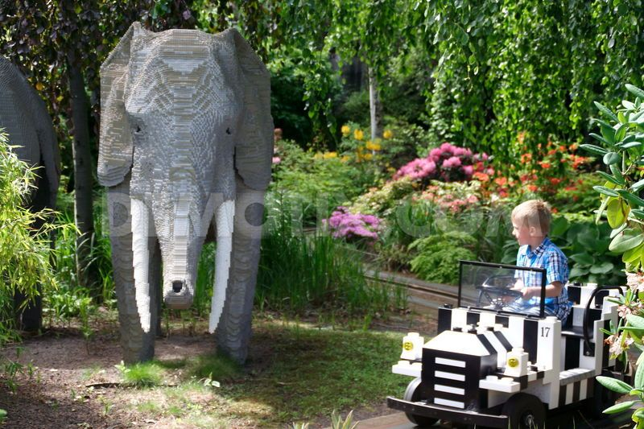
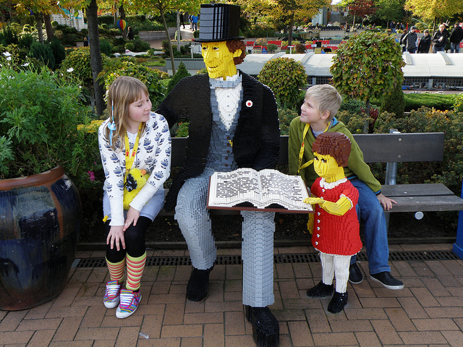
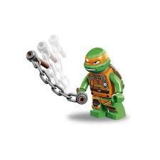
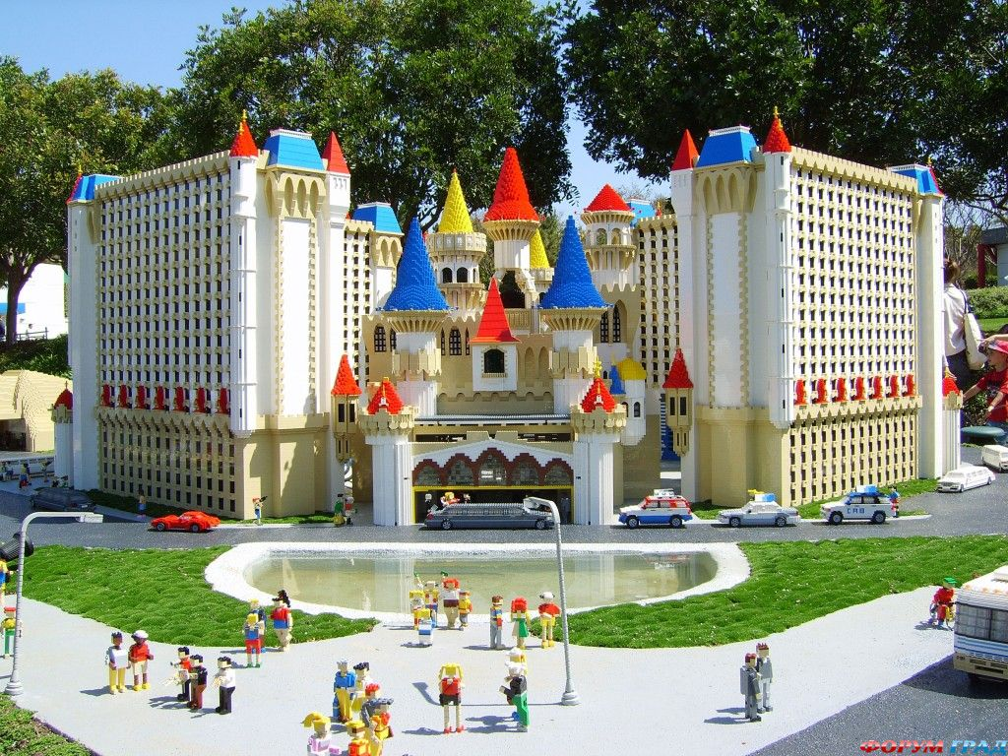
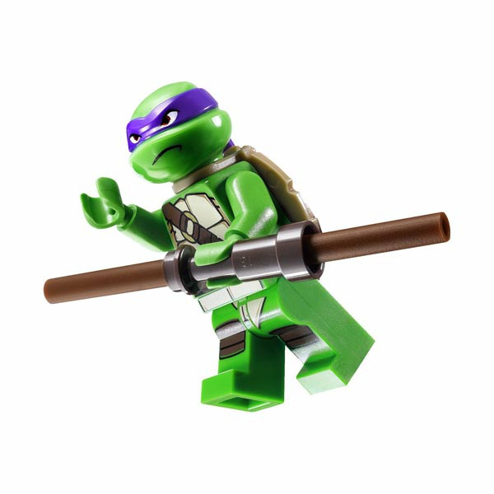
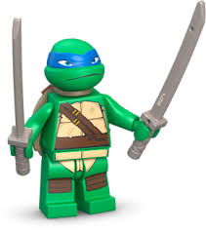
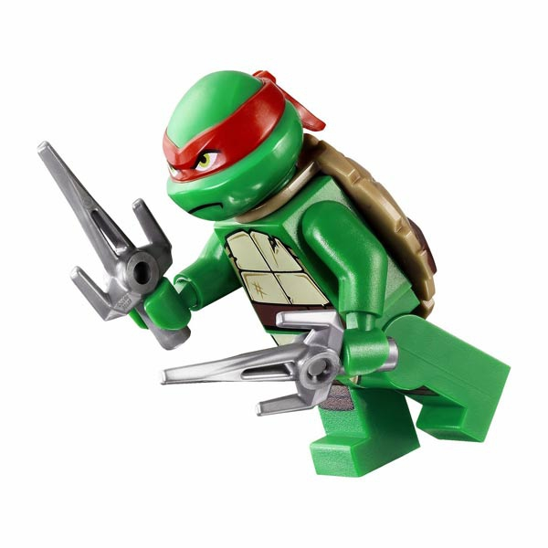
Imaginative zone
This zone contains the Lego Studio, a purpose built 600 seat 4-D Theater, complete with special effects and a giant screen. There are 4 movies that play daily (2010), these are Lego Racers, Spellbreaker, Bob the Builder 4D, and Clutch Powers. Lego Atlantis by Sea Life was added in 2007. The attraction starts off with an animated movie, featuring Lego figures and a submarine that travels down to the submerged city of Atlantis. There is also a Sea Life aquarium and other hands on activities with more than 800 sea creatures. Numerous Lego figures and models are in and around the aquarium.

Slide 8
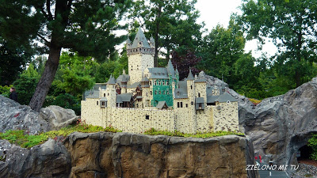
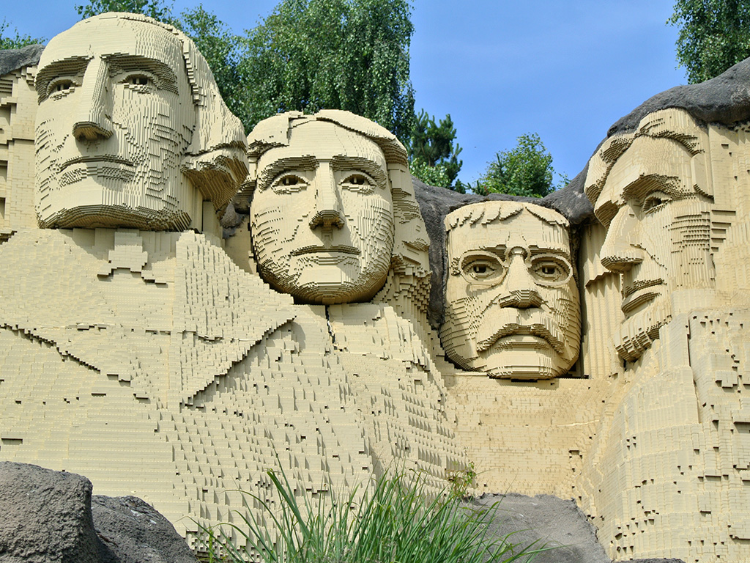
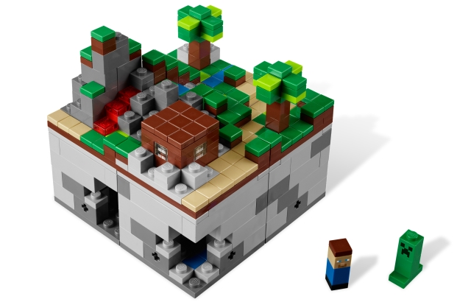
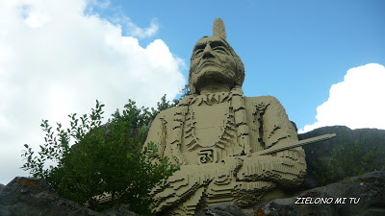
LEGOREDO town
LEGOREDO Town is a Western-themed land which contains the rides Lego Canoe, LEGOLDMINE, Westernride, Timber Ride, LEGOLDMINE Train. There is also an Indian camp led by the popular Chief Long Ears (referring to the long rabbit ears on his headgear). LEGOREDO also has its own band called "The Rattlesnakes" and they play country music all day long. The mountain terrain of Lego Canoe offers a scenic background, directly opposite on the other side of the town is the hilly landscape of The Mine Train which travels through mines in the mountain.

Slide 9
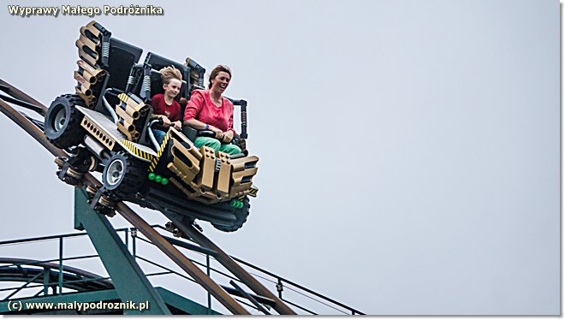
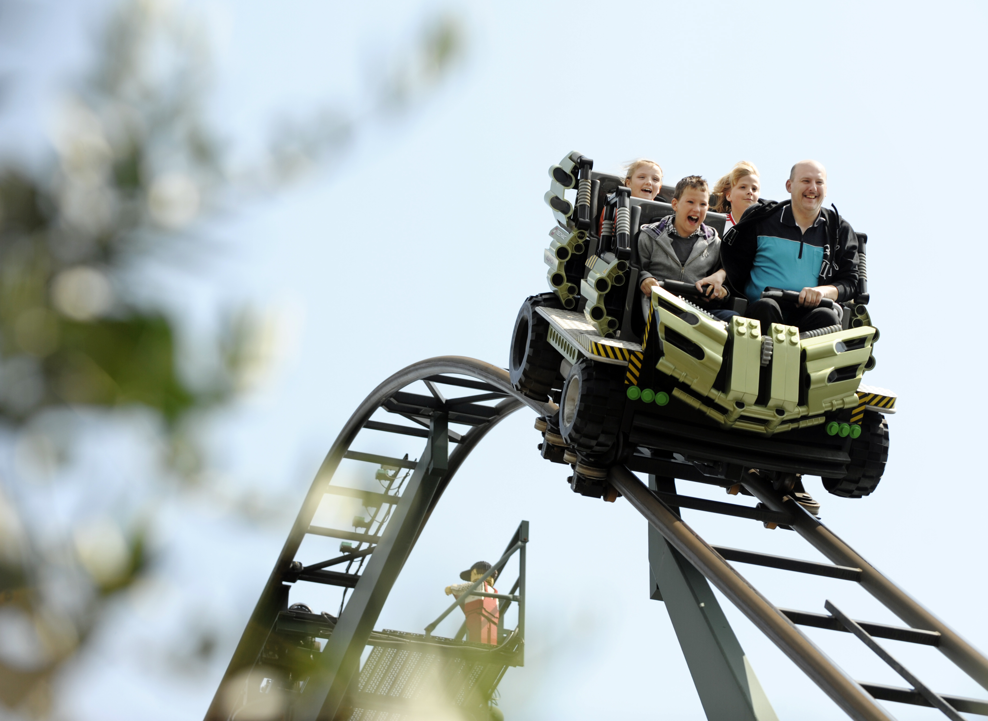
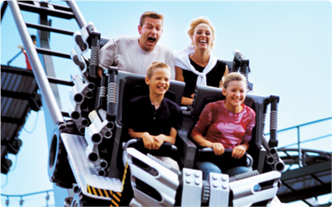
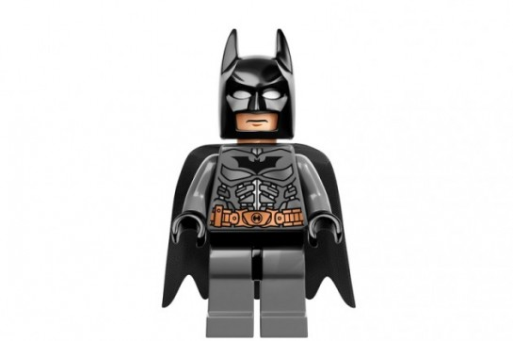
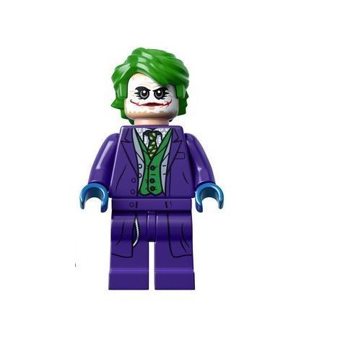
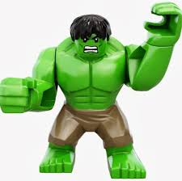
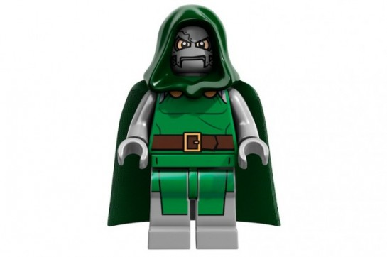
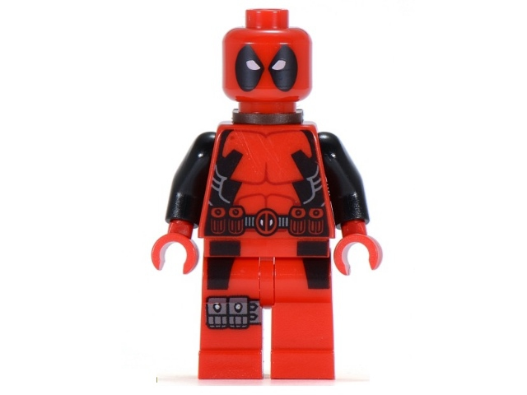
Adventure land
This area contains some of the park´s more exciting rides such as the wild mouse roller coaster X-treme Racers. Jungle Racers jet ski ride has a jungle theme and spins the riders quite fast. In 2010, The Temple was introduced: an indoor ride where riders board Explorer SUV´s and are equipped with laser guns to shoot at moving targets in 11 different scenes themed to ancient Egypt, the land of the Phaeros. The Temple has a game area with an Egyptian theme as well, containing ring-toss, water-shooting, balloon-popping and a mummy game. The area contains two gift shops (Temple Gifts and Adventure Shop) and two restaurants.

Slide 10
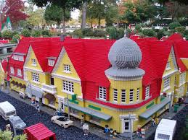
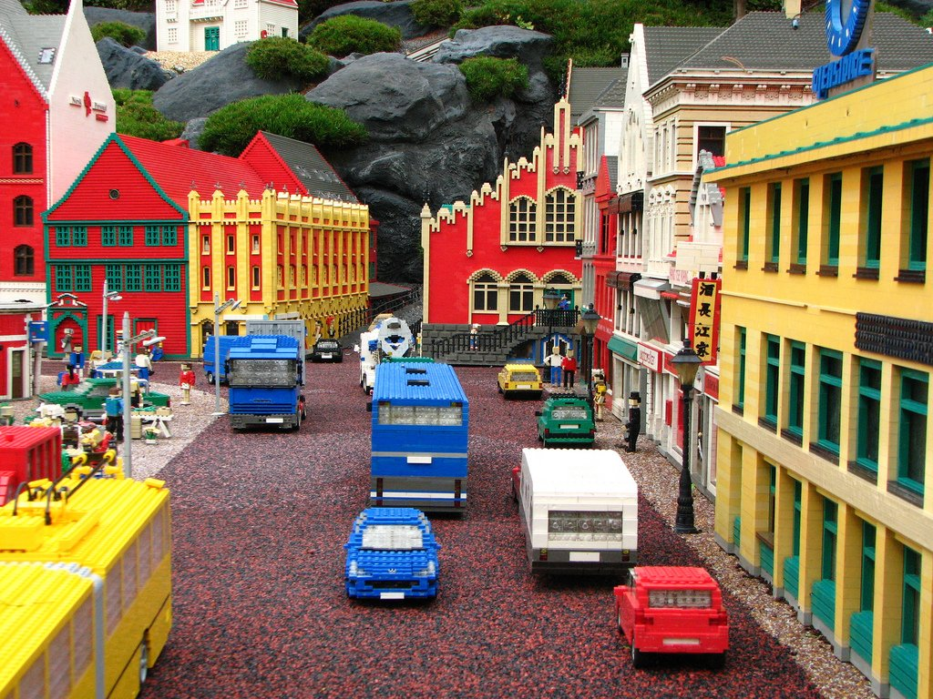
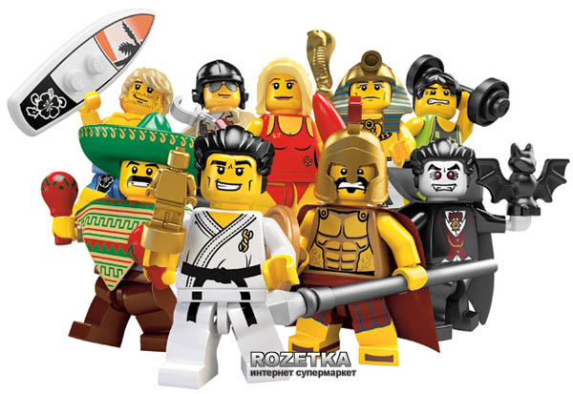
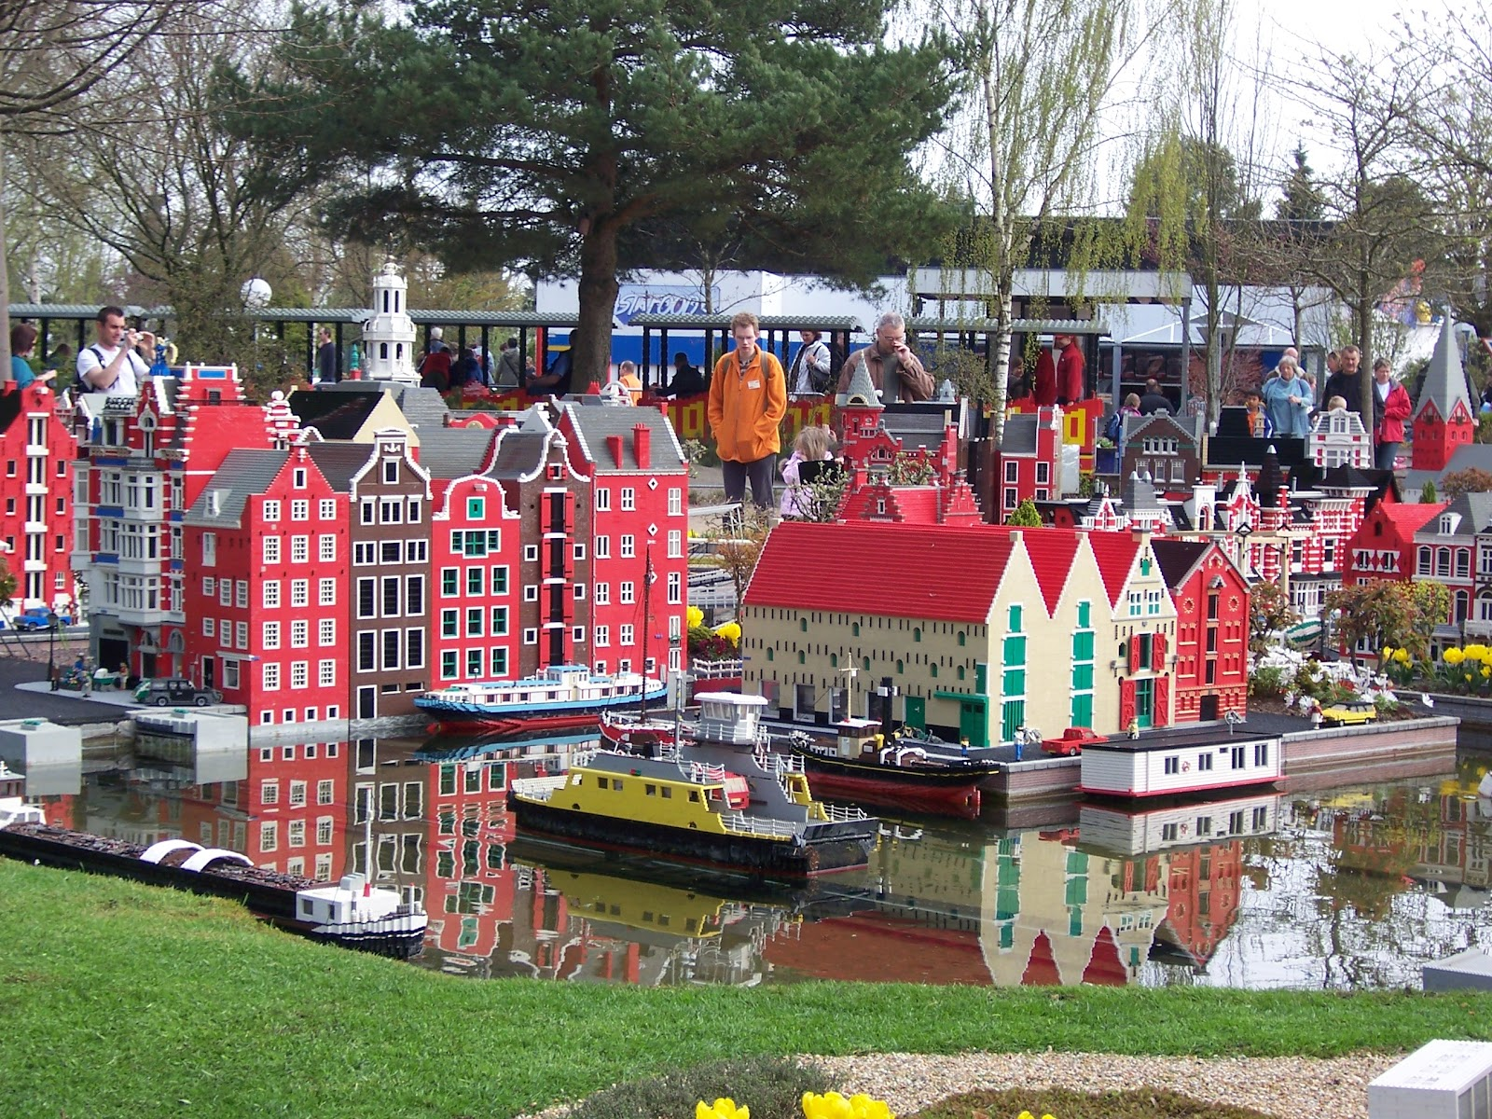
Lego city
This part of the park previously contained power builders, a bionicles themed ride (now changed to ice pilots school), now only contains the Flunck Fire Brigade, a ride where you take your assigned vehicle to the scene of a fire where you and your fellow firefighters have to put out a fire in a building, the fastest team wins.

Slide 11
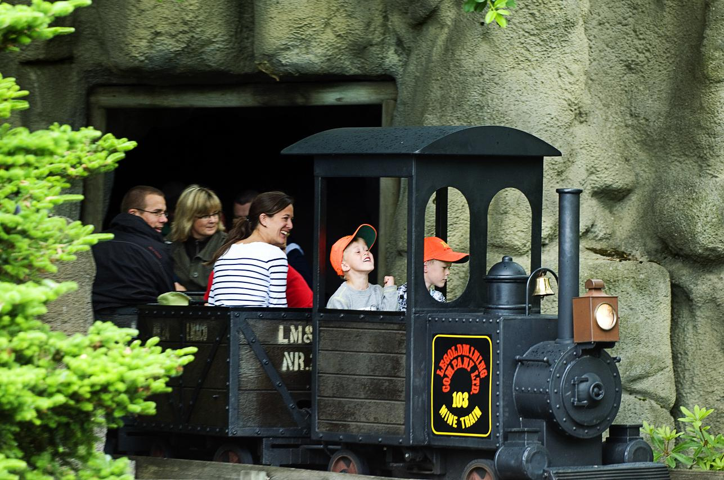
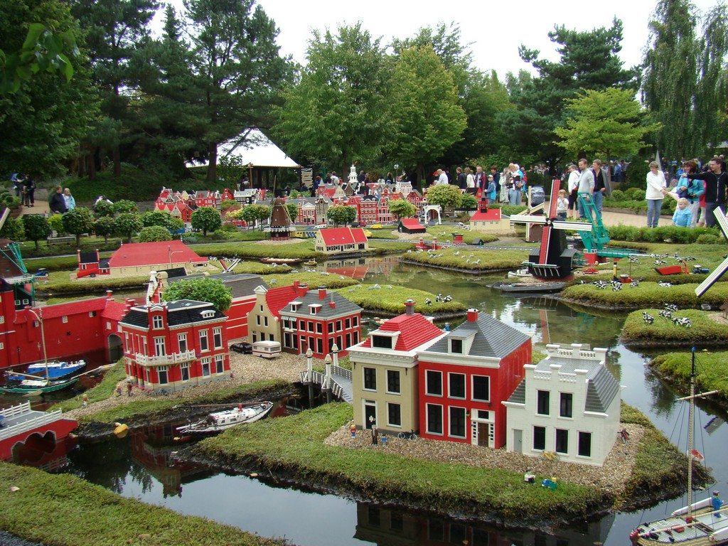
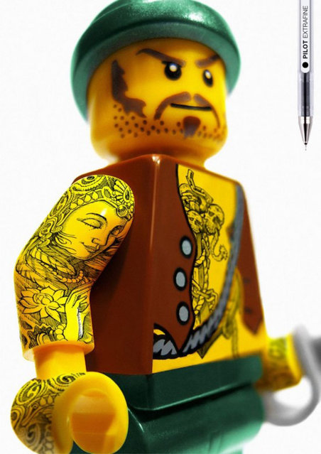
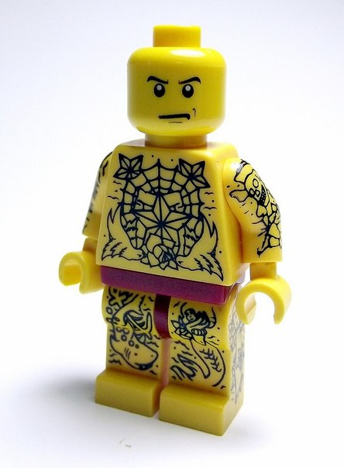
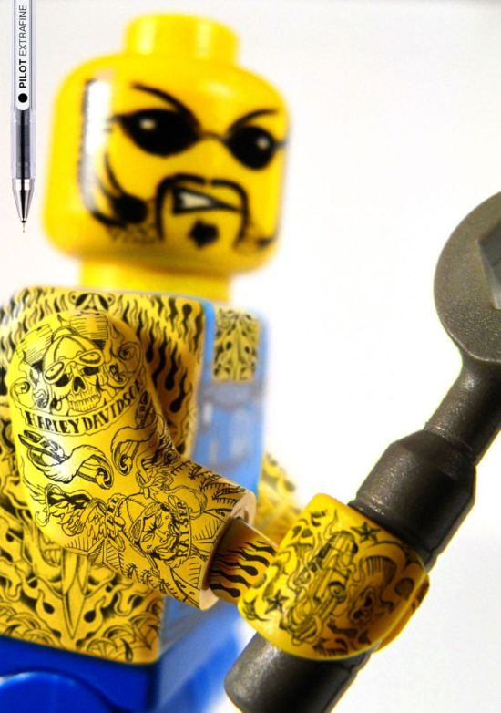
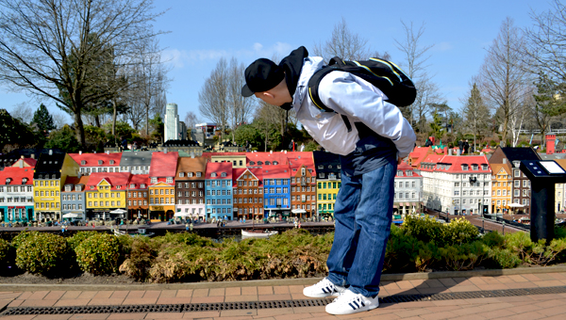
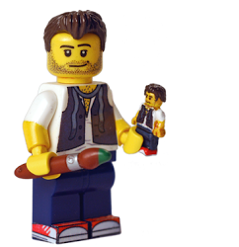
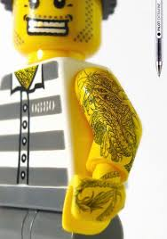
Knight’s Kingdom
Knight's Kingdom contains The Dragon coaster which is located inside a medieval Castle. The ride starts with a slow moving dark ride scene with Lego figures themed to medieval times that includes a mighty dragon. Viking's River Splash is a river rapids ride themed to Vikings that was added in 2006 and has plenty of wet surprises on the way, your photo is taken at the end of the ride. Knight's Kingdom also has granny's apple farms restaurant, Knight's barbecue grill and Castle burgers.

Slide 12
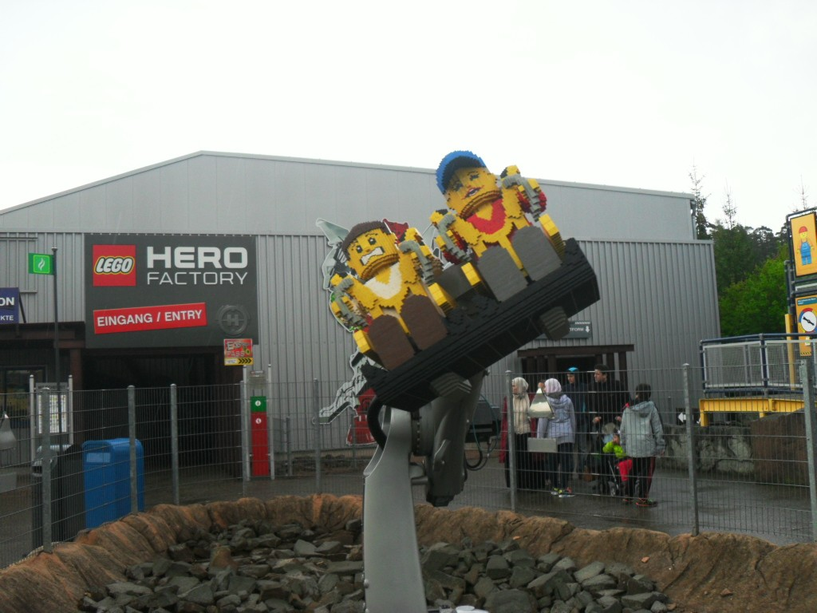
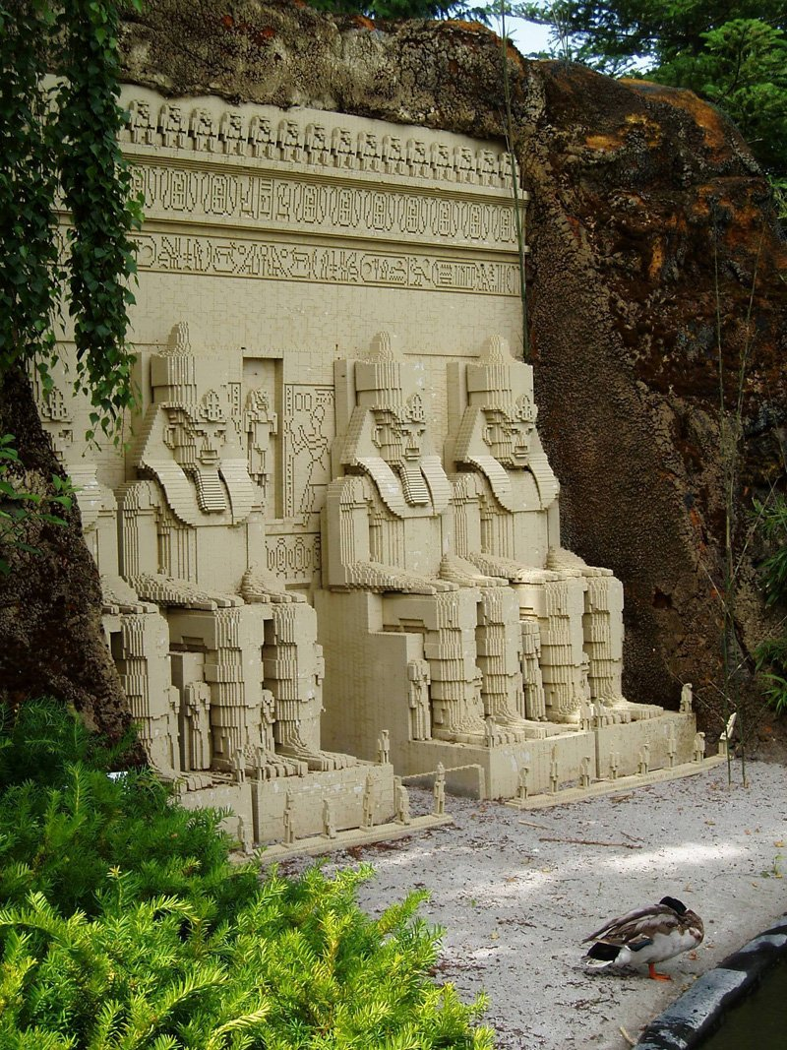
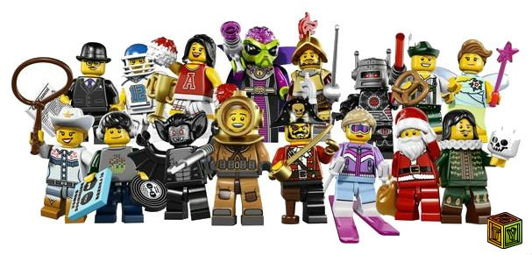
Mini land
Mini Land is the heart of any Legoland park. The 1:20 scale Lego brick models feature landscapes, sights and buildings from all over Denmark as well as famous landmarks from other parts of the world, these include from Denmark: Amalienborg Castle, Nyhavn, Skagen, Klampenborg Station, Ribe, Billund Airport, Dybbøl Mill, Møgeltønder, Lilleby (a fictional Danish village). In addition there are famous landmarks from Sweden, Bergen in Norway, Scotland, Germany, the Netherlands, Kennedy Space Center, Mount Rushmore, Abu Simbel in Egypt, Statue of Liberty, Acropolis of Athens, and Star Wars. The Lego Top offers a nice view of the entire park. The structures were made using more than 25 million Lego Bricks.

Slide 13
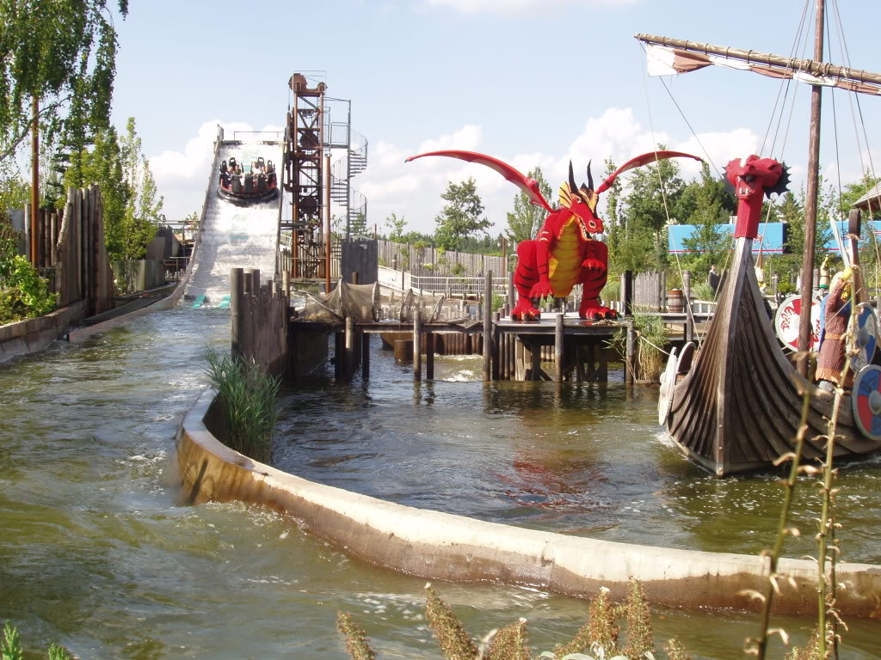
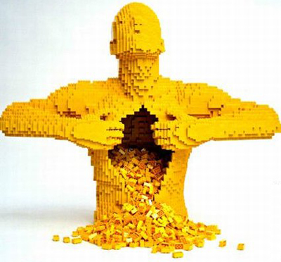

Pirate land
Pirate Land is a pirate-themed area. It features the Pirate Splash Battle where participants get wet. Other rides include: Pirate Wave Breaker, Pirate Water Falls and Pirate Boats.

Slide 14





Polar land
The newest part the park opened in 2012. Its aim is to bring the North Pole and South Pole together, with Polar X-plorer a new coaster and Penguin Bay, that will feature live penguins and a new restaurant called Polar Pizza and Pasta.

Slide 15

The end

