Slide 1
Endangered species in Ukraine

Slide 2
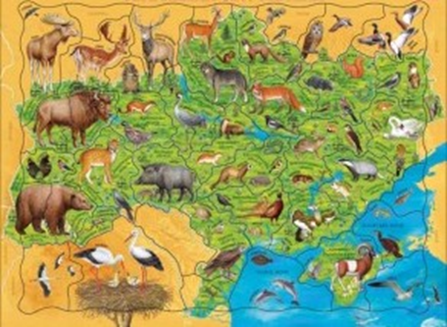
The wildlife of Ukraine is distinguished a large variety of species with almost 45 thousand kinds of animals.

Slide 3
Species of fauna: -ichthyofauna (fish) -herpetofauna (frog, newt) -avifauna (birds) -mammal fauna (mammals)

Slide 4
Red book is devoted
Ukrainian flora and fauna.

Slide 5
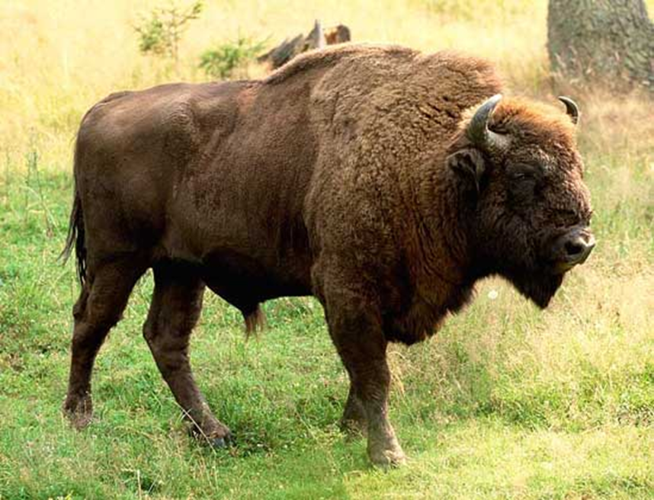
Among the endangered animals can not to offer more or less important. However, there are animals whose extinction is particularlyhigh risk. These animals are bison.

Slide 6
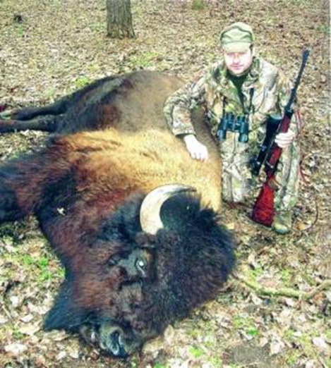
Нunting bison
Bison were brought to the threat of extinction. Bison included in the Red Book of Ukraine. This species is protected by Ukrainianr eserves.

Slide 7
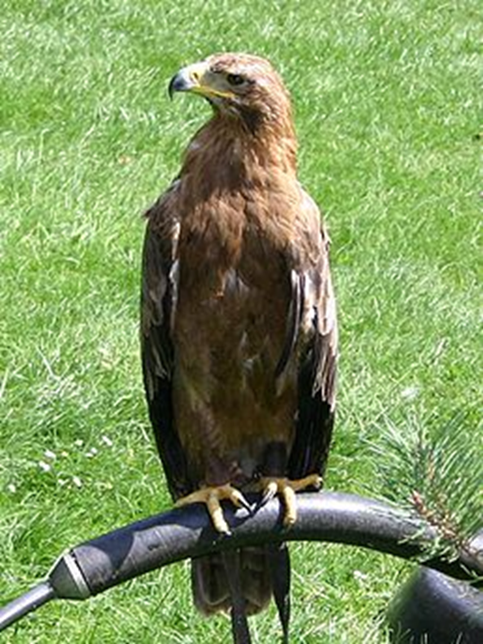
Steppe eagle rare bird and disappearing species.

Slide 8
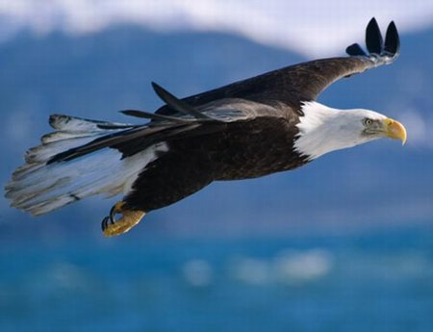
Eagle can be seen in southern Ukraine. It eats rodents or small birds. At the end of last century was the main bird of many steps, but the almost completely disappeared from the territory of Ukraine through intensive plowing of the steppes, hunting, deforestation and destroying nests by people.

Slide 9
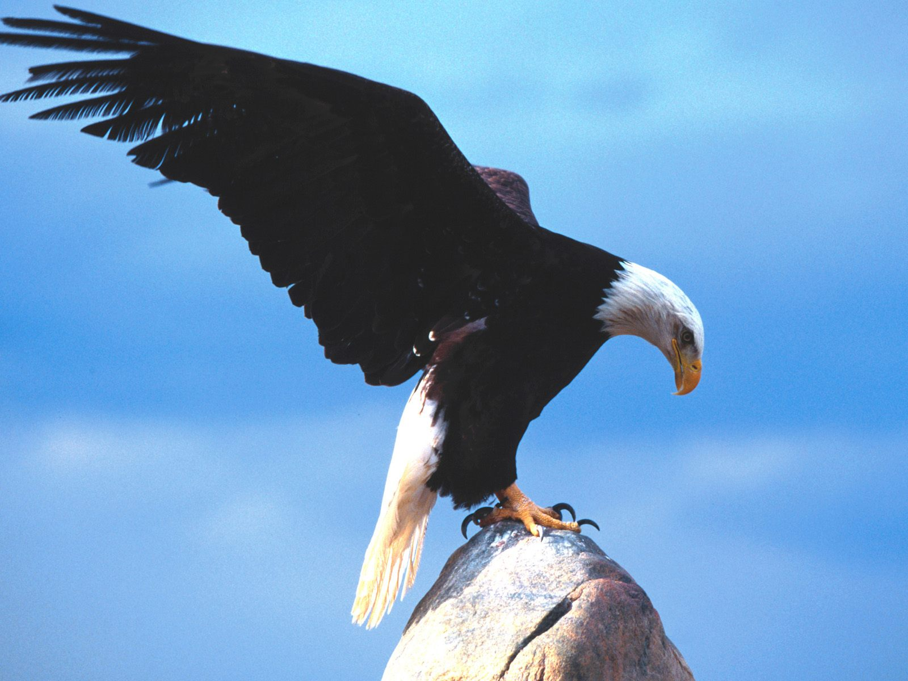
This species included as endangered and protected reserve Askania-Nova.

Slide 10
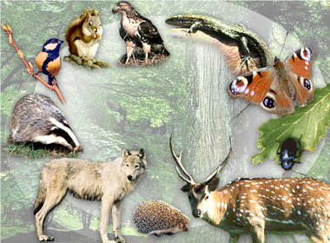
To protect and preserve endangered species, people create organizations that
make a donation. September 18, 2008 in Kiev the Ukrainian protest under the slogan "STOR ZOOTSYDU IN UKRAINE"

