Slide 1
Mass Media in the UK
Newspapers

Slide 2
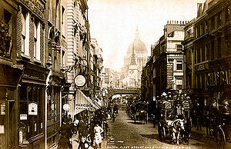

Fleet Street
Fleet Street has been the home of the British press for 300 years. Here are published almost all Britain’s national newspapers. Here also are the headquarters of many magazines, foreign and provincial press bureaus, international news agencies

Slide 3
National Newspapers
“Qualities or Heavies” |  | “Populars or Yellow Press”
Dailies | Sundays | Dailies | Sundays
The Daily Telegraph | The Sunday Telegraph | The Sun | The Sunday Mirror
The Guardian | The Observer | The Daily Mirror | The Mail on Sunday
The Times | The Sunday Times | The Daily Mail | The Sunday Express
The Independent |  | The Daily Express | The People
The Financial Times |  | The Daily Star | The News of the World

Slide 4
“Qualities”
National Dailies
Title, Foundation Date | Political Tendency | Circulation
The Daily Telegraph (1855) | Con | 1,138,000
The Guardian (1821) | Ind (Lib) | 470,000
The Times (1785) | Con | 450,000
The Independent (1886) | Ind | 375,000
The Financial Times (1888) | Ind | 206,000

Slide 5

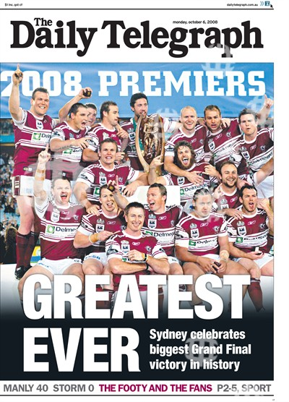
The Daily Telegraph
The Daily Telegraph is a daily morning broadsheet newspaper distributed throughout the UK and internationally. In January 2009 the Telegraph was the highest selling British broadsheet newspaper. It has been politically conservative in modern times, therefore the paper is often referred to as the Torygraph.

Slide 6


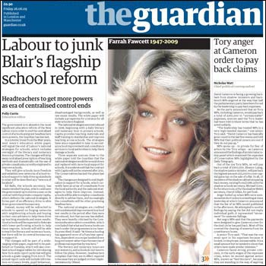
The Guardian
The Guardian is a British national daily newspaper owned by the Guardian Media Group.
It is unique among other British newspapers in being owned by a foundation (the Scott Trust).
Founded by textile traders and merchants, The Guardian had a reputation as an “organ of the middle class”.
It is known to be to the left of political spectrum. This is reflected in the paper’s readership.
It’s nickname is Grauniad because the paper has a reputation for frequent typographical errors.

Slide 7

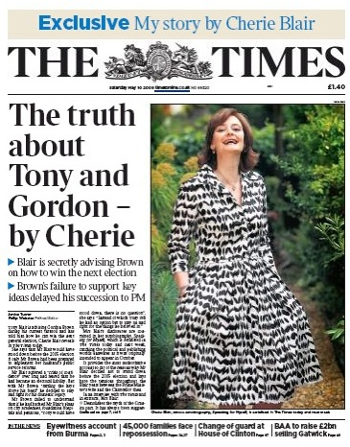
The Times
The Times is a daily national newspaper published in the United Kingdom since 1785, when it was known as The Daily Universal Register.
The newspaper was printed in broadsheet format for 219 years but switched to compact size in 2004 partly in an attempt to appeal to younger readers and partly to appeal to commuters using public transport.

Slide 8


The Independent
The Independent is a British newspaper published by Tony O’Reily’s Independent News & Media.
It is nicknamed the Indy, while the Sunday edition is the Sindy.
Launched in 1986, it is one of the youngest UK national daily newspapers.
It is regarded as leaning to the left politically, although it has not affiliated itself to any political party.
The Independent has a reputation for its emphasis on views, rather than on news. Not surprisingly so, T. Blair once called The Independent a “Viewspaper”.

Slide 9
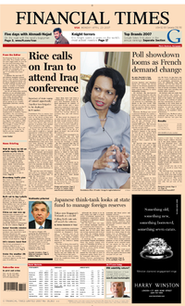
The Financial Times
The Financial Times (FT) is a British international business newspaper.
The FT specialises in business and financial news. The FT is the only paper in the UK providing full daily reports on the London Stock Exchange and world markets.

Slide 10
“Populars”
National Dailies
Title, Foundation Date | Political Tendency | Circulation
The Sun (1964) | Con | 4,146,000
The Daily Mirror (1903) | Lab | 3,061,000
The Daily Mail (1896) | Con | 1,792,000
The Daily Express (1900) | Con | 1,679,000
The Daily Star (1987) | Con | 1,013,000

Slide 11

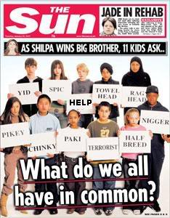
The Sun
The Sun is a daily tabloid published in the UK and Ireland.
It has the highest circulation of any daily newspaper in the world.
The Sun relies heavily on stories and scandals involving celebrities and the entertainment industry. It contains sections such as Bizarre (pop music stories and gossip) and TV Biz (television stories, concentrating on soap operas and reality TV).

Slide 12


The Daily Mirror
The Daily Mirror is a British tabloid newspaper founded in 1903.
Twice in history its title was changed to read simply The Mirror.
It contains cartoon strips, comics, a letters page, a problem page, “shock issues” intended to highlight a particular news story.

Slide 13

The Daily Mail
The Daily Mail is a British daily middle market tabloid newspaper.
It is the UK’s second biggest-selling daily newspaper after The Sun.
The Daily Mail was Britain’s first daily newspaper aimed at the newly literate “lower-middle class market resulting from mass education”.
It was from the outset, a newspaper for women, and is still the only British newspaper whose readership is more than 50% female.

Slide 14
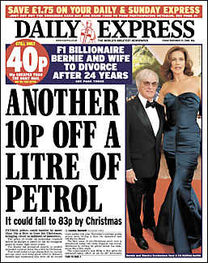
The Daily Express
The Daily Express is a conservative British tabloid newspaper.
The Daily Express select front-page stories that follow recurring themes, and often ignore the major news of the day in favour of spurious stories.
During 2009 and 2010, health stories were very popular. For example, they featured the discovery of rather unusual potential cures for diseases such as Alzheimer’s disease or cancer. The usual headlines: “Sunshine vitamins cut risk of cancer”.
The Daily Express also features global warming stories.

