Slide 1
The History
of UKRAINE

Slide 2
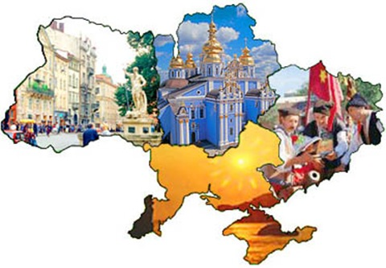
The history of Ukraine is divided into the following periods:
Prehistory
Middle Ages
Early modern period
Modern history

Slide 3
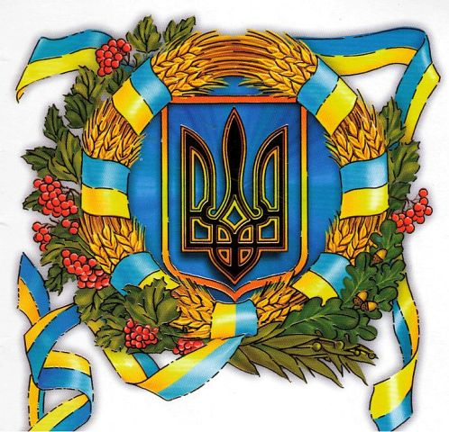
Prehistory
During this period, the Ukraine began populating the first people. The first settlers were Pithecanthropus. The oldest of their staying in Ukraine - is the area near the village of Korolevo and Rokosovo. Then Neandrthals inhabited the territory of Ukraine, who learned to build homes with mammoth bones and make fire. Neanderthals began to wear clothes from the skins. Subsequently, the Cro-Magnons occupied the territory of Ukraine. Cro-Magnons were more similar to modern humans.

Slide 4
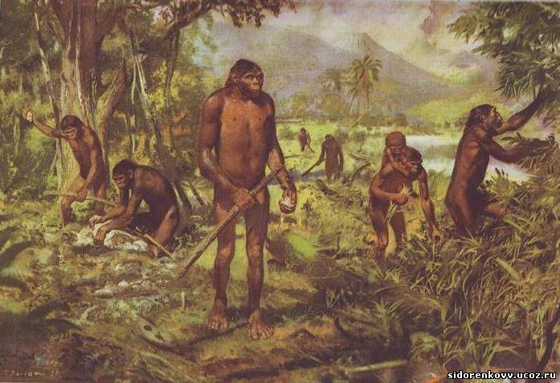
Pithecanthropus

Slide 5
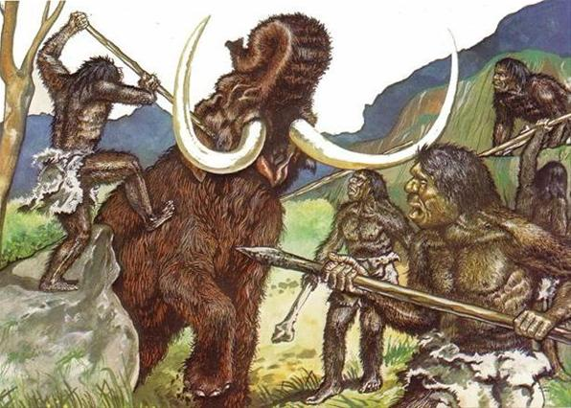
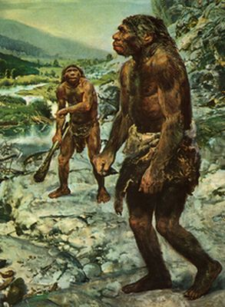
Neanderthals

Slide 6
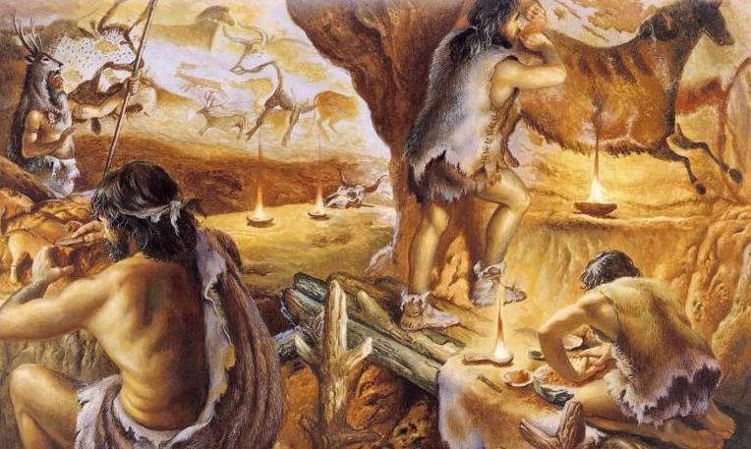
Cro-Magnons

Slide 7
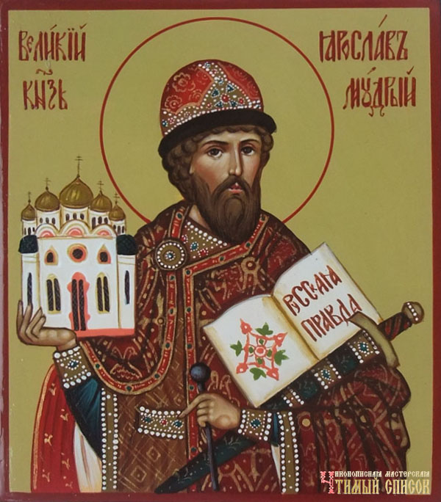
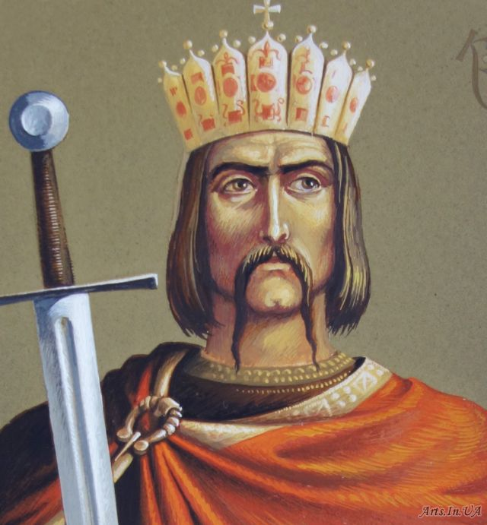
Middle Ages
Kievan Rus - In 882, Kyiv was conquered from the Khazars by the Varangian noble Oleg who started the long period of rule of the Rurikid princes. In the 11th century, Kievan Rus' was, geographically, the largest state in Europe, becoming known in the rest of Europe as Ruthenia. Greatest prosperity Kievan Rus was during the reign of Yaroslav the Wise and Vladimir the Great, who embraced Christianity.
Yaroslav the Wise
Vladimir the Great

Slide 8
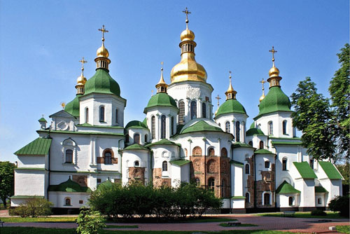
Yaroslav the Wise during his rule built an extraordinary architectural masterpiece - St. Sophia Cathedral, which is protected by UNESCO.

Slide 9
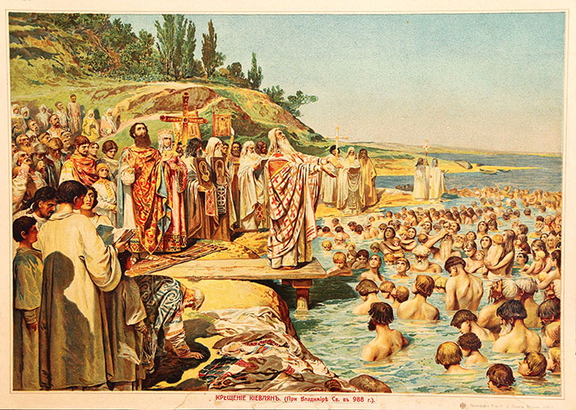
Baptism of Kyivan Rus

Slide 10
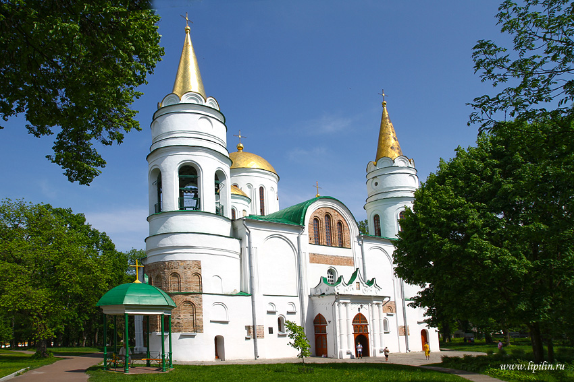
Sights of Kyiv Rus
Savior-Transfiguration Cathedral in Chernihiv

Slide 11
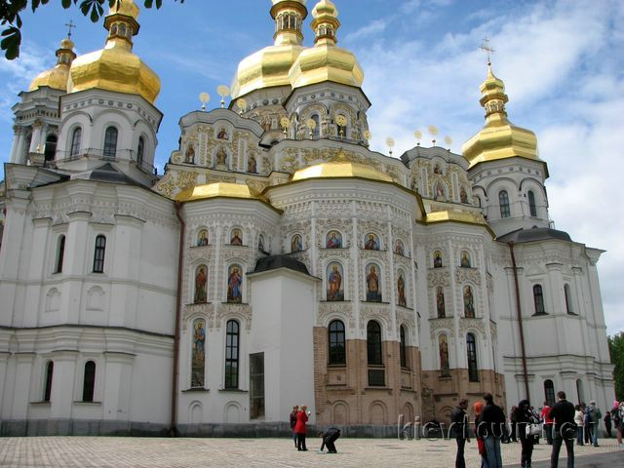
Assumption Church in Kiev

Slide 12
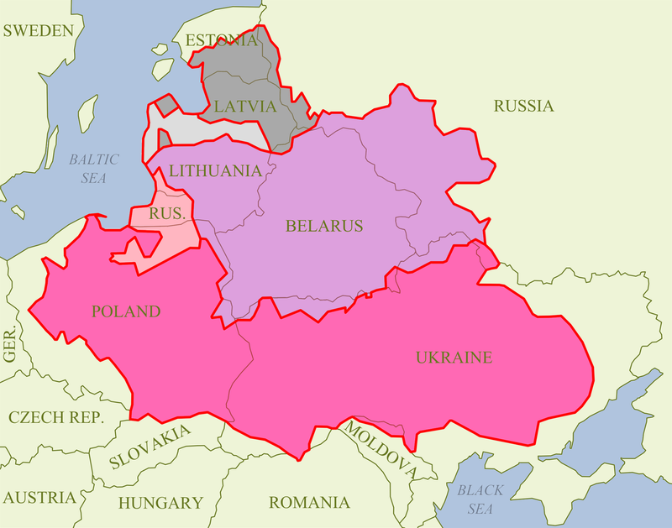
Early modern period
Polish–Lithuanian Commonwealth
After the Union of Lublin in 1569 and the formation of the Polish–Lithuanian Commonwealth Ukraine fell under Polish administration, becoming part of the Crown of the Kingdom of Poland. The period immediately following the creation of the Commonwealth saw a huge revitalisation in colonisation efforts. Many new cities and villages were founded.
Polish–Lithuanian Commonwealth.

Slide 13
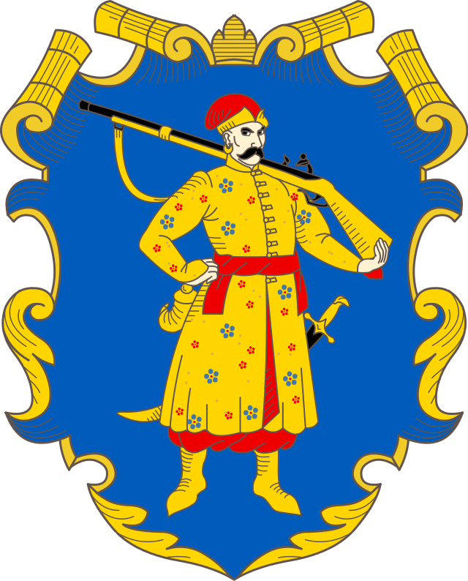
Cossack era
First mention of Cossacks appeared in 1489. In 1556 was founded the first Sich located on the island Khortytsya. Since then, the Cossacks in Ukraine is actively developing.
The Cossack with musket, emblem of the Zaporizhian Host, and later the Hetmanate and the Ukrainian State.

Slide 14
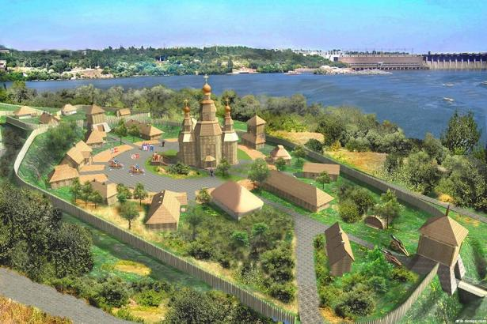
Zaporizhian Sich on the island Khortytsya

Slide 15
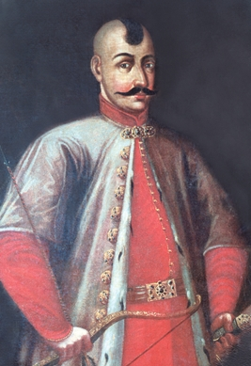
Famous Cossacks
Dmitry Vyshnevetskyy - founder of the first Zaporizhzhya Sich.

Slide 16
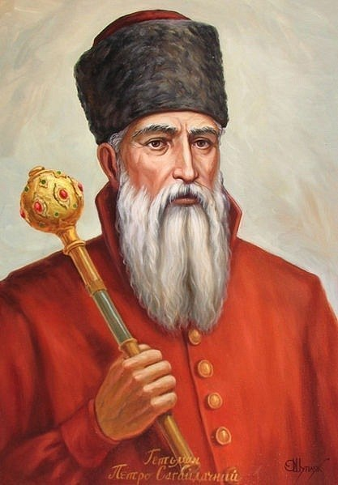
Peter Konashevych-Sahaidachny

Slide 17
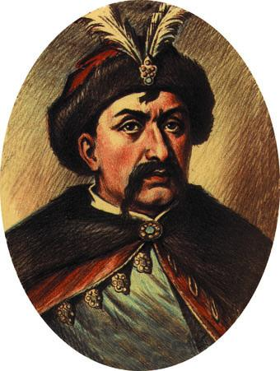
Bohdan Khmelnitsky - led by the National Liberation War of the Ukrainian people against the Commonwealth

Slide 18
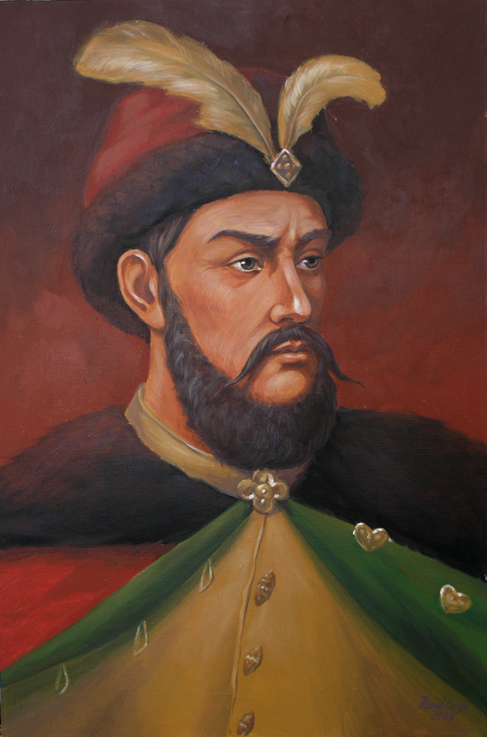
Peter Doroshenko

Slide 19
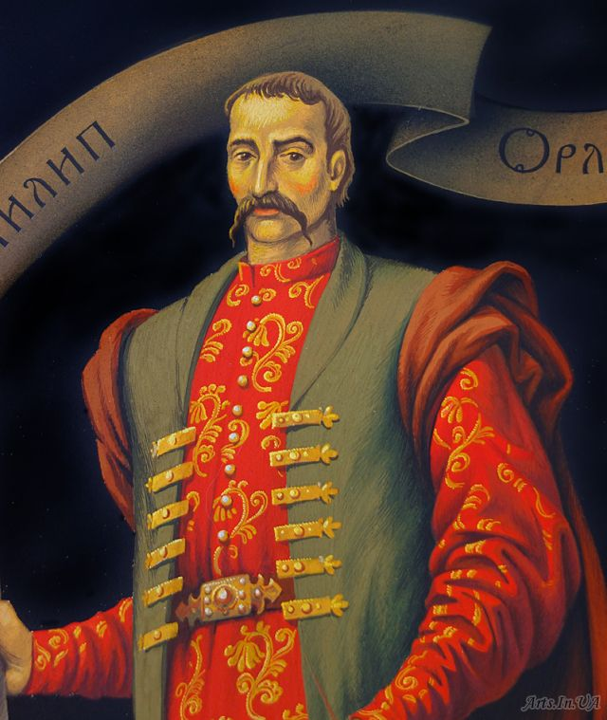
Philip Orlik - author of the first constitution in the history of Ukraine

Slide 20
The END

