Slide 1

The educational system of Germany

Slide 2
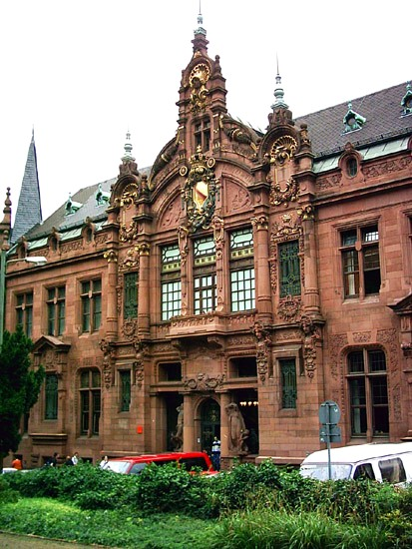
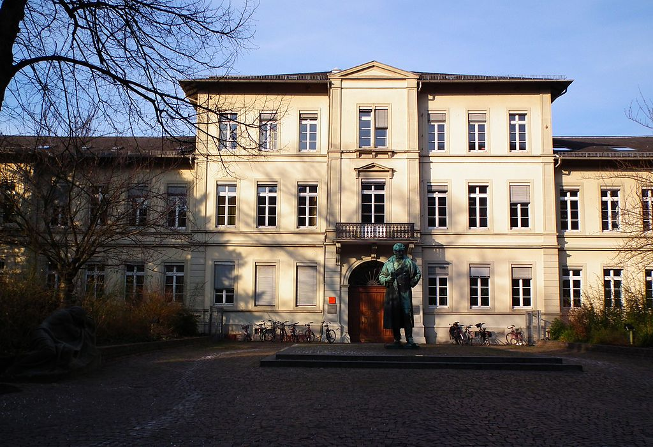
Germany is the centre of Europe. Here is a very ancient tradition of education: the oldest University in existence since 1386 .

Slide 3
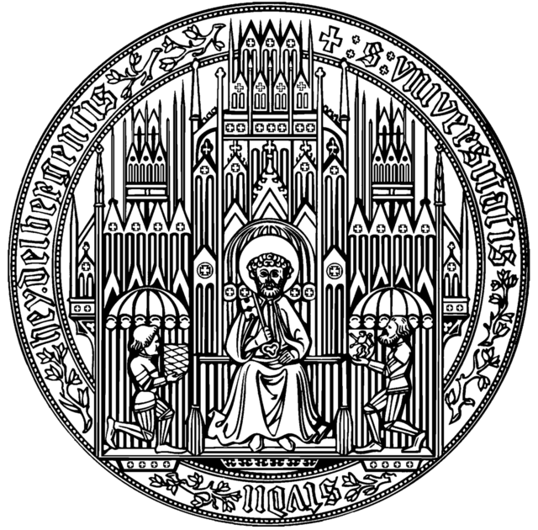
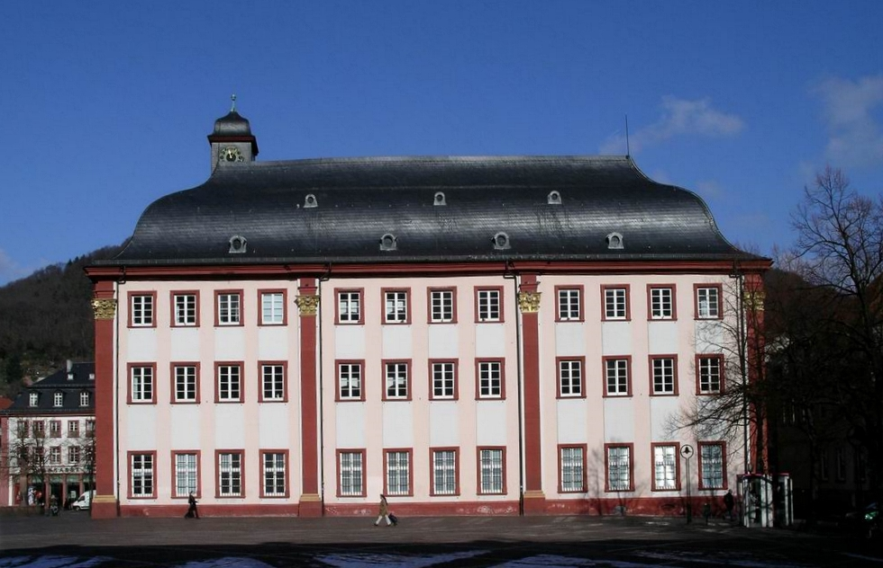
Heidelberg, Baden- Wurttemberg, Germany
University of Heidelberg

Slide 4
The German system of education:
Elementary school
Average school
High school
School education is divided into two stages:
Primary school
Secondary school
The school system across the country designed for 12-13 years.

Slide 5
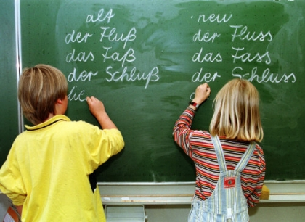
It is mandatory 9 -year education - is universal and free.
With 6 years of children go to primary school, where 4-6 classes.
Future profession is chosen in elementary school .

Slide 6
Types of secondary schools in Germany
Gymnasium (The most prestigious form of high school. School has a humanitarian orientation. Duration of training - 9 years ( 5-13 classes). Diploma gymnasium gives the opportunity to enroll in the University without entrance exams.)

Slide 7

2. Basic school (This type of school is designed for children who do not plan to pursue higher education. Here are preparing for professional work. Training is the weakest children.)

Slide 8
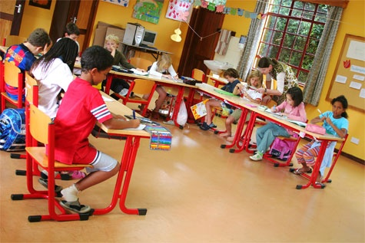
3. Professional school (For kids who want to get a working specialty. Do not plan to enroll in a higher education institution.)

Slide 9
4. Real school (Duration of training - 6 years. Designed for children with average achievers. After the school can continue their education in Gymnasium. Or go to work in the specialty.)

Slide 10
5. Joint school (A mixture of school and real school. Here and get a humanitarian education and technical. Then you can easily go to University.)

Slide 11
Original title in German
Gymnasium
2. Hauptschule
3. Professionalschule
4. Realschule
5. Gesamtschule

Slide 12
Most popular universities in Germany (Original title ):
Westfälische Wilhelms-Universität Münster
Ruprecht-Karls-Universität Heidelberg
Universität Leipzig
Martin-Luther Universität Halle-Wittenberg
Freie Universität

Slide 13
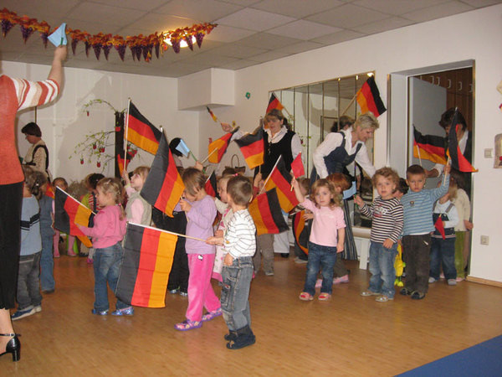
Thank you for your attention!

