Slide 1
Music in United States
Made by Kuzmenko Nadya, 11-A

Slide 2
Music life and styles at America
The formation of new music genres in America was influenced by a number of immigrants, especially from Africa and from Europe. New music styles appeared, music life was developing really fast from the 17th century. A lot of clubs where different bands play were opened. Political situation influnced the developing of Native American music and soon it brang the world a great amount of genius song writers and singers.

Slide 3
Native American Genres
Hip hop music
Jazz
Heavy metal music
Blues
Country music
Rock and roll
Funk
Psychedelic rock

Slide 4
Rock

Slide 5
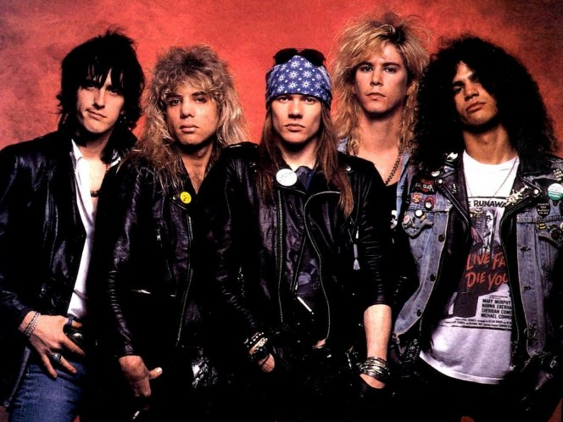
Best rock-bands (IMHO)
Guns N' Roses

Slide 6
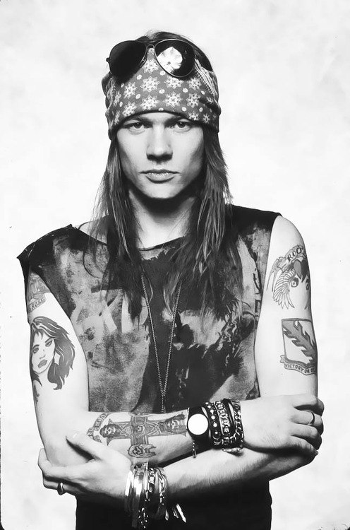
Guns N' Roses is an American hard rock band that was formed in Los Angeles, California, in 1985. The classic lineup consisted of vocalist Axl Rose, lead guitarist Slash, rhythm guitarist Izzy Stradlin, bassist Duff McKagan and drummer Steven Adler.
Today, Axl Rose is the only remaining original member
The band has released six studio albums, accumulating sales of more than 100 million records worldwide, making them one of the world’s best-selling bands of all time.

Slide 7
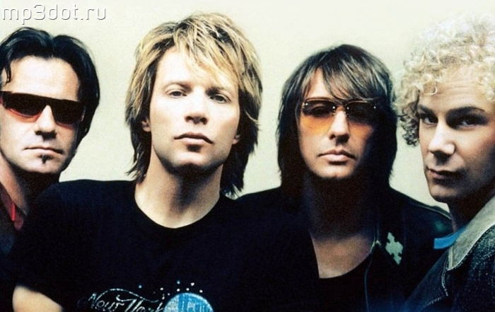
John Bon Jovi

Slide 8
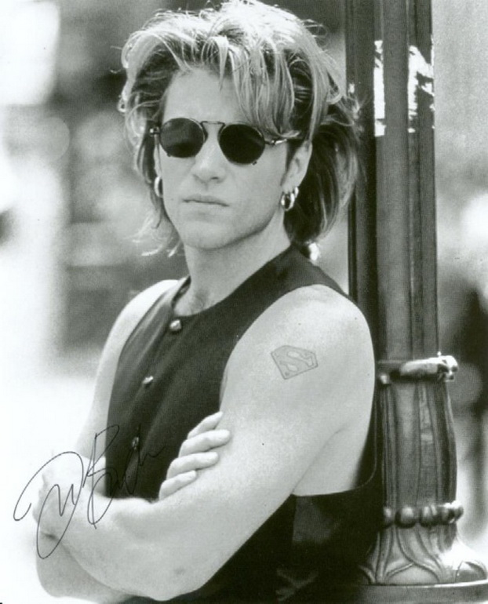
Bon Jovi is a rock band formed in 1983, consists of lead singer and namesake Jon Bon Jovi , guitarist Richie Sambora, David Bryan and drummer Tico Torres. The band's lineup has remained mostly static during its history. In 1986, Bon Jovi achieved widespread recognition with their third album, Slippery When Wet. The band's fourth album, New Jersey was equally successful in 1988, and Bon Jovi received four number-one songs on the Billboard Hot 100: "You Give Love a Bad Name", "Livin' on a Prayer", "Bad Medicine", and Other Top 10 record chart hits included "Wanted Dead or Alive", "Bed of Roses" and "Always“.

Slide 9
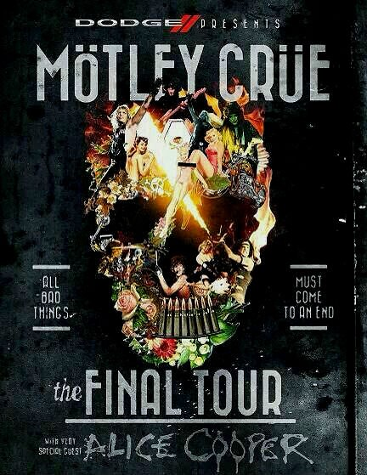
Last United Concert
Alice Cooper is shock rock singer, songwriter, and musician. With a stage show that electric chairs, fake blood and baby dolls, he is considered by fans and peers alike to be "The Godfather of Shock Rock"; Cooper has drawn equally from horror movies, vaudeville, and garage rock
Motley Crue is heavy metal band formed in Los Angeles in 1981. The group was founded by bass guitarist Nikki Sixx and drummer Tommy Lee. Mötley Crüe has been described through the years as the world's most notorious rock band and one of the world's best-selling groups of all time, having sold more than 75 million albums.

Slide 10
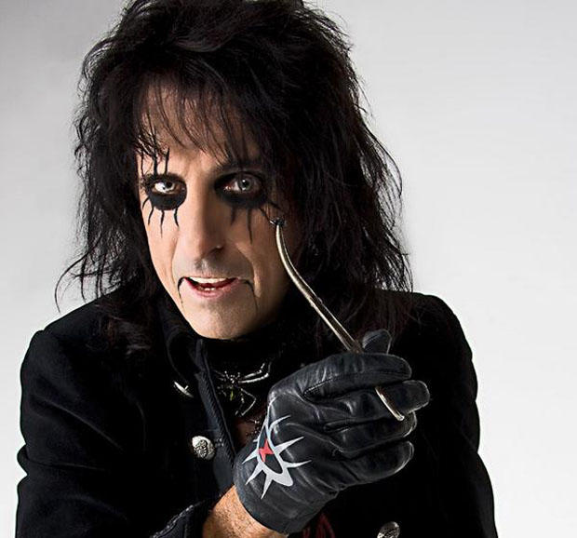
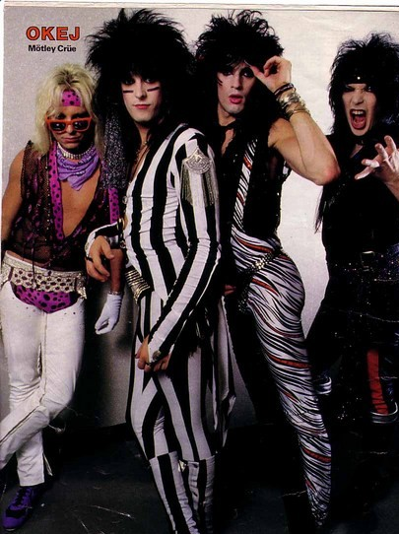

Slide 11
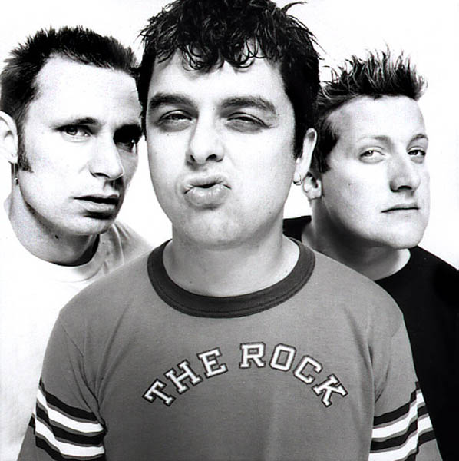
The best pop-band which thinks it rocks
“Green Day's sound is often compared to first wave punk bands such as the Ramones, The Clash,Sex Pistols”- said Wikipedia.

Slide 12
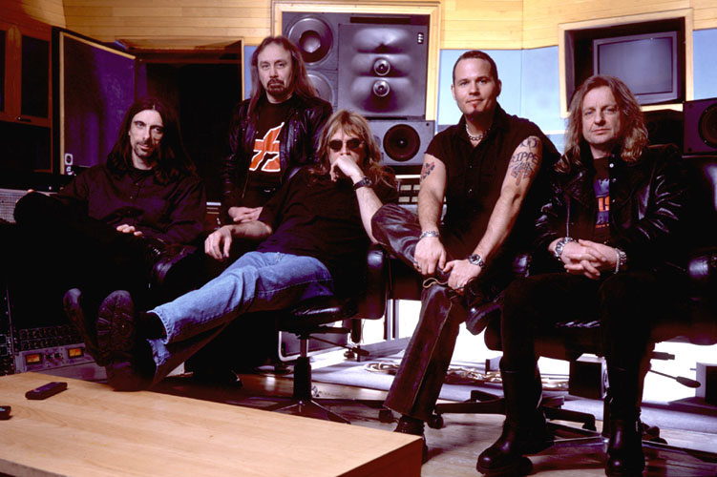
Judas Priest & Tim Ripper Owens
The band is widely recognised as one of the finest and most original heavy metal bands of all time, with many artists within the genre having cited them as a major influence

Slide 13
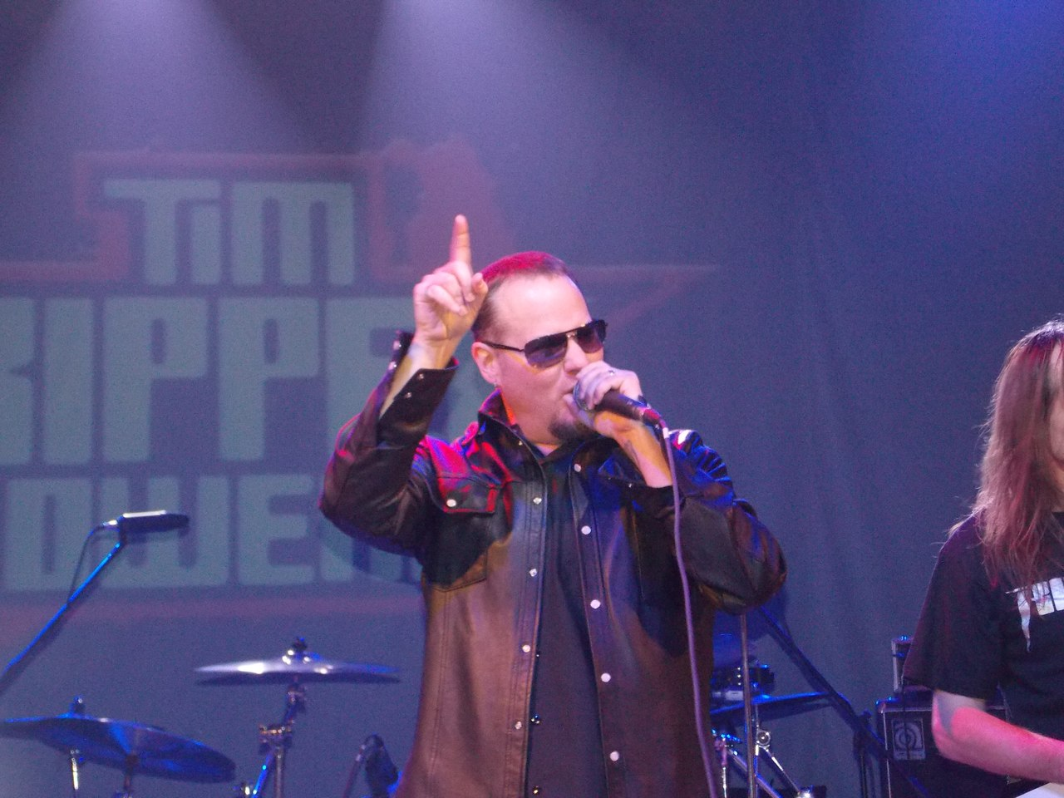
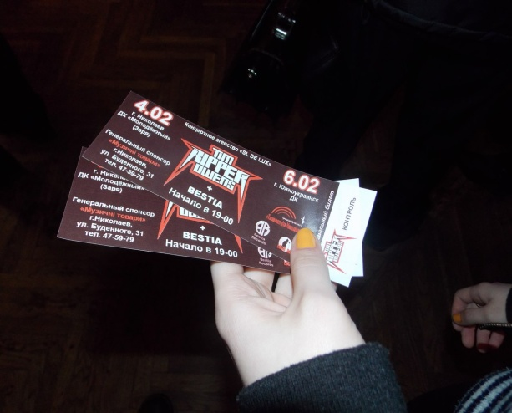
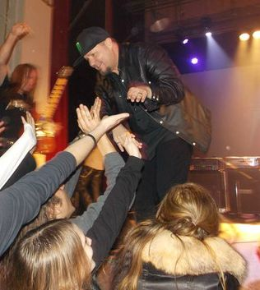
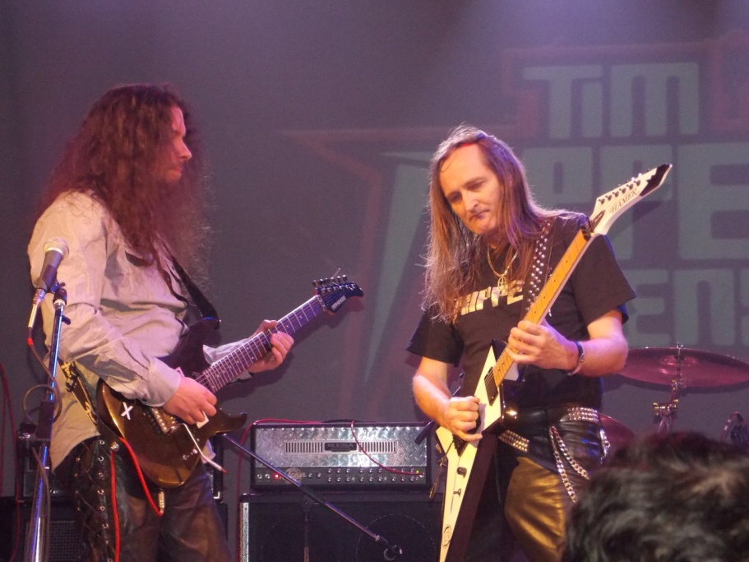
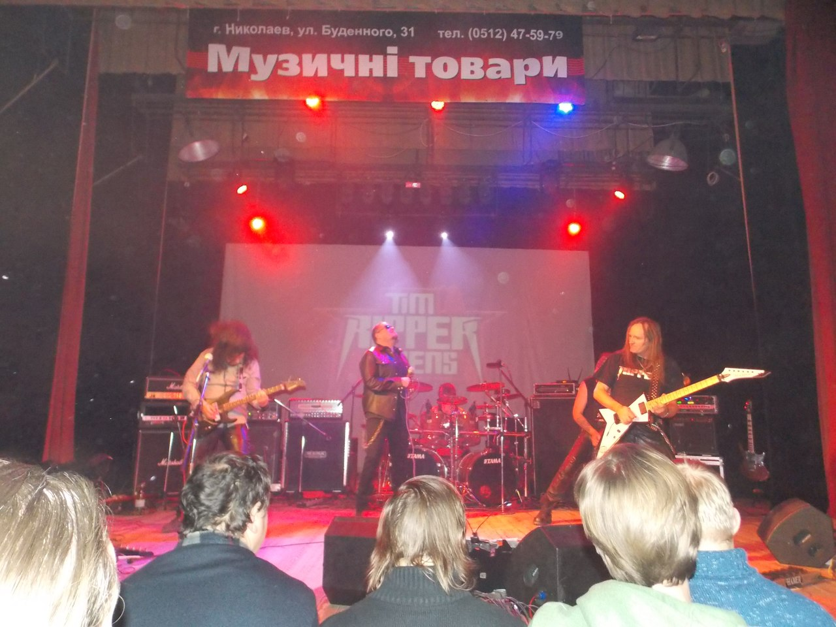
Ripper’s Concert in Mykolaiv

