Slide 1
Country Music

Slide 2
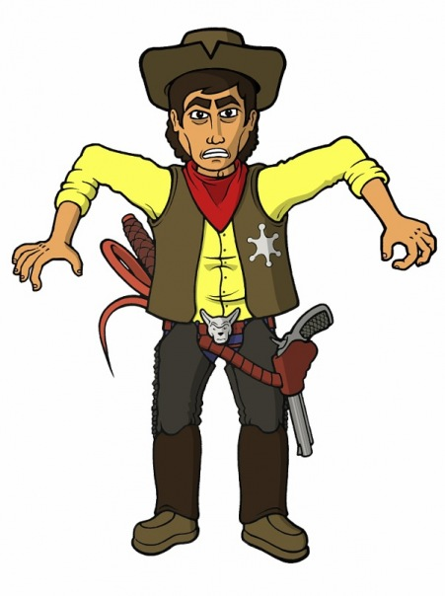
It has roots in :
Traditional folk music
Celtic music
Gospel music
Old-time music

Slide 3
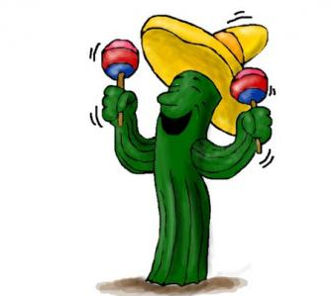
Instruments:
The Irish fiddle
the German derived dulcimer
the Italian mandolin
the Spanish guitar
and the African banjo

Slide 4
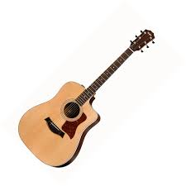
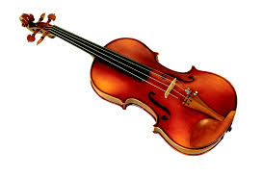
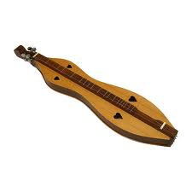
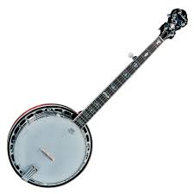
Fiddle
Guitar
Dulcimer
Mandolin
Banjo

Slide 5
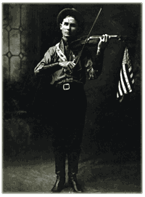
First commercial record - "Sallie Gooden" by fiddlist A.C. (Eck) Robertson (in 1922 )

Slide 6
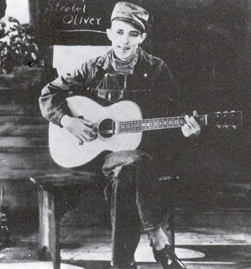
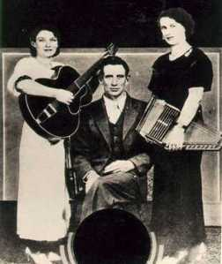
On 1st August , 1927 was recorded Jimmie Rodgers and the Carter Family
Jimmie Rodgers – Blue Yodel ( T for Texas)

Slide 7
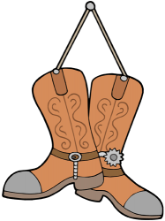
Styles of country music:
Early Country
Cowboy & Western
Western Swing
Honky Tonk
Rockabilly
Nashville Sound
Bakersfield Sound
Country rock
Urban Cowboy
Outlaw Country
New Traditionalist
Alternative Country
Contemporary Country

Slide 8
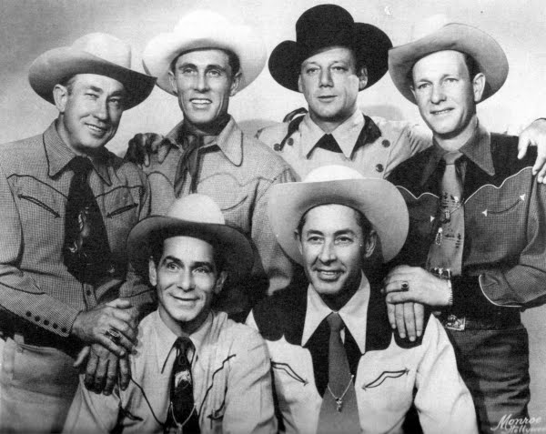
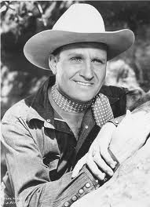
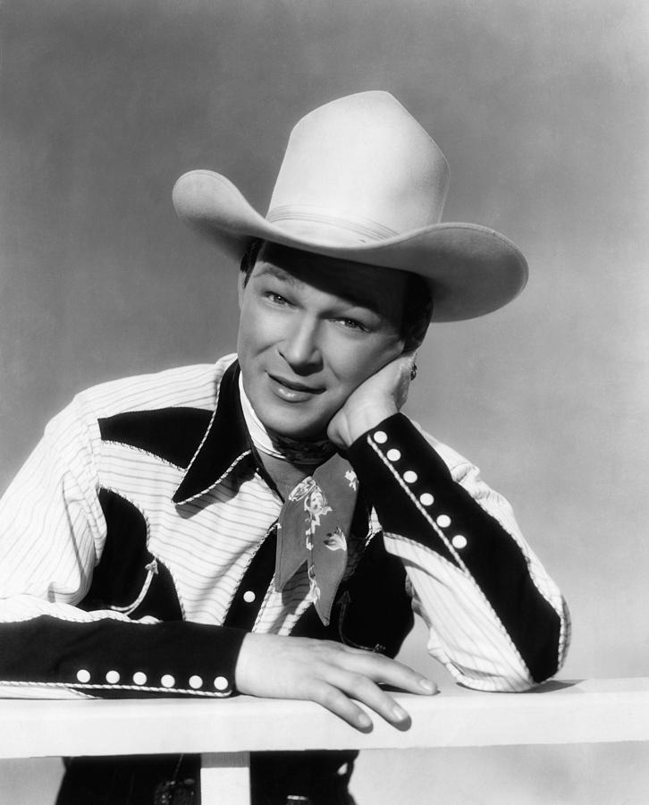
Cowboy songs or “Western music”
Gene Autry
The Sons of the Pioneers
Roy Rogers
Roy Rogers – Don’t Fence me in

Slide 9
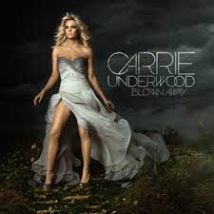
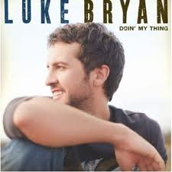
New Country Music

Slide 10
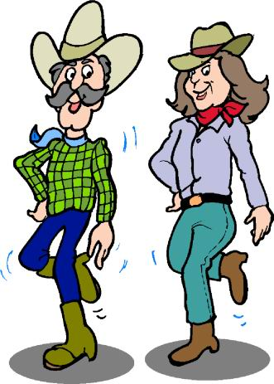
In the mid 1990s country western music was influenced on the creation of line dancing

