Slide 1
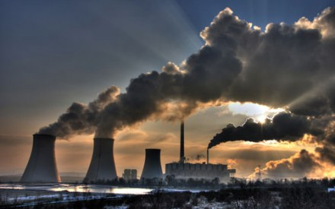
Pollution
From 11
Filimonova Katya

Slide 2
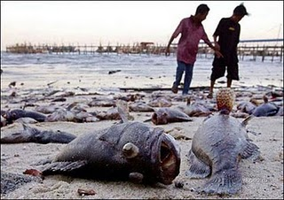
Pollution is the introduction of contaminants into the natural environment that cause adverse change. Pollution can take the form of chemical substances or energy, such as noise, heat or light.
Pollutants, the components of pollution, can be either foreign substances/energies or naturally occurring contaminants. Pollution is often classed as point source ornonpoint source pollution.

Slide 3
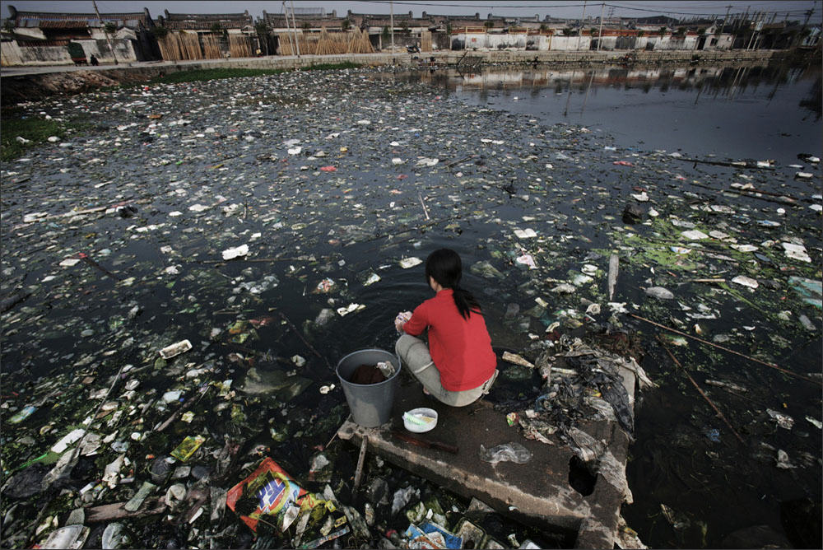
Industry
The main anthropogenic factors of ecological crisis in Ukraine are primarily large industrial complexes - voracious consumers of raw materials, energy , water, air , land and space at the same time the most powerful source of virtually all types of pollution ( mechanical, chemical, biochemical ).

Slide 4
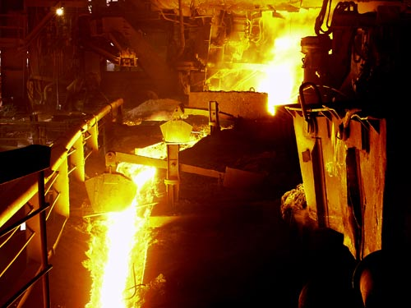
The main pollutants of the environment with heavy metals, especially lead and arsenic , as well as sulfuric and nitric acids - non-ferrous metals .

Slide 5
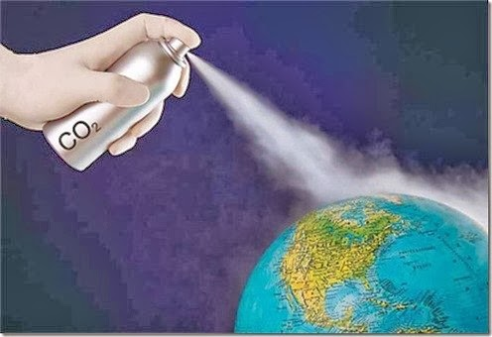
Aerosol pollution of the atmosphere
Aerosols - a solid or liquid particles that are suspended is air. Solid components of aerosols in some cases dangerous to organisms and humans cause specific diseases. The atmosphere aerosol pollution are perceived as smoke, fog or smog. The average size of aerosol particles is 1-5 microns.

Slide 6
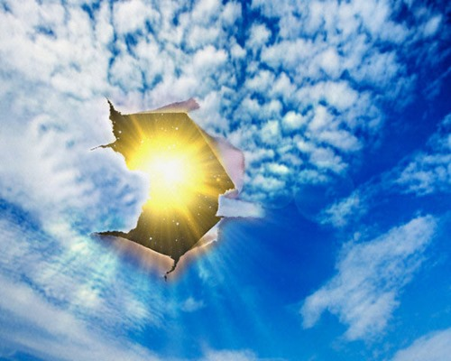
Violation ozone layer
Ozone - a form of existence of a chemical element oxygen in Earth's atmosphere - its molecule consisting of three oxygen atoms 03 to form ozone necessary preliminary formation of free oxygen atoms.
The ozone hole - a phenomenon reduction in the total amount of ozone .
Many countries have begun to take measures to reduce the production and use of CFCs . Since 1978 the US was banned CFC use in aerosols . Unfortunately , the use of CFCs in other areas was not limited .

Slide 7
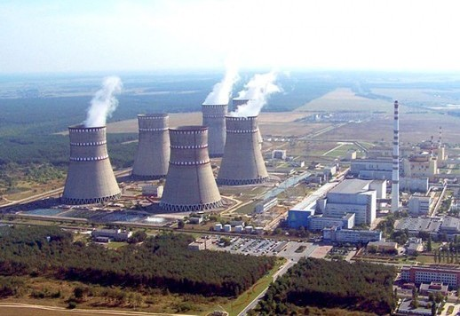
Energetics
Heavily polluting energy facilities , especially TPP and TPP. By absorbing a huge amount of oil , gas and coal, they emit millions of cubic meters of harmful gases , aerosols and soot, clutter hundred acres slag and ash.

Slide 8
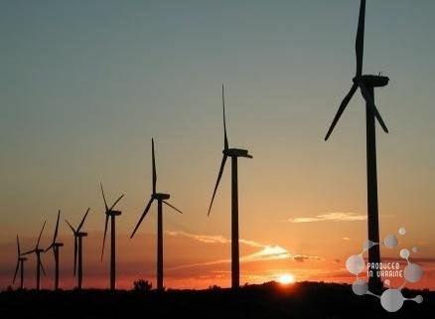
Energy prospects for Ukraine
Alternative Energy - the criteria by which a country can show the degree of development. Many European countries have already had the desire to preserve the environment and solve the problem of environmental pollution with preservation of natural resources.

Slide 9
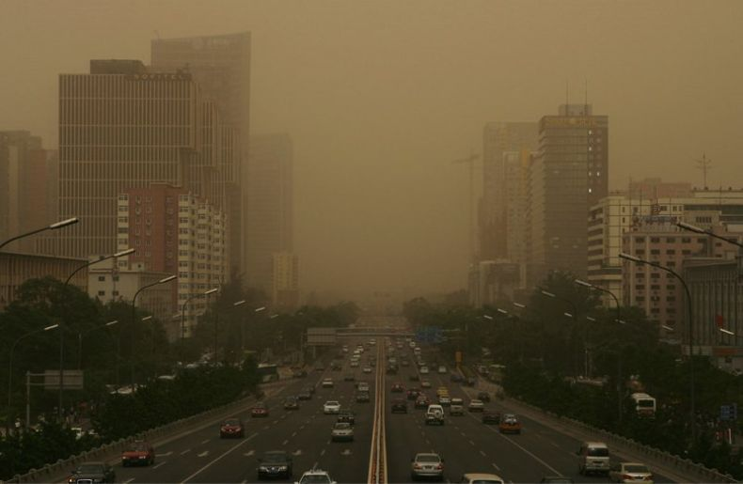
Transport - road, rail, water and air - is another source of pollution of nature Ukraine
Emissions of pollutants road in an average year is about 5.5 million . Tons ( 39 % of total emissions in Ukraine ). In large cities, air pollution sometimes reaches 70-90 % overall pollution. In addition, more than 20 % of vehicles operated in excess of established standards for content of harmful substances in exhaust gases.

Slide 11
Alternative electric cars

Slide 12
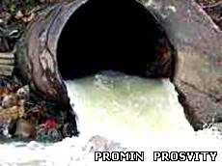
Municipal wastewater
More urgent environmental problem cities in Ukraine, especially large and spa , is cleaning various municipal waste - residential and industrial - and their processing . Every year in Ukraine reservoir dropped about 4 billion . M3 of contaminated wastewater.

Slide 13
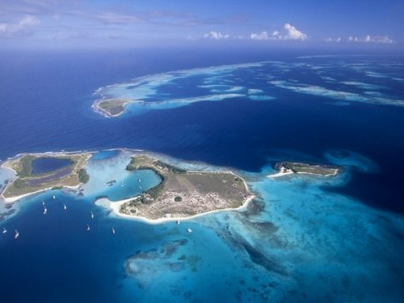
OUR

Slide 14
Planet

Slide 15
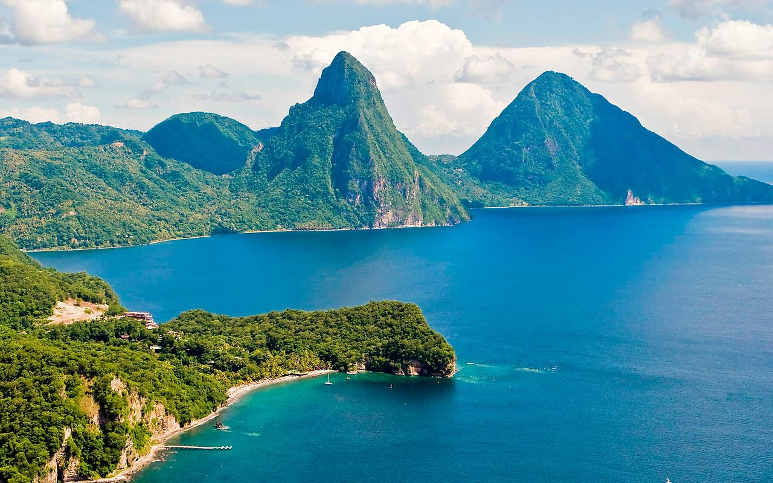
Should

Slide 16
be

Slide 17
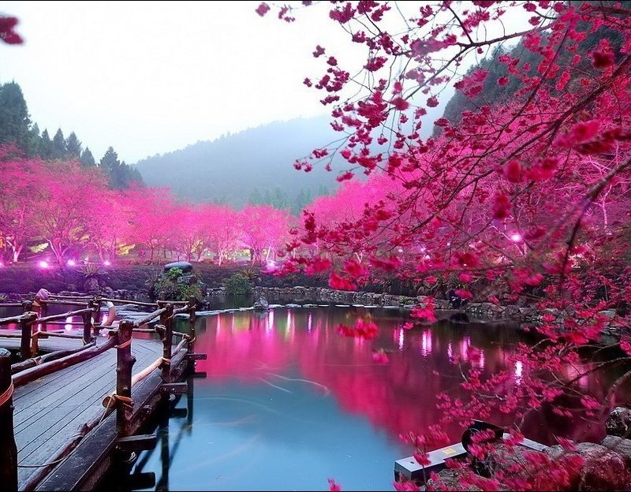
the

