Slide 1
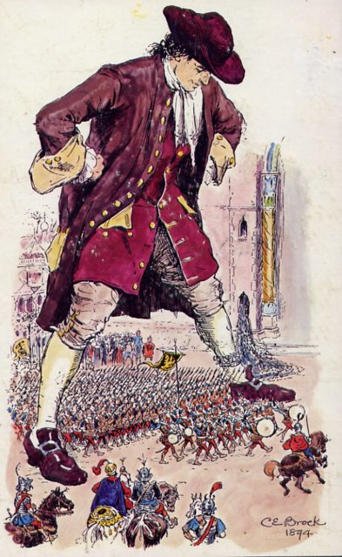

Gulliver's Travels: Voyage To Lilliput

Slide 2
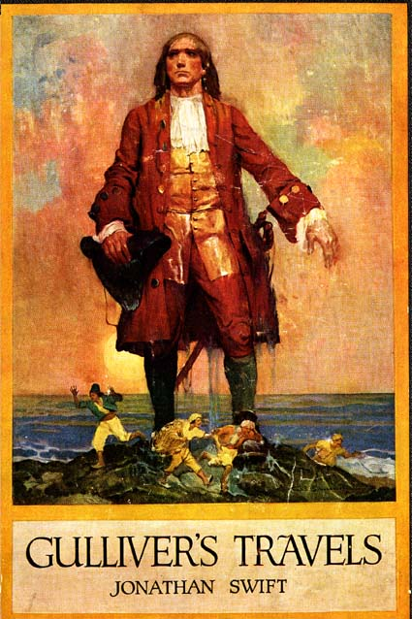
"A Voyage to Lilliput" is the first of four sections into which Gulliver's main voyages are separated into. In this section of Gulliver's Travels, Gulliver encounters serveral figuers and a miniature society that Swift uses to satirize and represent England's modern political conflicts.

Slide 3
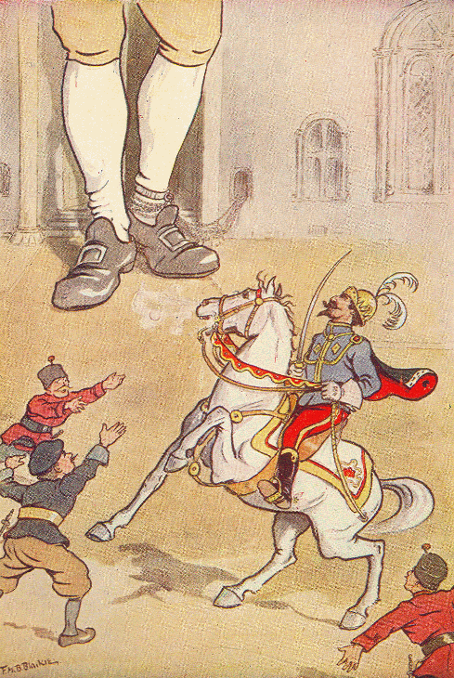
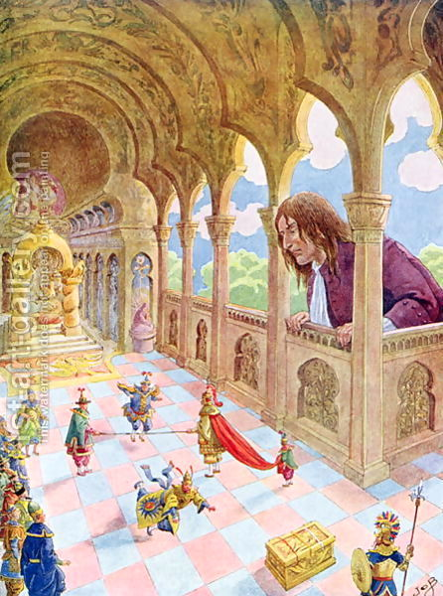
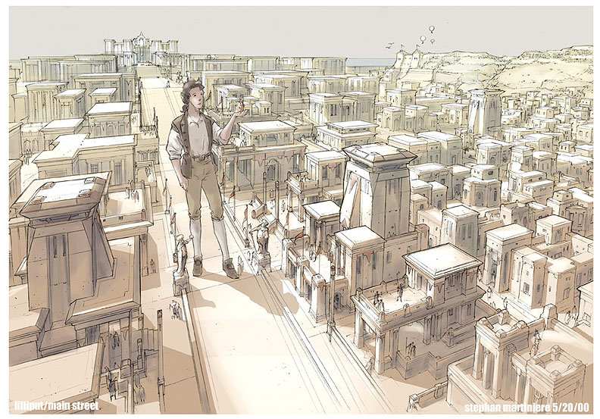
The Lilliputians inhabit the first island Gulliver visits. They all stand about six inches tall, with proportionally tiny buildings and trees and horses.

Slide 4
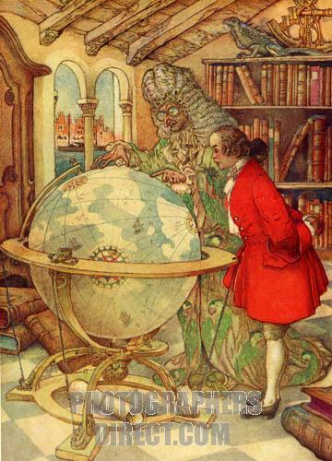
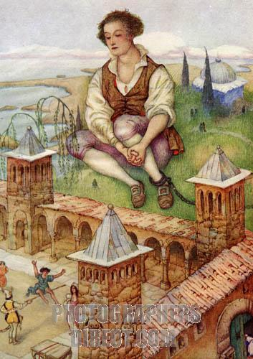
The Lilliputians are ruled by an Emperor who appoints his high court officials according to their skills with rope dancing rather than their actual abilities. In other words, they're not exactly governed according to rational principles.

Slide 5
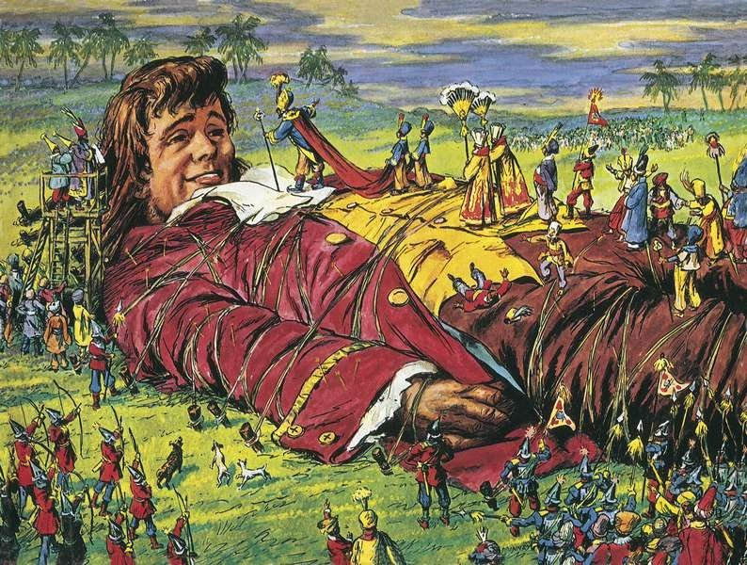
The court of Lilliput mostly seems to spend its time plotting against one another. Gulliver, unfortunately, forms one of the primary targets of these plots.

Slide 6
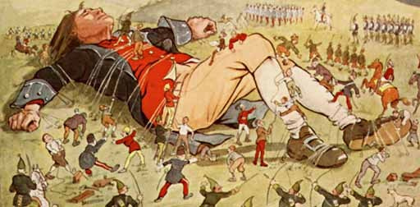
His enormous size makes him both expensive and dangerous for the Emperor to keep, so, even though he has made himself useful in Lilliput's wars against Blefuscu, Gulliver eventually has to flee the country to avoid having his eyes put out.

Slide 7
THE END!
Made by: Olena Slyvka
Tetiana Chekh

