Slide 1
Pablo Picasso
Підготувала
Учениця 10-А класу
Безнощенко Валентина

Slide 2
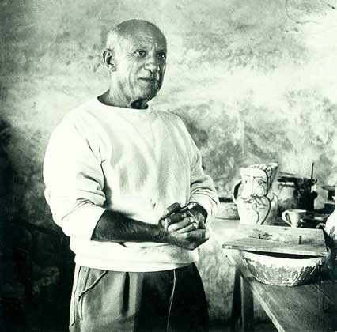
Pablo Ruiz y Picasso, known as Pablo Picasso was a Spanish painter, sculptor, printmaker, ceramicist, and stage designer who spent most of his adult life in France.

Slide 3
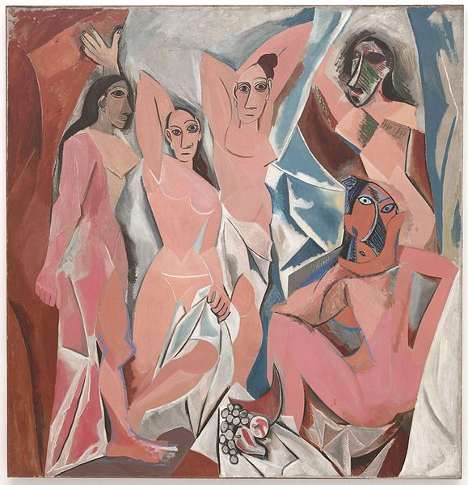
Among his most famous works are the proto-Cubist Les Demoiselles d'Avignon (1907), and Guernica (1937), a portrayal of the German bombing of Guernica during the Spanish Civil War.
Les Demoiselles d'Avignon

Slide 4
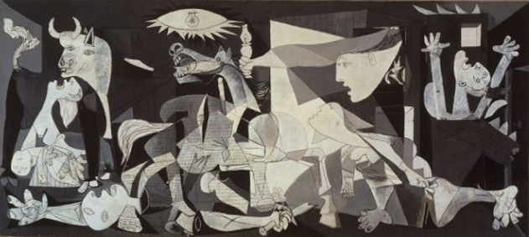
Guernica

