Slide 1
Internet and The World Wide Web

Slide 2

THE INTERNET
Also called net
is a worldwide collection of networks that links millions of businesses, government agencies, educational institutions, and individuals

Slide 3
COMMON USES OF INTERNET
COMMUNICATING
SHOPPING
SEARCHING
ENTERTAINMENT
EDUCATION OR LEARNING

Slide 4
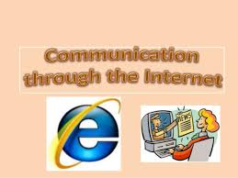
COMMON USES OF INTERNET
COMMUNICATING
the most popular internet activity
You can exchange email with your family and friends
The three most popular types of Internet communication are e-mail, instant messaging, and discussion groups.

Slide 5


COMMON USES OF INTERNET
SHOPPING
one of the fastest growing Internet applications
You can purchase goods using checks, credit cards, or electronic cash.

Slide 6

COMMON USES OF INTERNET
SEARCHING
You can access some of the world’s largest libraries directly from your home computer
You also will find the latest local, national, and international news

Slide 7
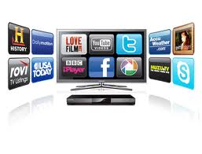
COMMON USES OF INTERNET
ENTERTAINMENT
You can find music, movies, magazines, and computer games
You will find live concerts, movie previews, book clubs, and interactive live games.

Slide 8
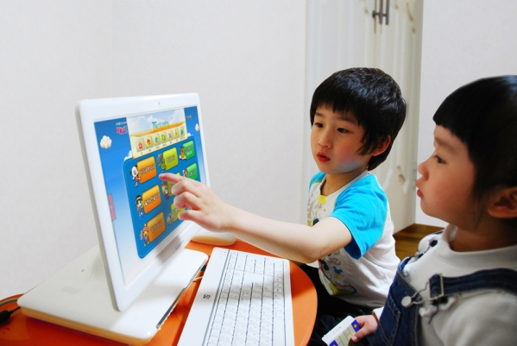
COMMON USES OF INTERNET
Education or E-learning
You can take classes on almost any subject
There are courses for high school, college, and graduate school credit.

Slide 9
OTHER INTERNET SERVICES
Electronic Communications
permit the users to communicate with other people on the Internet via electronic Mail, bulleting boards, chat rooms, social networking, and news groups.
EMAIL
INSTANT MESSAGING
REAL TIME CHAT
SOCIAL NETWORKING

Slide 10
OTHER INTERNET SERVICES
Information Services
are commonly referred to as remote login, or information access
permit users to log in to other computers from their computers for the purpose of obtaining information
TELNET

Slide 11
OTHER INTERNET SERVICES
Information Retrieval
These services permit users to obtain files from other sites and bring them to their computers.
This is commonly referred to as file transfer.
FILE TRANSFERPROTOCOL

Slide 12
Data Transmission Speeds
Data transmitted in characters or collections of bits.
A bit the smallest unit of information used by computers
Today’s data transmission speeds are measured in bits, kilobits, megabits, and gigabits per second:
Bps (bits per second) A computer with an older modem might have a speed of 28,800 bps, which is considered the minimum speed for visiting websites with graphics.
Kbps (kilobits per second or 1 thousand bits per second) This is the most frequently used measure. The speed of a modem that is 28,800 bps might be expressed as 28.8 Kbps.

Slide 13
Data Transmission Speeds
Mbps (megabits per second or 1 million bits per second) Faster means of connection.
Gbps (gigabits per second or 1 billion bits per second)
Upload – is the transmission of data from a local computer to a remote computer, as from your PC to a website you are constructing
Download – is the transmission of data from a remote computer to a local computer, as from a website to your own PC.

Slide 14
WIRELESS CONNECTION
Wireless Fidelity (Wi-Fi ) - is the name given to any of several standards – so called 802.11 standards-set by the Institute of Electrical and Electronic Engineers (IEEE) for wireless transmission One standard, 802.11b, permits wireless transmission f data at 1.11 Mbps up to 300 feet from an access point, or hot spot, a station that sends and receives data to and from a Wi-Fi network.
3G (Third Generation) - Wireless 3G is loosely defined as high-speed wireless technology that does not need access points because it uses the existing cellphone system.

Slide 15
TYPES OF WEBSITES
Portal – is a Web site that offers a variety of Internet services from a single, convenient location.
Wireless portal is a portal designed for Internet-enabled mobile devices

Slide 16
TYPES OF WEBSITES
News
A news Web site contains newsworthy material including stories and articles relating to current events, life, money, sports, and the weather.
Many magazines and newspapers sponsor Web sites that provide summaries of printed articles, as well as articles not included in the printed versions. Newspapers and television and radio stations are some of the media that maintain news Web sites.

Slide 17
TYPES OF WEBSITES
Information
An information Web site contains factual information.
Government agencies have informational Web sites providing information such as census data, tax codes, and the congressional budget.
Other organizations provide information such as public transportation schedules and published research findings

Slide 18
TYPES OF WEBSITES
Business/Marketing
this site contains content that promotes or sells products or services. Nearly every business has a business/marketing Web site.
Many of these companies also allow you to purchase their products or services online.

Slide 19
TYPES OF WEBSITES
Educational
An educational Web site offers exciting, challenging avenues for formal and informal teaching and earning.
For a more structured learning experience, companies provide online training to employees and colleges offer online classes and degrees.
Instructors often use the Web to enhance classroom teaching by publishing course materials, grades, and other pertinent class information.

Slide 20
TYPES OF WEBSITES
Entertainment
this site offers an interactive and engaging environment. Popular entertainment Web sites offer music, videos, sports, games, ongoing Web episodes, sweepstakes, chats, and more. Sophisticated entertainment Web sites often partner with other technologies.
For example, you can cast your vote about a topic on a television show.

Slide 21
TYPES OF WEBSITES
Advocacy
An advocacy Web site contains content that describes a cause, opinion, or idea.
The purpose of an advocacy Web site is to convince the reader of the validity of the cause, opinion, or idea.
These Web sites usually present views of a particular group or association.

Slide 22
TYPES OF WEBSITES
Blog
A blog, short for Web log, is a Web site that uses regularly updated journal format to reflect the interests, opinions, and personalities of the author and sometimes site visitors.
Blogs have an informal style that consists of a single individual’s ideas (similar to a diary) or a collection of ideas and thoughts among visitors.

Slide 23
TYPES OF WEBSITES
Personal
A private individual or family not usually associated with any organization may maintain a personal Web site of just a single Web page.
People publish personal Web pages for a variety of reasons. Some are job hunting.
Other simply want to share life experiences with the world

