Slide 1
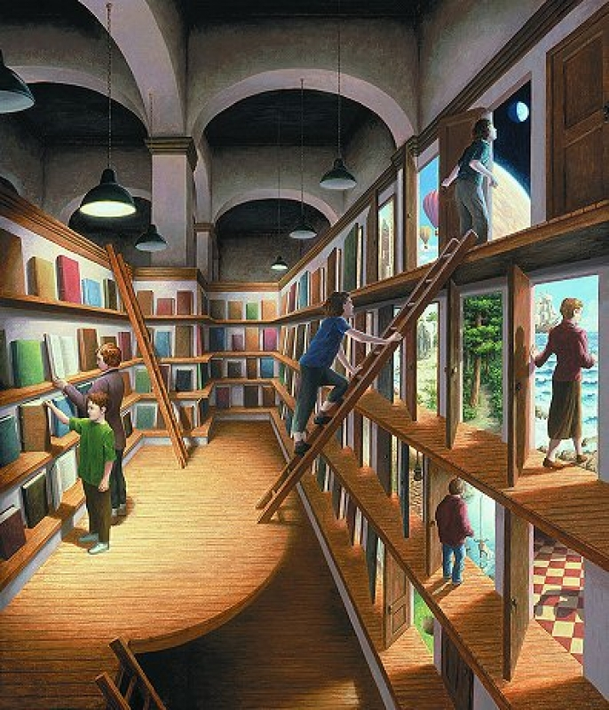
Rob Gonsalves
Made by
Olesya Samoylenko

Slide 2
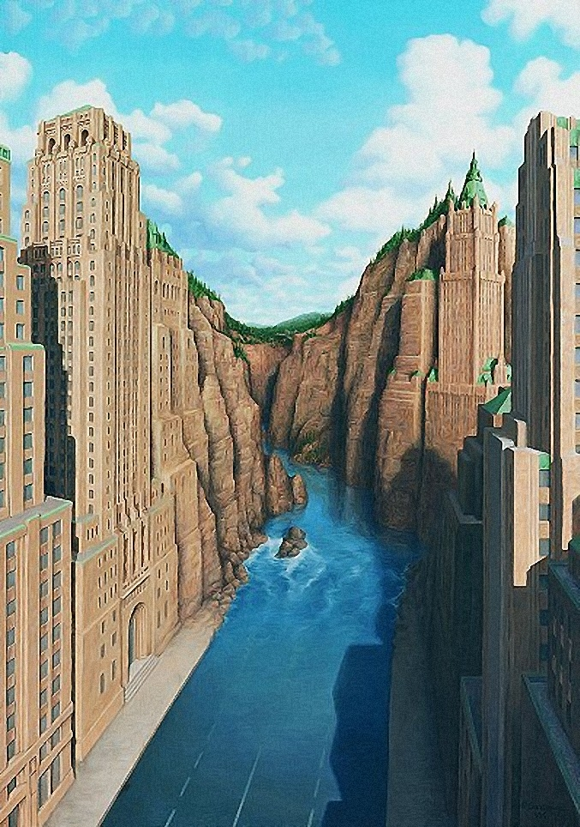
Rob Gonsalves is a Canadian painter of magic realism with a unique perspective and style. He produces original works, limited edition prints and illustrations for his own books.

Slide 3
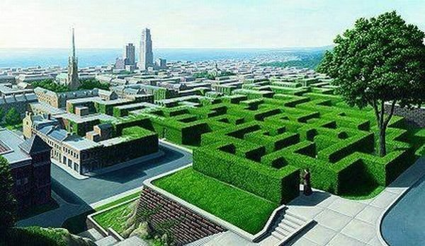
During his childhood, Gonsalves developed an interest in drawing from imagination using various media. By the age of twelve, his awareness of architecture grew as he learned perspective techniques and he began to create his first paintings and renderings of imagined buildings.

Slide 4
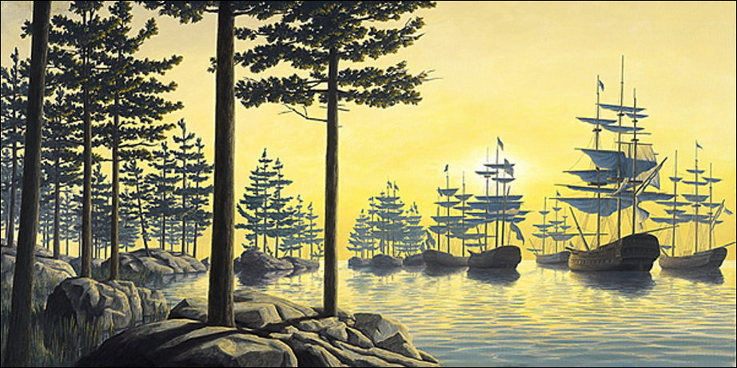
After an introduction to artists Dalí and Tanguy, Gonsalves began his first surrealist paintings. The "Magic Realism" approach of Magritte along with the precise perspective illusions of Escher came to be influences in his future work.

Slide 5
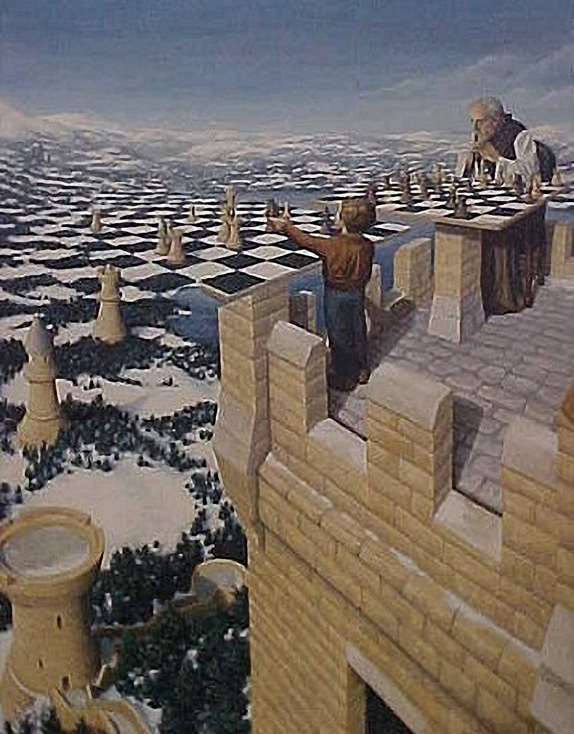
In his post college years, Gonsalves worked full-time as an architect, also painting trompe-l'œil murals and theater sets. After an enthusiastic response in 1990 at the Toronto Outdoor Art Exhibition, Gonsalves devoted himself to painting full-time.

Slide 6
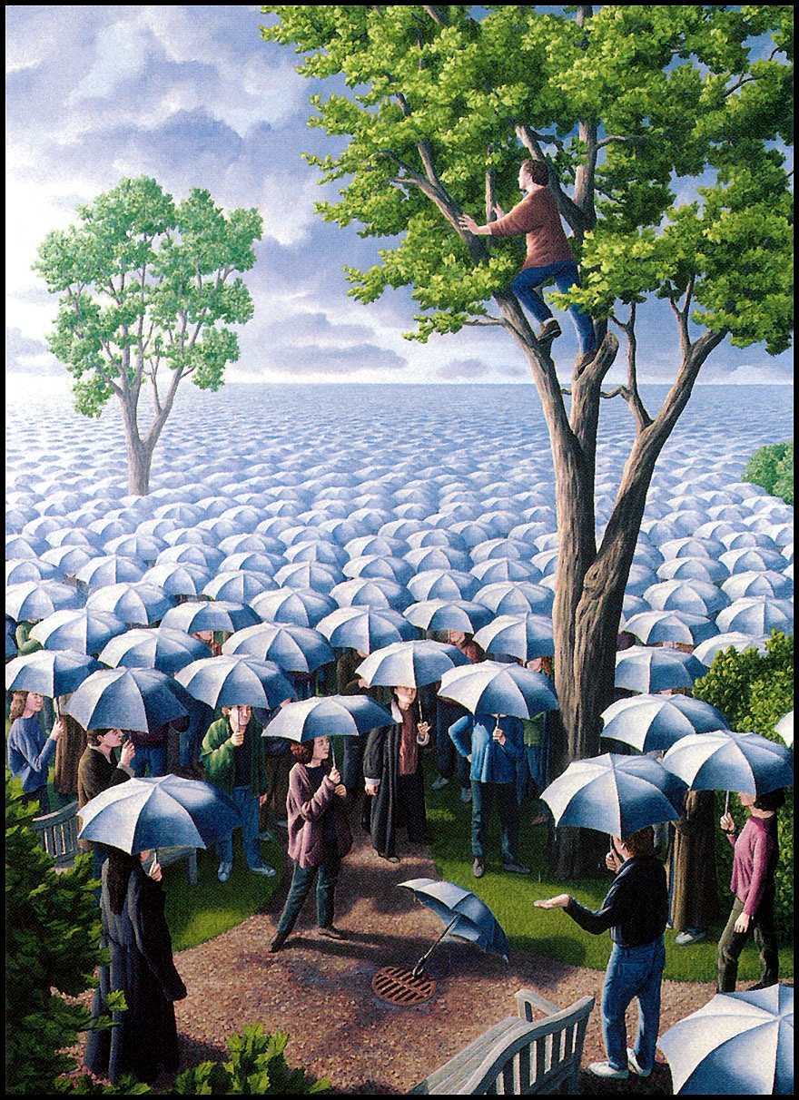
Although Gonsalves' work is often categorized as surrealistic, it differs because the images are deliberately planned and result from conscious thought. Ideas are largely generated by the external world and involve recognizable human activities, using carefully planned illusionist devices.

Slide 7
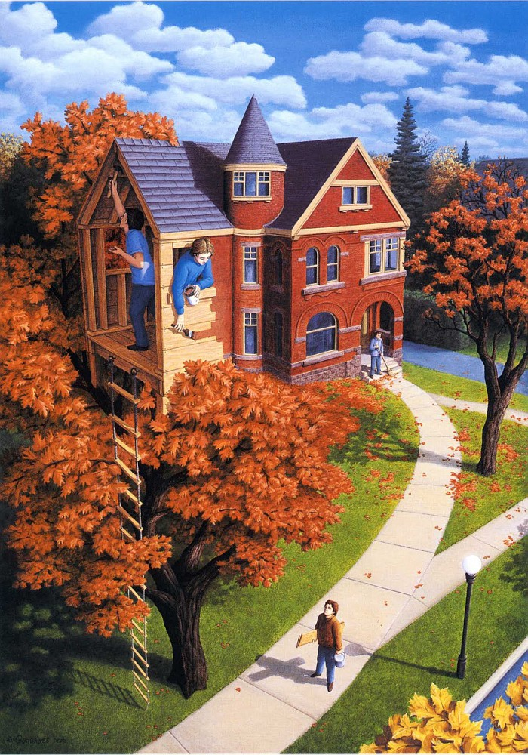
Gonsalves injects a sense of magic into realistic scenes. As a result, the term "Magic Realism" describes his work accurately. His work is an attempt to represent human beings' desire to believe the impossible, to be open to possibility.

Slide 8
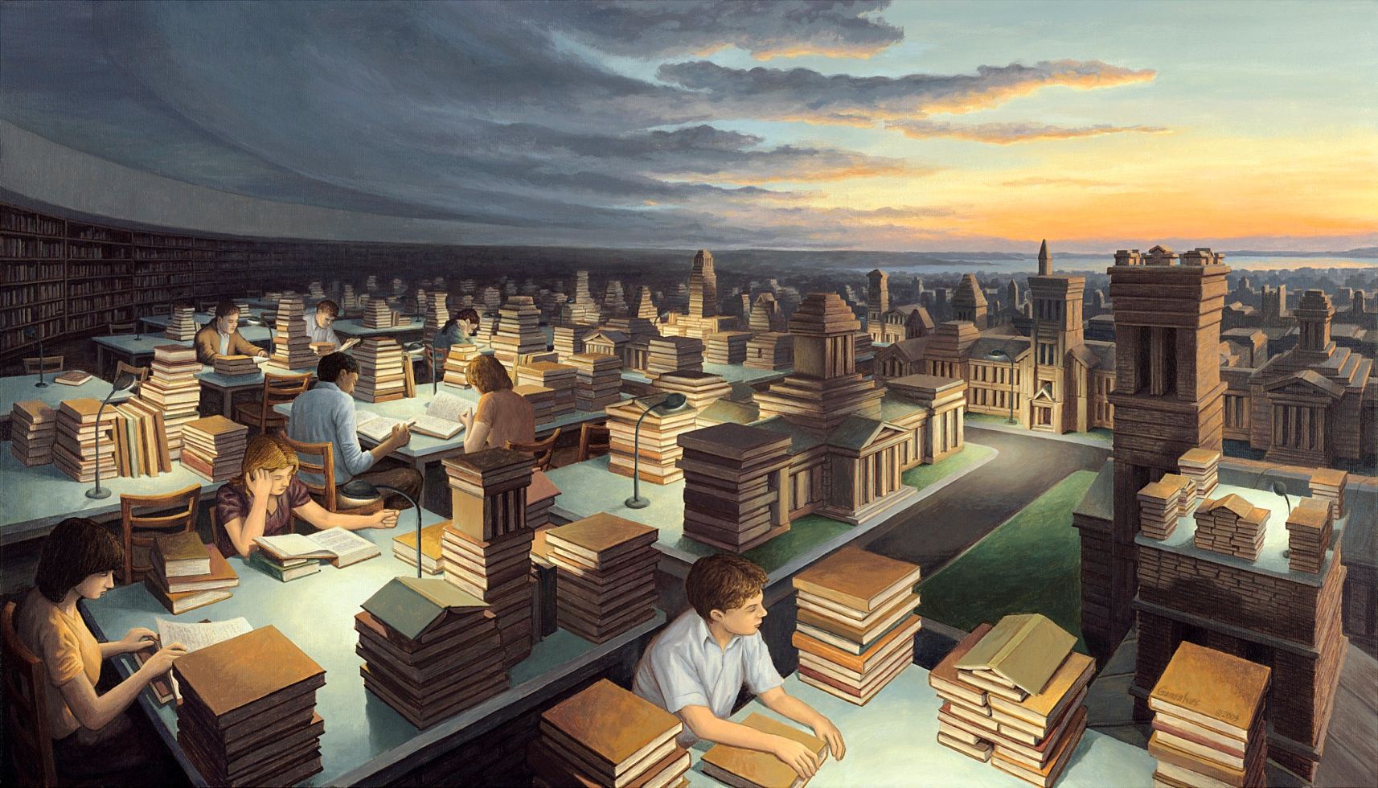
Numerous individuals around the world, including a United States Senator, as well as corporations and embassies collect Gonsalves' original work and limited edition prints.

Slide 9
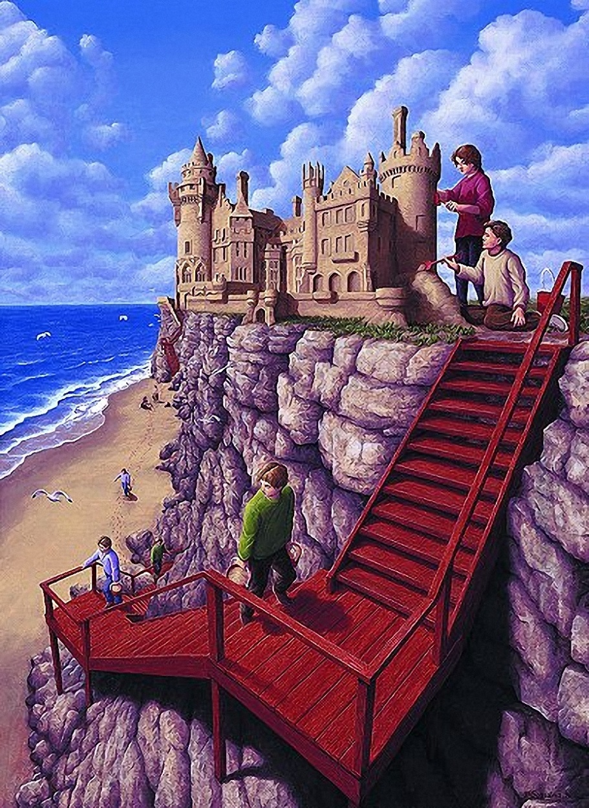
In June 2003, Simon & Schuster introduced North America and Canada to "Imagine a Night", Gonsalves' first hardcover book featuring sixteen paintings. Due to the success of "Imagine a Night", Simon & Schuster released a second book “Imagine A Day” in 2004 for which he won the 2005 Governor General's Award in the Children's Literature - Illustration category. His book "Imagine a Place" was released in 2008.

Slide 10
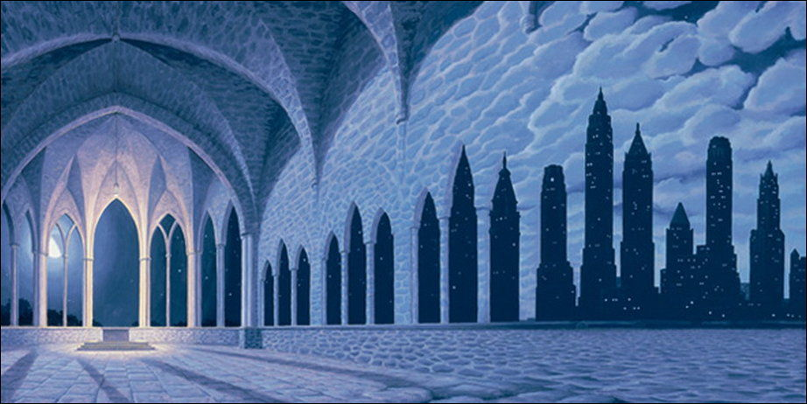
Gonsalves now has 70 paintings and is working on more. He spends a notable amount of time planning each piece in order to make the transitions flawless and usually finishes about four paintings each year.

Slide 11
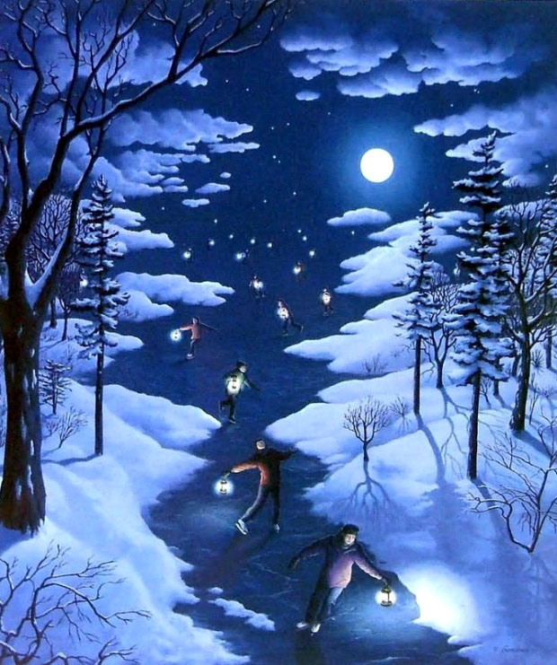

Slide 12
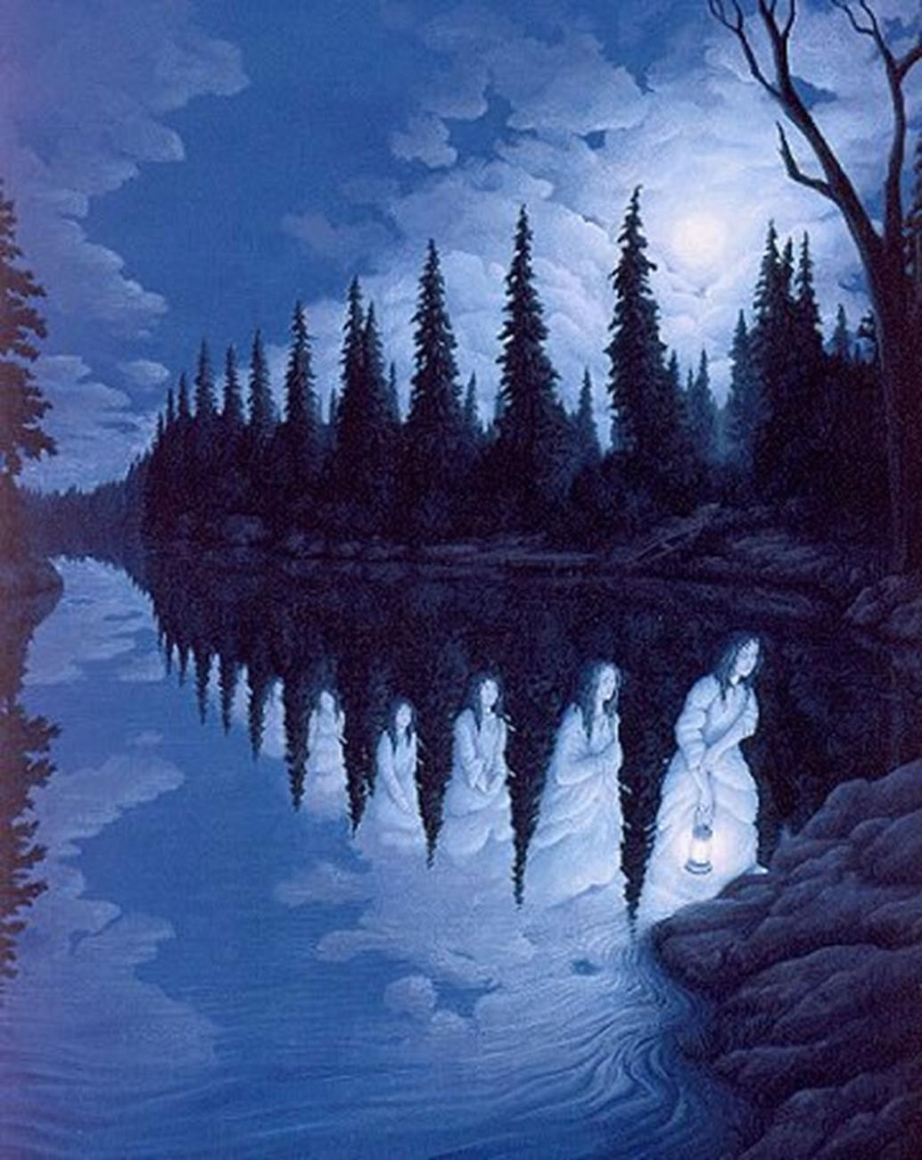

Slide 13
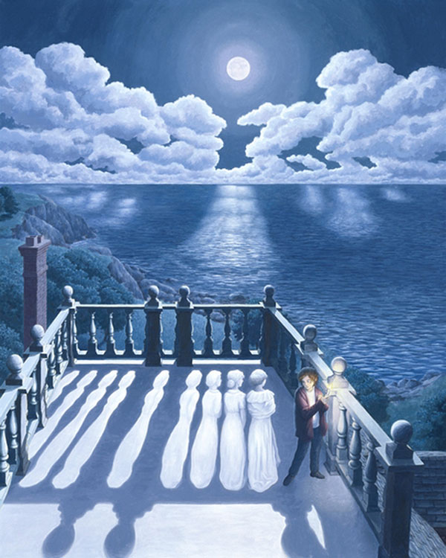

Slide 14
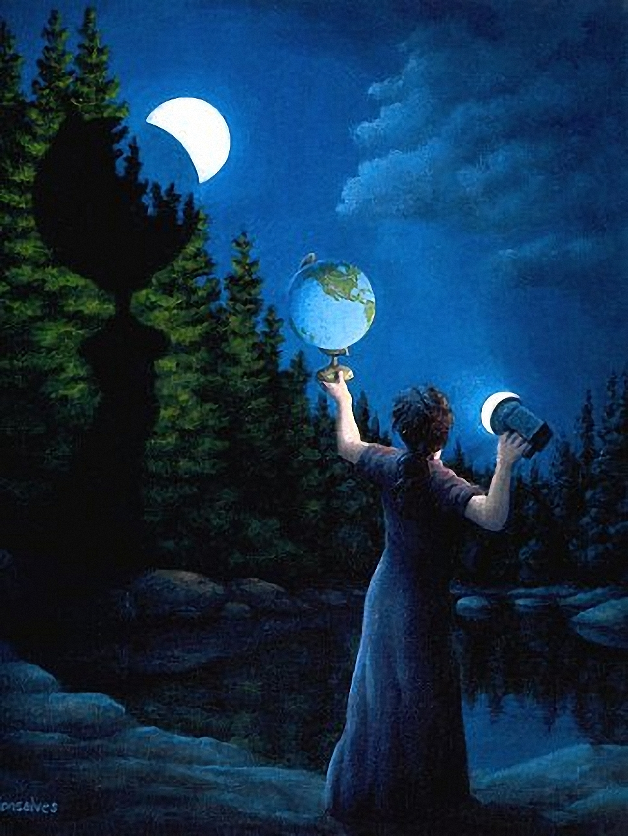

Slide 15
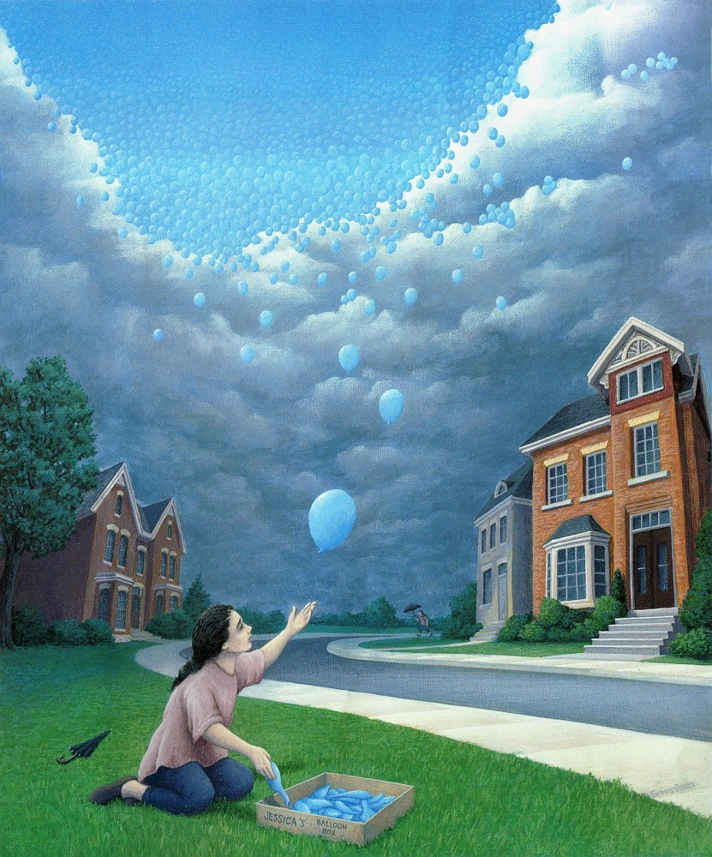

Slide 16
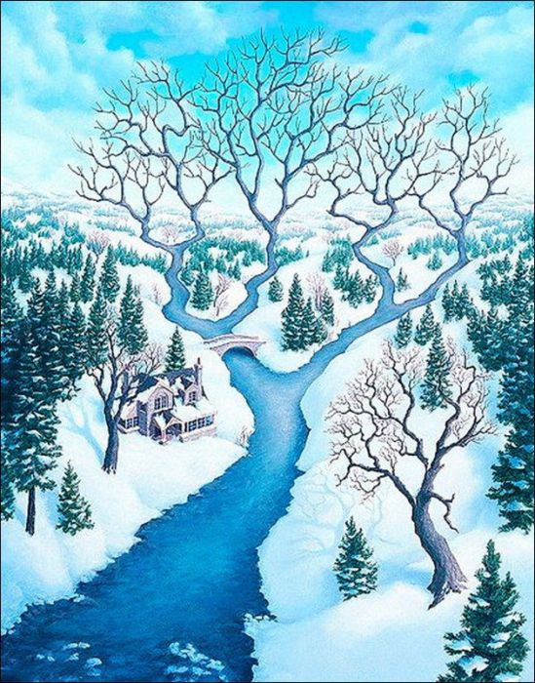

Slide 17
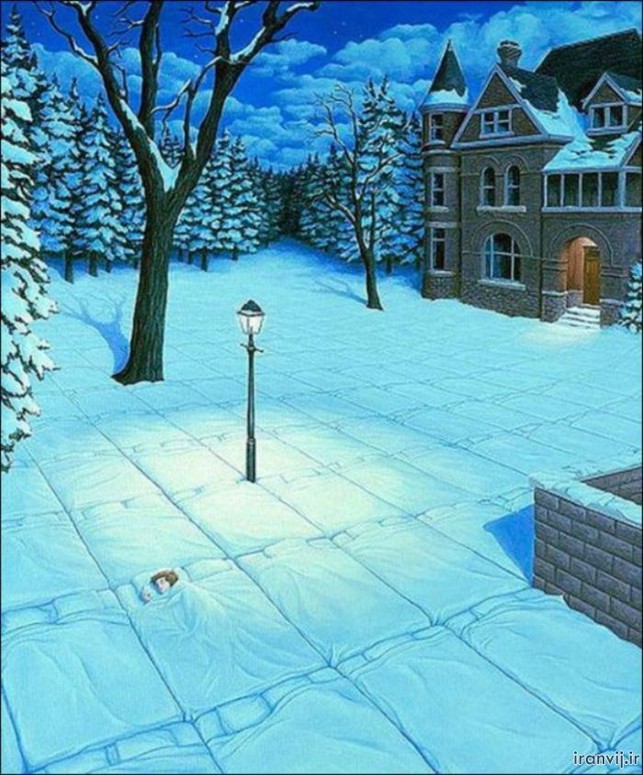

Slide 18
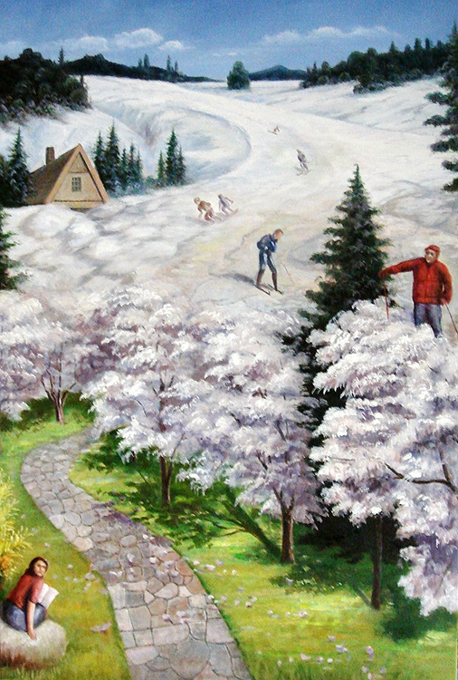

Slide 19
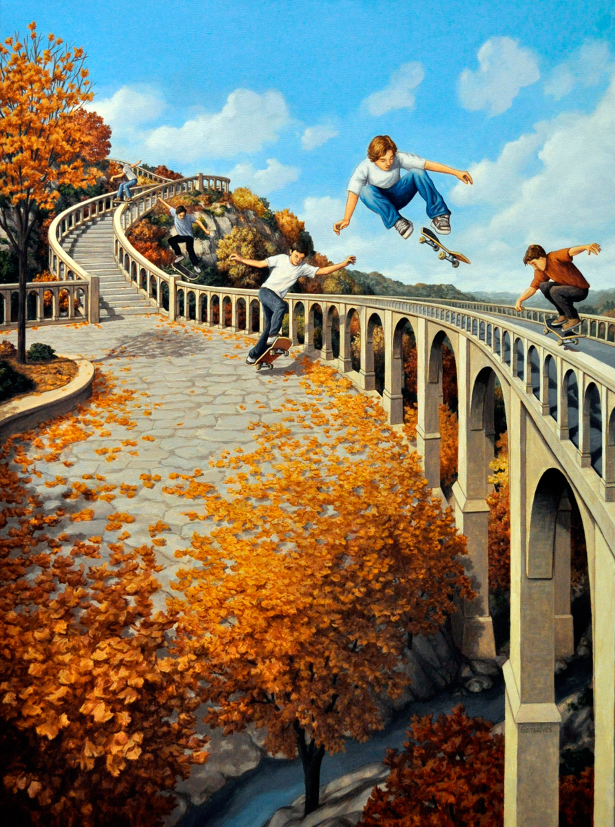

Slide 20
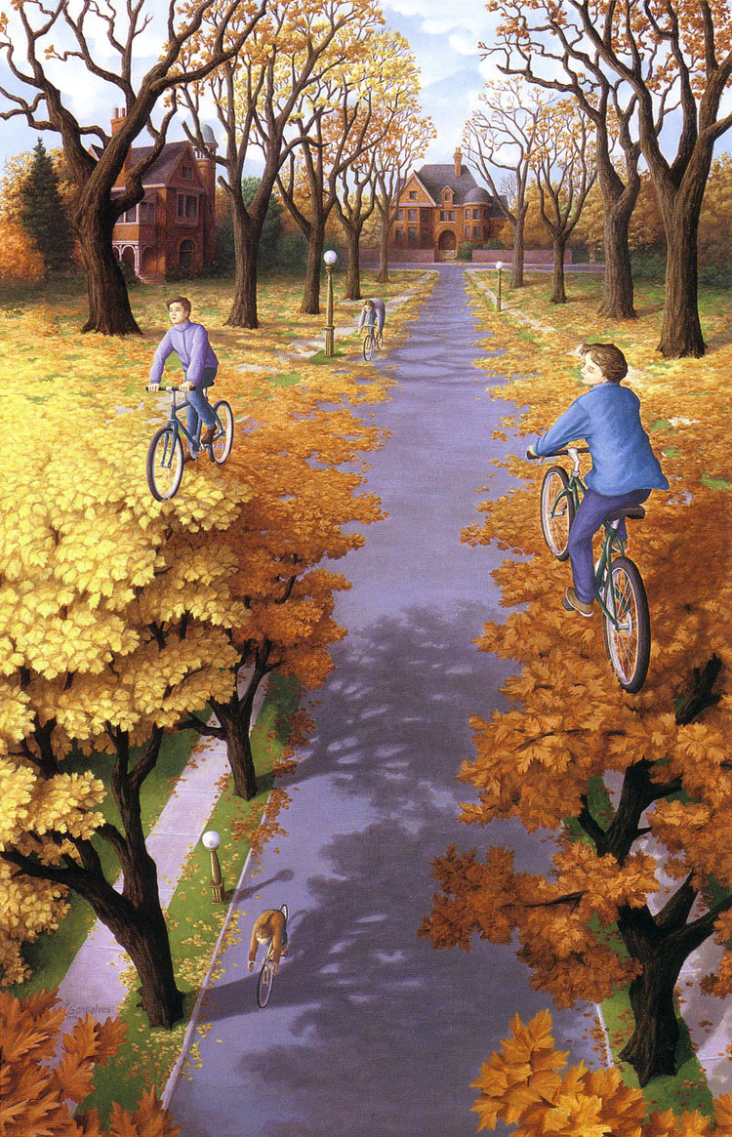

Slide 21
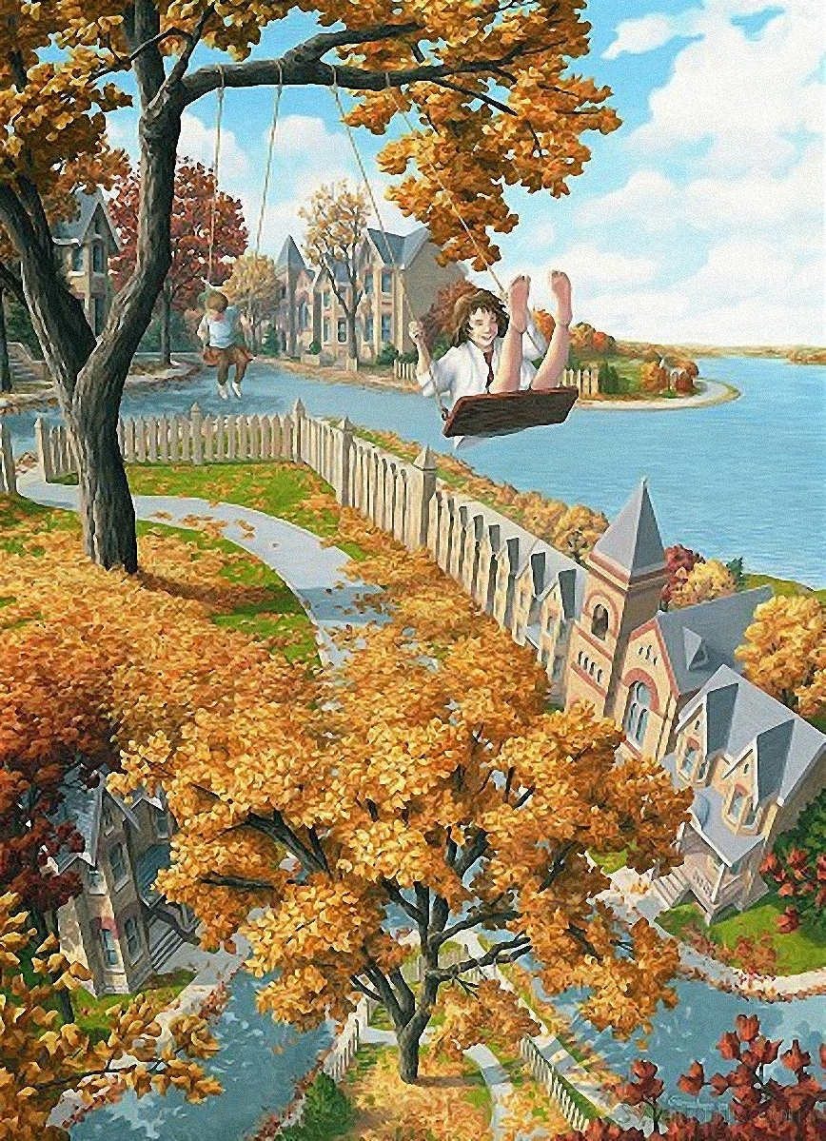

Slide 22
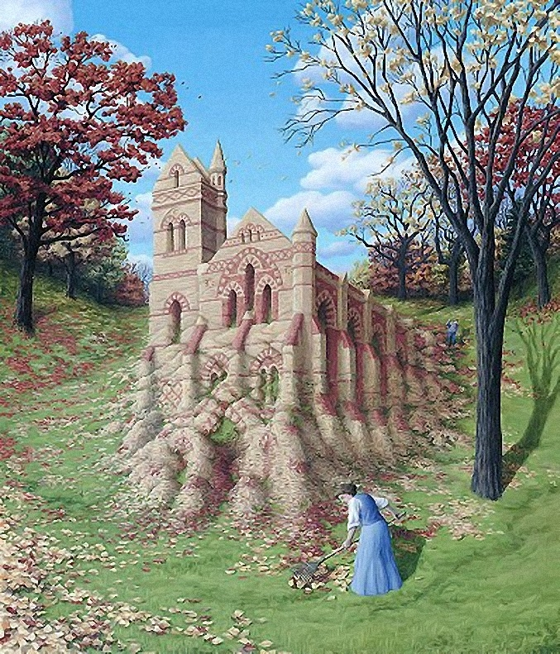

Slide 23
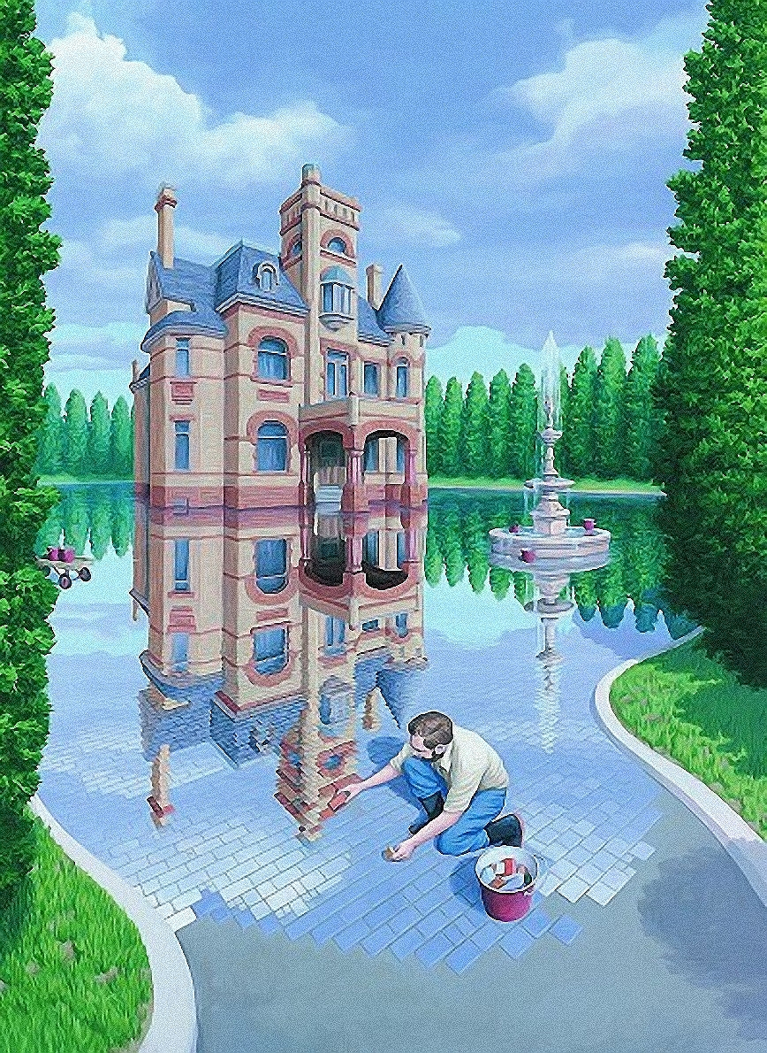

Slide 24
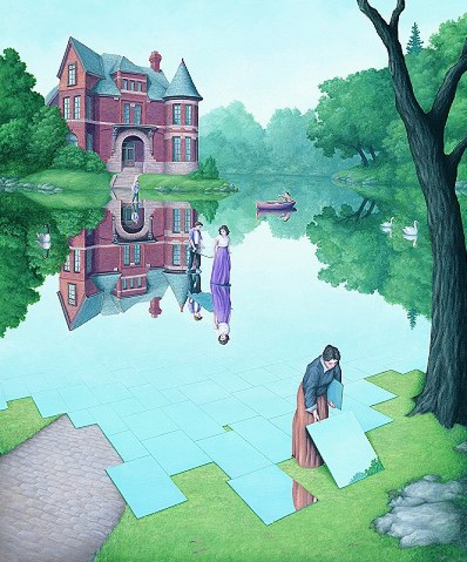

Slide 25
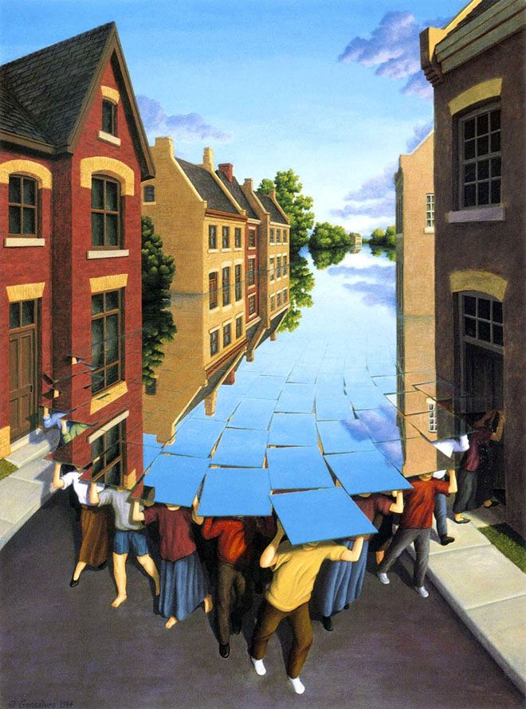

Slide 26
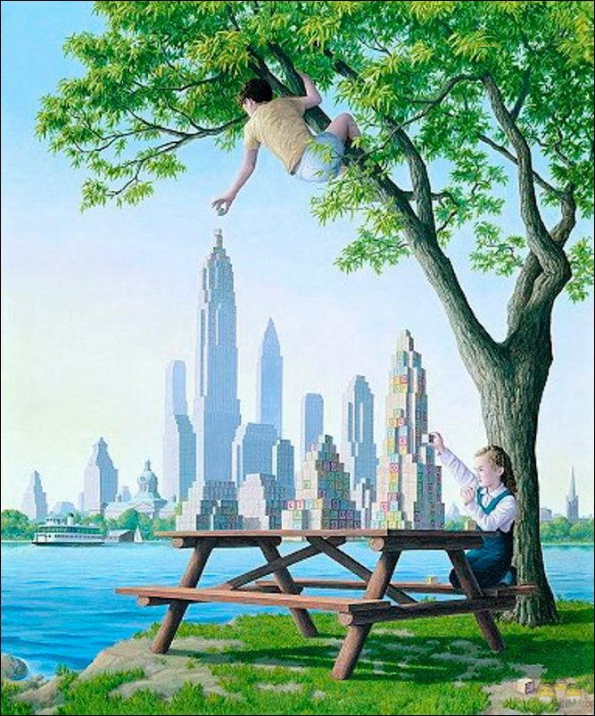

Slide 27
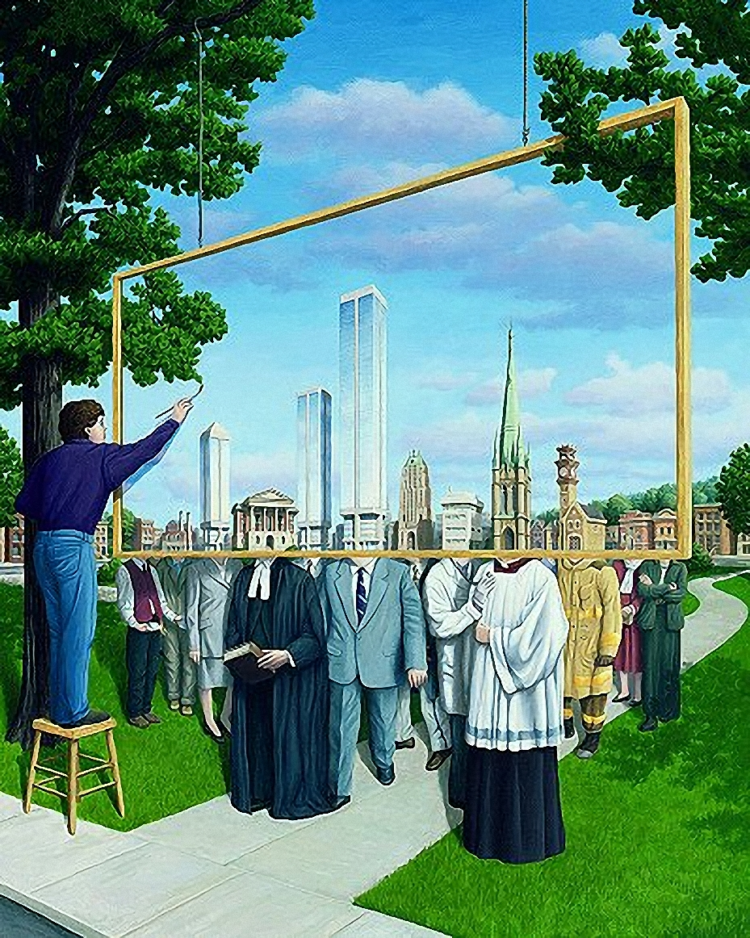

Slide 28
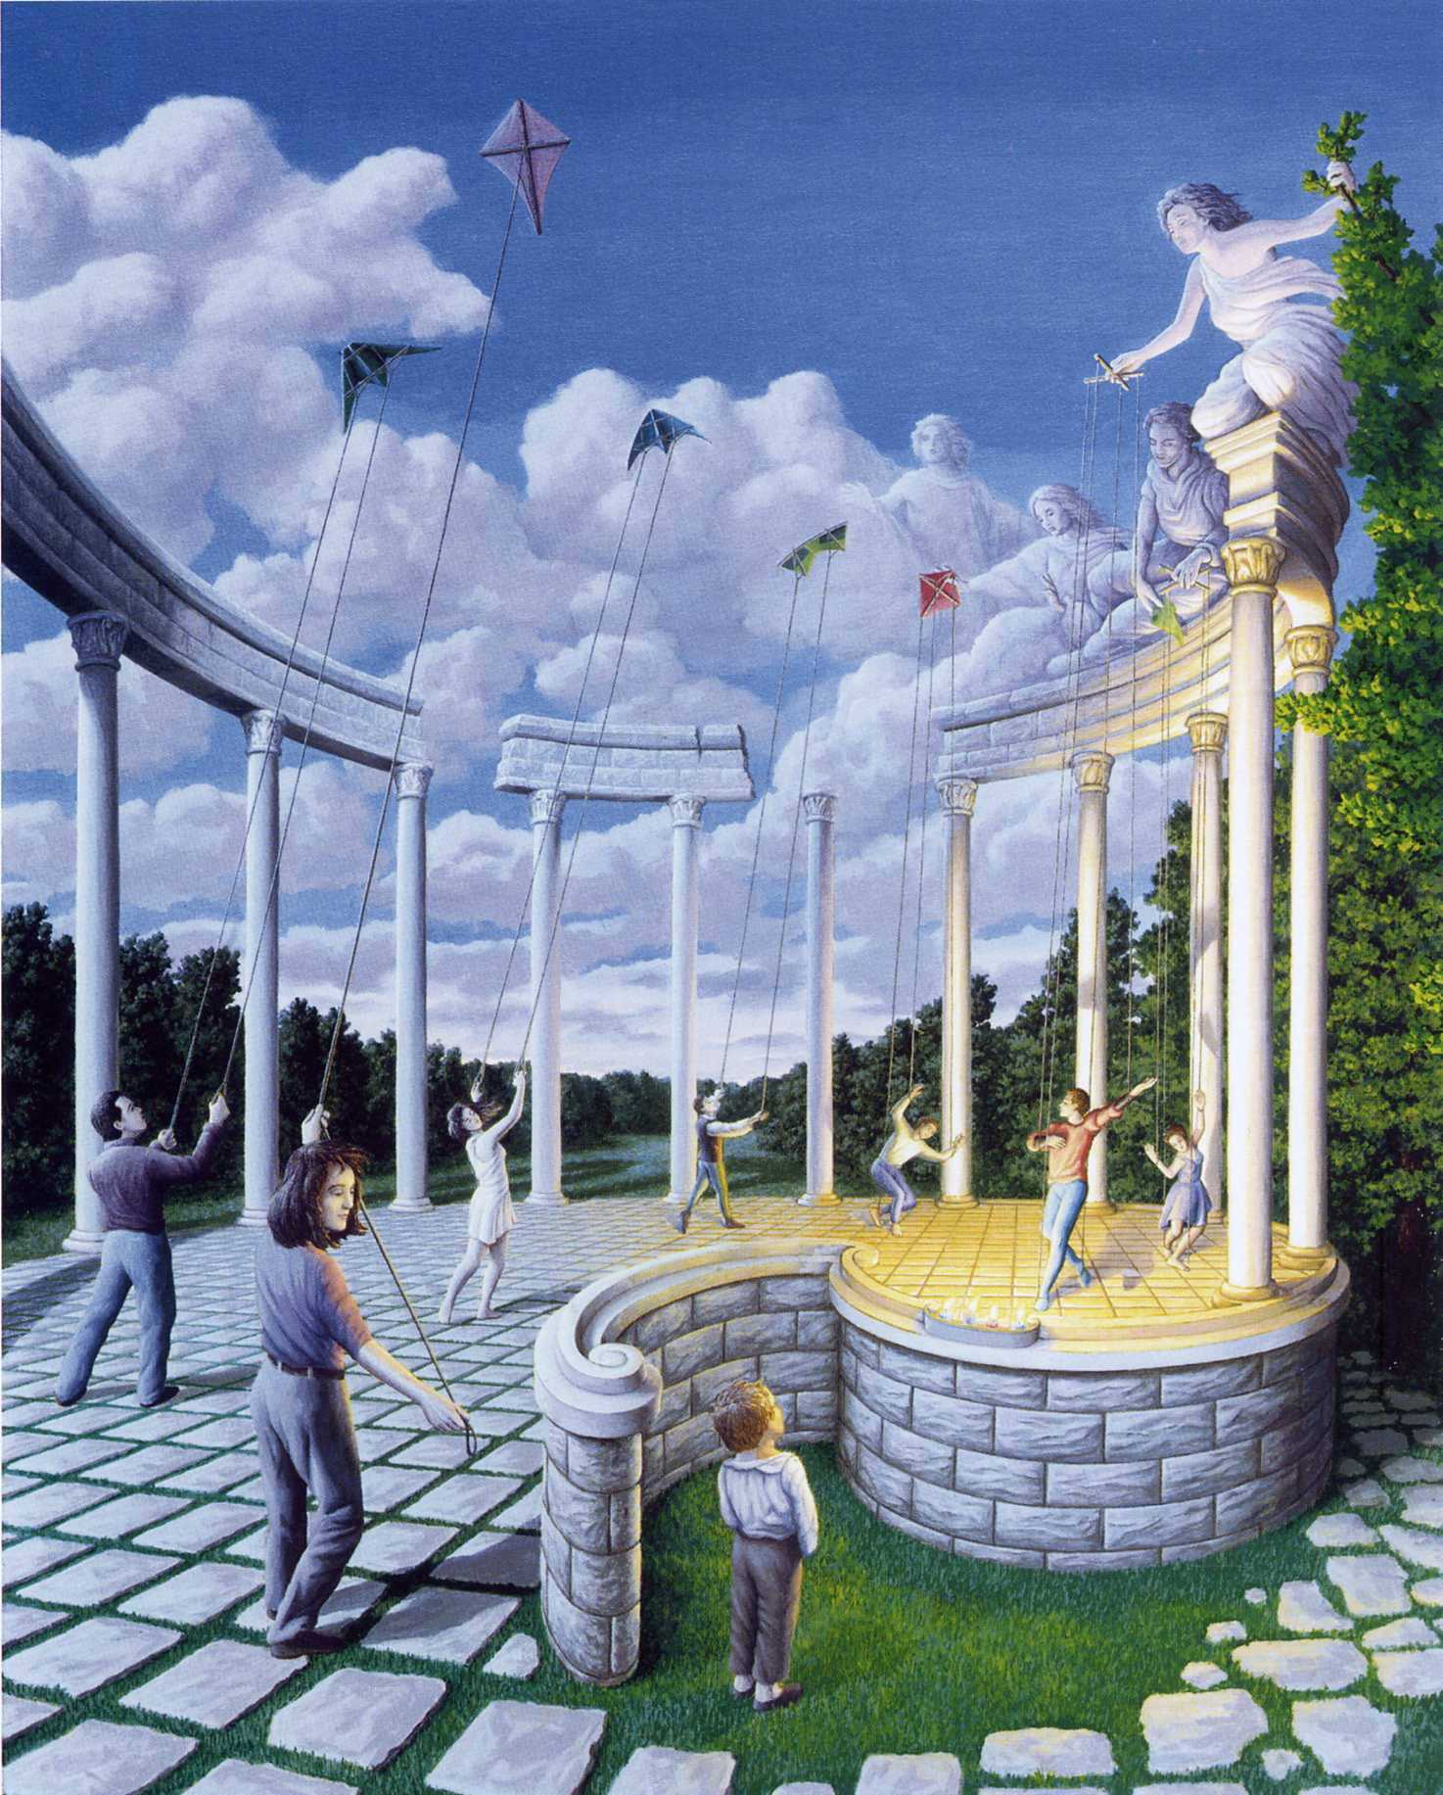

Slide 29
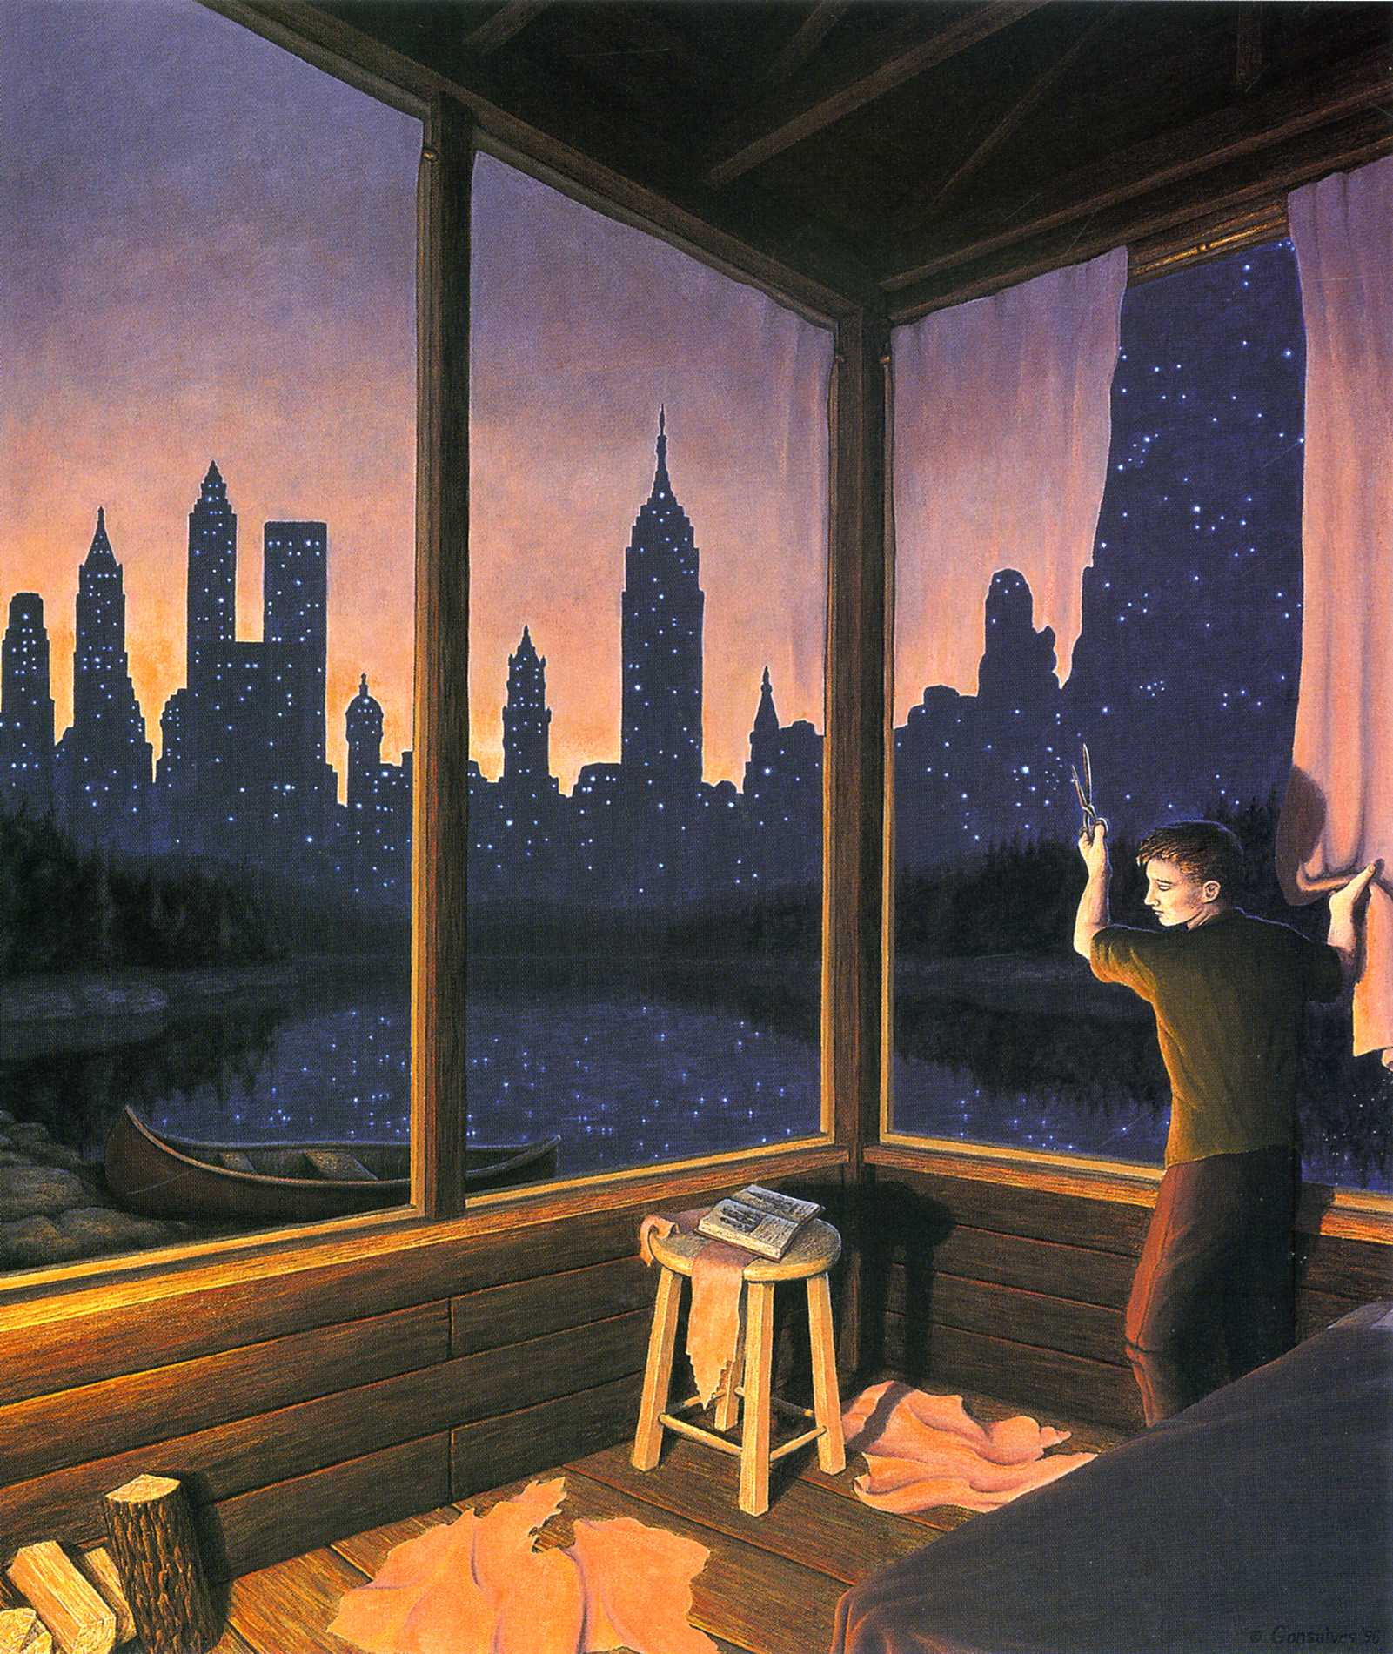

Slide 30
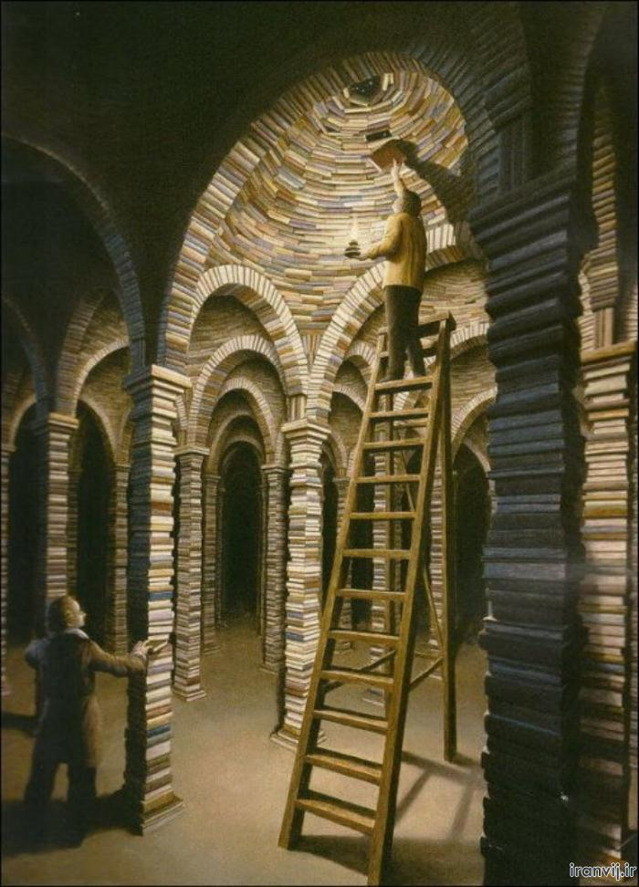

Slide 31
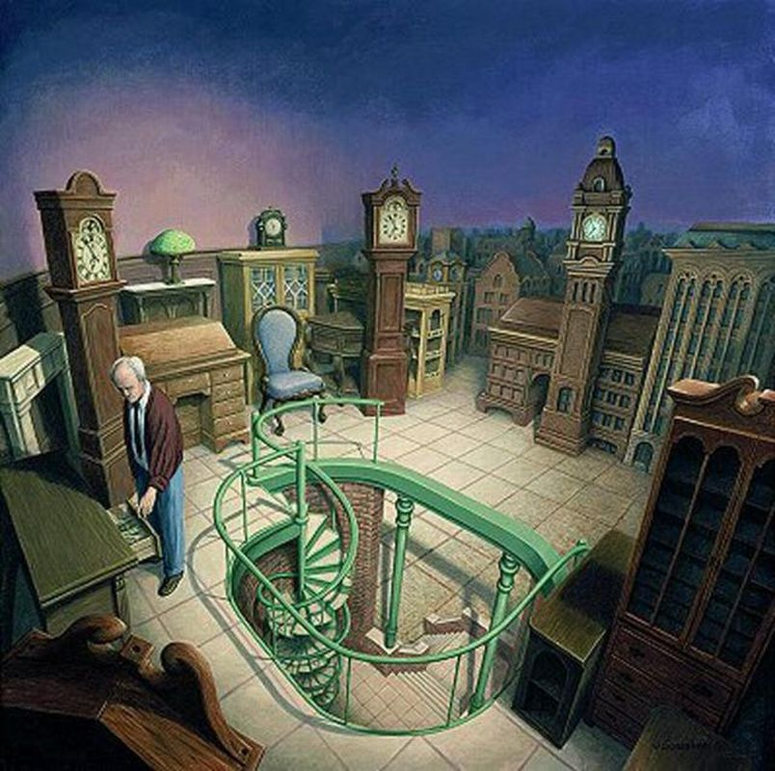

Slide 32
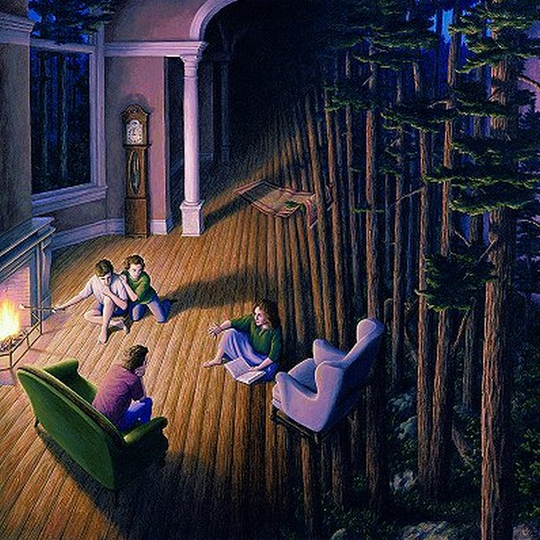

Slide 33
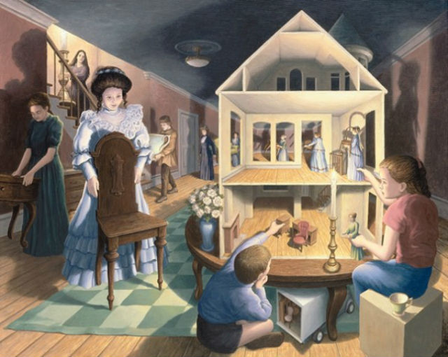

Slide 34
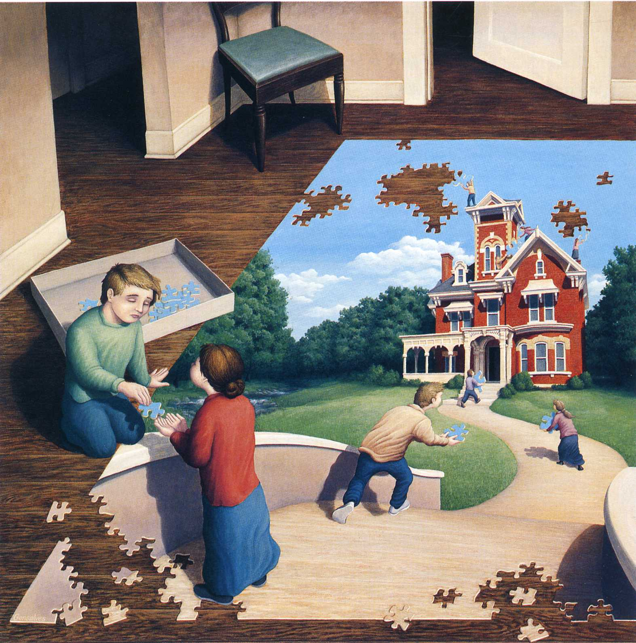

Slide 35
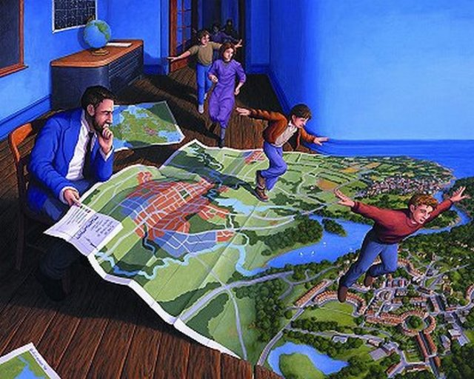

Slide 36
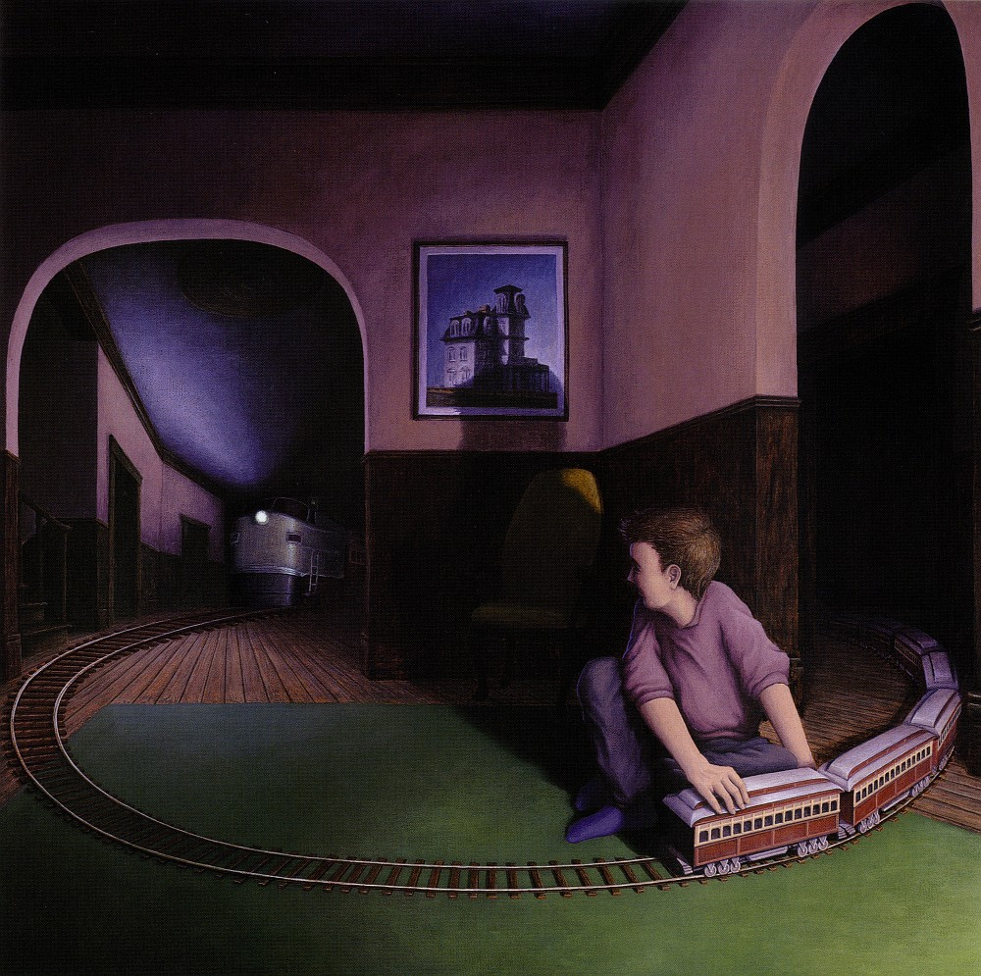

Slide 37
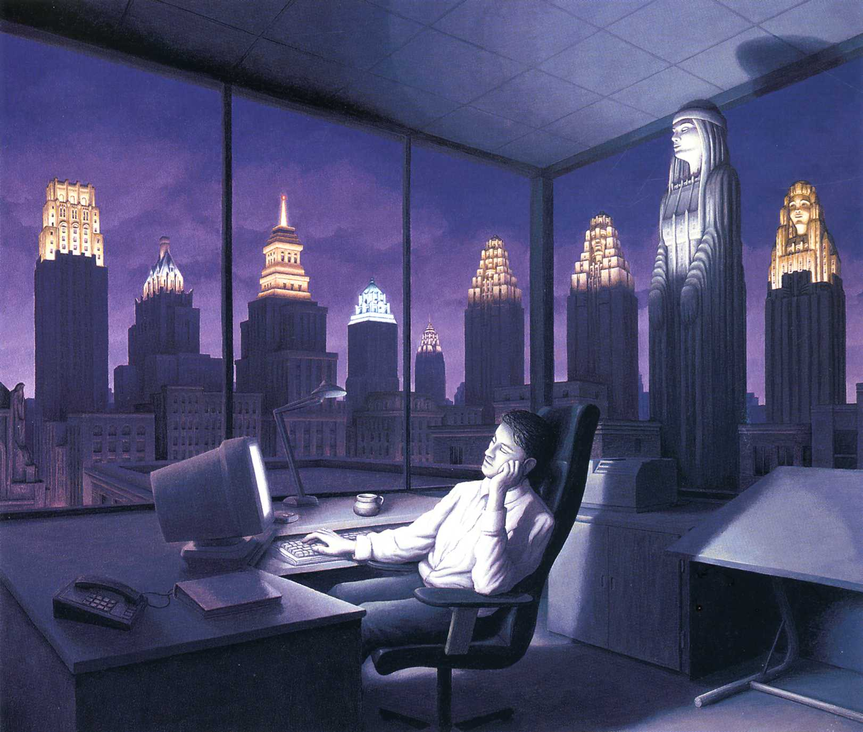

Slide 38
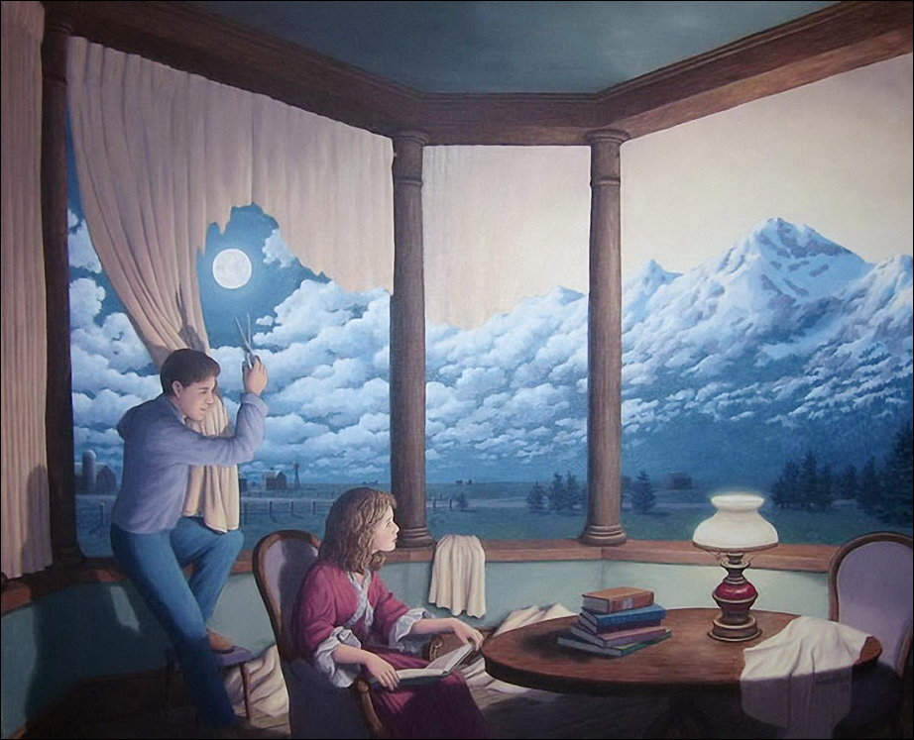

Slide 39
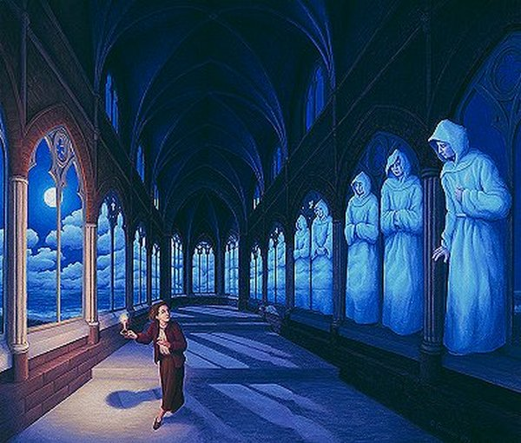

Slide 40
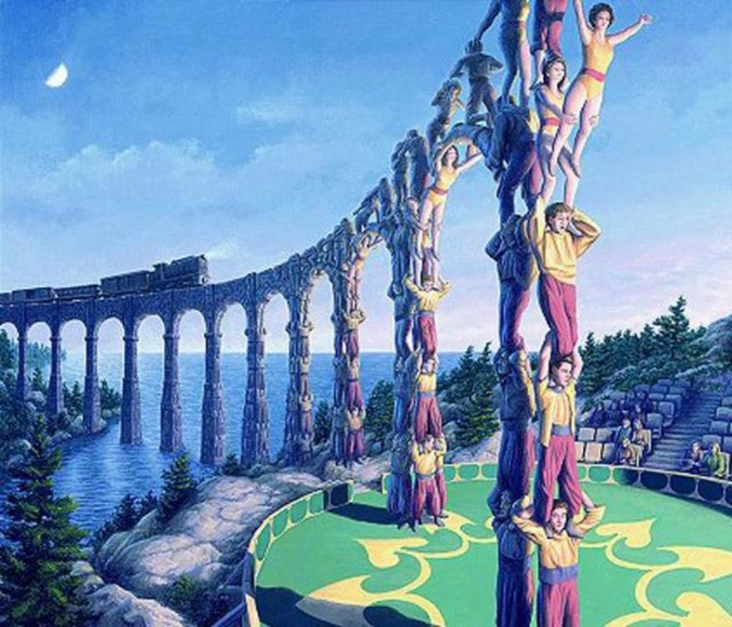

Slide 41
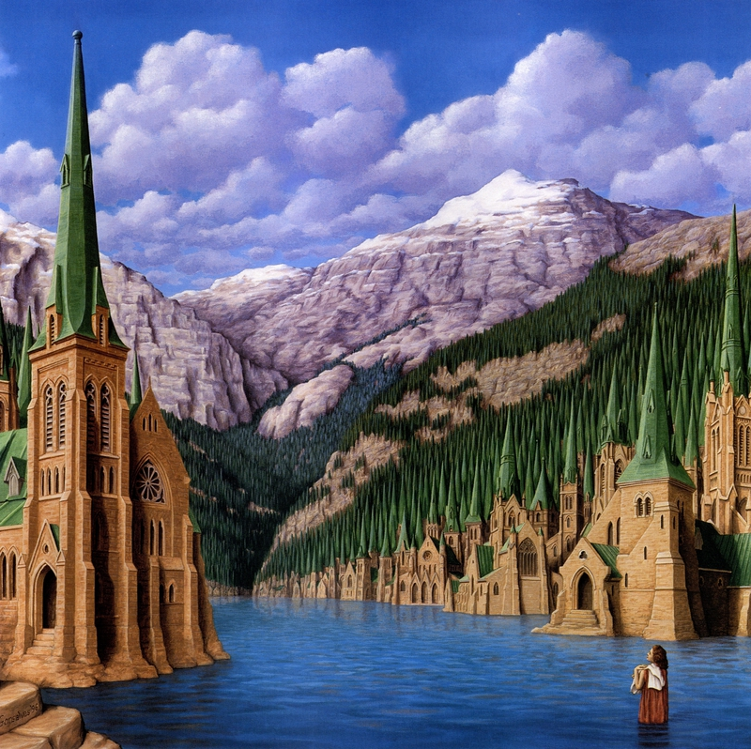

Slide 42
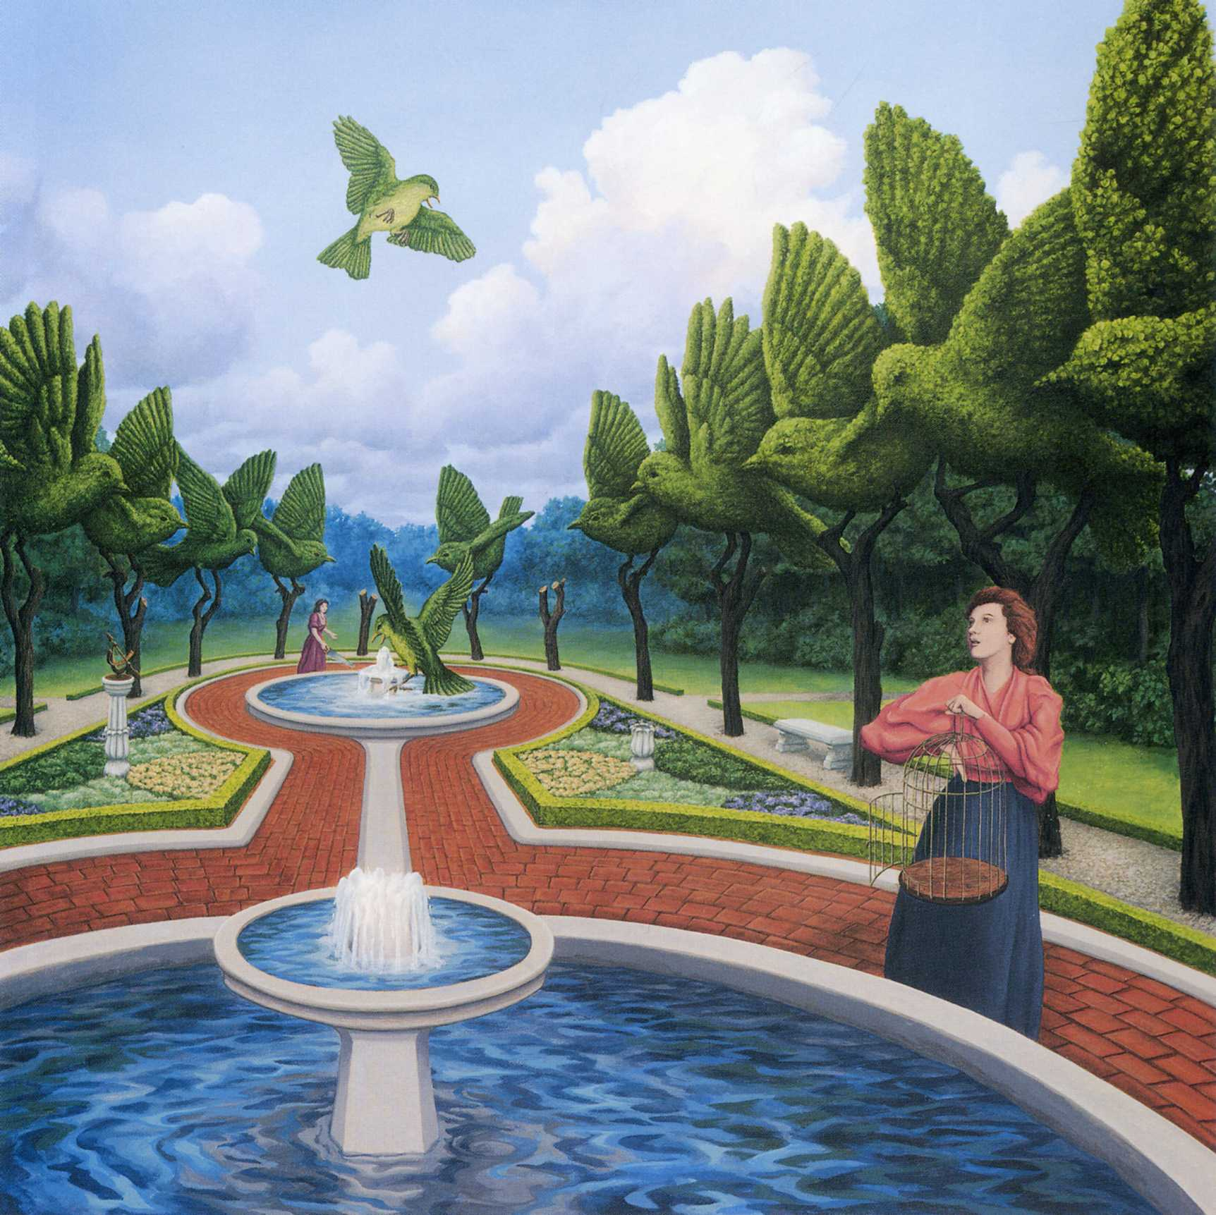

Slide 43
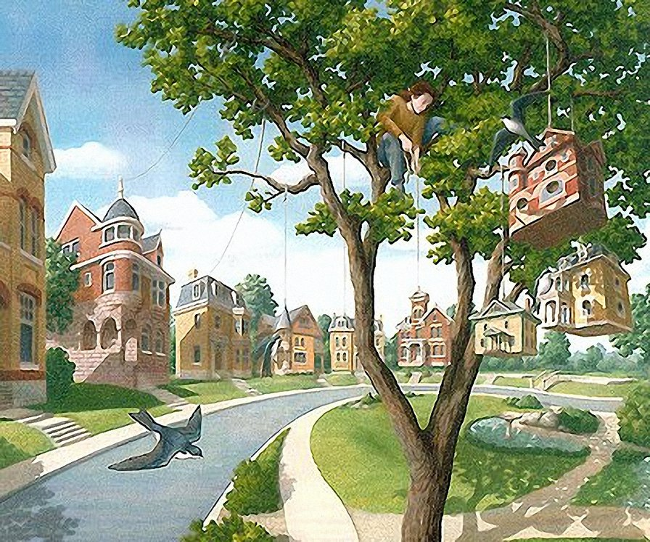

Slide 44
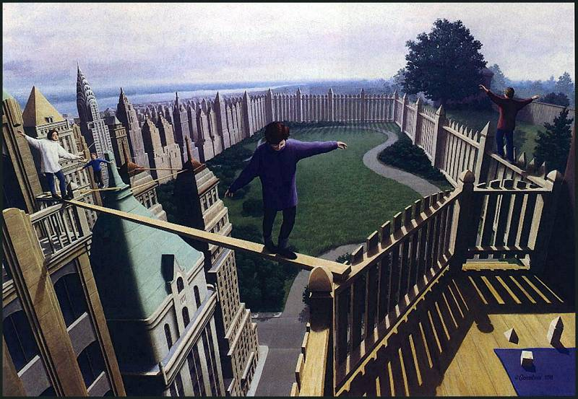

Slide 45
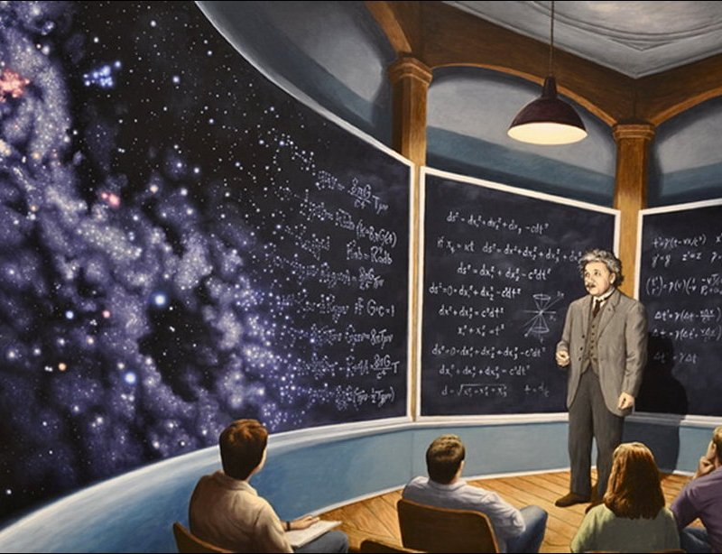

Slide 46
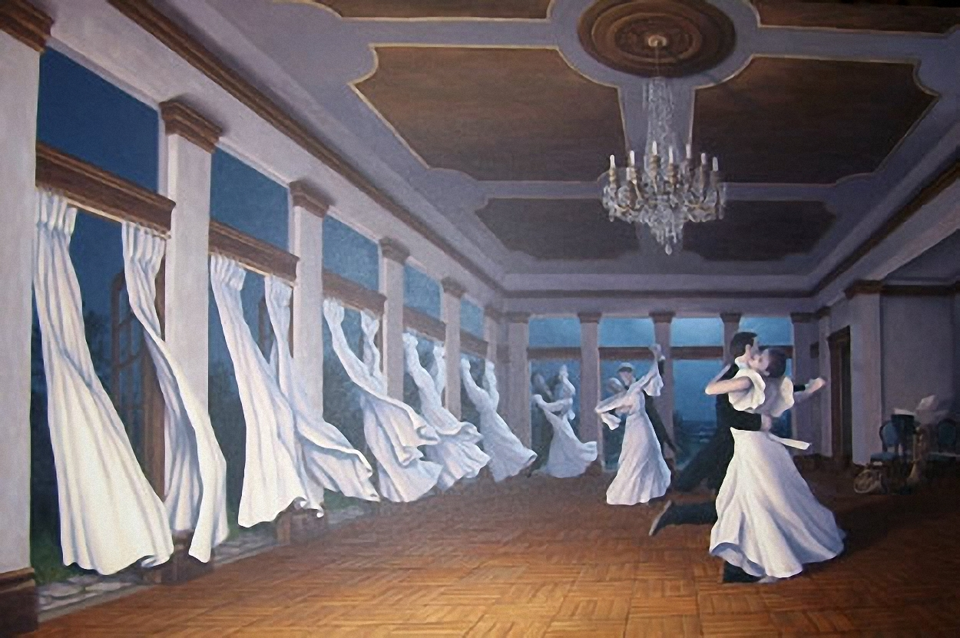

Slide 47
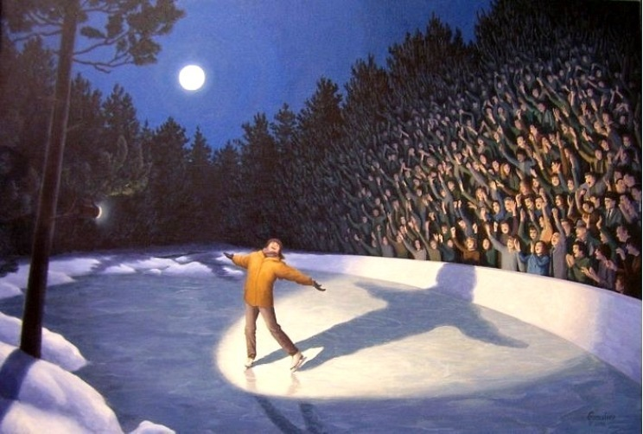

Slide 48
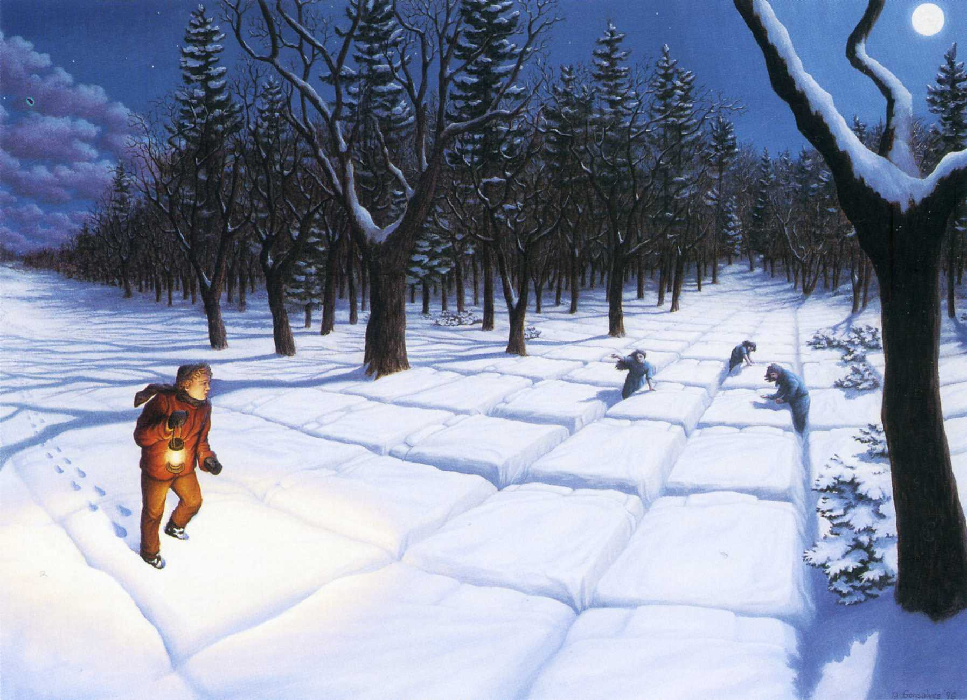

Slide 49
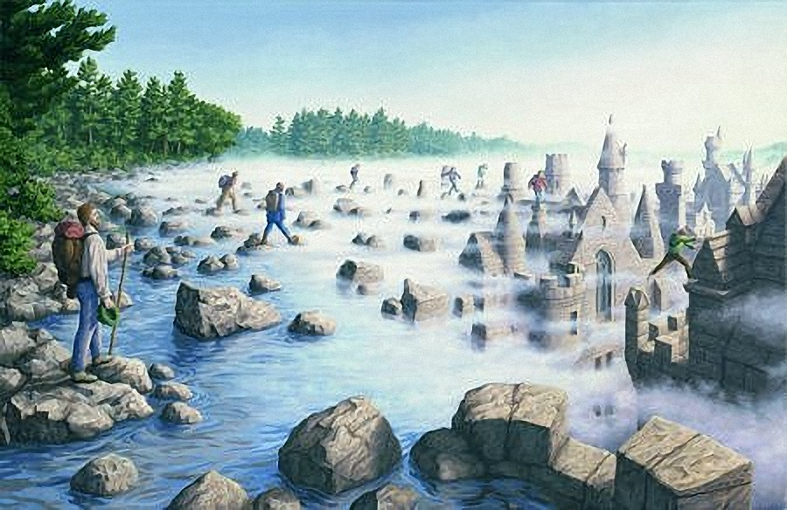

Slide 50
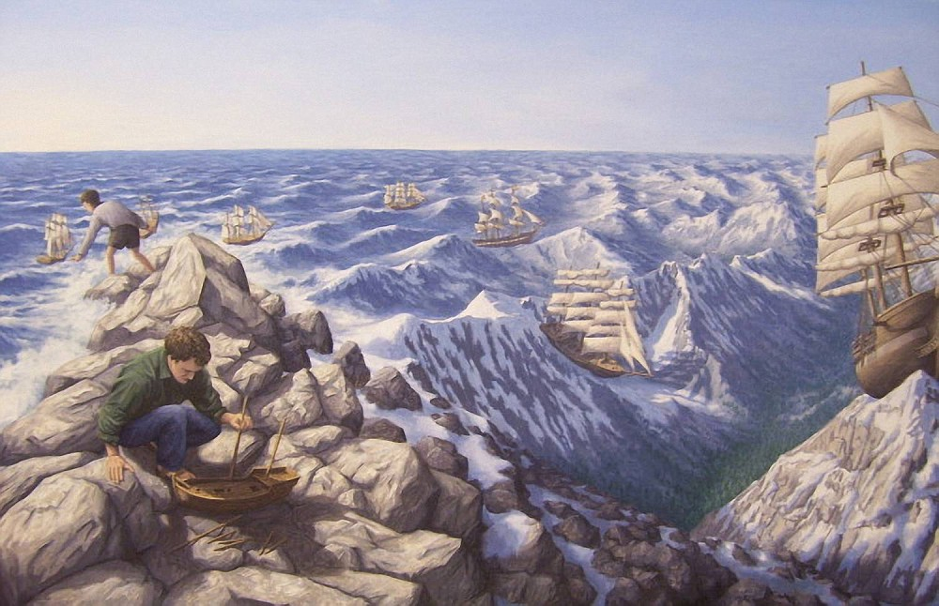

Slide 51


Slide 52


Slide 53


Slide 54


Slide 55


Slide 56


Slide 57


Slide 58


Slide 59


Slide 60


Slide 61


Slide 62
Thank you for attention!

