Slide 1
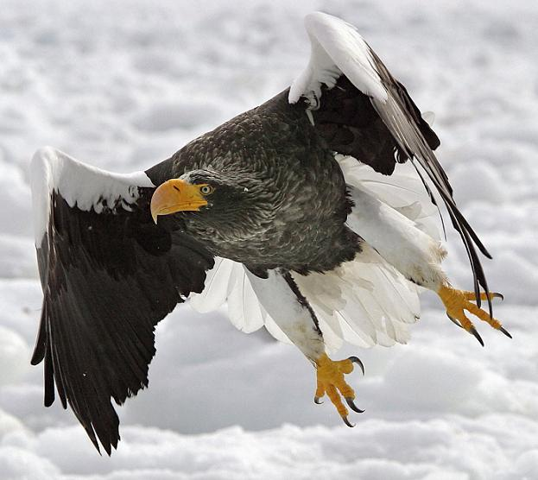
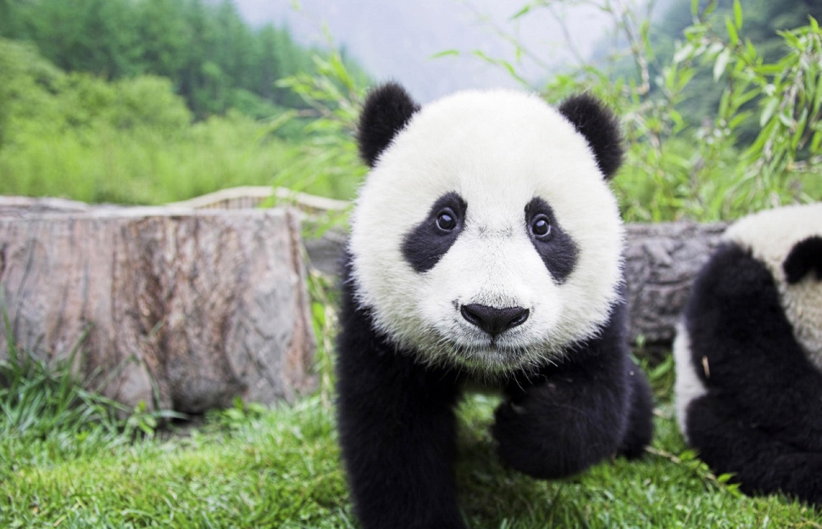
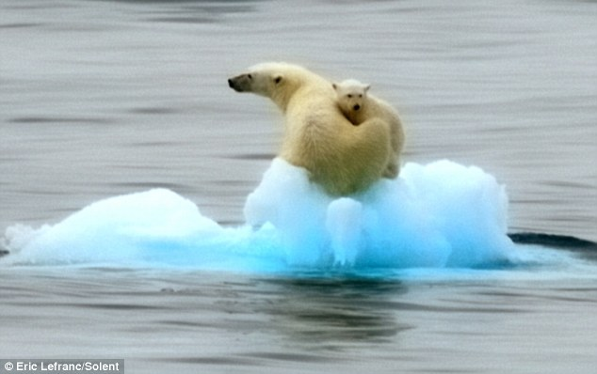
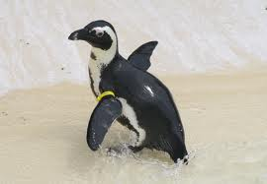
Endangered species

Slide 2
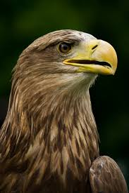
The White Tailed Eagle
The White Tailed Eagle could be found in huge numbers across the globe, before humans started to pollute its wetland habits with insecticides and other chemical sprays. The population of the bird in the Middle East is the least of them all.

Slide 3
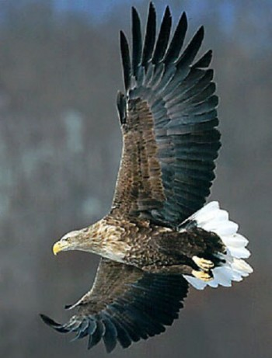
The bird flies across distances and several geographical locations in search of its food, fish. However, feeding on poisoned fish has lead to the bird laying thin-shelled or infertile eggs that could be easily broken apart.
The nesting places, on the other hand, have also been destroyed by modern forestry techniques. Though the bird was completely extinct in Britain during the 1900s, it still exists in Scotland after it was reintroduced in the year, 1975.

Slide 4
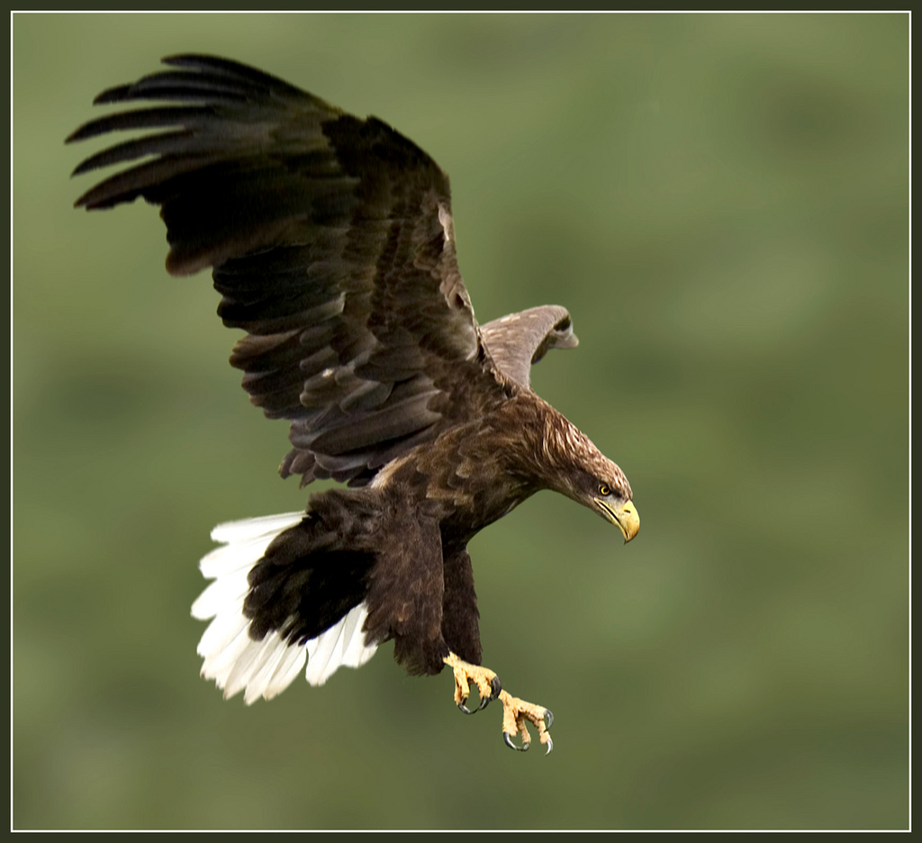
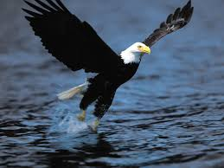
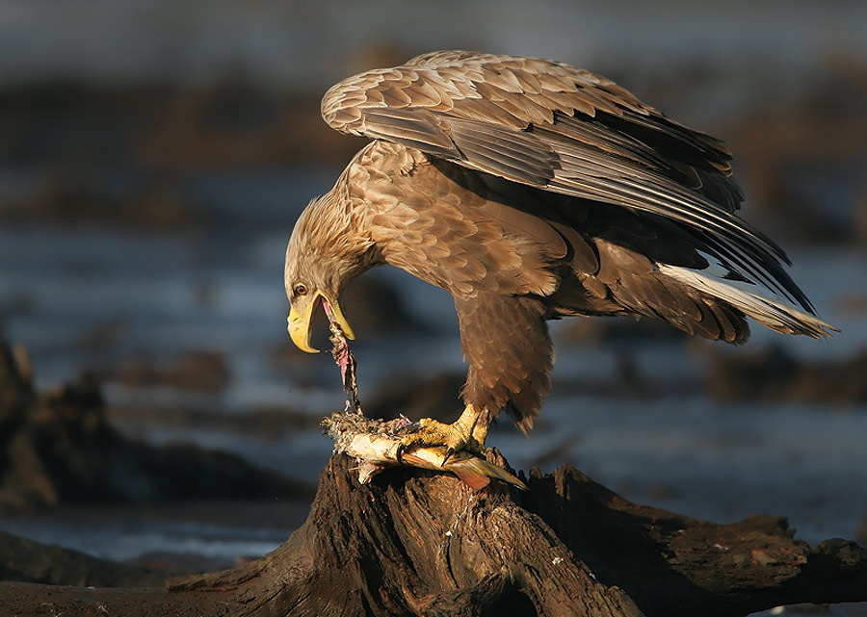
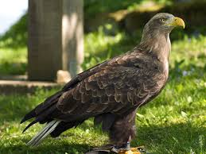

Slide 5
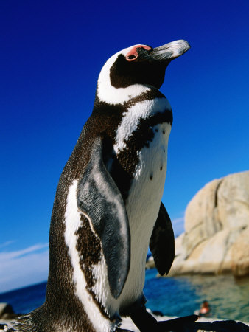
Jackass Penguin
When you think of penguins, you may picture them surrounded by snow and ice. However, there is one species of penguins that is acclimated to warmer climates. African penguins live in colonies on the coast and islands of southern Africa.

Slide 6
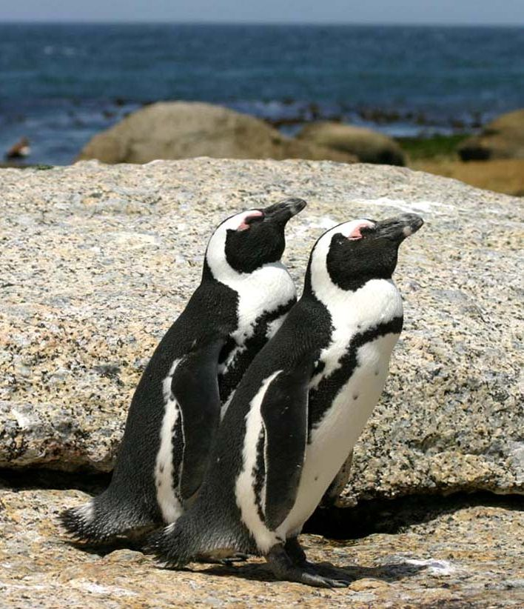
The bird’s survival is primarily dependent on sea creatures. However, the constant fishing around the area has led to a scarcity of appropriate food for the bird.
The African penguin averages about 60 cm tall and weighs up to 3.6 kg . Their short tails and flipper-like wings that help them navigate in the water, while their webbed feet help propel them.

Slide 7
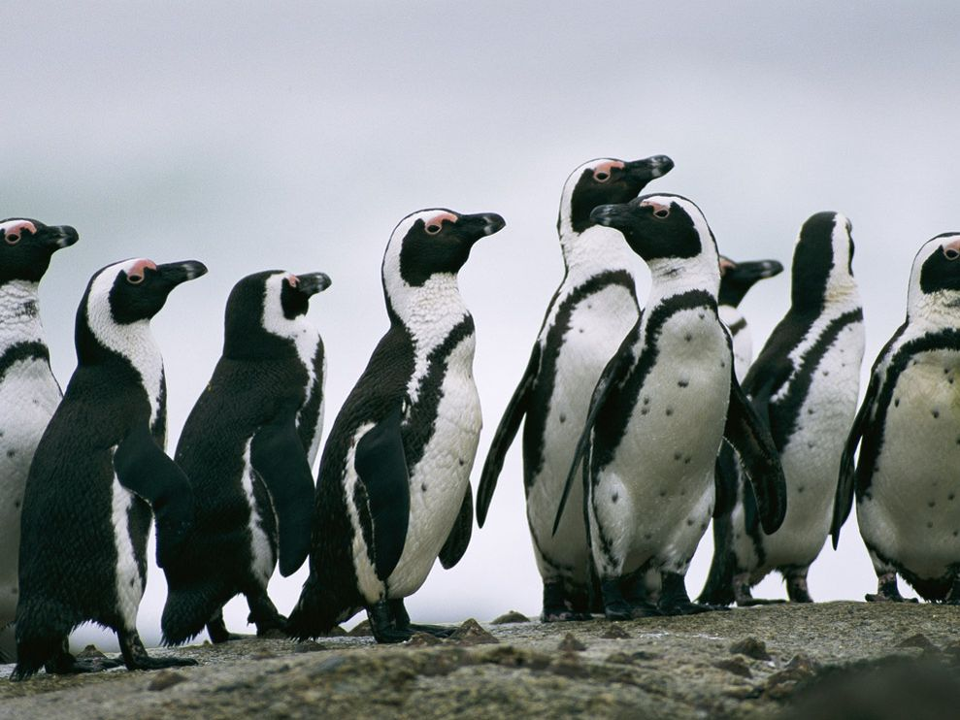
The loss of nesting places due to guano removal has contributed to the population decline as well as a decrease of food due to overfishing and pollution. As such, African penguins are now considered vulnerable by IUCN’s Red List. This means there is a risk they may become extinct.

Slide 8
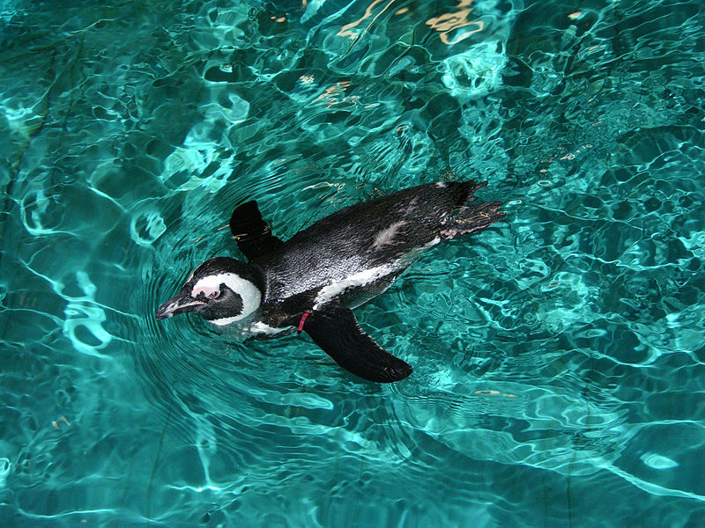
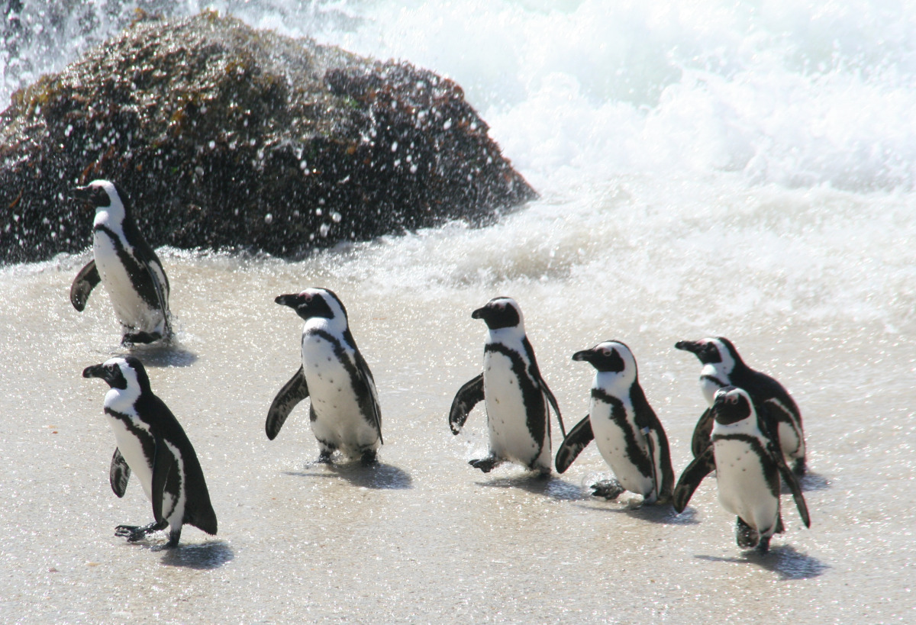
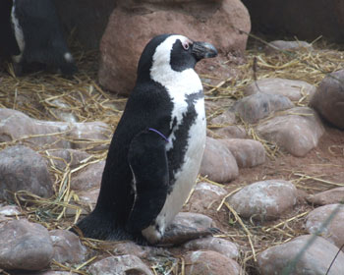
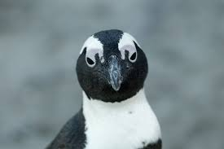

Slide 9
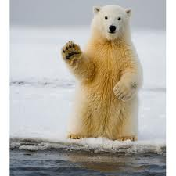
A Polar Bear.
Many environmentalists have protested against the idea of arctic drilling not only because of its environmental impact, but because of the threat it will pose to the species existing within the area in question. Polar bears are marine mammals that live on the ice of the Arctic Ocean. Polar bears are listed as a threatened species in the US under the Endangered Species Act.

Slide 10
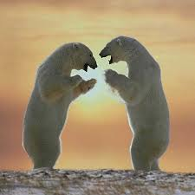
Knowledge and education about the extinction of animals and the threats posed on them is important. Spreading the word to outlets which wouldn’t normally learn or understand the importance of an animal planet is a key element to cooperation and finding a solution for survival.
Polar bears live in the Arctic in areas where they hunt seals at openings in sea ice called leads. Five nations have polar bear populations: the United States (Alaska), Canada, Russia, Greenland, and Norway.

Slide 11
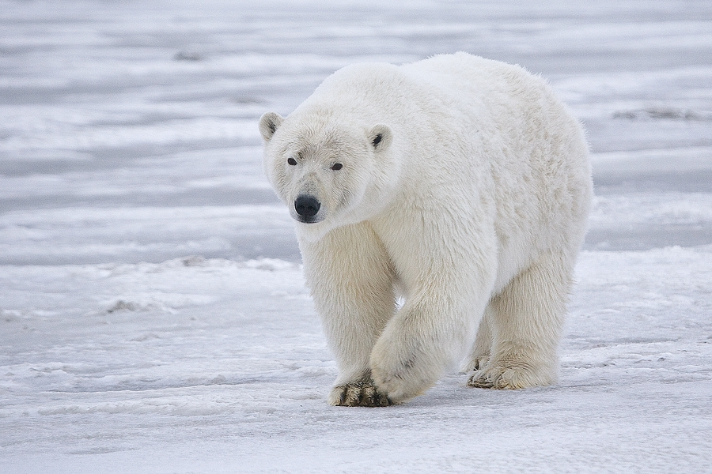
Polar bears' fur consists of a dense, insulating undercoat topped by guard hairs of various lengths. It is not actually white—it just looks that way. Polar bears look whitest when they are clean and in sunlight, especially just after the molt period, which usually begins in spring and is complete by late summer. Before molting, oils from the seals they eat can make them look yellow.

Slide 12
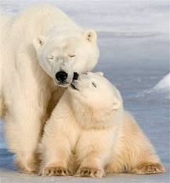
Polar bear paws are perfect for roaming the Arctic. Paws measure up to 12 inches across (31 centimeters) and help distribute weight when treading on thin ice. When ice is very thin, polar bears extend their legs far apart and lower their bodies to distribute their weight even more. They are expert at placing each paw precisely and quietly when stalking seals.

Slide 13
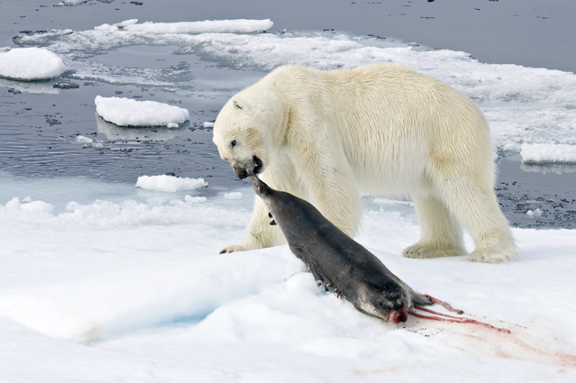
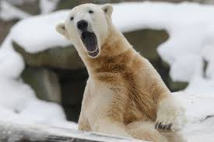
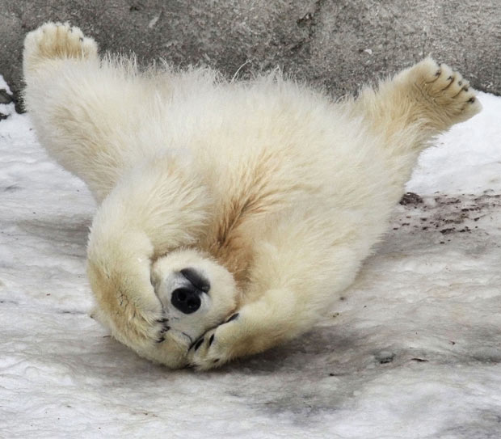
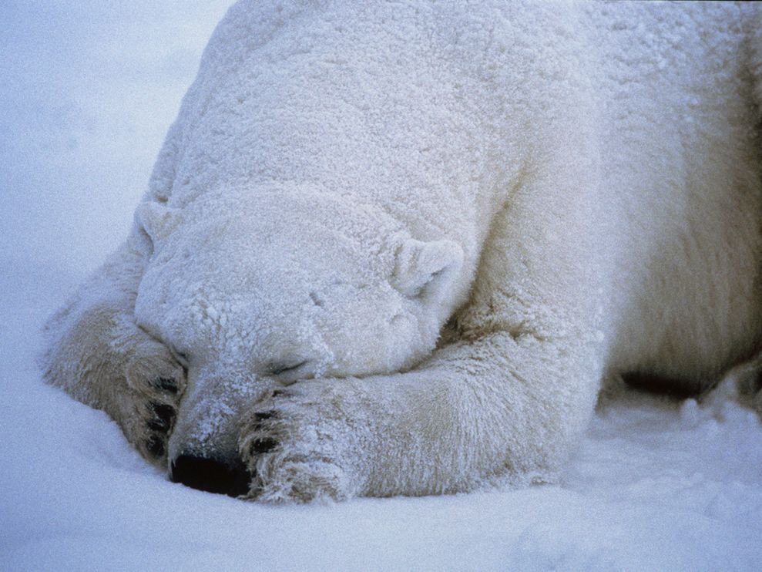

Slide 14
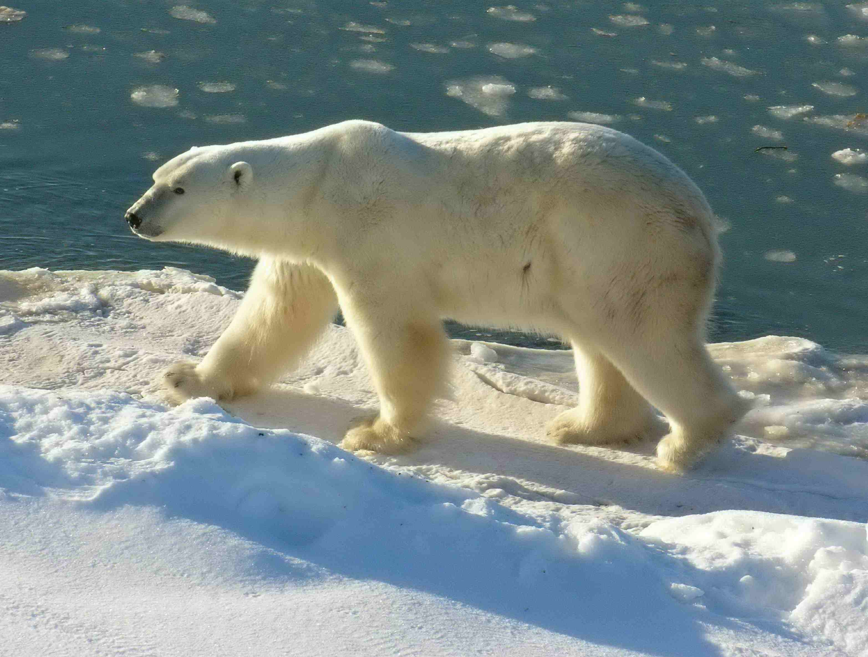

Slide 15
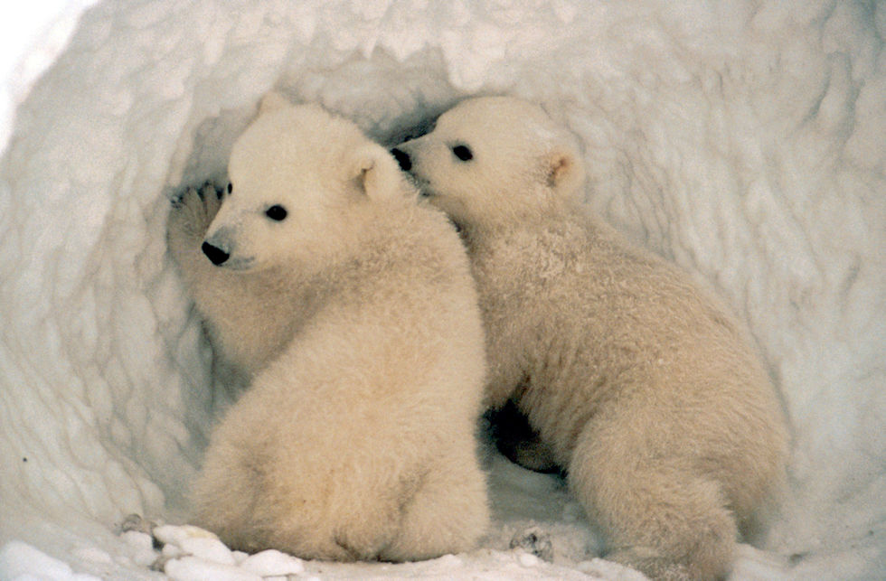

Slide 16
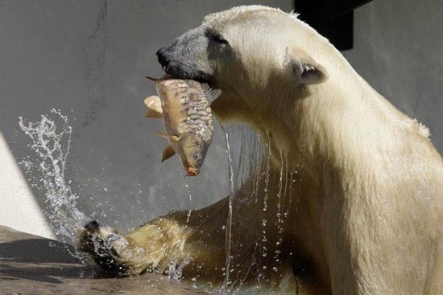

Slide 17
It is important to keep the future secure for these wild animals and steer them away from the edge of extinction.
We must protect the environment and endangered species of animals.

Slide 18
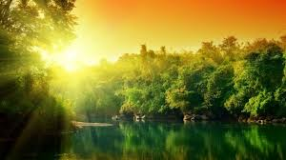
Thank you for attention)

