Slide 1
Educational
System of
Ukraine

Slide 2
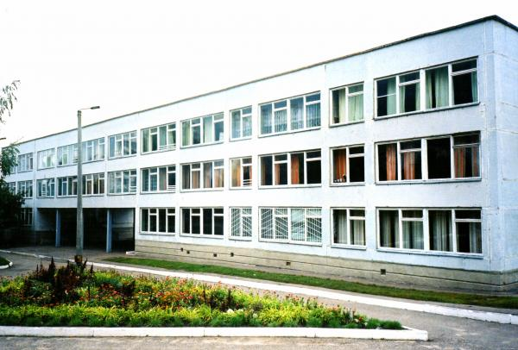



Ukraine has got rather developed system of education. General secondary education is free and compulsory. There are many gymnasiums, lycees and private schools in Ukraine. The secondary school must secure a uniform level of knowledge necessary for each student.

Slide 3
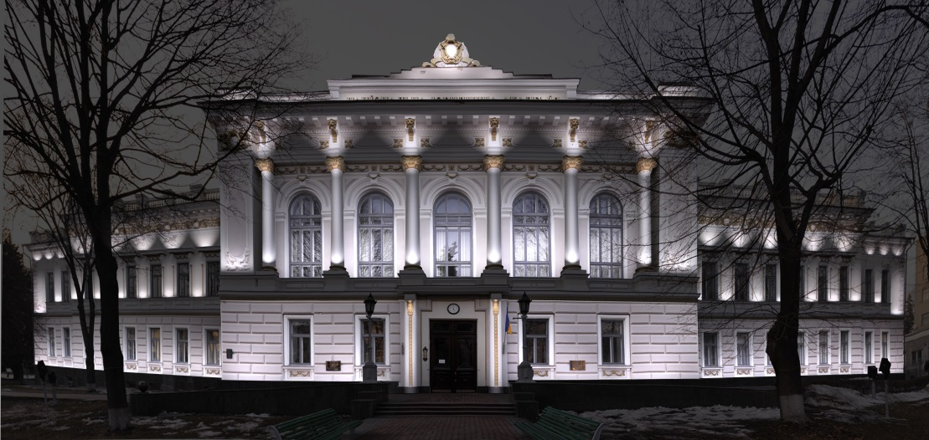

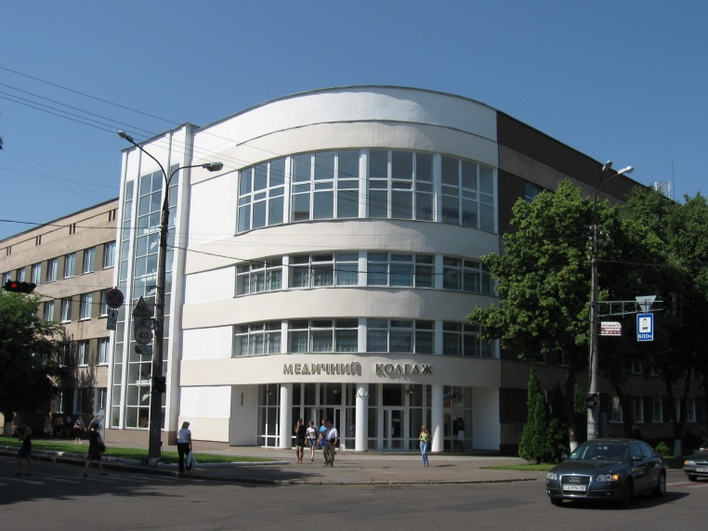
Post-secondary education is provided by technical schools, colleges and institution of higher learning: universities, academies and institutes. At each institute or university there is a post-graduate course with postgraduates working for their scientific degrees.

Slide 4
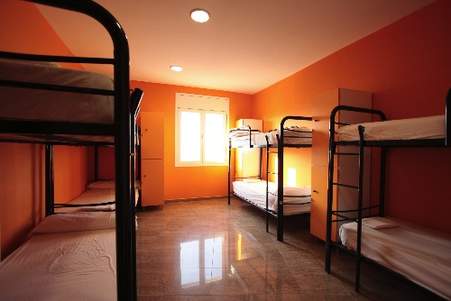
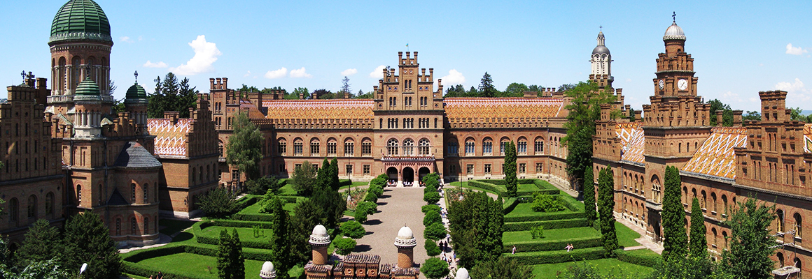
Higher educational establishments of our country fall into three main types. The first type includes the universities and institutes where there are only full-time students, which receive state grants. Students who do not live at home get accommodation in the hostels.

Slide 5
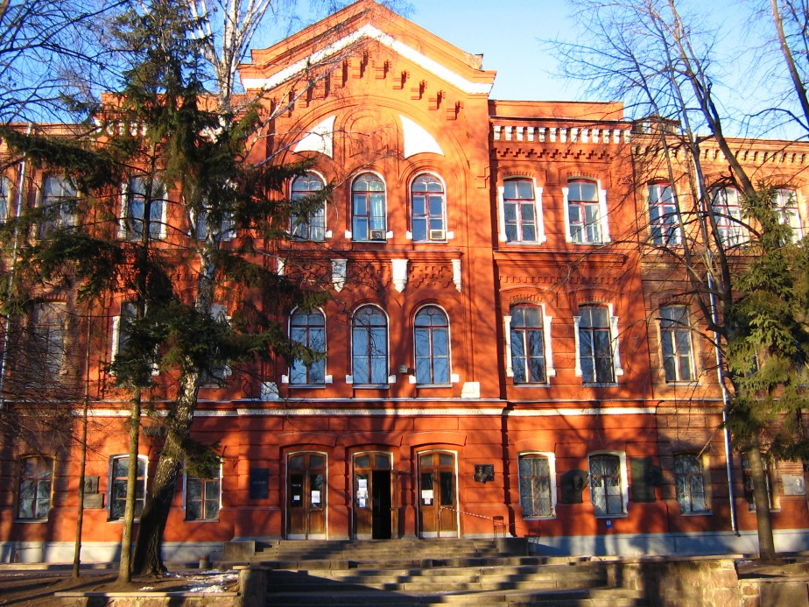
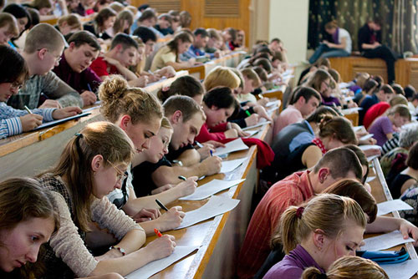
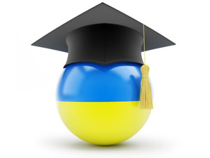
The second and third types of higher schools provide educational facilities for factory and office workers who combine work with studies. The second type of higher education in establishments includes evening faculties and evening higher schools for those who study in their spare time.

Slide 6
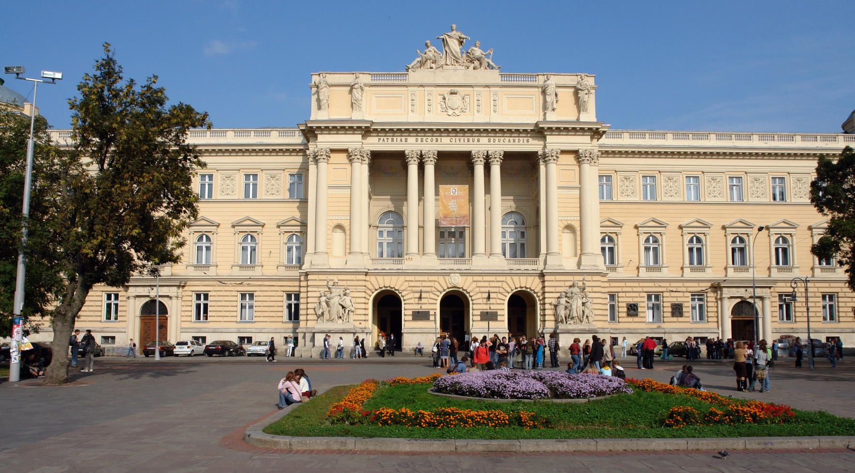
The third type covers extra-mural higher schools where students take correspondence courses. Every year extra-mural students receive from 30 to 40 days’ leave to prepare for their exams.

Slide 7
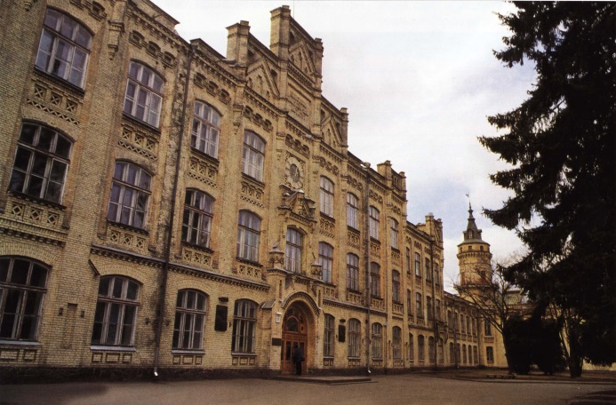
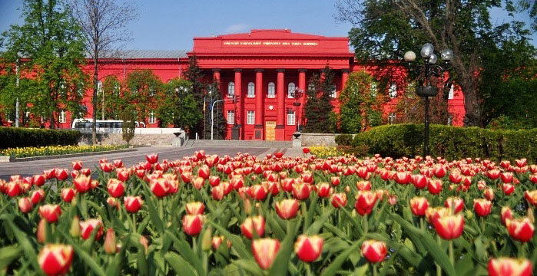
There are many scientific, educational and academic centres in Ukraine. Kyiv with its famous National University named after T. Shevchenko, Polytechnic University, Kyivo-Mohylyanska Academy which resumed its work in 1991.

Slide 8
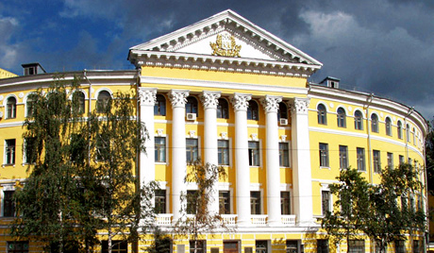

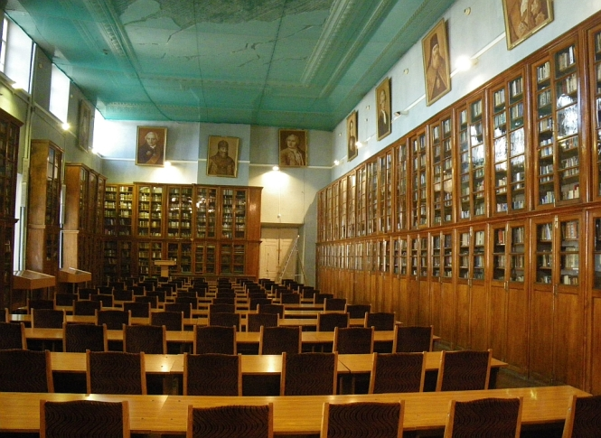
There are three
faculties in Kyivo- Mohylyanska Academy now: the humanities, social and national sciences.

Slide 9
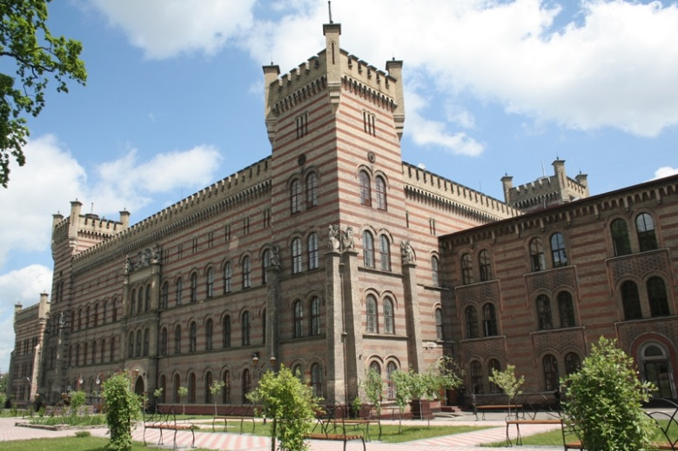
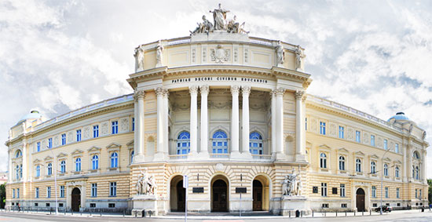
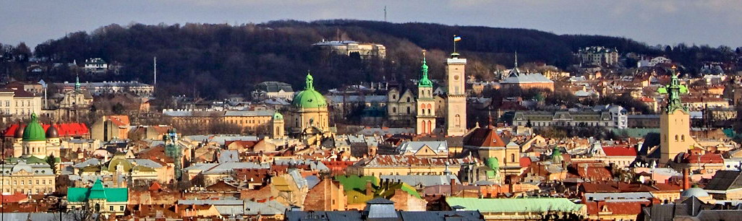
Lviv is the leading scientific and cultural centre of Western Ukraine. It has a number of research institutes of high level.

Slide 10
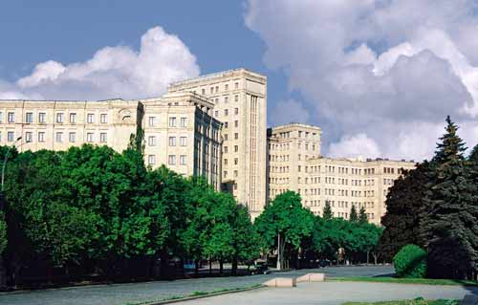

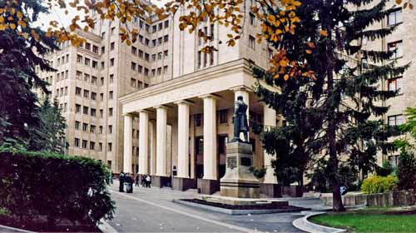
Kharkiv University has 10 faculties: mechanics-mathematics, physics, physics-technology, radio-physics, chemistry, biology, economics, history, philology and foreign languages.

Slide 11


Ukraine numbers a total of 2 million college and university students. Graduates from the Ukrainian institution of higher learning become famous writers, prominent diplomats, economists, chemists, mathematicians and others.

Slide 12
ThankS for your attention!
hope you liked it!

