Slide 1
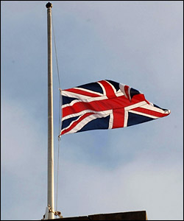
LONDON
Presentation prepared by Tania Shchur

Slide 2
London is the capital of Great Britain . It is situated on the Thames River and It is the largest city in Europe with a population of eight and a quarter million. London is divided into four parts: the City, Westminster, the West End and the East End.

Slide 4
London on the map of Great Britain

Slide 5
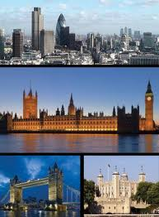
There are many interesting places to visit in London, such as Hyde Park, St. Paul's Cathedral, Westminster Cathedral, Kenwood House, Buckingham Palace, British Museum, London Eye, Tower Bridge etc.

Slide 6
St. Paul's Cathedral
St. Paul's Cathedral is the biggest cathedral of London, the second in the world on the size of a dome. It is a cathedral and residence of the bishop and it is considered one of the best buildings constructed at the time of Renaissance.

Slide 7
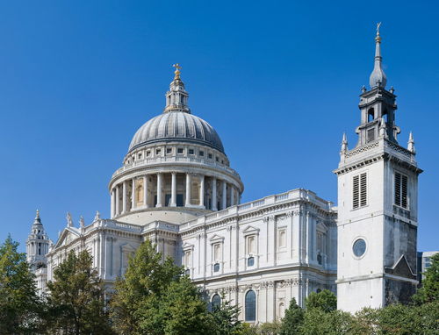

Slide 8
Westminster Cathedral
Westminster Cathedral is the main Catholic church in England and Wales, which Located in central London's Westminster. It was built in 1895-1903 years. The interior is very rare in English churches mosaic. In the crypt of the cathedral was buried Benkendorf - the last ambassador of the Russian Empire in the UK.

Slide 9
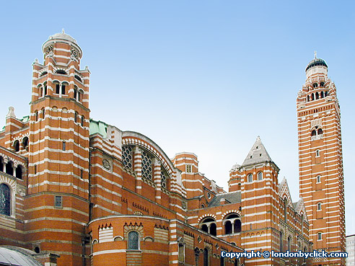
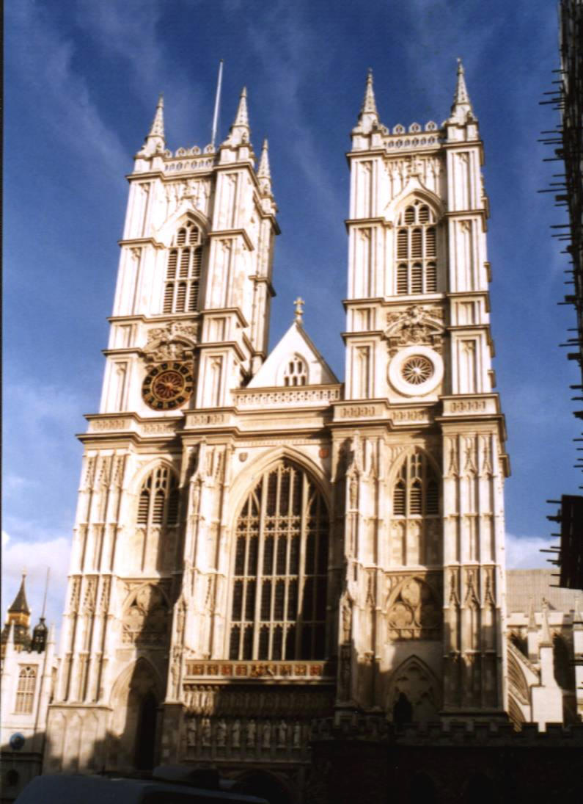

Slide 10
Highgate Cemetery
Highgate Cemetery — a cemetery located in Hajgejte, London. The cemetery in the original form has been opened in 1839, as a plan part on creation of seven big, modern cemeteries (known as the Magic seven) round London. The Highgate Cemetery is also known to the occult past connected with ostensibly activity of vampires. In a press the given events have received name Highgate Vampire.

Slide 11
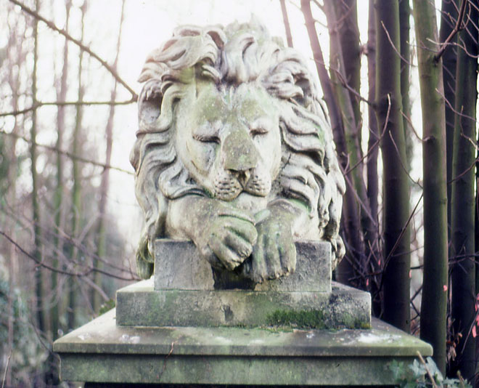
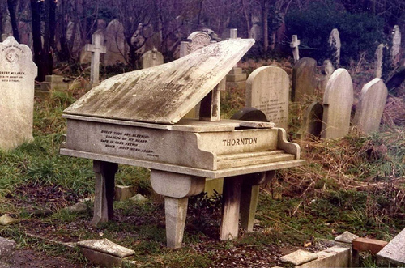

Slide 12
The London Eye
The London eye is one of the largest big wheels in the world, located in the London area Lambet on southern coast of Thames. From height of 135 meters (approximately 45 floors) open a kind practically on all city. A big wheel — the project of the architects David Marx and Julia Barfild which have won at competition of projects of constructions in honor of approach of a new millenium. The project embodiment in life has taken six years.

Slide 13
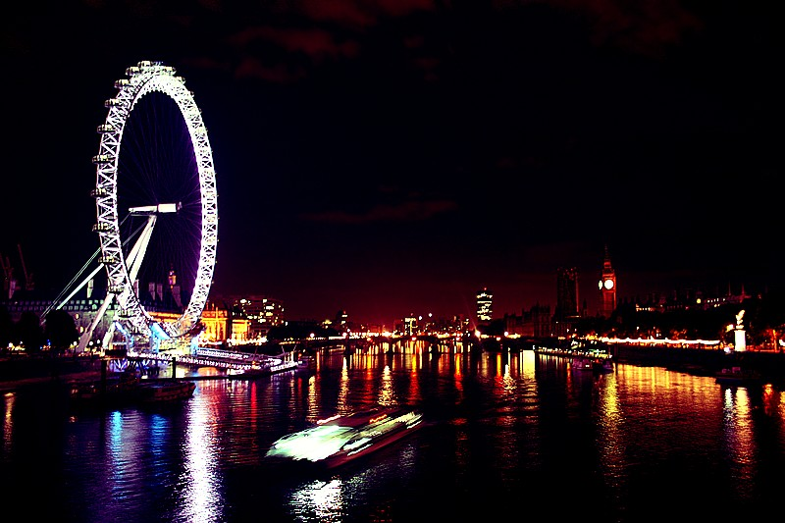
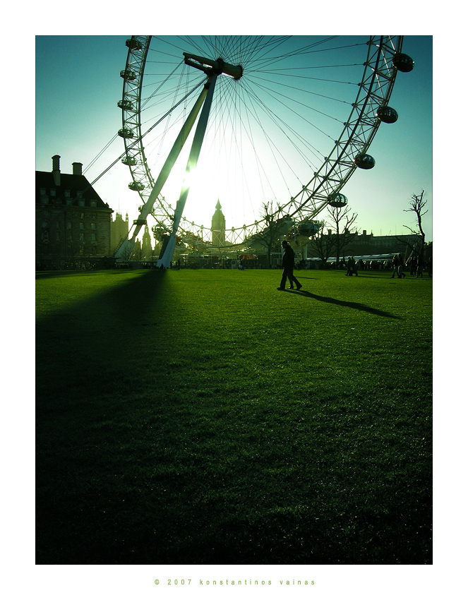
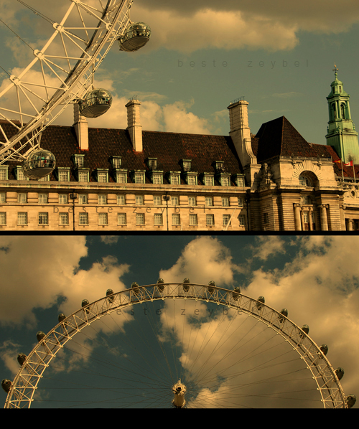

Slide 14
The British Museum
The British museum — the main Historical and Archaeological museum of British Empire (nowadays — Great Britain) and one of the largest museums of the world. The British museum has been created in 1753 on the basis of three collections — collections of the known British doctor and naturalist Hens Sloun, a collection of count Robert Harli, and also library of antiquary Robert Kotton, which became a basis of the British library.

Slide 15
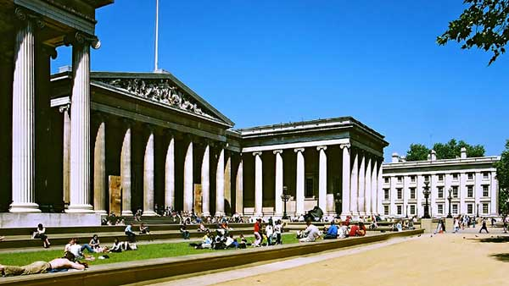
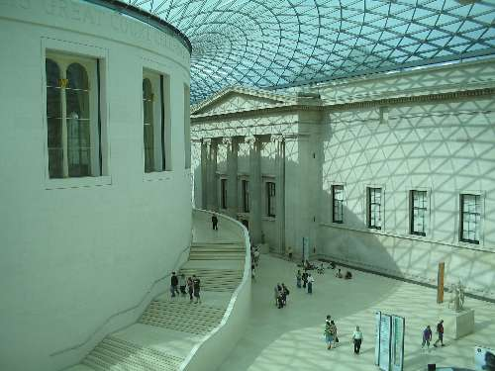

Slide 16
Buckingham Palace
Originally It was known as the Bakingem-house and was under construction for the duke Buckingham (since 1703). It has been got by king George III in 1762 as the future private residence of the monarch. Within the next 75 years architects John Nash and Edward Blor, taking for a basis the Bakingem-house, have constructed three more similar buildings. All together form in the plan a square, in which center — the big courtyard. The palace has been officially declared by the main residence of the British monarchs at the introduction on a throne of queen Victoria in 1837.

Slide 17
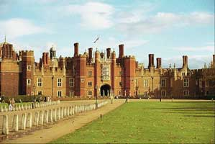
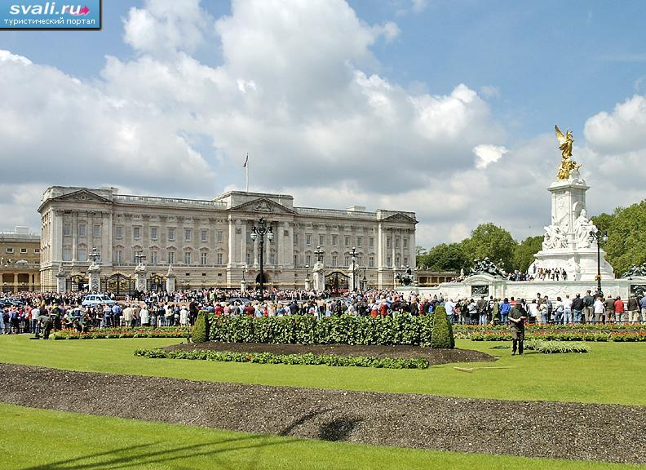
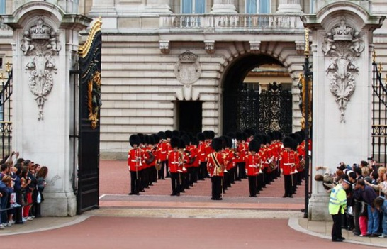

Slide 18
Trafalgar Square
Trafalgar Square is the area in the center of London where, on a place of the Charingsky cross, three paramount streets of Westminster — Strend converge, Uajtholl and Mell. In the area center — a column of Nelson from a dark gray granite in height of 44 m, topped with a statue of an admiral of Nelson. Four parties of a column are decorated by the frescos made of grasped and melted Napoleonic guns. It is built in 1840-1843, surrounded by sculptures of lions and fountains. On corners of the square — four sculptures.

Slide 19
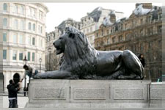
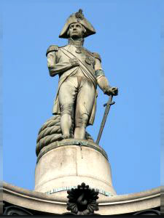

Slide 20
Tower Bridge
Tower Bridge — a leaf bridge in the centre of London over the river Thames, near to the London Tower. Sometimes it confuse to the London bridge located above on a current. It is opened in 1894. Also it is one of symbols of London and Britain. The bridge was designed by Goratse Johns, it represents a leaf bridge in length of 244 m with two towers put on intermediate support in height of 65 m.

Slide 21
