Slide 1
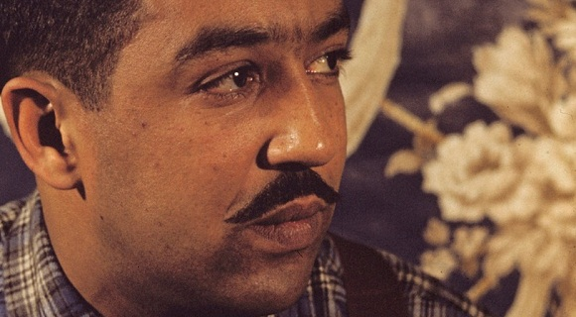
James Mercer Langston Hughes

Slide 2
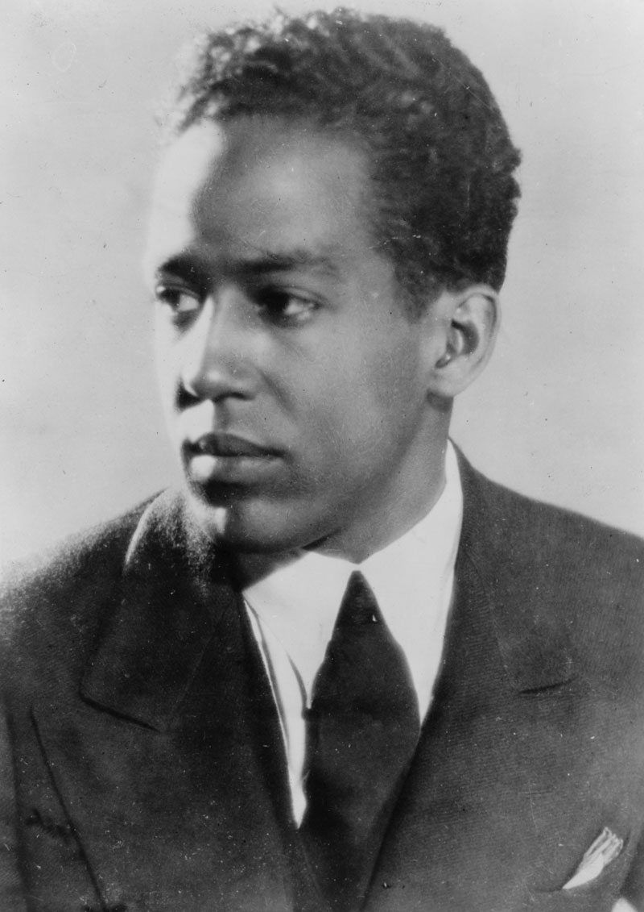
Was an American poet, social activist, novelist, playwright, and columnist.
James Mercer Langston Hughes was born on February 1, 1902, in Joplin, Missouri. His parents, James Hughes and Carrie Langston, separated soon after his birth, and his father moved to Mexico. While Hughes’s mother moved around during his youth, Hughes was raised primarily by his maternal grandmother, Mary, until she died in his early teens. From that point, he went to live with his mother, and they moved to several cities before eventually settling in Cleveland, Ohio.

Slide 3
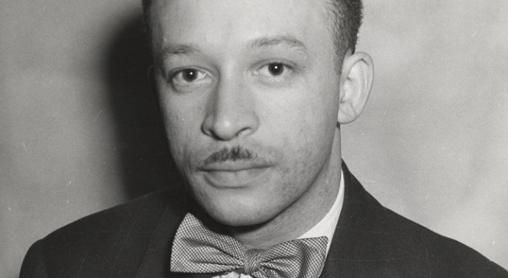
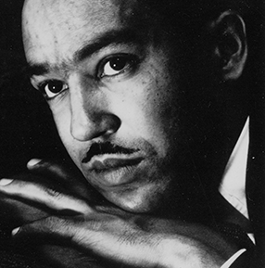
It was during this time that Hughes first began to write poetry, and that one of his teachers first introduced him to the poetry of Carl Sandburg and Walt Whitman, both whom Hughes would later cite as primary influences. Hughes was also a regular contributor to his school's literary magazine, and frequently submitted to other poetry magazines, although they would ultimately reject him.

Slide 4
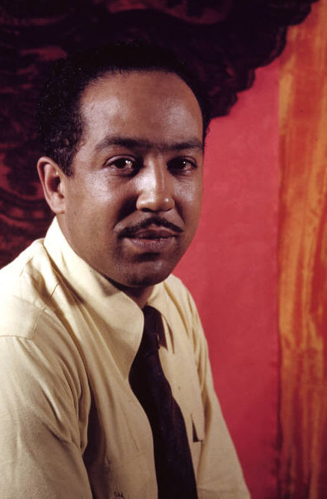
Hughes graduated from high school in 1920 and spent the following year in Mexico with his father. Around this time, Hughes's poem "The Negro Speaks of Rivers" was published in The Crisis magazine and was highly praised. In 1921 Hughes returned to the United States and enrolled at Columbia University where he studied briefly, and during which time he quickly became a part of Harlem's burgeoning cultural movement, what is commonly known as the Harlem Renaissance. But Hughes dropped out of Columbia in 1922 and worked various odd jobs around New York for the following year, before signing on as a steward on a freighter that took him to Africa and Spain. He left the ship in 1924 and lived for a brief time in Paris, where he continued to develop and publish his poetry.

Slide 5
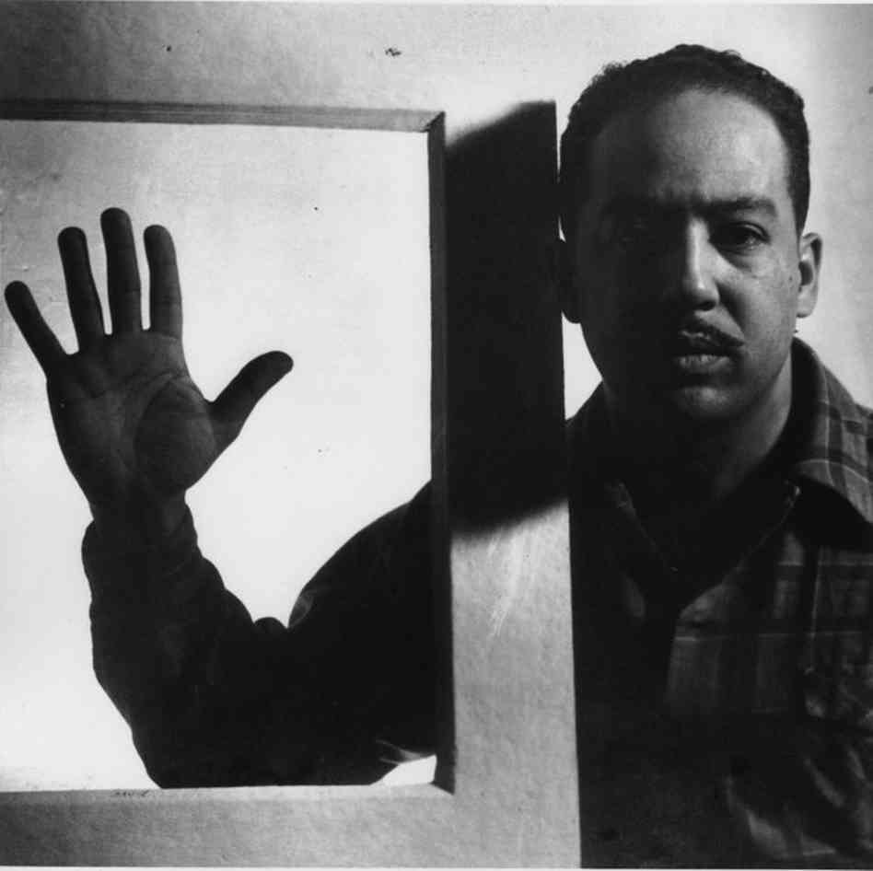
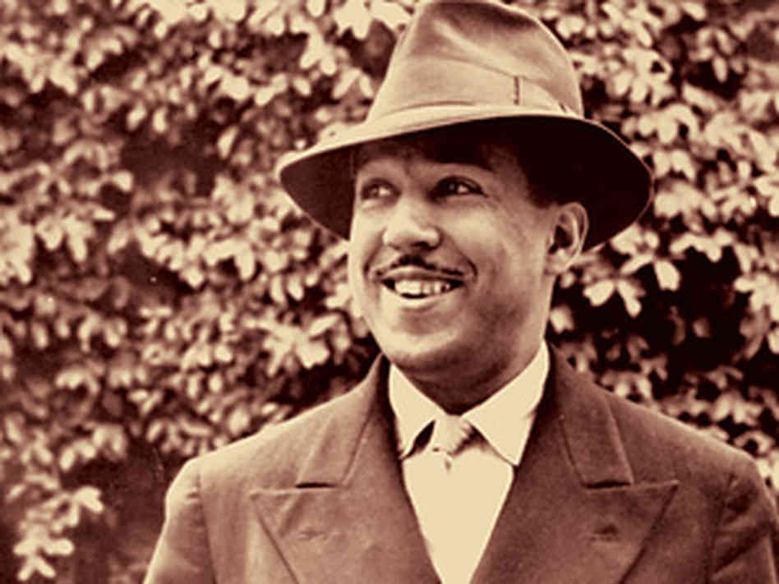
In November 1924, Hughes returned to the United States and worked various jobs. In 1925, he was working as a busboy in a Washington, D.C. hotel restaurant when he met American poet Vachel Lindsay. Hughes showed some of his poems to Lindsay, who was impressed enough to use his connections to promote Hughes’s poetry and ultimately bring it to a wider audience. In 1925, Hughes’s poem “The Weary Blues” won first prize in theOpportunity magazine literary competition, and Hughes also received a scholarship to attend Lincoln University, in Pennsylvania. While studying at Lincoln, Hughes poetry came to the attention of novelist and critic Carl Van Vechten, who used his connections to help get Hughes’s first book of poetry,The Weary Blues, published by Knopf in 1926. The book had popular appeal and established both his poetic style and his commitment to black themes and heritage. Hughes was also among the first to use jazz rhythms and dialect to depict the life of urban blacks in his work. He published a second volume of poetry, Fine Clothes to the Jew, in 1927.

Slide 6
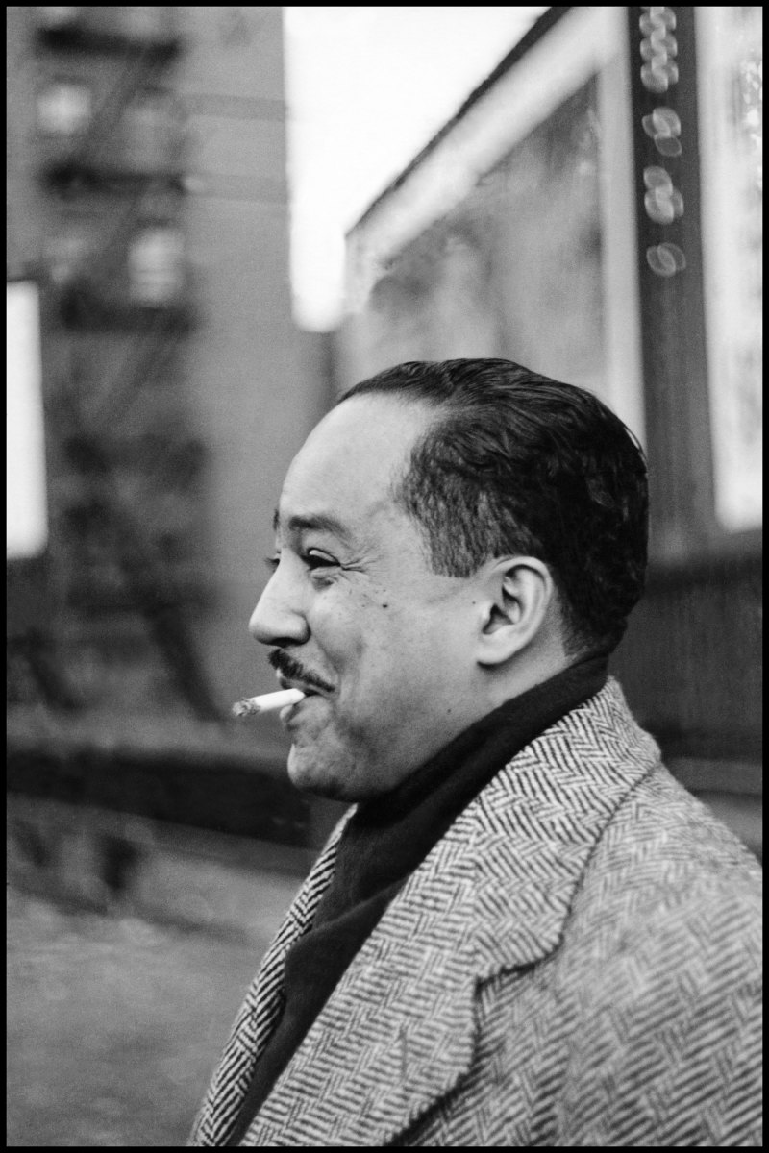
On May 22, 1967, Langston Hughes died from complications of prostate cancer. A tribute to his poetry, his funeral contained little in the way of spoken eulogy, but was filled with jazz and blues music. Hughes's ashes were interred beneath the entrance of the Arthur Schomburg Center for Research in Black culture in Harlem. The inscription marking the spot features a line from Hughes's poem "The Negro Speaks of Rivers." It reads: "My soul has grown deep like the rivers."

