Slide 1
Albert Einstein

Slide 2
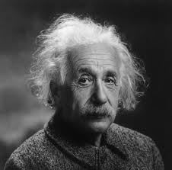
Albert Einstein - is one of the greatest physicists of XX century. Nobel Prize in 1921.

Slide 3
Albert Einstein was born on March 14, 1879 in the German city of Ulm, in a Jewish family. Lived in the USA. He created a special and general relativity , discovered the law relating mass and energy. Author fundamental papers on quantum theory: introduced the concept of the photon, established the laws of the photoelectric effect , the basic law of photochemistry.
In the 30 years he emigrated from Germany to the U.S. and later in protest against National Socialism renounced German citizenship and resigned from the Prussian and the Bavarian Academy of Sciences. Also opposed the war in 1940 - against the use of nuclear weapons. In 1940 he signed a letter to U.S. president about the dangers of nuclear weapons in Germany. Hot supported the idea of ​​a Jewish state.

Slide 4
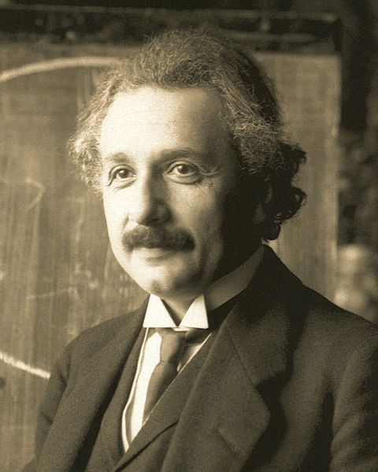

Slide 5
Albert Einstein was born on March 14, 1879 in the German city of Ulm in poor Jewish parents Hermann and Pauline Einstein. Hermann Einstein with outstanding mathematical abilities, had little now .. His mother, Pauline came from a merchant family has corn in 1842 has changed. Einstein was the younger sister of Mary. The house in which he was born scientist, was destroyed during the bombing of 1944 and was not renewed. Preserved City registration book in which is written.

Slide 6
