Slide 1
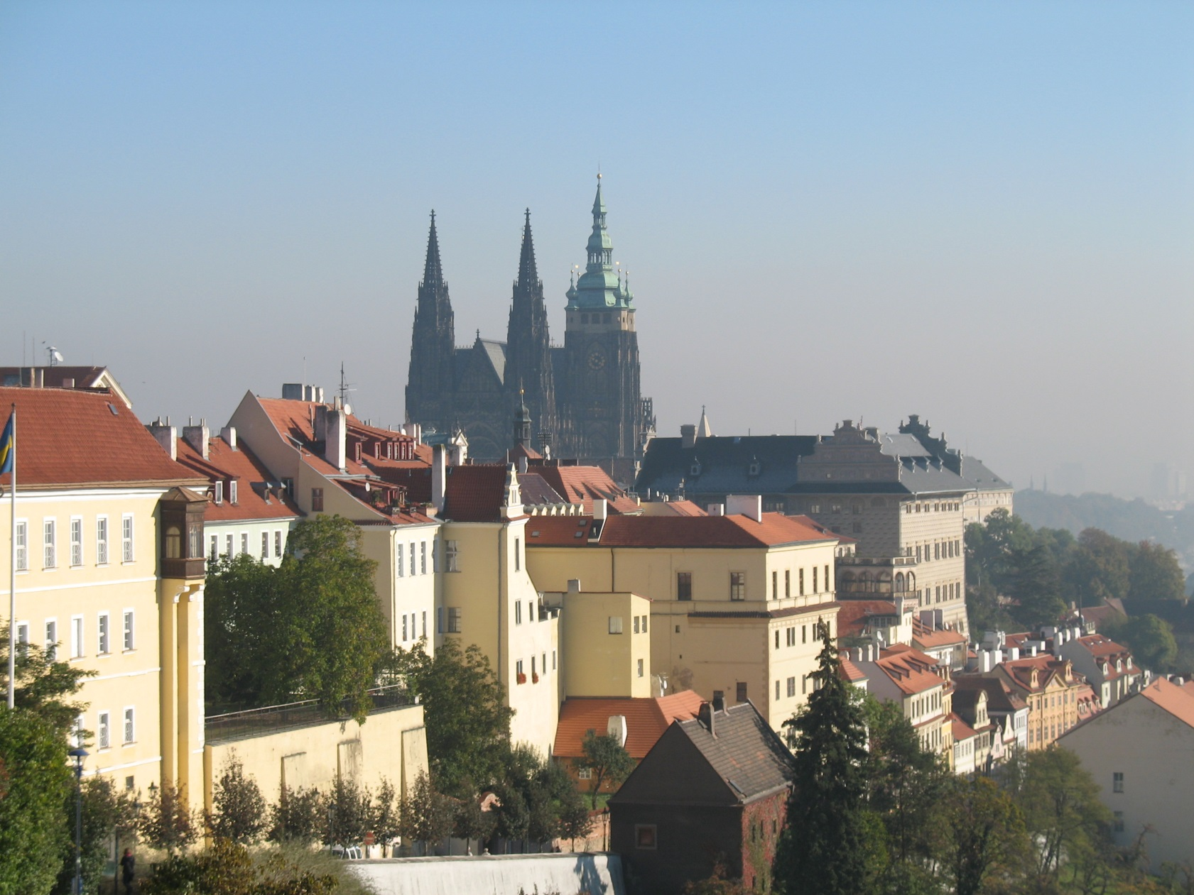
My favorite city is Prague

Slide 2
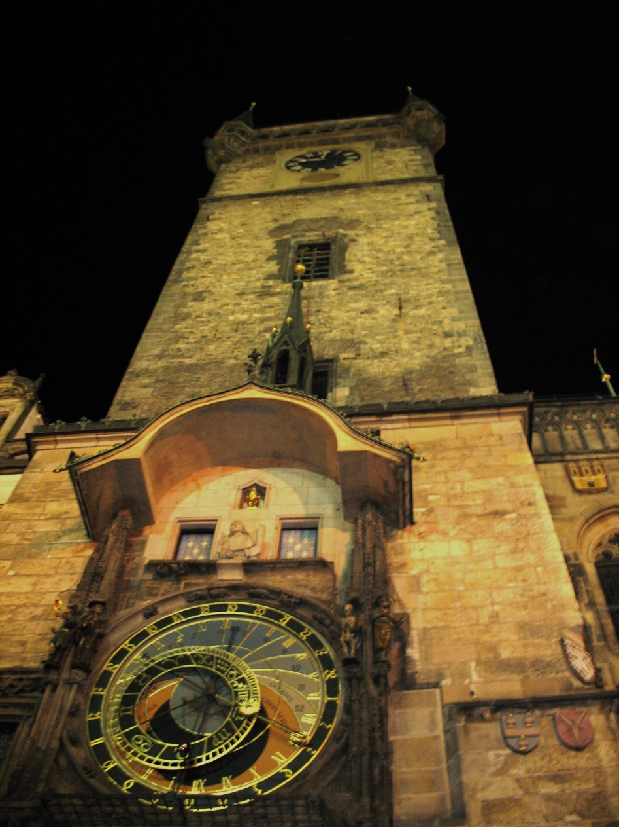
It`s known by the famous clock on Staromestskaya square

Slide 3
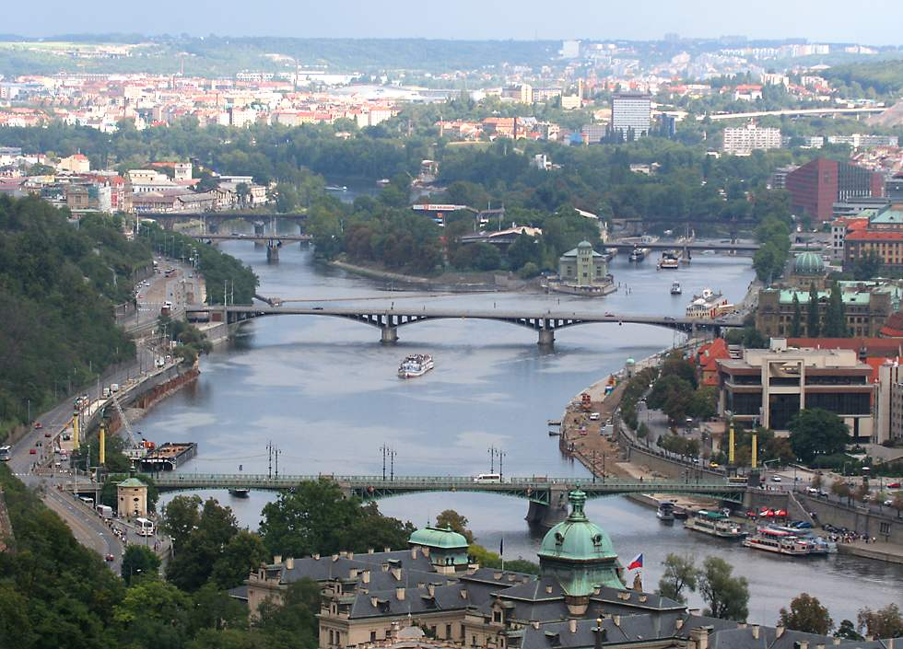
Prague like Kyiv is situated on both banks of river - Vltava

Slide 4
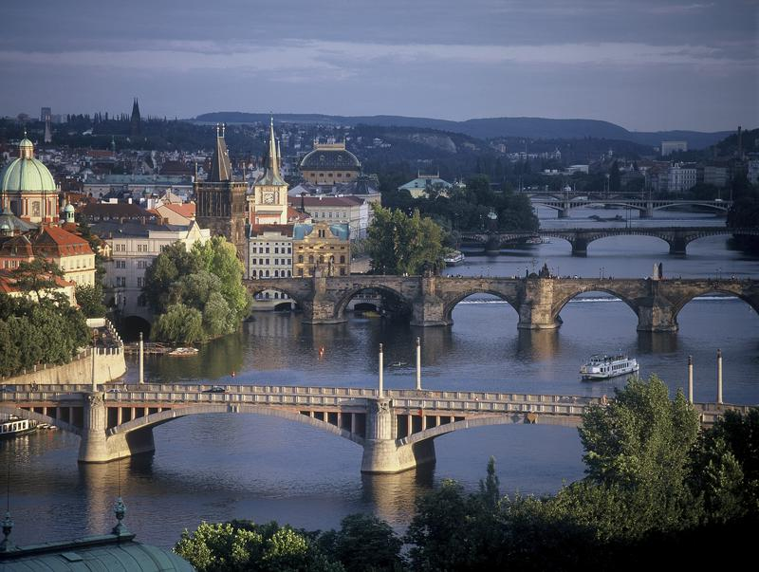
Right and left banks connect several bridges

Slide 5
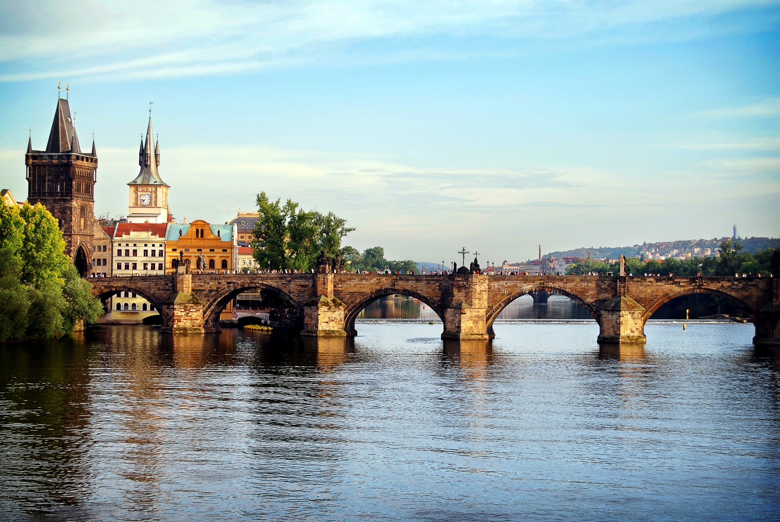
The most famous is Karlow bridge, where you can ask for any dreams

Slide 6
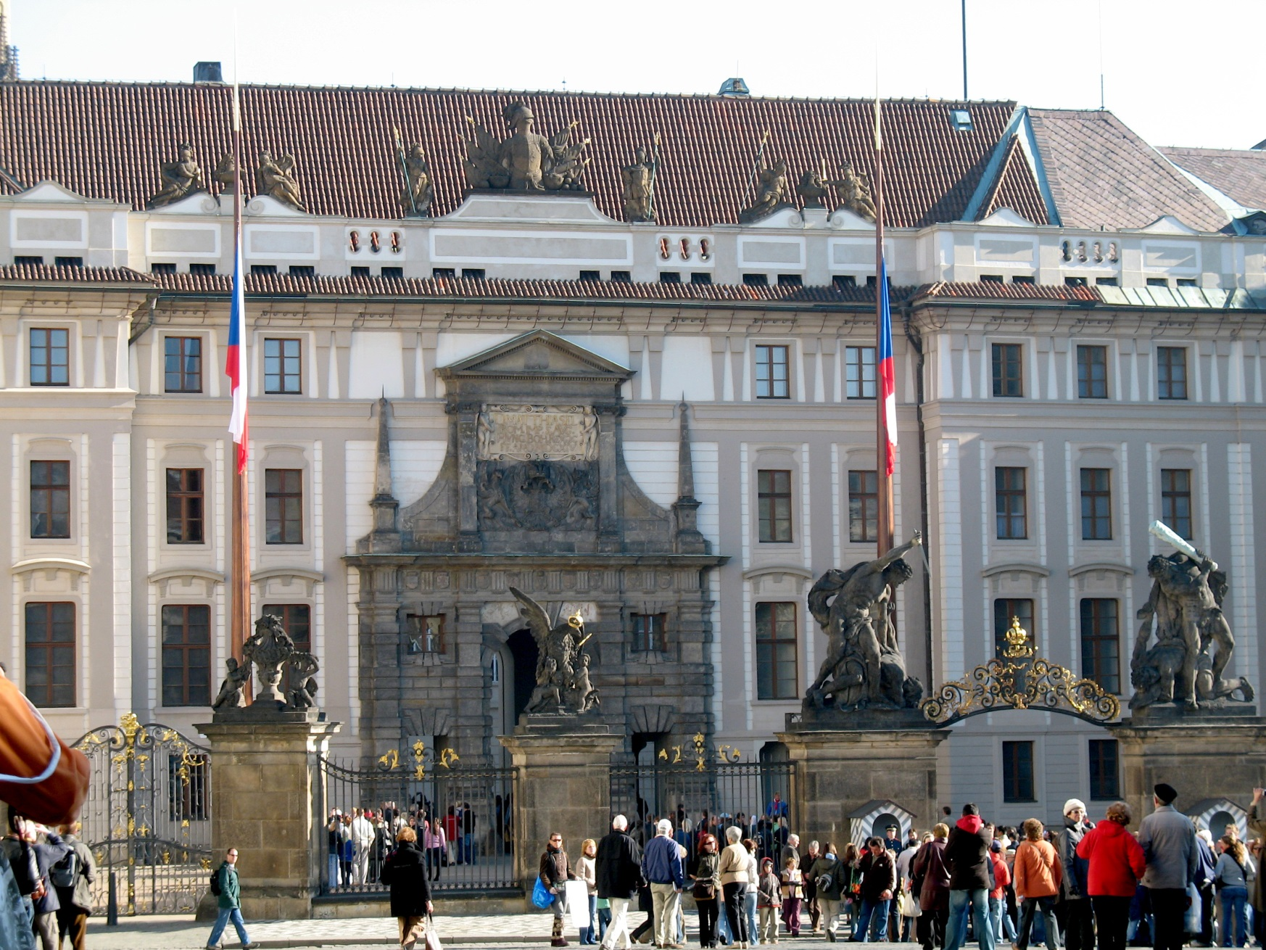
On the left bank located the King`s palace

Slide 7
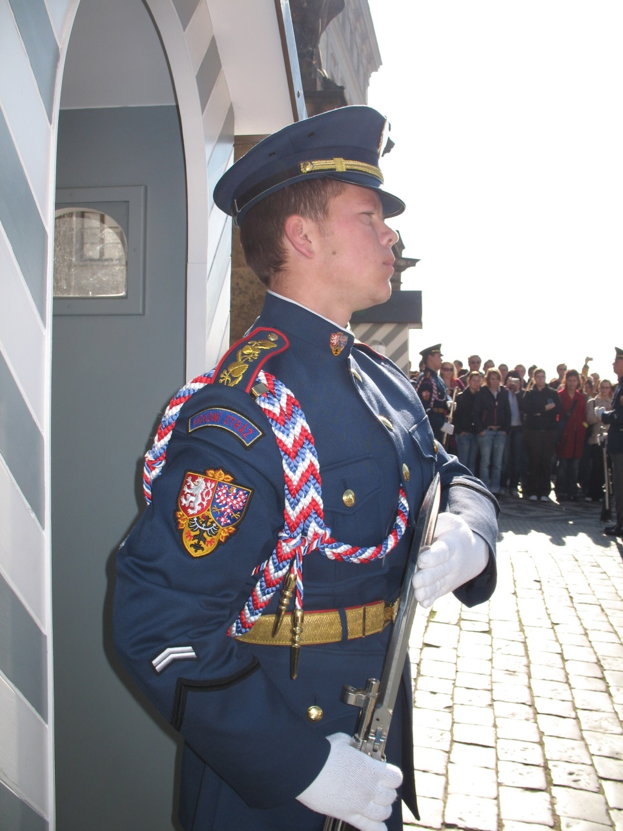
Near the Palace watches the honor guard of the President of the Czech Republic

Slide 8
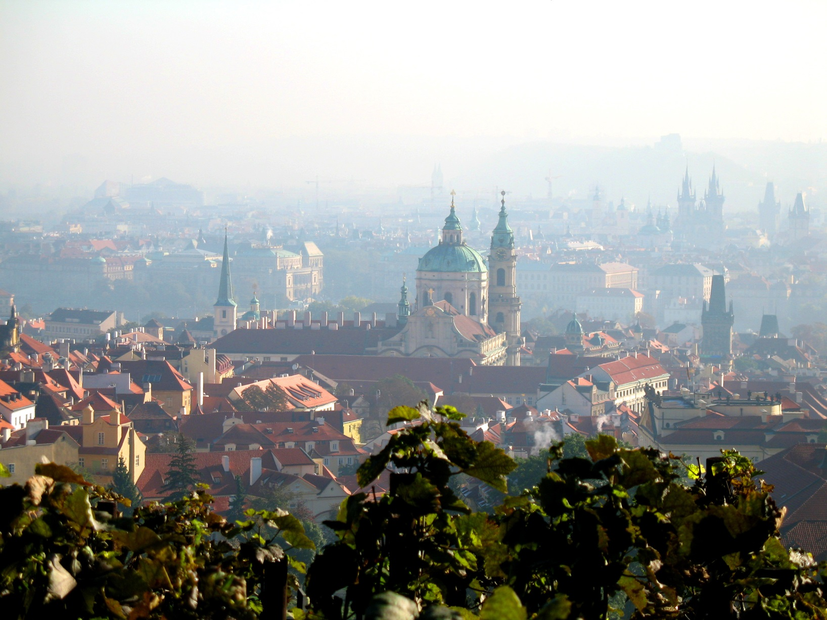
From the lookout near the Palace you can see the entire Old City

Slide 9
Виконала:
Василенко Наталія
група 1КЕ9-061

