Slide 1
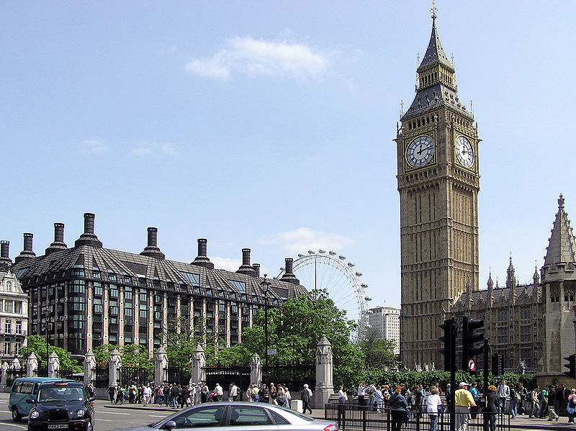
Big Ben

Slide 2
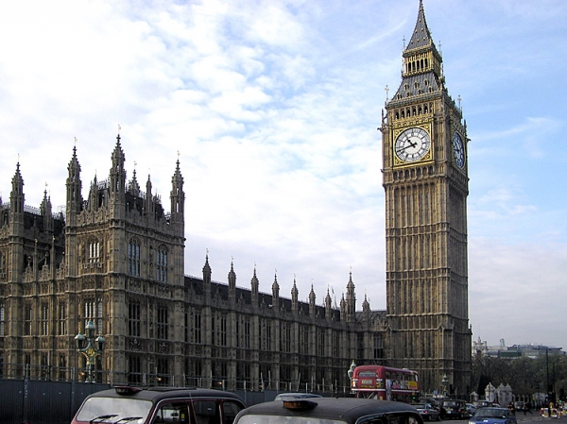
Big-Ben — a bell tower in London, a part of an architectural complex of the Westminster palace
The official name — «the Hour tower of the Westminster palace», also it name «the Tower of St. Stefana».

Slide 3
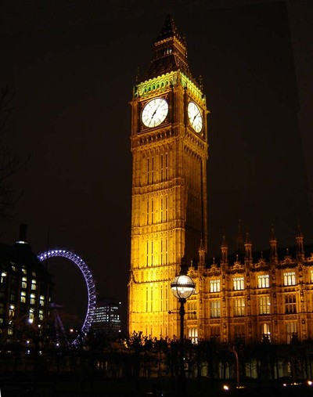
Big Ben is one of London's best-known landmarks, and looks most spectacular at night when the clock faces are illuminated. You even know when parliament is in session, because a light shines above the clock face.

Slide 4
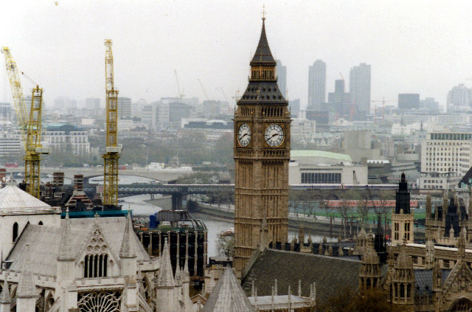
The tower has been erected
In 1858, a tower clock has been started up a course on May, 21st, 1859..

Slide 5
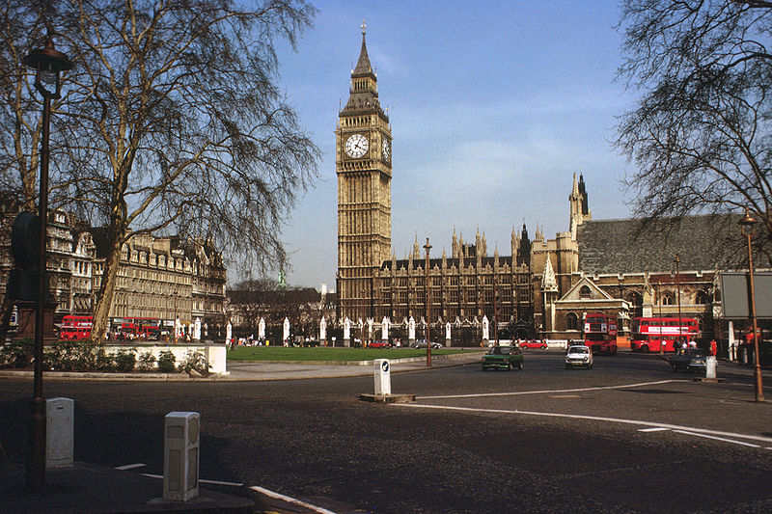
The name Big Ben actually refers not to the clock-tower itself, but to the thirteen ton bell hung within. The bell was named after the first commissioner of works, Sir Benjamin Hall.

Slide 6
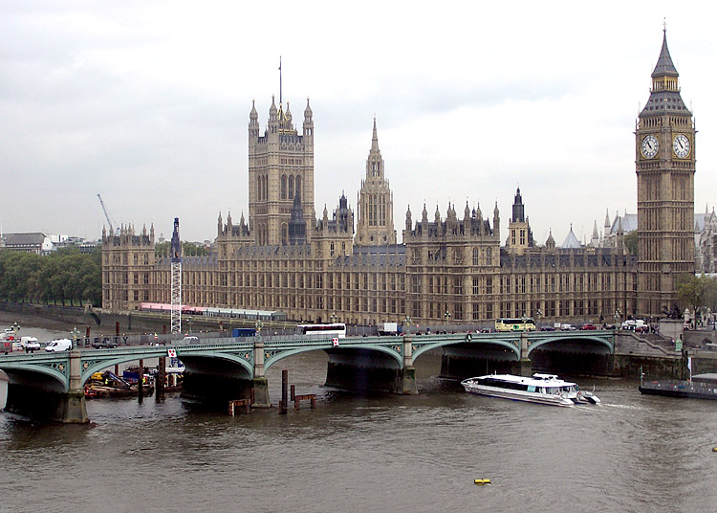
Big Ben - a symbol of time. The period of the greatest dawn of the country. And an inscription in Latin: «My God store queen Victoria» - a tribute of personal respect to the monarch at which there was such concept as British Empire.

Slide 7
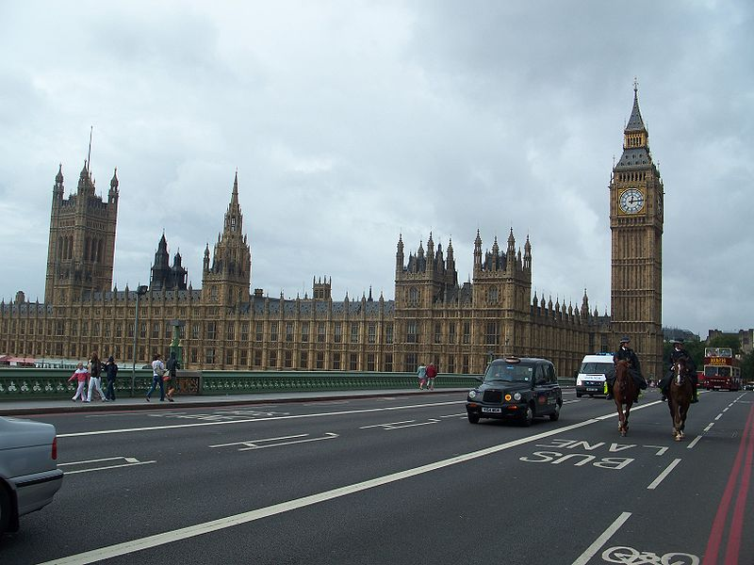
Big Ben's dials look at all 4 parts of the world. They from Birmingham are made has fallen down, hour hands are cast from pig-iron, and minute are made of copper sheet. It is counted up that the minute
Arrows pass the general distance for a year In190 km.

Slide 8
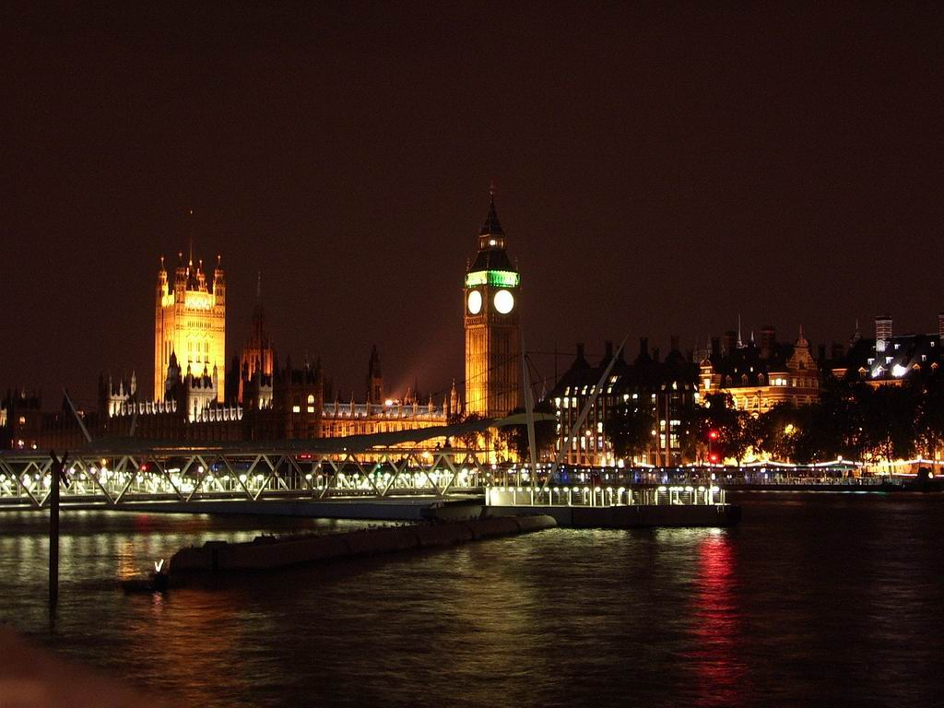
Big Ben and other small bells surrounding it beat out a ringing of following words:
«Through this hour the Lord stores me and force it won't allow to anybody to stumble»

Slide 9
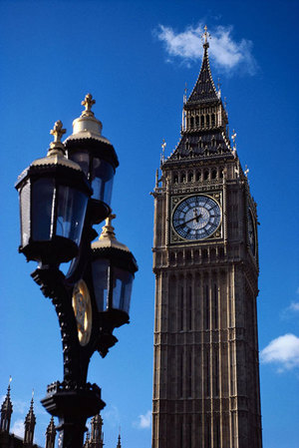
Big Ben also is only one bell.
Its height
More than 2 meters,
And diameter is equal almost to 3 meters.

Slide 10

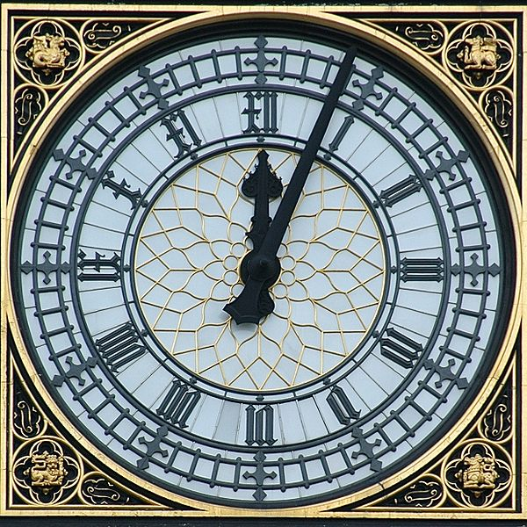
Tower height
61 meter (without considering a spike);
Hours settle down at height of 55 m from the earth. At diameter of a dial in
7 meters and length of arrows 2,7 and 4,2 meters, height of each figure — only 61 centimeter. Hours
Long time were considered as the greatest in the world.

Slide 11
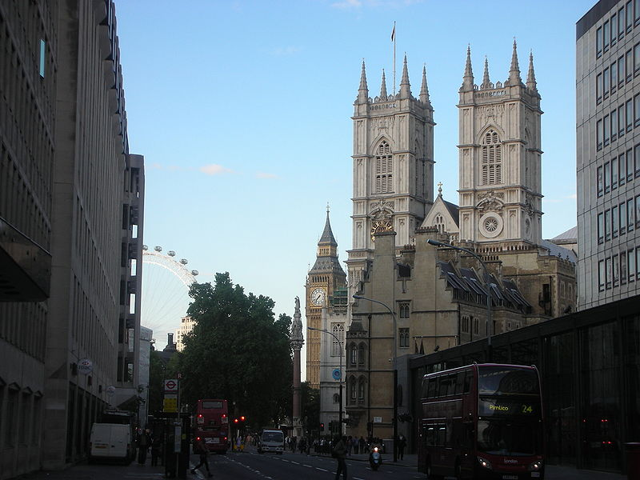
In Big Ben tourists don't start up. To get on top 96 meter towers it is possible only on a narrow spiral staircase.
334 steps will result on
The small opened
Platform, in
Which center and
There is a legendary
Bell.

Slide 12

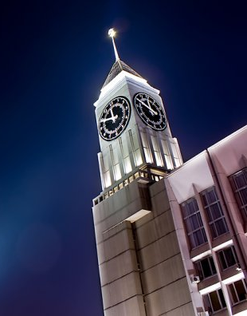
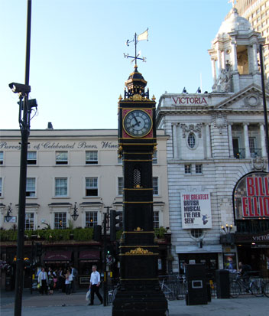

Slide 13

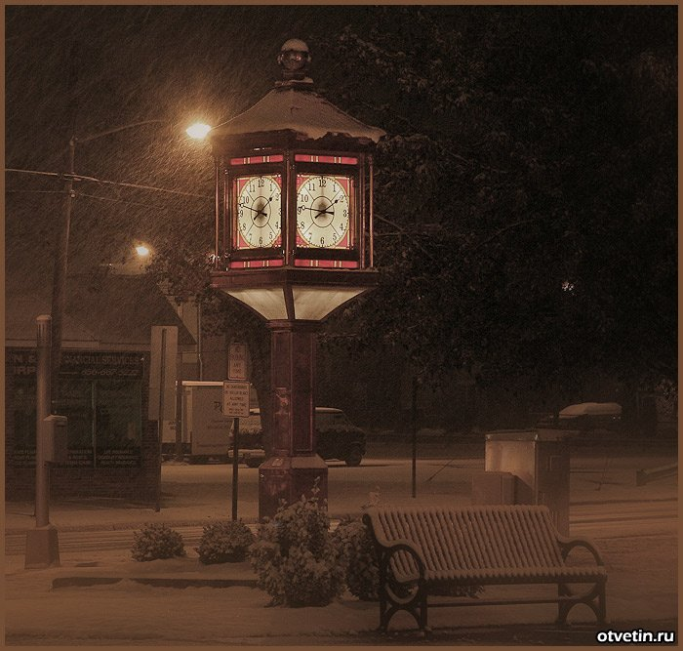
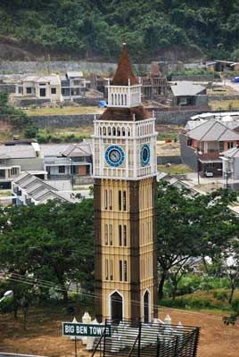

Slide 14
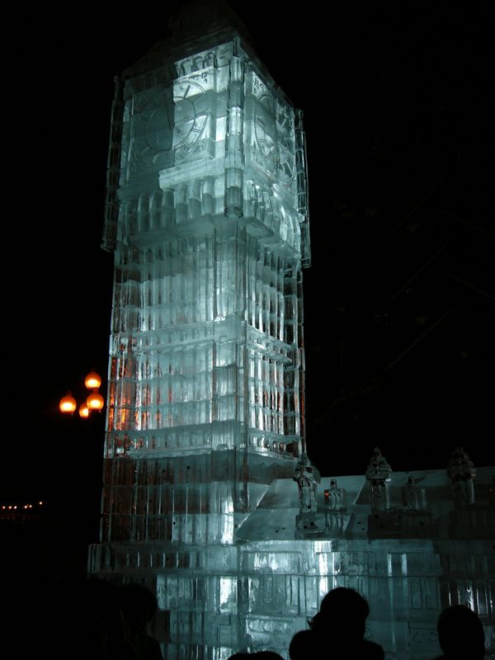
Биг Бен изо льда

Slide 15

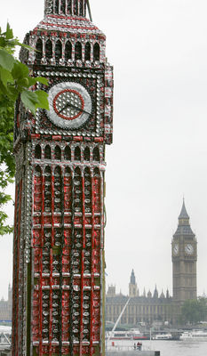
Шести-метровая копия "Биг-Бена", сделанная из банок Кока-Колы была выставлена в лондонском парке, дабы привлечь внимание людей к вопросу переработки мусора.
Художественная инсталляция, созданная скульптором Робертом Бредфордом,
стала открытием Недели переработки мусора.
"Биг-Бен" – одна из четырех скульптур, появившихся в Великобритании с целью поднять вопрос важности правильной утилизации отходов.

Slide 16
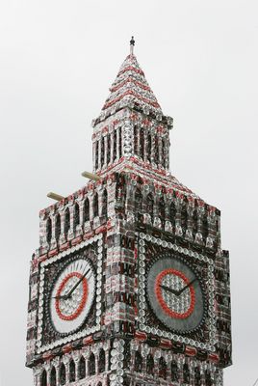
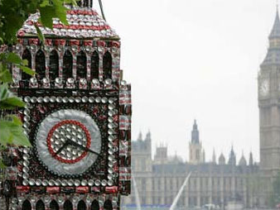

Slide 17

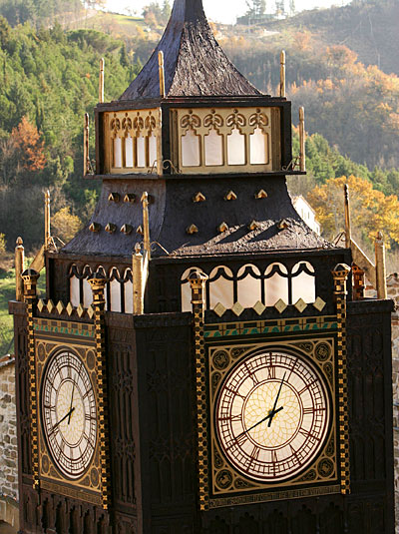
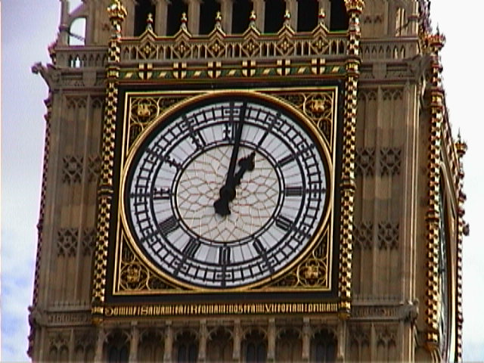

Slide 18
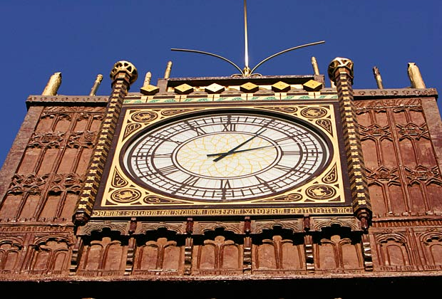

Slide 19
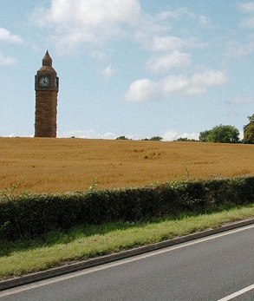
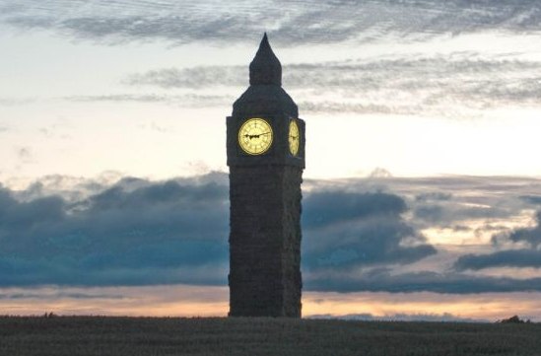
Пара бизнесменов Крис Садлер и Майк Харпер из английского графства Чешир создали копию башни Биг Бен высотой около 20 м. Сделано сооружение из соломы. Авторы говорят, что для воплощения проекта им понадобилось более 500 тюков соломы общей массой свыше 20 т.

Slide 20
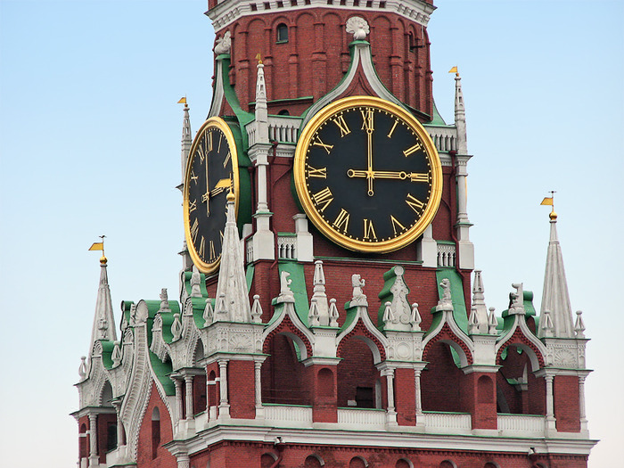

Slide 21
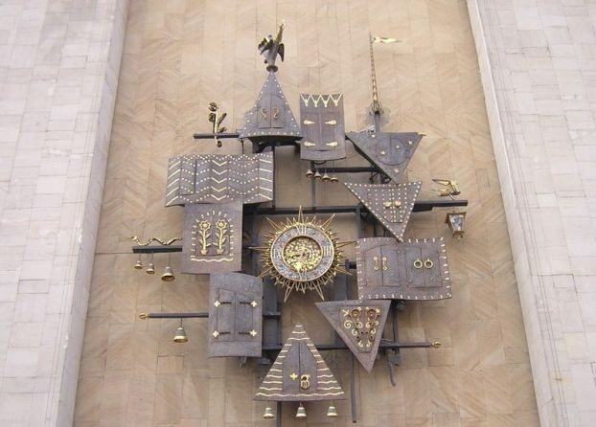

Slide 22
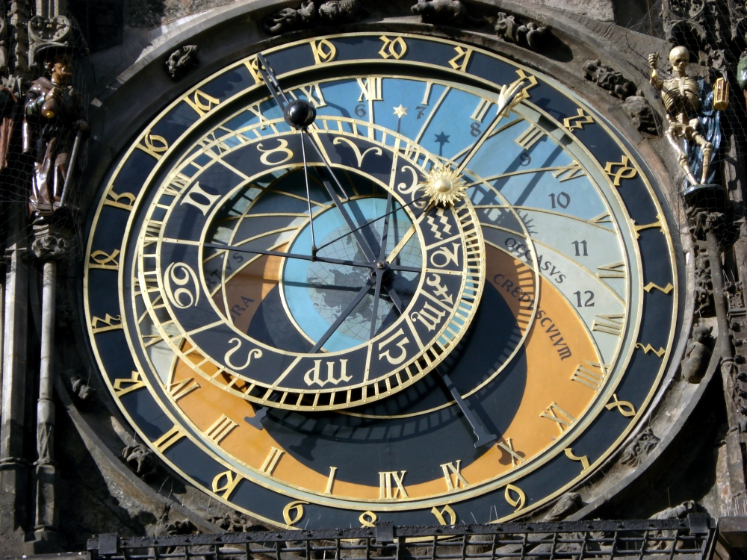

Slide 23
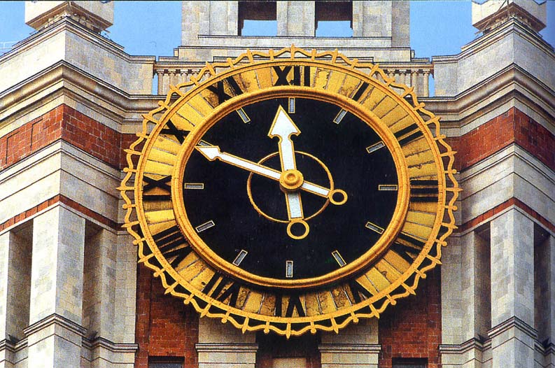

Slide 24
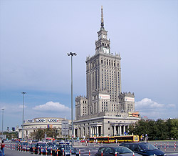

Slide 25
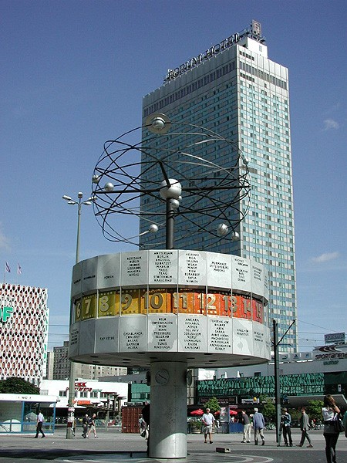

Slide 26
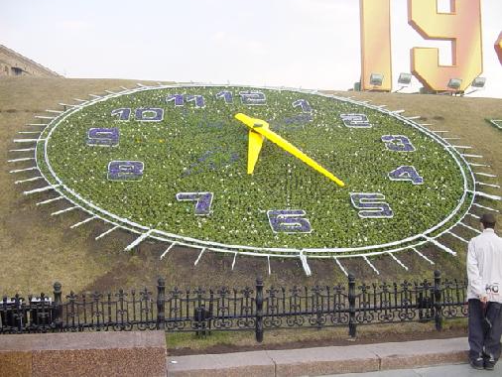

Slide 27
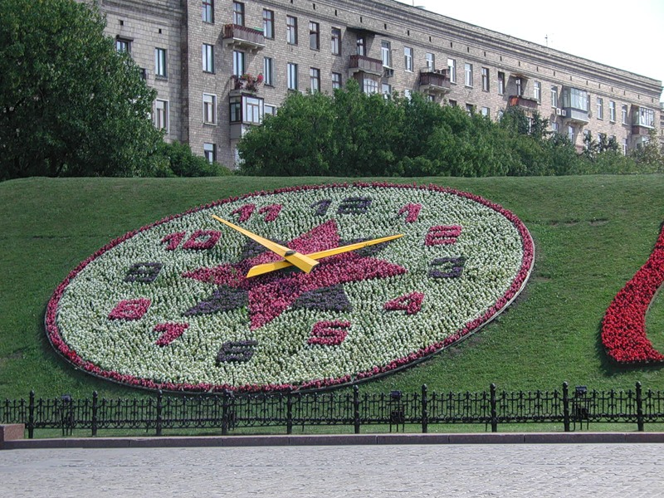

Slide 28
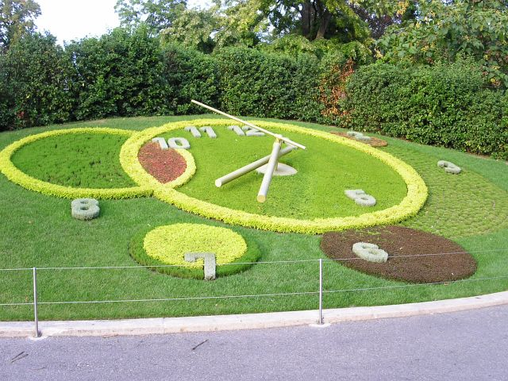

Slide 29
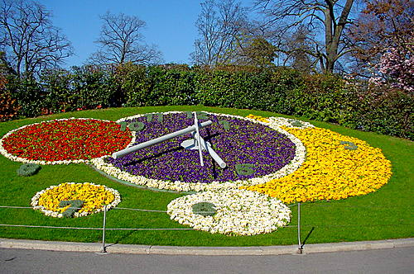

Slide 30
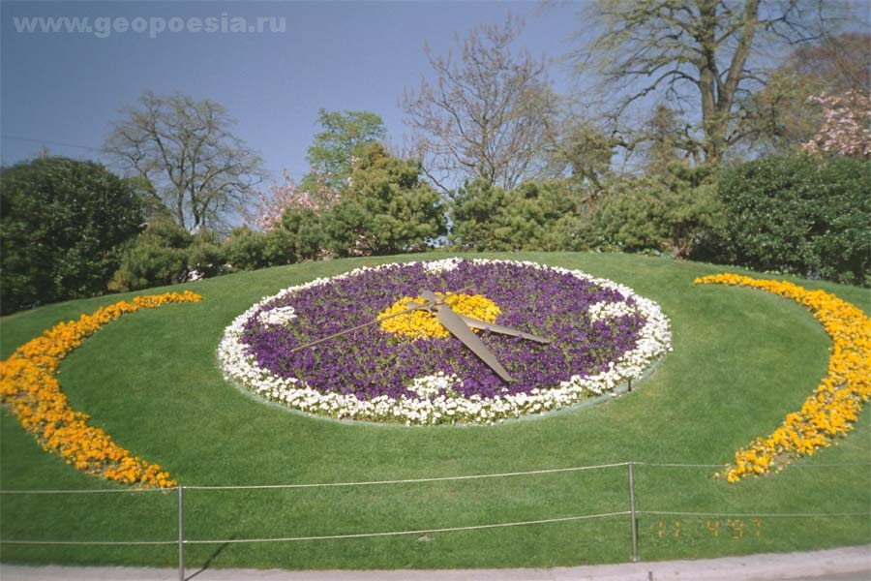

Slide 31
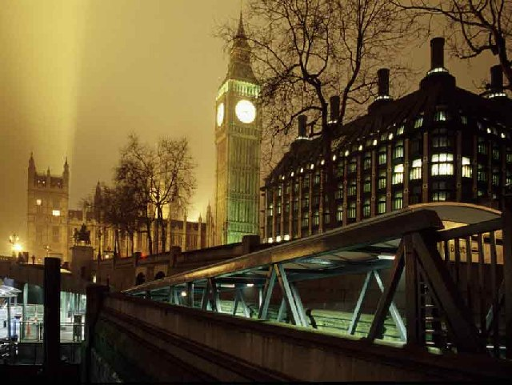
The End

