Slide 1

"Knockin' on Heaven's Door"

Slide 2
Description:
Two young men, Martin and Rudi, both suffering from terminal cancer, get to know each other in a hospital room. They drown their desperation in Tequila and decide to take one last trip to the sea. Drunk and still in pajamas they steal the first fancy car they find, a 60's Mercedes convertible. The car happens to belong to a bunch of gangsters, which immediately start to chase it, since it contains more than the pistol Martin finds in the glove box.

Slide 3


Slide 5
Type: Movie
Genre: Action, Crime, Comedy
Directed by : Thomas Jahn
Produced by: Til Schweiger, Thomas Zickler, André Hennicke
Written by: Thomas Jahn, Til Schweiger
Music by : Selig, Franz Plasa

Slide 6
Studio: Mr. Brown Entertainment
Distributed by: Buena Vista International
Release dates: 20 February 1997
Running time: 86 minutes
Country: Germany

Slide 7
Play the main part:
Til Schweiger
Jan Josef Liefers
Moritz Bleibtreu
Thierry Van Werveke

Slide 8

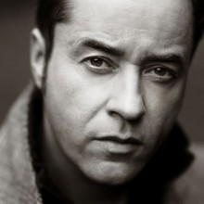
Til Schweiger
Jan Josef Liefers

Slide 9
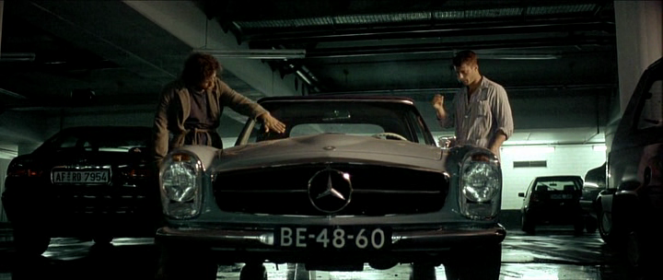

Slide 10
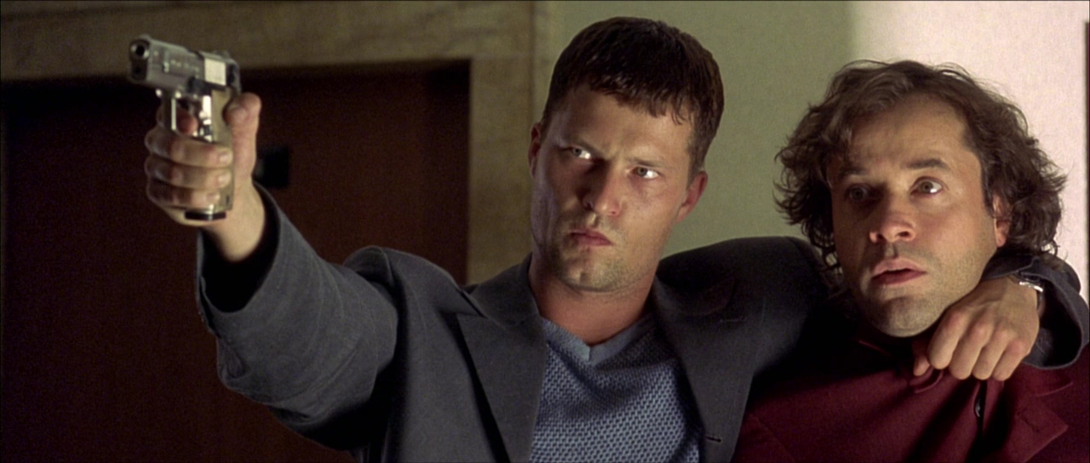

Slide 11
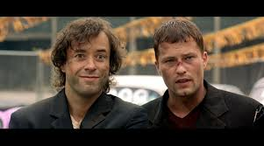

Slide 12
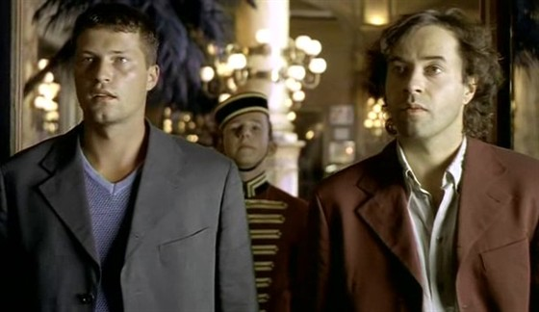

Slide 13
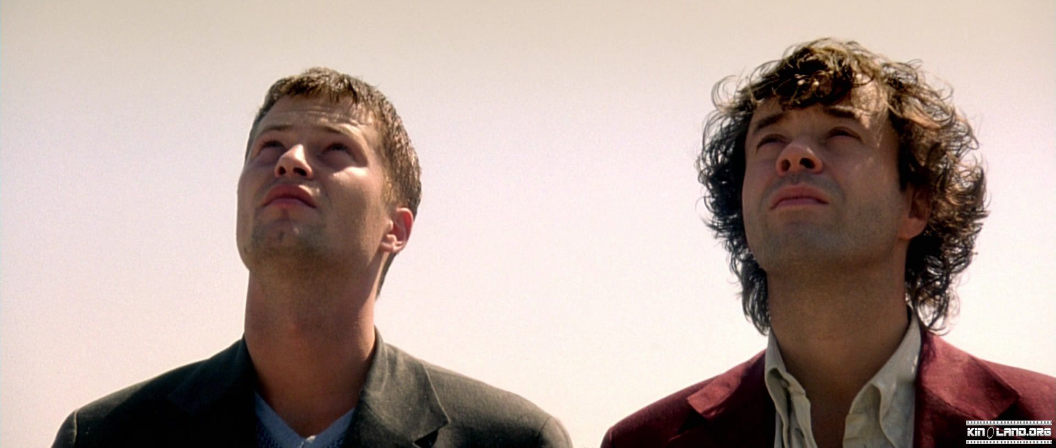

Slide 14
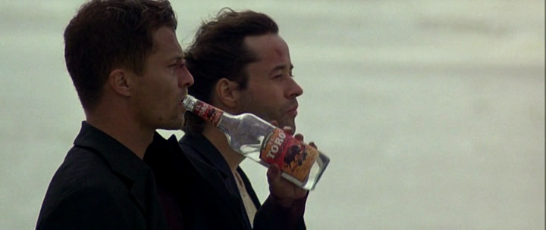

Slide 15
