Slide 1
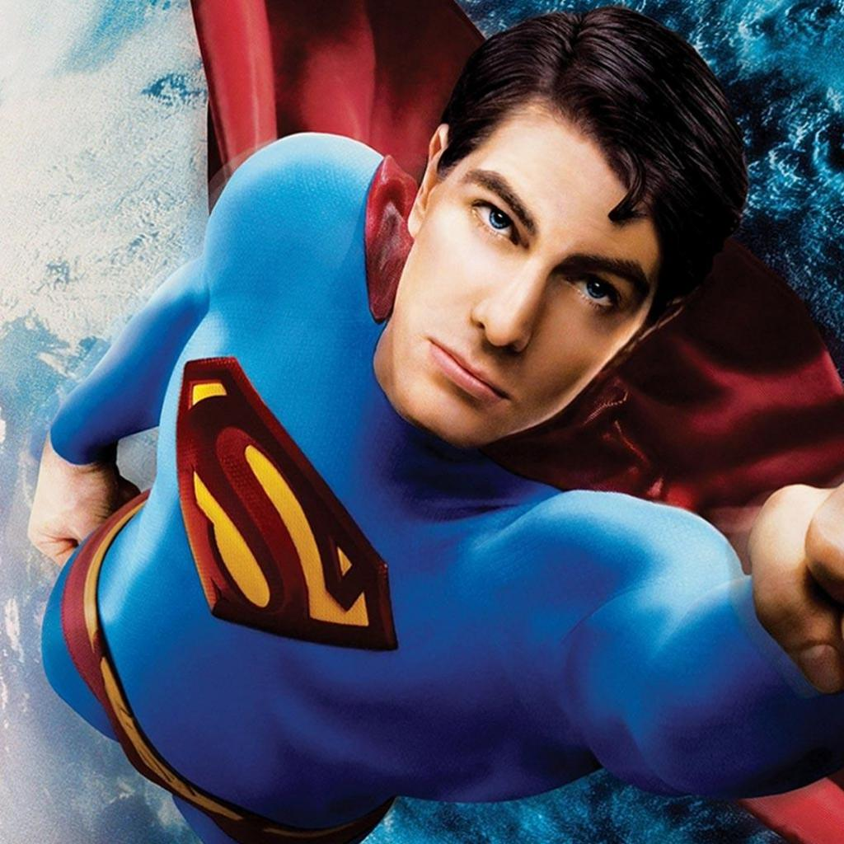
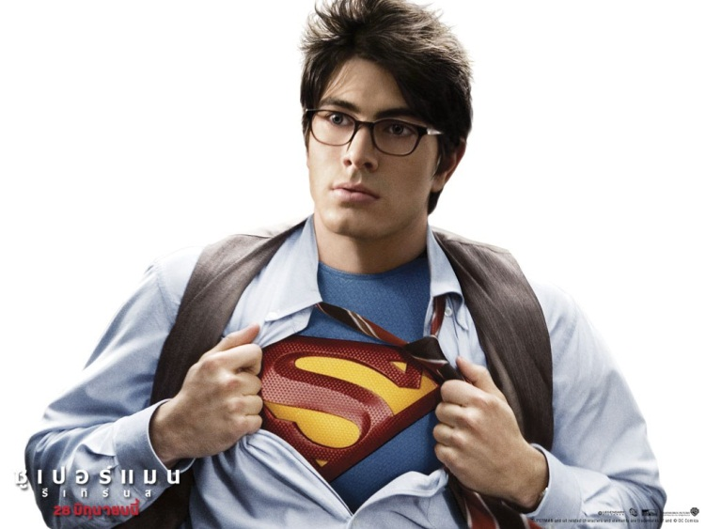
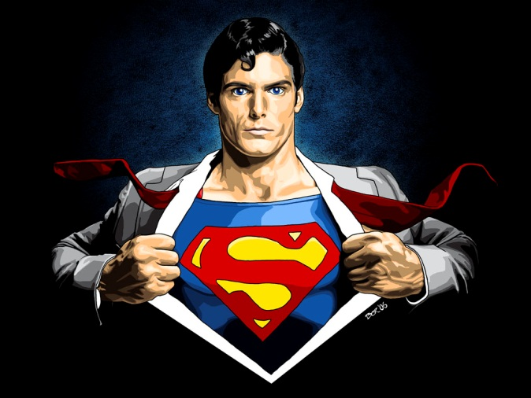
Superman

Slide 2
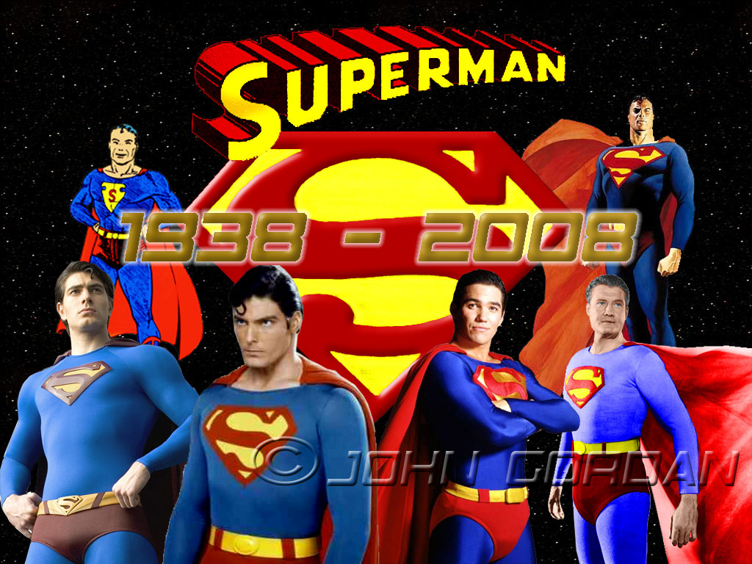

Slide 3
Clark Kent grew up to be a tall shy teenager with short dark hair and glasses

Slide 4


Slide 5
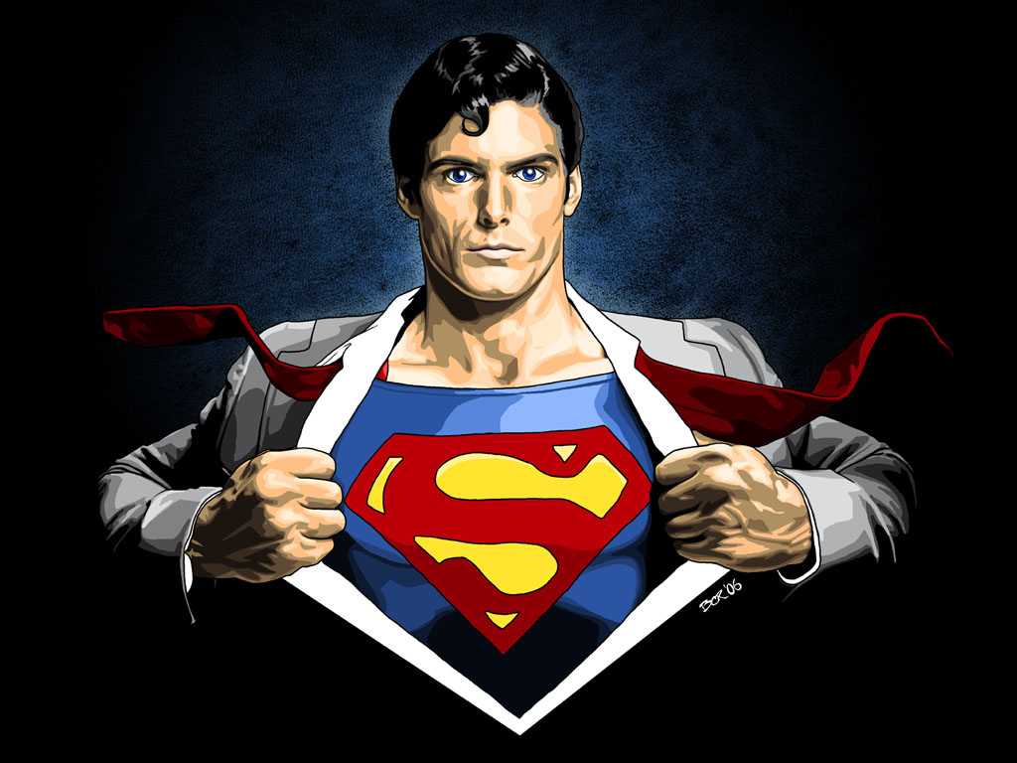
Clark isn’t an ordinary person

Slide 6
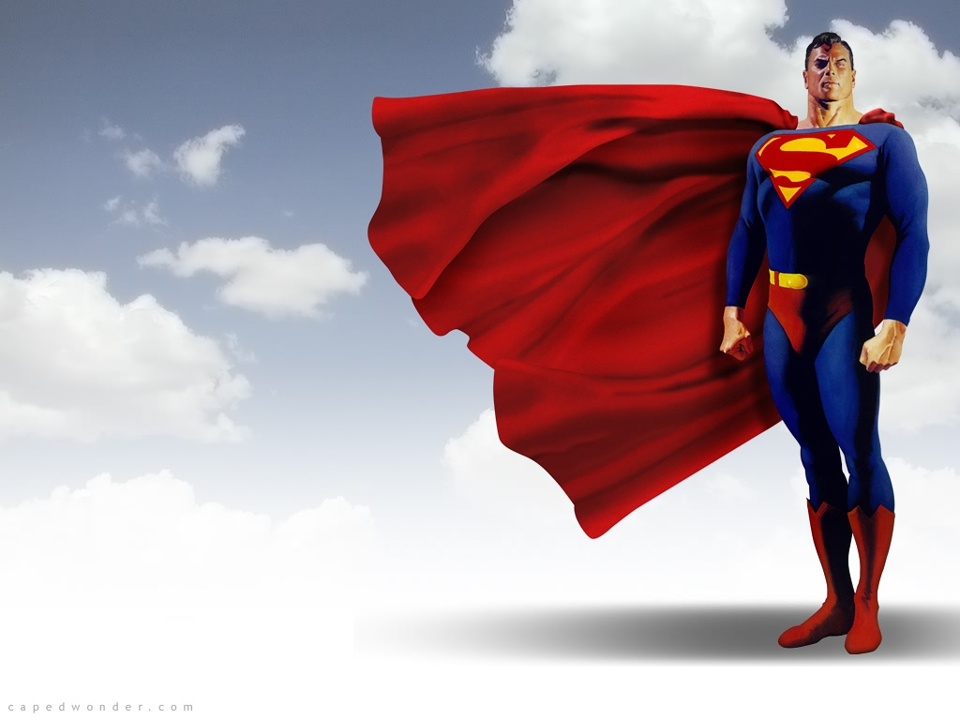
Dressed in blue uniform and red cape

Slide 7
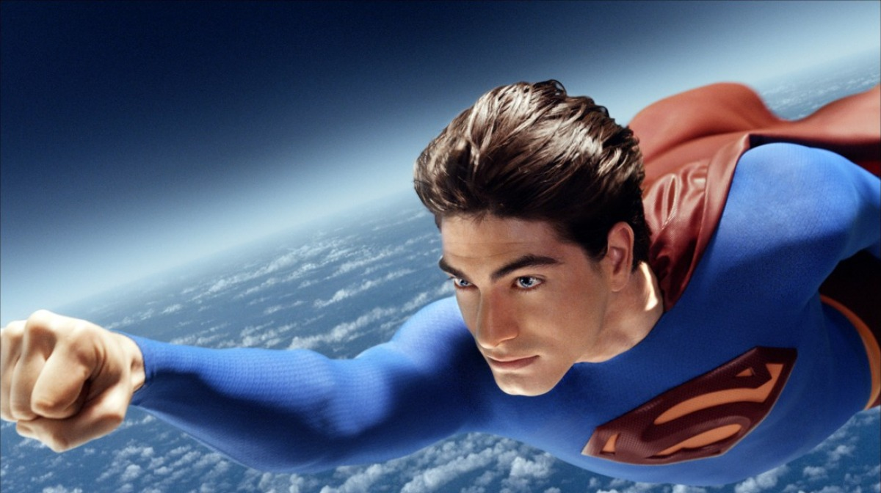
Superman can fly very fast

Slide 8
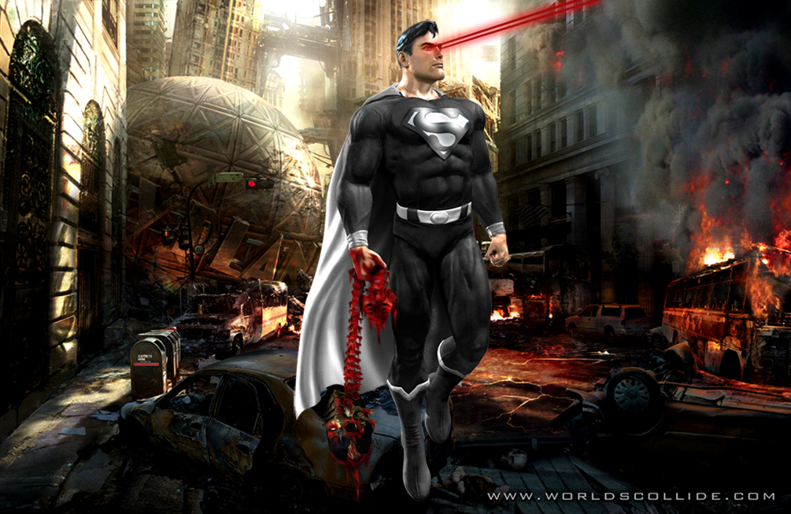
Superman can shoot lasers from his eyes and see through walls

Slide 9
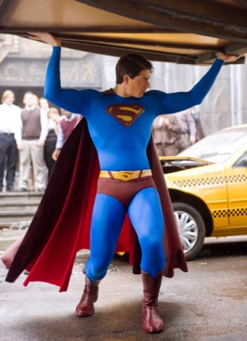
Superman has superhuman strength

Slide 10
