Slide 1
Nature and environment
How to Save Our Planet

Slide 2
Buy used items whenever possible. The production of new products consumes energy and natural resources. Scour thrift stores, estate and yard sales, flea markets, online auctions and classified sites for clothing, appliances, electronics and furniture.

Slide 3



Rent or borrow items you use infrequently such as chainsaws, ladders and party decorations.

Slide 4




Buy items with as little packaging as possible. For example, bring a jar or plastic container to the grocery story and buy oatmeal and other grains in bulk. Buy supplies such as scissors, pens and note pads that are free of plastic packaging. Purchase fresh produce rather than canned or frozen.

Slide 5
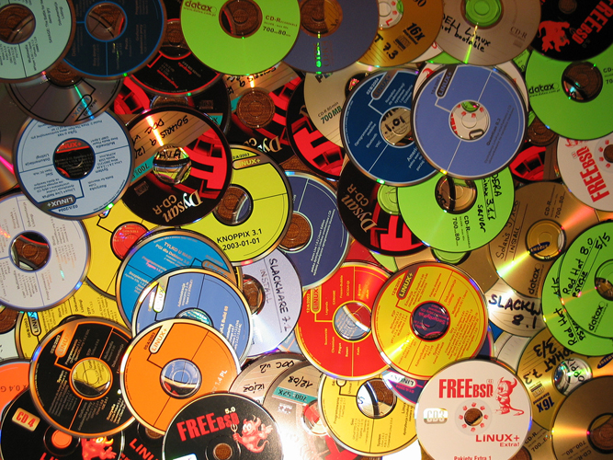


Donate clothing, furniture, books, CDs and household goods you no longer need or give them to friends or family members instead of throwing them in the trash.

Slide 6
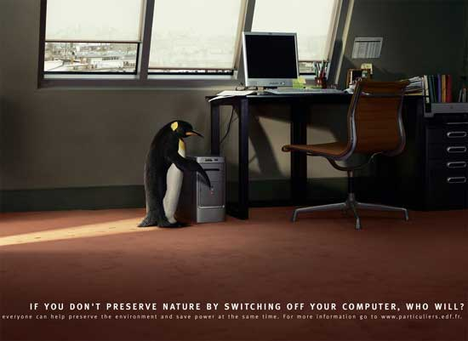

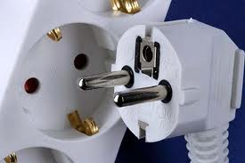
Turn off computers, lights and other appliances when they not in use. Unplug "energy vampires" - adapters for cell phones and other electronics as well as appliances with standby capabilities such as televisions and DVD players - which draw power when plugged into an outlet.

Slide 7

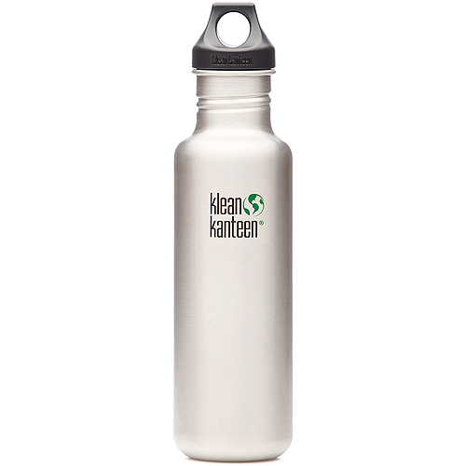
Use ceramic coffee mugs instead of disposable cups. Use a refillable aluminum water bottle rather than buying water in plastic bottles, which clog landfills and can leach a chemical called BPA.

Slide 8
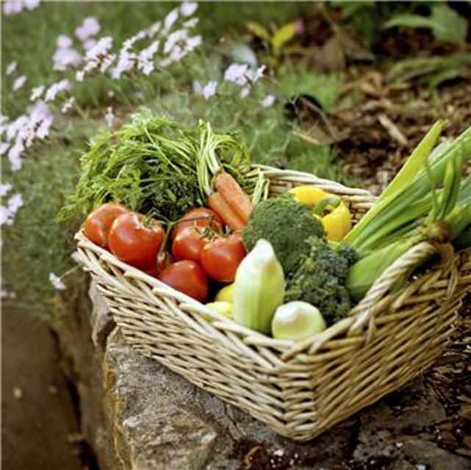
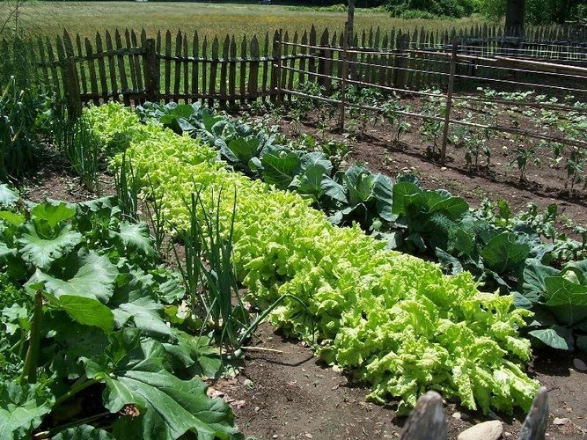


Grow an organic garden. Commercial food transportation and storage is energy-intensive. When you grow your own produce, you eliminate the middleman and ensure your food is free of harsh pesticides. Can your fruits and vegetables so you will be able to eat them year round.

Slide 9



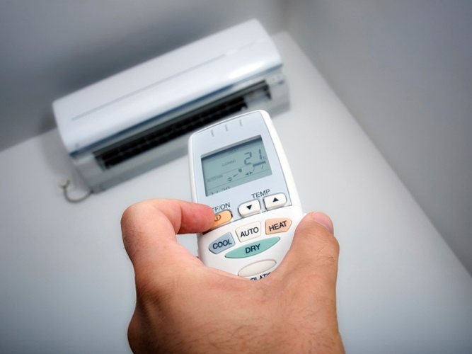
Conserve energy by cleaning the filters on your home's air conditioning unit once a month.

Slide 10
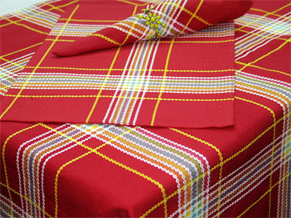


Use cloth napkins instead of disposable paper napkins, which account for 500,000 tons of paper-based trash each year, according to "Country Living" magazine.

Slide 11
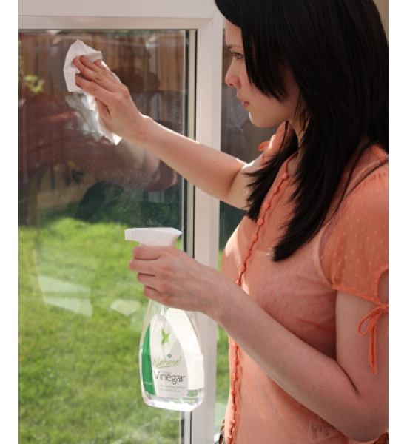
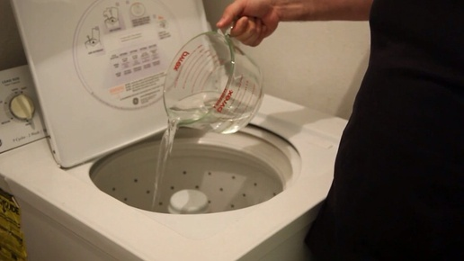

Clean your home with organic products. You can use distilled white vinegar by itself or mixed with mild, organic soap to clean and deodorize nearly anything, including stoves, refrigerators, garbage disposals, glassware, coffee makers, exhaust fan grids, walls and grout.

Slide 12
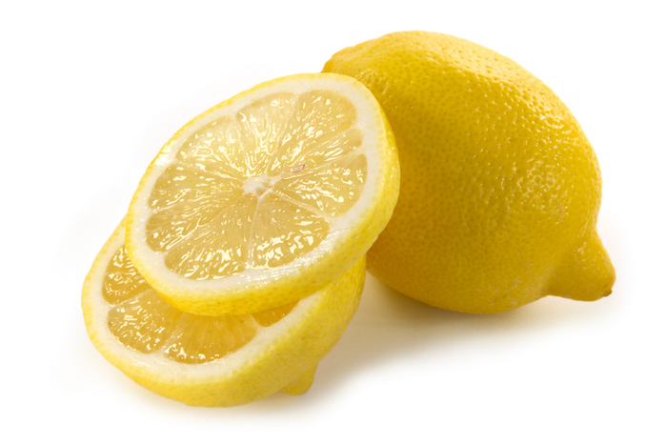
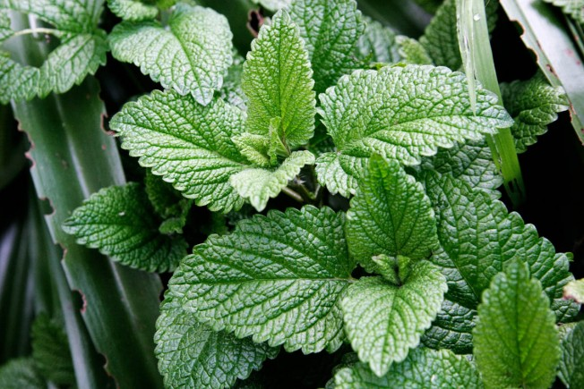


Eliminate ants naturally. Spray white distilled vinegar or lemon juice around doorways and windowsills to deter ants from entering your home. You can also sprinkle mint, cinnamon, chili powder or black pepper in spots frequented by ants.

Slide 13



Build fireplace fires with man-made, petroleum-free logs made with bio-waxes and wood fiber. Artificial logs burn longer than firewood and produce 75 percent less carbon monoxide, according to "Country Living" magazine.

