Slide 1
How to be a good vocabulary learner
by Maria Tarasyuk

Slide 2
What good learners do?
Pay attention to spelling, pronunciation
Pay attention to meaning
Guess the words from the context
Take risks and are not afraid of making mistakes
Organize their own learning

Slide 3
Vocabulary learning techniques
Mnemonics
Word cards
Guessing from context
Coping strategies for production
Using dictionaries
Spelling rules
Keeping records

Slide 4
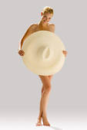



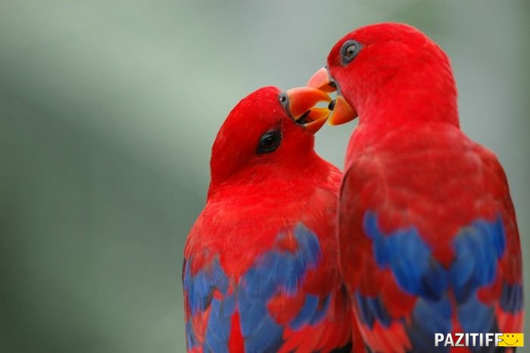

Mnemonics
love
paradise
go

Slide 5
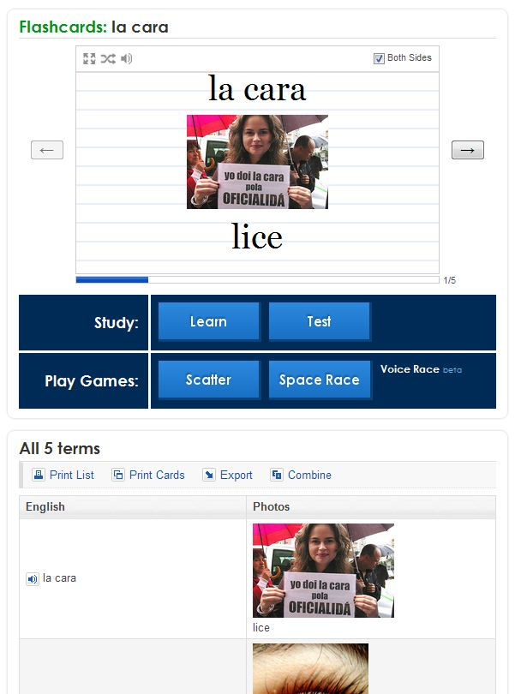
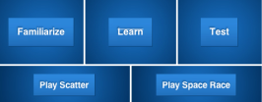

Word cards

Slide 6
Guessing from context
The tiger's roar could be heard in villages far away.
What does roar probably mean?
A) food a tiger eats
B) a tiger's dream
C) a tiger's ear
D) a sound a tiger makes

Slide 7
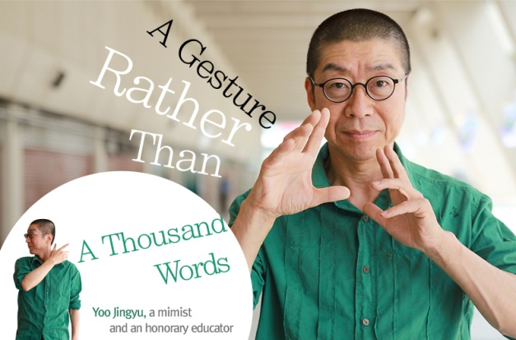
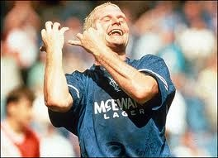
Coping strategies for production
Paraphrasing
Describing
Using synonyms
Using gestures and mime
Using L1 word
House
Sense:
A habitation
  home
  dwelling
  residence
house = comfort

Slide 8
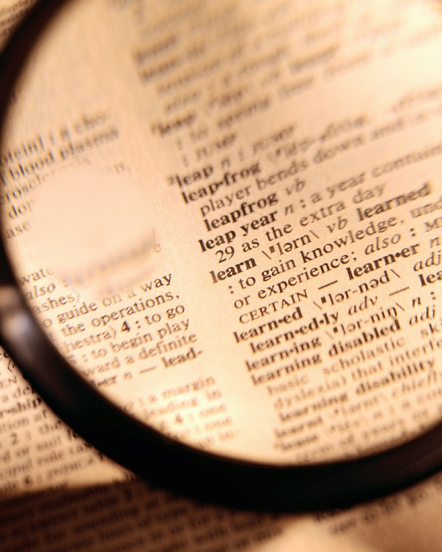
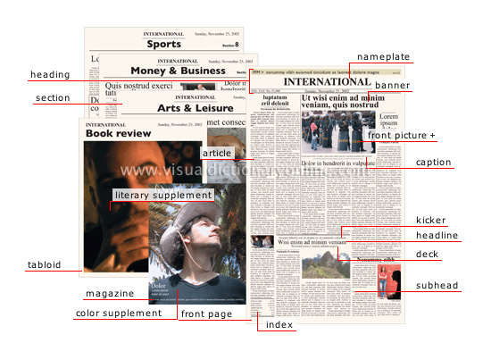
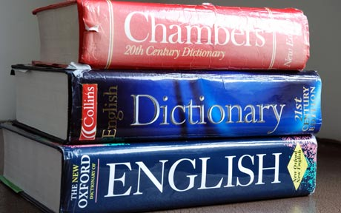
Using dictionaries

Slide 9
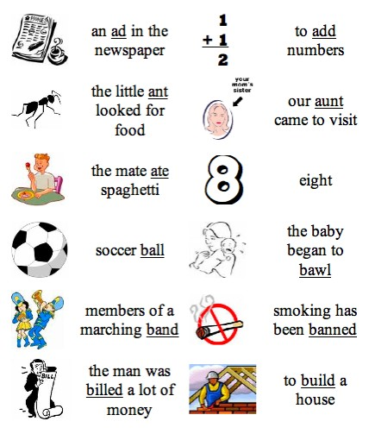
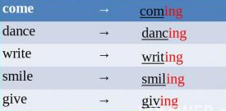
Spelling rules

Slide 10
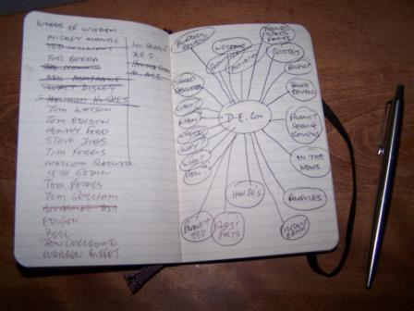

Note-taking

Slide 11
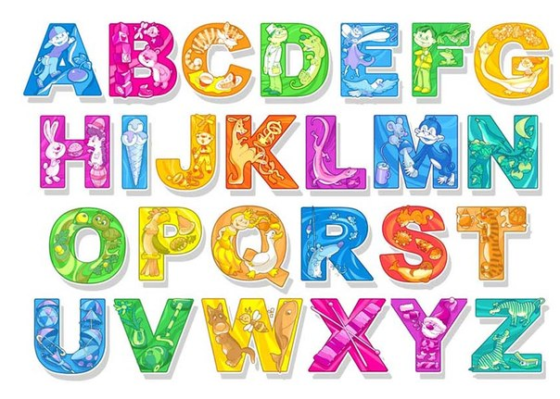


Visual memory
Practice words
Motivation

Slide 12

Enjoy learning vocabulary!

